Slide 1
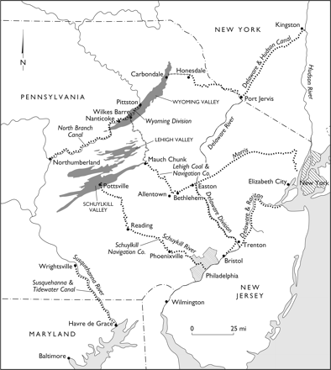
Map 1. Anthracite Canal Network, circa 1845.
Notes:
Map 1. Anthracite Canal Network, circa 1845. Map design by Bill Nelson, for the author.
Unless provided in the caption above, the following copyright applies to the content of this slide: © 2010 The Author. Published by Oxford University Press on behalf of the American Society for Environmental History and the Forest History Society. All rights reserved. For Permissions, please email: journals.permissions@oxfordjournals.org

