Slide 1
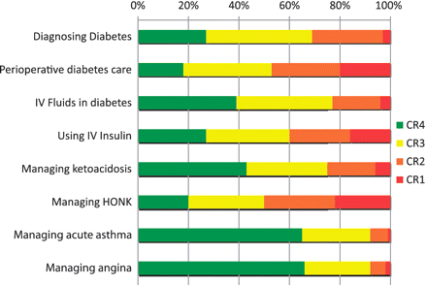
Figure 1. Confidence in managing aspects of diabetes care vs. other common diseases (CR4: ‘fully confident in most ...
Notes:
Figure 1. Confidence in managing aspects of diabetes care vs. other common diseases (CR4: ‘fully confident in most cases’, CR3: ‘confident in some cases’, CR2: ‘satisfactory but lacking confidence’ and CR1: ‘not confident’. Confidence in managing all aspects of diabetes care is significantly lower compared with confidence in managing angina or acute asthma.
Unless provided in the caption above, the following copyright applies to the content of this slide: © The Author(s) 2011. Published by Oxford University Press.This is an Open Access article distributed under the terms of the Creative Commons Attribution Non-Commercial License (<http://creativecommons.org/licenses/by-nc/2.0/uk/>) which permits unrestricted non-commercial use, distribution, and reproduction in any medium, provided the original work is properly cited.

