Slide 1
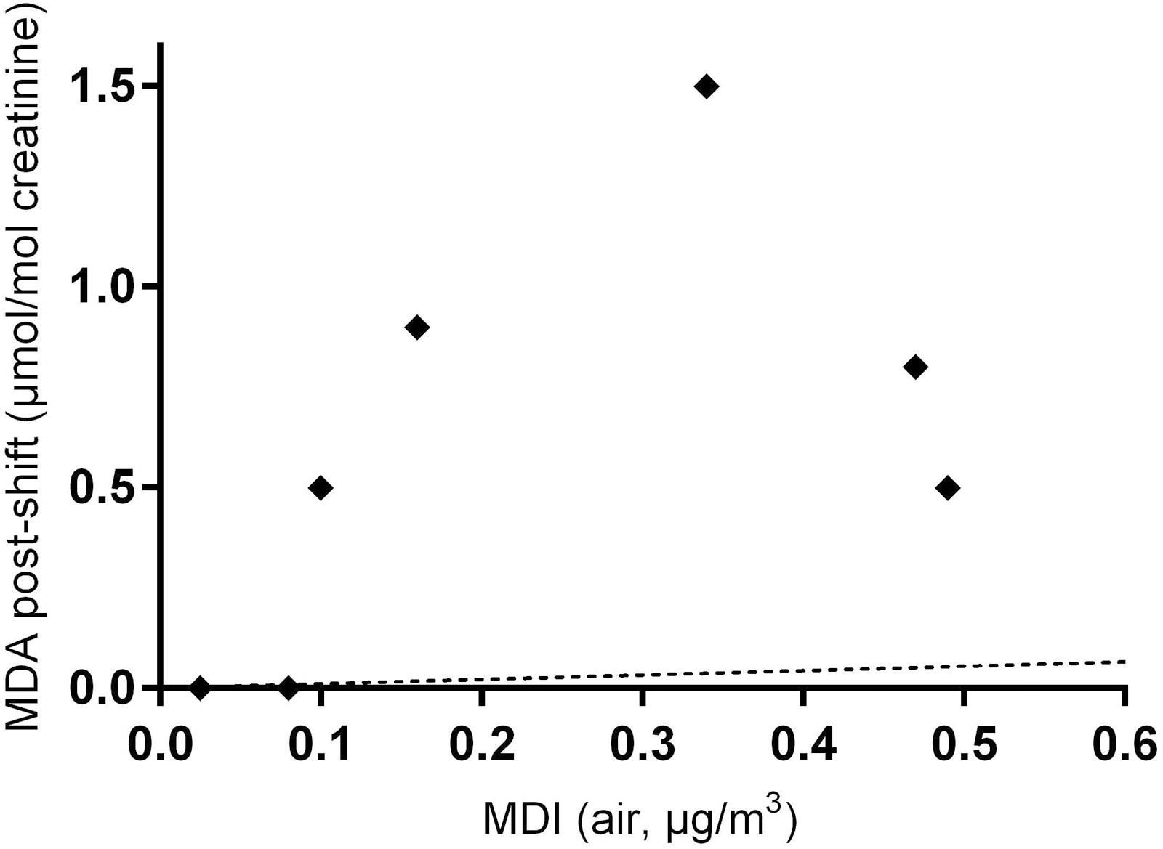
Figure 1. Correlation between airborne MDI (8-h TWA, µg m⁻³) and urinary post-shift MDA (µmol ...
Notes:
Figure 1. Correlation between airborne MDI (8-h TWA, µg m−3) and urinary post-shift MDA (µmol mol−1 creatinine), n = 9 (three points were below the limit of detection for both air and urine measurements). Black dotted line indicates expected correlation assuming MDI inhalation only exposure (adapted from DFG, 2007).
Unless provided in the caption above, the following copyright applies to the content of this slide: © Crown Copyright 2017This Open Access article contains public sector information licensed under the Open Government Licence v2.0 (http://www.nationalarchives.gov.uk/doc/open-government-licence/version/2/).

Slide 2
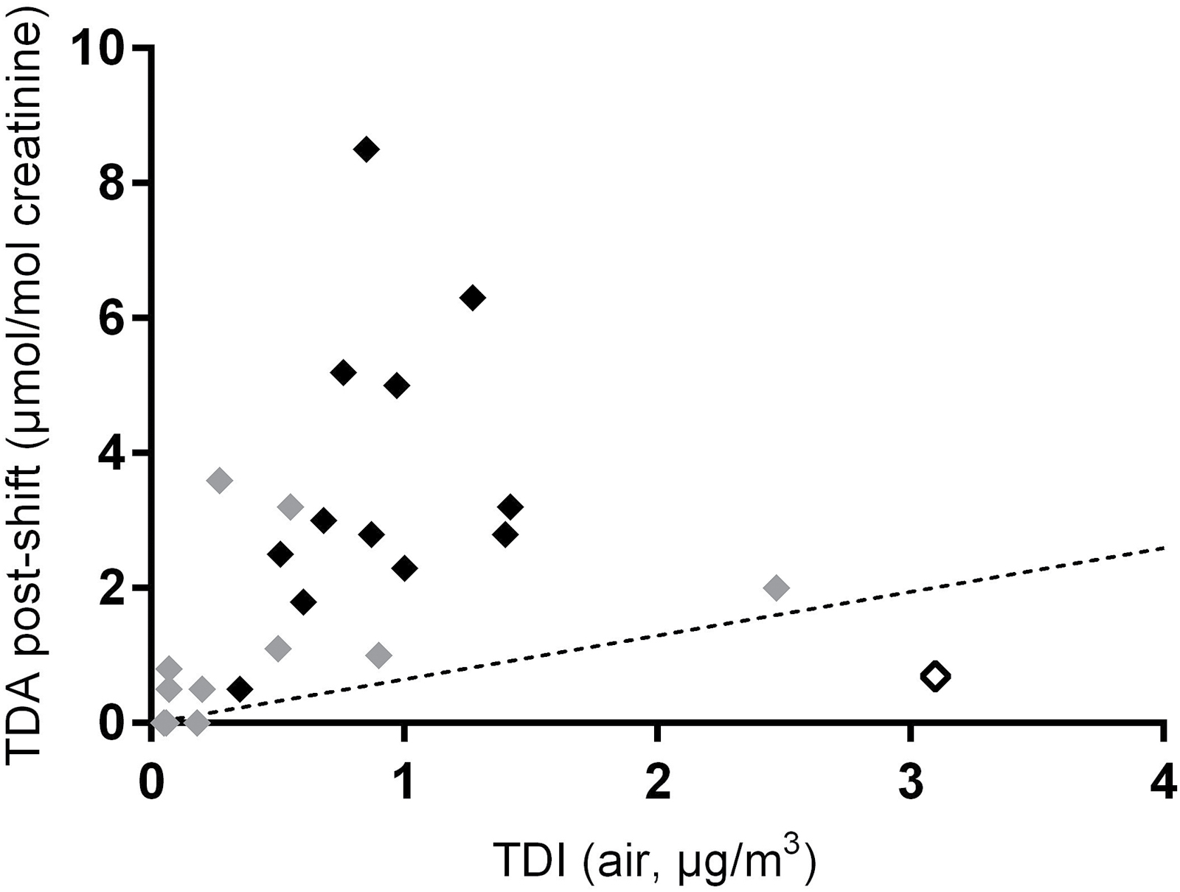
Figure 2. Correlation between airborne TDI (8-h TWA, µg m⁻³) and urinary post-shift TDA (µmol ...
Notes:
Figure 2. Correlation between airborne TDI (8-h TWA, µg m−3) and urinary post-shift TDA (µmol mol−1 creatinine), n = 24. Black dotted line indicates expected correlation assuming TDI inhalation only exposure [adapted from Skarping et al., 1991 (volunteer study) and Rosenberg and Savolainen, 1986 (workplace study)]. Grey diamonds indicate workers with low (<0.5 µg m−3, 8 h TWA) exposure to airborne TDA. Black diamonds indicate workers with co-exposure (>0.5 µg m−3, 8 h TWA) to airborne TDA. White open diamond indicates worker who wore RPE.
Unless provided in the caption above, the following copyright applies to the content of this slide: © Crown Copyright 2017This Open Access article contains public sector information licensed under the Open Government Licence v2.0 (http://www.nationalarchives.gov.uk/doc/open-government-licence/version/2/).

