Slide 1
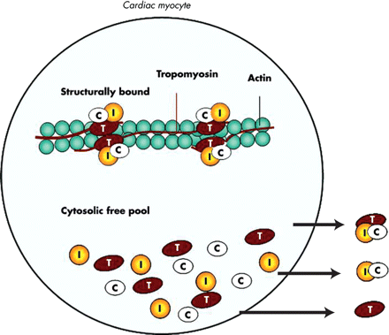
Figure 1 Schematic representation of the cardiac myofibrillar thin filament. Cardiac troponins exist in a structural ...
Notes:
Figure 1 Schematic representation of the cardiac myofibrillar thin filament. Cardiac troponins exist in a structural (bound) form and in a free cytosolic pool. Cardiac troponins are released from myocytes as complexes or as free protein. Permission received from the authors and BMJ.
Unless provided in the caption above, the following copyright applies to the content of this slide: Published on behalf of the European Society of Cardiology. All rights reserved. © The Author 2010. For permissions please email: journals.permissions@oup.com.

Slide 2
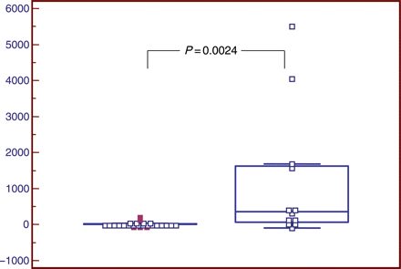
Figure 2 Box and whiskers plot showing delta change between presentation and subsequent blood sample obtained within 3 ...
Notes:
Figure 2 Box and whiskers plot showing delta change between presentation and subsequent blood sample obtained within 3 h in patients with a diagnosis of unstable angina (left, n = 25) and evolving non-STEMI (right, n = 12). Diagnosis of myocardial infarction was based on fourth generation cTnT (≥0.03 ng/mL). hsTnT concentration increased significantly (P = 0.0024) from a mean of 10.66% (SEM 10.8, median 0%, range −84.6 to 192.8%) to a mean of 1176.9% (SEM 520.9, Median 358.4%, range: −96.6 to 5503.6%).
Unless provided in the caption above, the following copyright applies to the content of this slide: Published on behalf of the European Society of Cardiology. All rights reserved. © The Author 2010. For permissions please email: journals.permissions@oup.com.

Slide 3
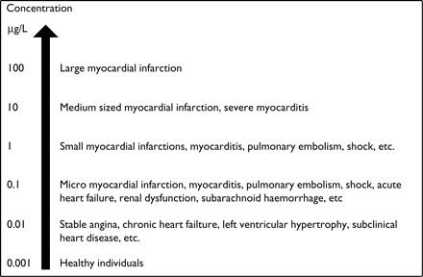
Figure 3 Relation between troponin level and possible causes.
Notes:
Figure 3 Relation between troponin level and possible causes.
Unless provided in the caption above, the following copyright applies to the content of this slide: Published on behalf of the European Society of Cardiology. All rights reserved. © The Author 2010. For permissions please email: journals.permissions@oup.com.

