Slide 1
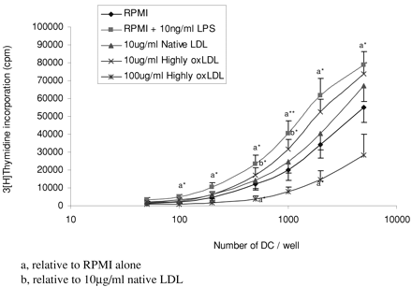
Fig. 6 Effects of highly-oxidised LDL on the ability of DC to induce the proliferation of T cells. DC were prepared ...
Notes:
Fig. 6 Effects of highly-oxidised LDL on the ability of DC to induce the proliferation of T cells. DC were prepared according to the method of day 4 purification as detailed in the Methods. Following a total of 6 days in culture DC were washed twice in RPMI-1640 and resuspended at 5×105 DC/ml in the given media for 24 h. DC were harvested, washed twice in CM, and added to 105 purified autologous T cells for a further 48 h, according to the oxidative mitogenesis assay. Functional responses were assessed by [3H]thymidine incorporation during a further 16 h of incubation. Samples were run in triplicate. Mean values±S.E.M. of five independent experiments are shown. Statistical analysis is given relative (a) to RPMI alone and (b) relative to 10 μg/ml native LDL. *P<0.05; **P<0.01.
Unless provided in the caption above, the following copyright applies to the content of this slide: Copyright © 2002, European Society of Cardiology

Slide 2
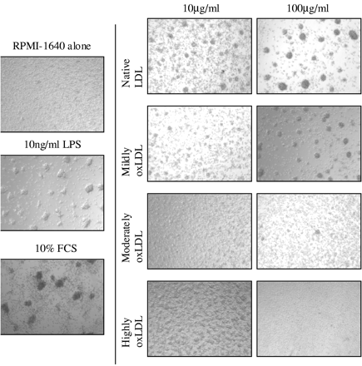
Fig. 5 Effects of LDL on the formation of homotypic DC clusters. DC were prepared according to the method of day 4 ...
Notes:
Fig. 5 Effects of LDL on the formation of homotypic DC clusters. DC were prepared according to the method of day 4 purification as detailed in the Methods. Following a total of 6 days in culture DC were washed twice in RPMI-1640 and resuspended at 5×105 DC/ml in the given media for 24 h. Random unselected fields from a representative experiment are shown, as outlined in the Methods.
Unless provided in the caption above, the following copyright applies to the content of this slide: Copyright © 2002, European Society of Cardiology

Slide 3
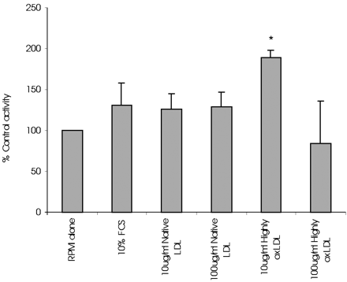
Fig. 3 Cell activity of DC following culture for 24 h in different media. DC were prepared according to the method ...
Notes:
Fig. 3 Cell activity of DC following culture for 24 h in different media. DC were prepared according to the method of day 4 purification as detailed in the Methods. Following a total of 6 days in culture DC were washed twice in RPMI-1640 and resuspended at 5×105 DC/ml in the given media for 24 h. MTT was added for the final 4 h of the culture and activity was calculated as detailed in the Methods. All samples were run in triplicate. Mean±S.E.M. of six independent experiments are shown for each data point. Statistical analysis is given relative to RPMI-1640 alone. *P<0.05.
Unless provided in the caption above, the following copyright applies to the content of this slide: Copyright © 2002, European Society of Cardiology

Slide 4
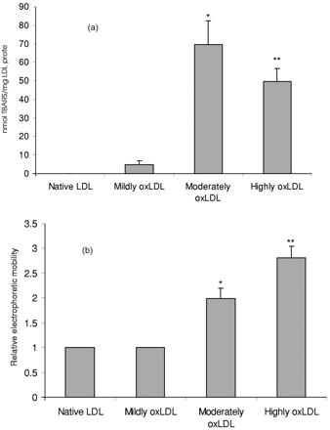
Fig. 2 (a) Thiobarbituric acid reactive substances (TBARS) formation during the oxidation of LDL. Native LDL were ...
Notes:
Fig. 2 (a) Thiobarbituric acid reactive substances (TBARS) formation during the oxidation of LDL. Native LDL were freshly prepared and diluted to 100 μg protein/ml in a phosphate buffer, and a final concentration of 5 μM Cu2+ added. Samples were prevented from further oxidation by the addition of 100 μM EDTA at the time points corresponding to the predefined states of oxidation as outlined in the Methods. TBARS was then assayed by spectrophotometry as outlined in the Methods. Mean±S.E.M. of four independent experiments are shown. Statistical analysis is given relative to both native and minimally-oxidised LDL. *P<0.05; **P<0.01. (b) Agarose gel electrophoresis of LDL following oxidation. Native LDL were freshly prepared and diluted to 100 μg/ml protein in phosphate buffer and a final concentration of 5 μM Cu2+ added. Samples were prevented from further oxidation by the addition of 100 μM EDTA at the time points corresponding to the predefined states of oxidation as outlined in the Methods. Migration was measured and expressed relative to native LDL. Mean±S.E.M. of four independent experiments are shown. Statistical analysis is given relative to both native and minimally-oxidised LDL. *P<0.05; **P<0.01.
Unless provided in the caption above, the following copyright applies to the content of this slide: Copyright © 2002, European Society of Cardiology

Slide 5
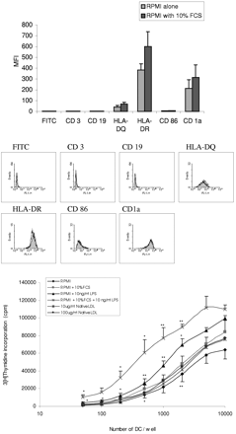
Fig. 1 (a) Phenotype of DC incubated in the absence of serum for 24 h. DC were prepared according to the method of ...
Notes:
Fig. 1 (a) Phenotype of DC incubated in the absence of serum for 24 h. DC were prepared according to the method of day 4 purification as detailed in the Methods. Following a total of 6 days in culture DC were washed twice in RPMI-1640 and resuspended at 5×105 DC/ml in the given media for 24 h. Surface expression of the given markers was assessed by flow cytometry. FITC represents control fluorescence in the absence of primary antibody. Mean values±S.E.M. are given from three independent experiments. Lower histograms represent individual examples. Filled profiles give RPMI-1640 with 10% FCS, and overlays give RPMI-1640 alone. Statistical analysis was performed; no statistically significant differences were observed. (b) Effects of native LDL on the ability of DC to induce the proliferation of T cells. DC were prepared according to the method of day 4 purification as detailed in the Methods. Following a total of 6 days in culture DC were washed twice in RPMI-1640 and resuspended at 5×105 DC/ml in the given media for 24 h. DC were harvested, washed twice in CM, and added to 105 purified autologous T cells for a further 48 h, according to the oxidative mitogenesis assay. Functional responses were assessed by [3H]thymidine incorporation during a further 16 h of incubation. Samples were run in triplicate. Mean values±S.E.M. of five independent experiments are shown. Statistical analysis is given relative to RPMI-1640 alone. *P<0.05; **P<0.01.
Unless provided in the caption above, the following copyright applies to the content of this slide: Copyright © 2002, European Society of Cardiology

Slide 6
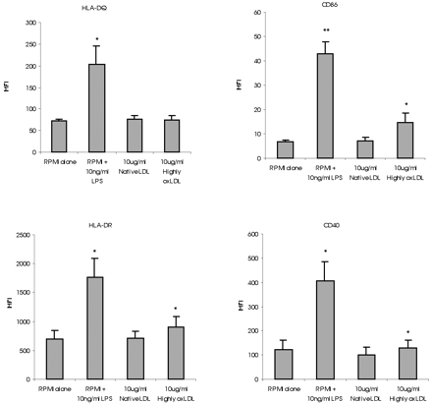
Fig. 4 Effects of highly-oxidised LDL on DC phenotype. DC were prepared according to the method of day 4 ...
Notes:
Fig. 4 Effects of highly-oxidised LDL on DC phenotype. DC were prepared according to the method of day 4 purification as detailed in the Methods. Following a total of 6 days in culture DC were washed twice in RPMI-1640 and resuspended at 5×105 DC/ml in the given media for 24 h. Surface expression of the given markers was assessed by flow cytometry. Mean values±S.E.M. are given from four independent experiments. Statistical analysis is given relative to both RPMI-1640 alone and 10 μg/ml native LDL. *P<0.05; **P<0.01.
Unless provided in the caption above, the following copyright applies to the content of this slide: Copyright © 2002, European Society of Cardiology

Slide 7
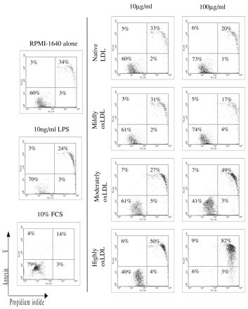
Fig. 7 Effects of LDL on DC apoptosis. DC were prepared according to the method of day 4 purification as detailed in ...
Notes:
Fig. 7 Effects of LDL on DC apoptosis. DC were prepared according to the method of day 4 purification as detailed in the Methods. Following a total of 6 days in culture DC were washed twice in RPMI-1640 and resuspended at 5×105 DC/ml in the given media for 24 h. DC were harvested, washed twice in CM, and stained with annexin V and propidium iodide as detailed in the Methods. A representative experiment of three is shown.
Unless provided in the caption above, the following copyright applies to the content of this slide: Copyright © 2002, European Society of Cardiology

Slide 8
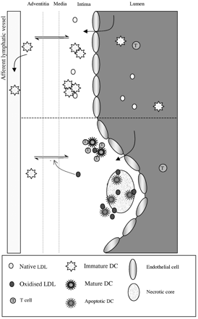
Fig. 8 Schematic diagram illustrating the proposed role of DC in the pathogenesis of atherosclerosis.
Notes:
Fig. 8 Schematic diagram illustrating the proposed role of DC in the pathogenesis of atherosclerosis.
Unless provided in the caption above, the following copyright applies to the content of this slide: Copyright © 2002, European Society of Cardiology

