Slide 1
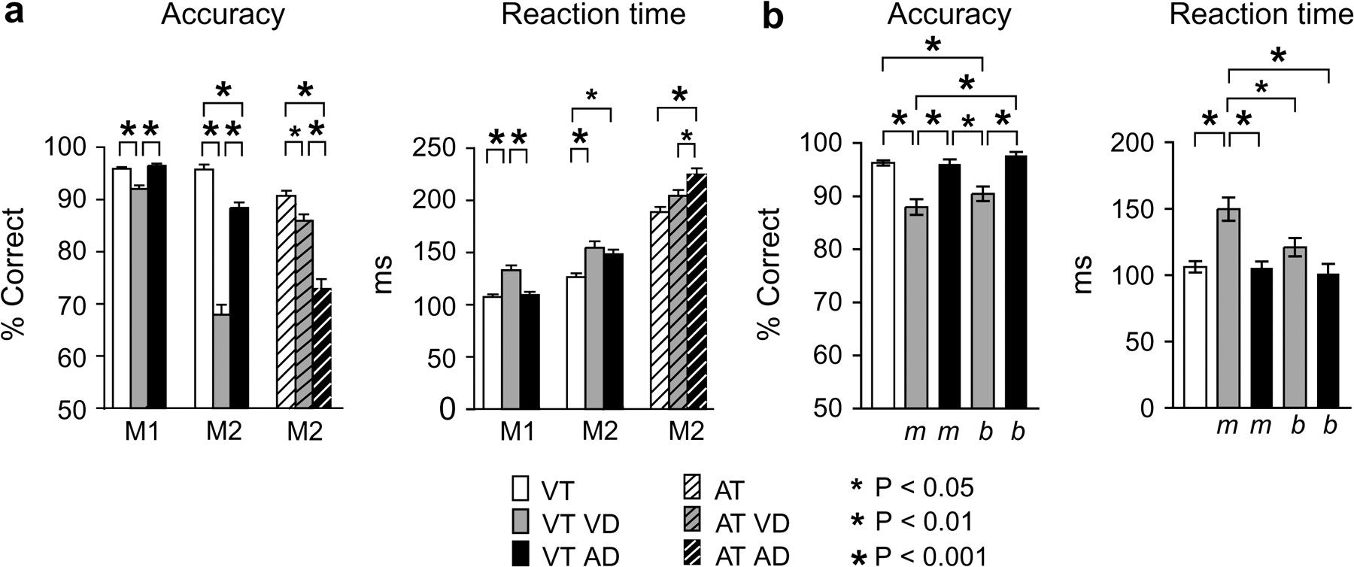
Figure 2. Results of the behavioral performance. (a) Accuracy was poorer and RT longer in trials with a distracter of ...
Notes:
Figure 2. Results of the behavioral performance. (a) Accuracy was poorer and RT longer in trials with a distracter of the same sensory modality as the memorandum than in the control trials or trials with a distracter of a different sensory modality. (1-way ANOVA; accuracy: Monkey 1 (M1): visual task, F2,1809 = 22.5, P < 0.0001; Monkey 2 (M2): visual task, F2,983 = 124.9, P < 0.0001; auditory task, F2,805 = 44.8, P < 0.0001. RT: 1-way ANOVA, Monkey 1: visual task, F2,887 = 17.0, P < 0.0001; Monkey 2: visual task, F2,472 = 10.0, P < 0.0001; auditory task, F2,391 = 10.6, P < 0.0001). (b) Effect of timing of the distracter on the behavioral result. The timing of the distracter did not affect the accuracy, but the accuracy was poorer in trials with visual distracters than in trials with auditory distracters or in the control trials (1-way ANOVA, F4,547 = 9.3, P < 0.0001). The RT was longest when the visual distracter was presented in the middle of the delay (F4,1126 = 16.8, P < 0.0001). VT, visual DMTS; AT, auditory DMTS; VD, visual distracter; AD, auditory distracter; m, distracter in the middle of the delay; and b, distracter at the beginning of the delay. Stars above the columns illustrate statistical results from Tukey–Kramer post hoc test.
Unless provided in the caption above, the following copyright applies to the content of this slide: © The Author 2009. Published by Oxford University Press. All rights reserved. For permissions, please e-mail: journals.permissions@oxfordjournals.org

Slide 2
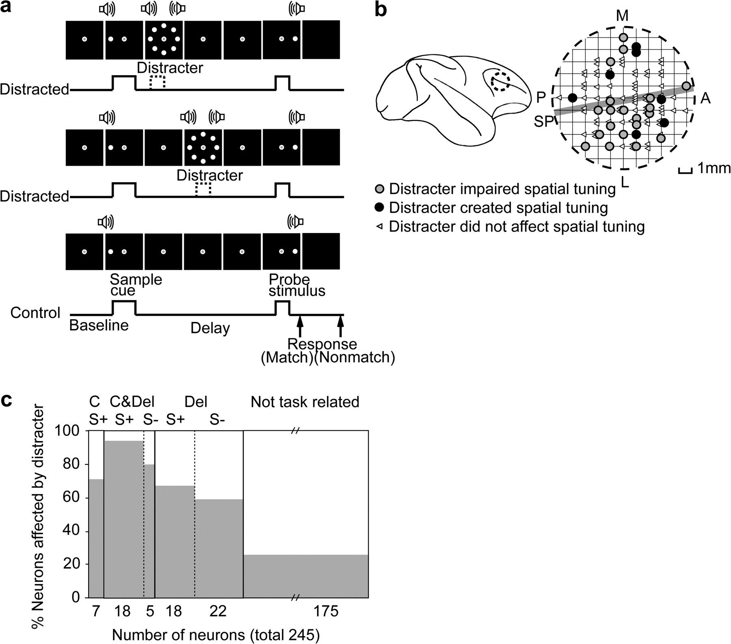
Figure 1. Illustration of the DMTS task, recorded area of the brain, and the neuronal database. (a) The DMTS task. The ...
Notes:
Figure 1. Illustration of the DMTS task, recorded area of the brain, and the neuronal database. (a) The DMTS task. The experimental design shows a control trial without distraction (bottom panel) and distracted trials with a distracter in the middle (middle panel) and at the beginning (top panel) of the delay. (b) Location of the recorded area in the dorsolateral PFC and distribution of penetrations where neurons with distracter effects were recorded. SP, Sulcus principalis. (c) Distribution of the neurons in different categories and the proportions (%) of them that were affected by distracters. C, cue-related neurons; Del, delay-related neurons; CDel, cue- and delay-related neurons; S+, spatially tuned activity; and S−, spatially nontuned activity.
Unless provided in the caption above, the following copyright applies to the content of this slide: © The Author 2009. Published by Oxford University Press. All rights reserved. For permissions, please e-mail: journals.permissions@oxfordjournals.org

Slide 3
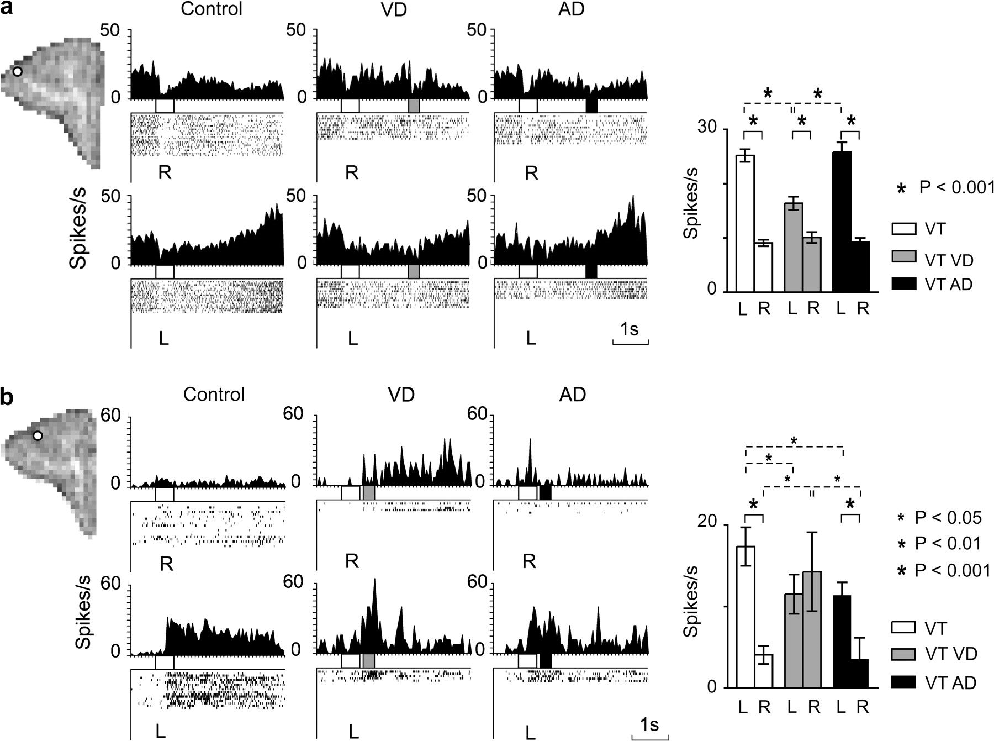
Figure 3. Impairment of spatially tuned delay activity. Two neurons exhibiting spatially tuned neuronal activity in ...
Notes:
Figure 3. Impairment of spatially tuned delay activity. Two neurons exhibiting spatially tuned neuronal activity in visual task (2-way ANOVA, main effect of location, F1,328 = 156.05, P < 0.001 in [a], and F1,256 = 135.34, P < 0.001 in [b]). In both neurons, the delay activity increased when monkey memorized left cues. (a) Visual distracter in the middle of the delay impaired spatial tuning (3-way ANOVA, main effect of distracter, F2,324 = 13.46, P < 0.001; location × distracter, F2,324 = 20.44, P < 0.001). Activity in all intervals of delay after visual distracter onset was significantly lower than in left control trials and left trials with auditory distracter and higher in left than right trials. Columns illustrate mean spiking frequency (± standard error of the mean [SEM]) after distracter onset (intervals combined). (b) Distracter at the beginning of delay affected the spatial tuning of the neuron (3-way ANOVA, main effect of distracter, F2,305 = 4.41, P < 0.05; location × distracter, F2,305 = 14.40, P < 0.001). Visual distracter at the beginning of the delay destroyed spatial tuning in all intervals of delay after distracter offset by increasing the discharge rate in the right trials and decreasing it in the left trials. Auditory distracter impaired delay activity in the left trials. Columns illustrate mean spiking frequency (± SEM) after distracter offset (intervals combined). Match and nonmatch trials combined. L, left; R, right. Bars under the histogram: white, sample cue; gray, visual distracter; and black, auditory distracter. Stars above the columns illustrate statistical results from Dunn–Sidak post hoc test. Other explanations, see Figure 2.
Unless provided in the caption above, the following copyright applies to the content of this slide: © The Author 2009. Published by Oxford University Press. All rights reserved. For permissions, please e-mail: journals.permissions@oxfordjournals.org

Slide 4
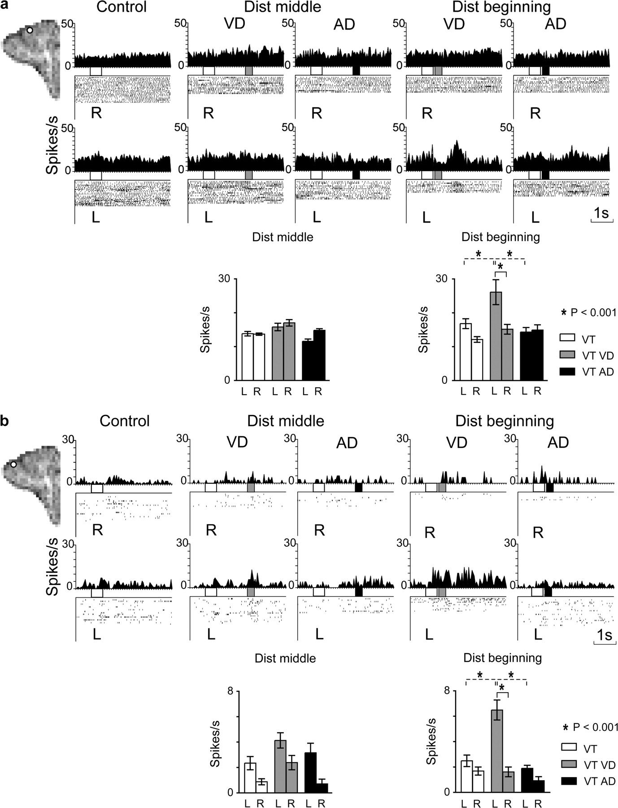
Figure 4. Creation of spatially tuned delay activity. Rasters and histograms and corresponding mean frequencies (± ...
Notes:
Figure 4. Creation of spatially tuned delay activity. Rasters and histograms and corresponding mean frequencies (± standard error of the mean [SEM]) of 2 neurons displaying spatially nontuned activity during control trials (leftmost pair of panels). Spatially tuned delay activity developed in trials in which the monkey memorized a sample cue on the left and a distracter was presented at the beginning of the delay (3-way ANOVA, location × distraction, F2,574 = 5.71, P < 0.01 in (a), and F2,525 = 7.78, P < 0.001 in [b]). (a) The neuron displayed spatially tuned activity in the second interval after distracter offset when a visual distracter occurred at the beginning of the delay (fourth pair of rasters and histograms from the left). Columns below rasters illustrate mean spiking frequency (± SEM) for the second interval after distracter offset. (b) The neuron displayed spatially tuned activity during whole delay after distracter onset. Columns below rasters illustrate mean spiking frequency (± SEM) for the delay after distracter onset (intervals combined). Other explanations, see Figure 3.
Unless provided in the caption above, the following copyright applies to the content of this slide: © The Author 2009. Published by Oxford University Press. All rights reserved. For permissions, please e-mail: journals.permissions@oxfordjournals.org

Slide 5
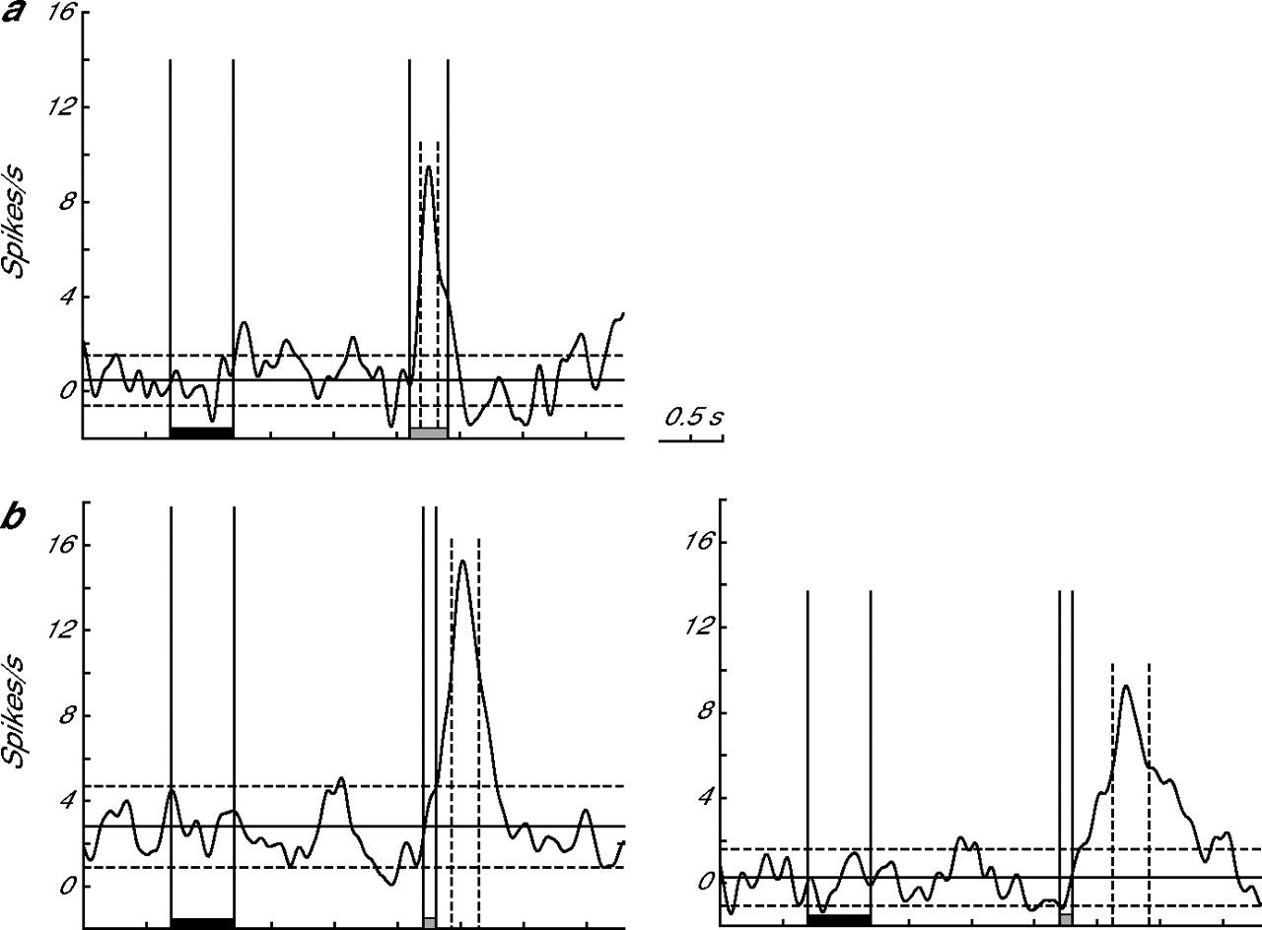
Figure 5. Examples of distracter effects in 2 neurons that did not change their spatial tuning as a result of the ...
Notes:
Figure 5. Examples of distracter effects in 2 neurons that did not change their spatial tuning as a result of the distracter (i.e., the response to the distracter was similar in left and right trials). (a) Response of a single neuron to the visual distracter presented in the middle of the delay period in the visual DMTS task. (b) Response of a single neuron to the visual (left panel) and auditory (right panel) distracters presented in the middle of the delay period in the visual DMTS task. The neuronal activity was low-pass filtered (see Materials and Methods) and is illustrated as a difference wave (activity during the control condition was subtracted from the activity during the distracted condition). Responses in match and nonmatch trials and right and left trials are combined. Bars on the horizontal axis: black = sample cue, gray = distracter. Dashed vertical lines indicate the onset latency (first line) and the offset latency (second line) of the response. Dashed horizontal lines indicate the 95% CI from the baseline (solid horizontal line).
Unless provided in the caption above, the following copyright applies to the content of this slide: © The Author 2009. Published by Oxford University Press. All rights reserved. For permissions, please e-mail: journals.permissions@oxfordjournals.org

Slide 6
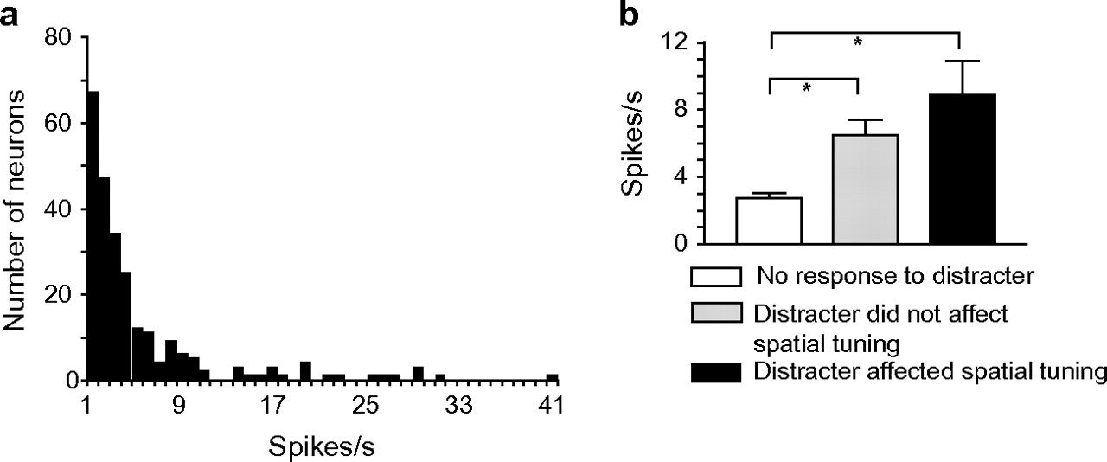
Figure 6. Distribution of baseline activity. (a) Distribution of the neuronal frequencies of all recorded neurons ...
Notes:
Figure 6. Distribution of baseline activity. (a) Distribution of the neuronal frequencies of all recorded neurons during the baseline period. (b) Distribution of the baseline frequencies of all neurons grouped by the type of distracter effect. The groups differed from each other significantly (ANOVA, F2,242 = 17.126, P < 0.001; Tukey–Kramer, *P < 0.001).
Unless provided in the caption above, the following copyright applies to the content of this slide: © The Author 2009. Published by Oxford University Press. All rights reserved. For permissions, please e-mail: journals.permissions@oxfordjournals.org

