Slide 1
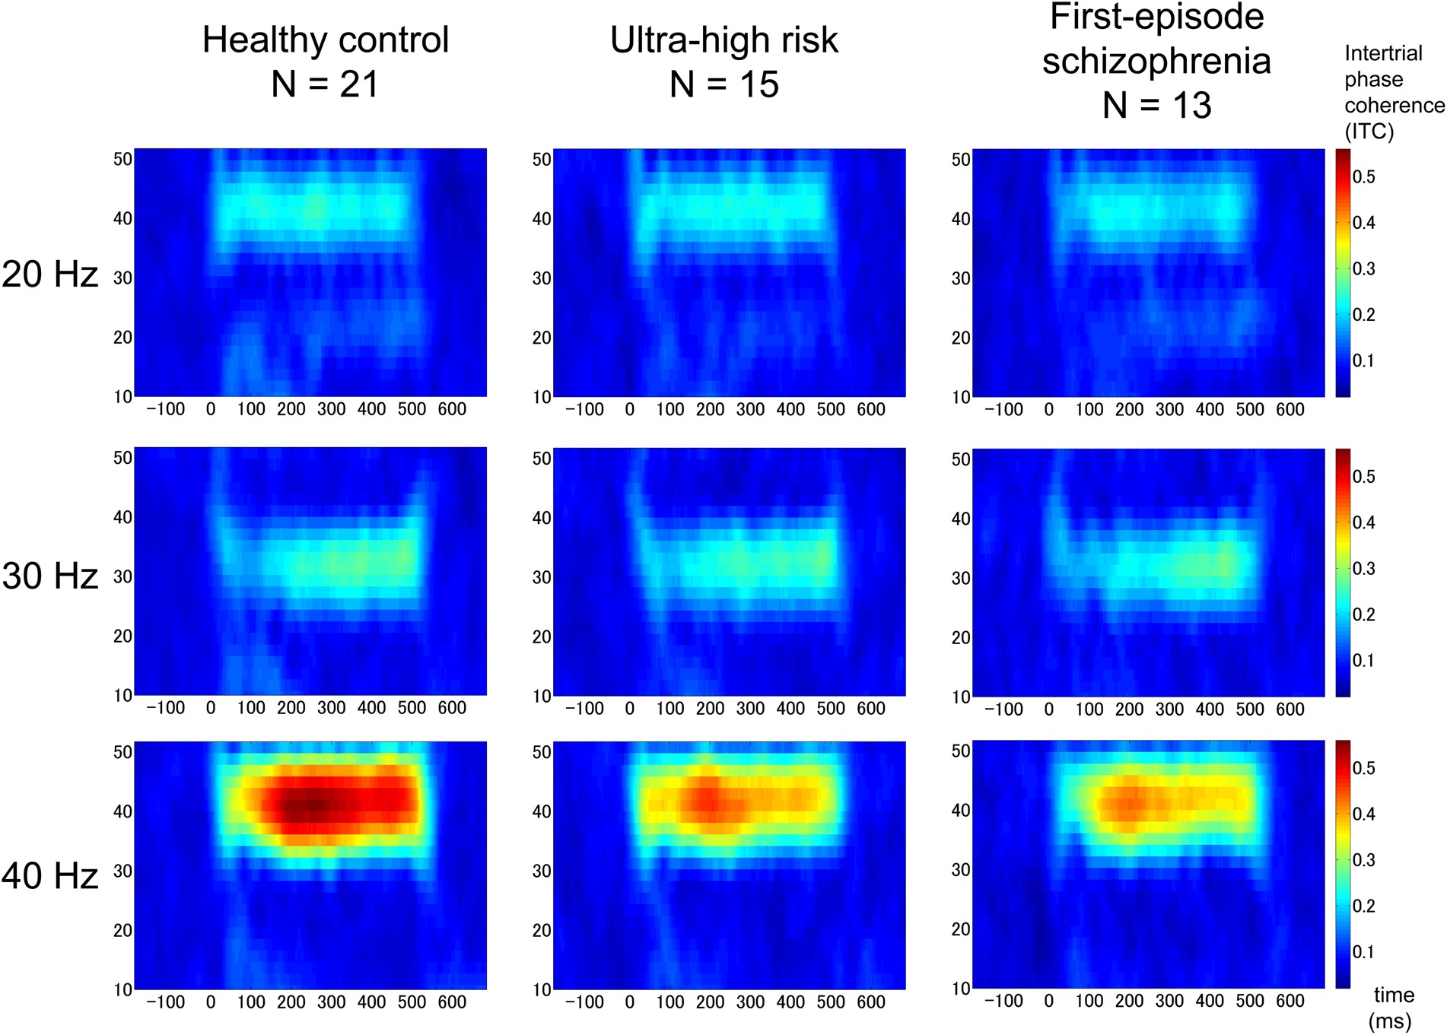
Figure 1. The grand average of time–frequency maps for intertrial phase coherence (ITC) at the frontocentral electrode ...
Notes:
Figure 1. The grand average of time–frequency maps for intertrial phase coherence (ITC) at the frontocentral electrode site (FCz) in each stimulation frequency and for each group. In each map, the x-axis indicates time (ms), and the y-axis indicates frequency (Hz). Color indicates ITC at each time–frequency point.
Unless provided in the caption above, the following copyright applies to the content of this slide: © The Author 2014. Published by Oxford University Press. All rights reserved. For Permissions, please e-mail: journals.permissions@oup.com

Slide 2
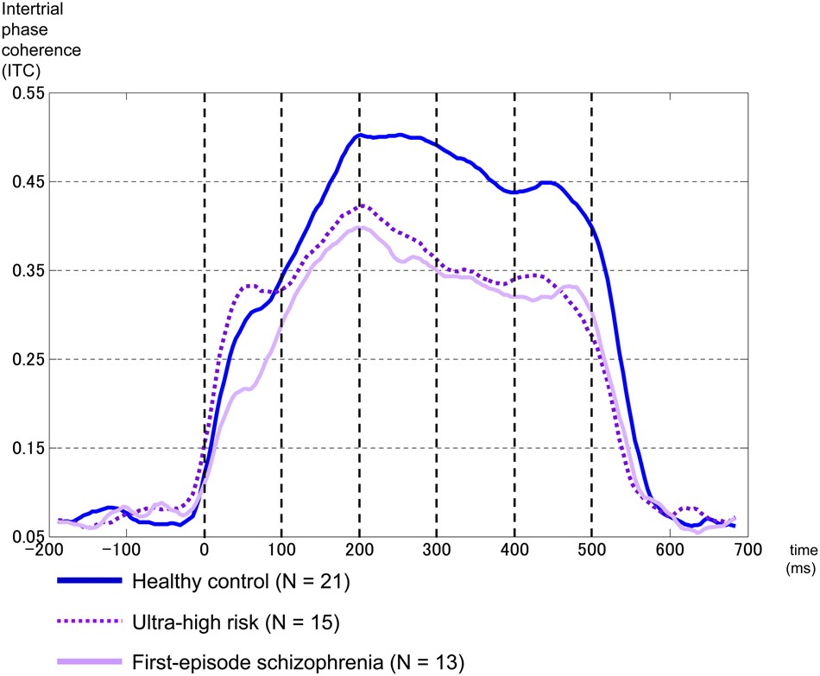
Figure 2. The time course of the 40-Hz ITC. The x-axis indicates time (ms), and the y-axis indicates ITC. The blue ...
Notes:
Figure 2. The time course of the 40-Hz ITC. The x-axis indicates time (ms), and the y-axis indicates ITC. The blue line, dotted line, and purple line indicate the 40-Hz ITC in healthy controls, ultra-high risk, and first-episode schizophrenia, respectively.
Unless provided in the caption above, the following copyright applies to the content of this slide: © The Author 2014. Published by Oxford University Press. All rights reserved. For Permissions, please e-mail: journals.permissions@oup.com

Slide 3
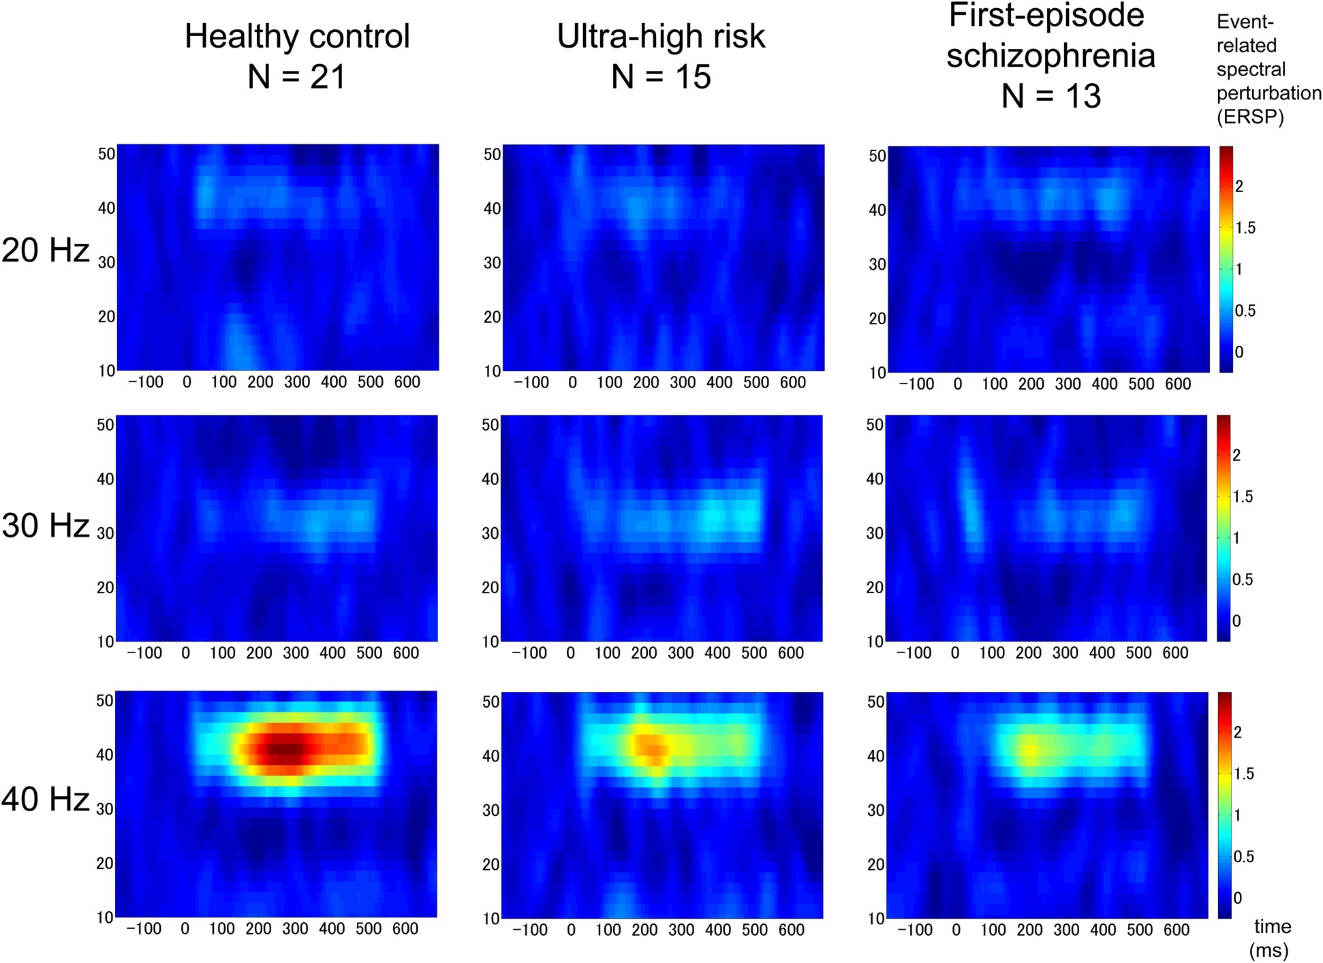
Figure 3. The grand average of time–frequency maps of event-related spectral perturbation (ERSP) at FCz in each ...
Notes:
Figure 3. The grand average of time–frequency maps of event-related spectral perturbation (ERSP) at FCz in each stimulation frequency and for each group. In each map, the x-axis indicates time (ms), and the y-axis indicates frequency (Hz). Color indicates ERSP at each time–frequency point.
Unless provided in the caption above, the following copyright applies to the content of this slide: © The Author 2014. Published by Oxford University Press. All rights reserved. For Permissions, please e-mail: journals.permissions@oup.com

Slide 4
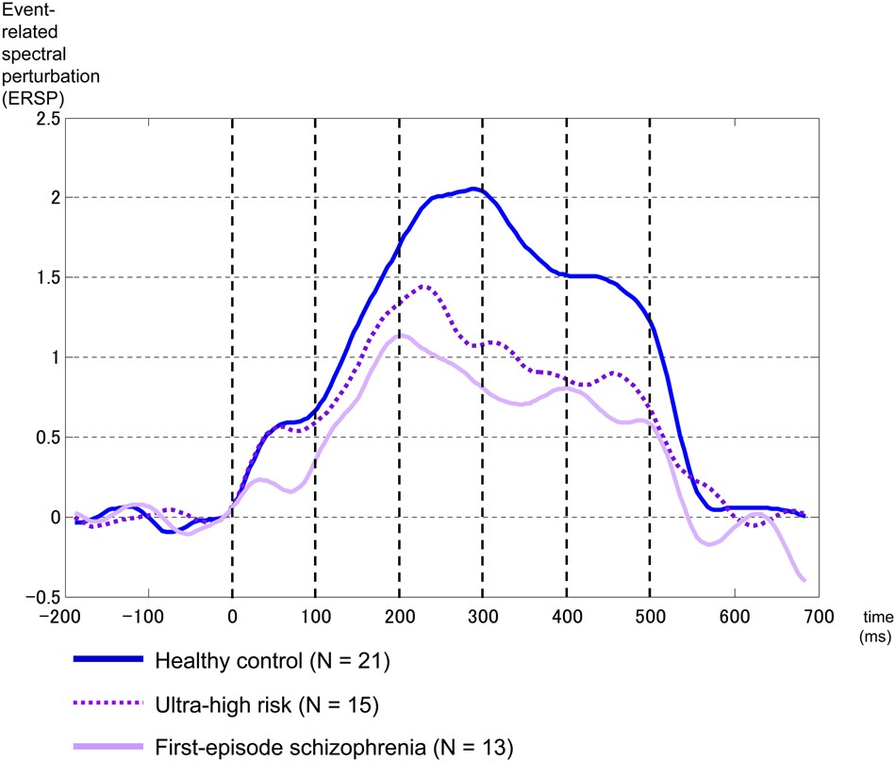
Figure 4. The time course of the 40-Hz ERSP. The x-axis indicates time (ms), and the y-axis indicates ERSP. The blue ...
Notes:
Figure 4. The time course of the 40-Hz ERSP. The x-axis indicates time (ms), and the y-axis indicates ERSP. The blue line, dotted line, and purple line indicate the 40-Hz ERSP in healthy controls, ultra-high risk, and first-episode schizophrenia, respectively.
Unless provided in the caption above, the following copyright applies to the content of this slide: © The Author 2014. Published by Oxford University Press. All rights reserved. For Permissions, please e-mail: journals.permissions@oup.com

Slide 5
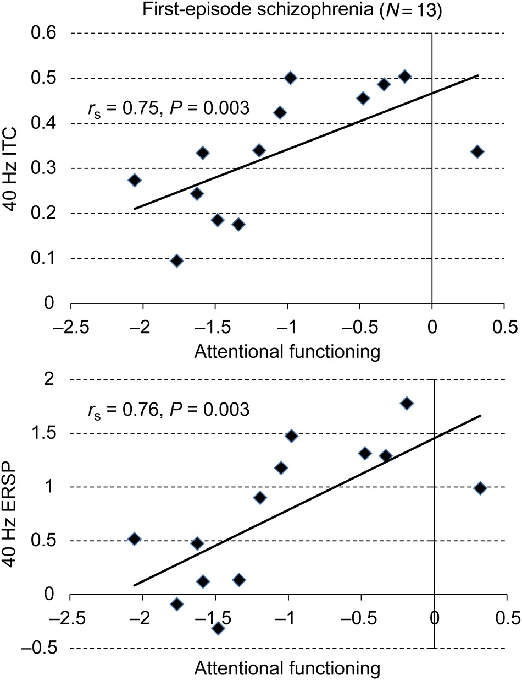
Figure 5. Attentional functioning was associated with 40-Hz ITC (top) and ERSP (bottom) of the late-latency gamma-band ...
Notes:
Figure 5. Attentional functioning was associated with 40-Hz ITC (top) and ERSP (bottom) of the late-latency gamma-band ASSR in first-episode schizophrenia. The x-axis indicates the score of the attentional functioning in the Brief Assessment of Cognition in Schizophrenia. The y-axis indicates 40-Hz ITC (top) and ERSP (bottom).
Unless provided in the caption above, the following copyright applies to the content of this slide: © The Author 2014. Published by Oxford University Press. All rights reserved. For Permissions, please e-mail: journals.permissions@oup.com

