Slide 1
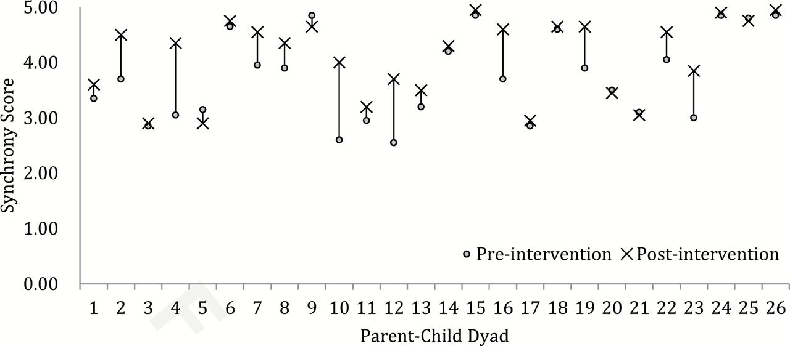
F igure 1. Pre- and post-intervention means of parent-child synchrony ( N = 26).
Notes:
F igure 1. Pre- and post-intervention means of parent-child synchrony ( N = 26).
Unless provided in the caption above, the following copyright applies to the content of this slide: © the American Music Therapy Association 2015. All rights reserved. For permissions, please e-mail: journals.permissions@oup.com

Slide 2
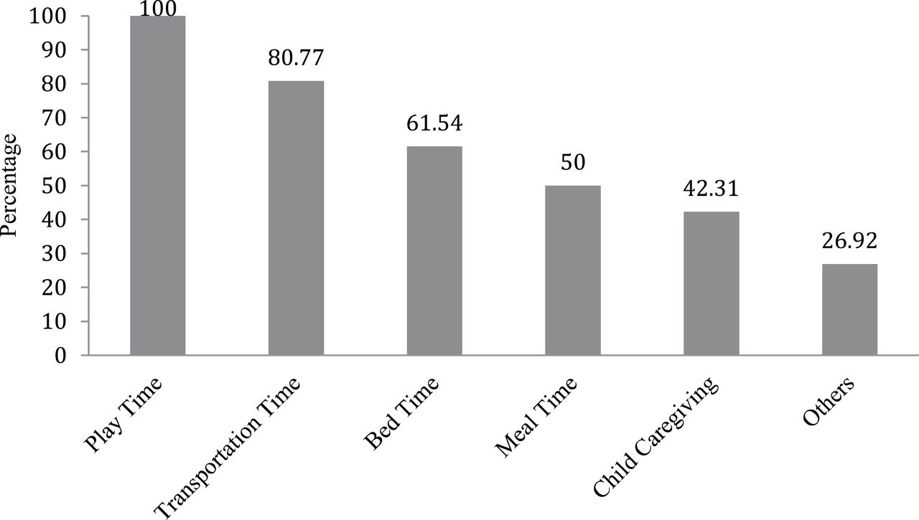
F igure 2. Parents’ use of music within children’s daily routines.
Notes:
F igure 2. Parents’ use of music within children’s daily routines.
Unless provided in the caption above, the following copyright applies to the content of this slide: © the American Music Therapy Association 2015. All rights reserved. For permissions, please e-mail: journals.permissions@oup.com

