Slide 1
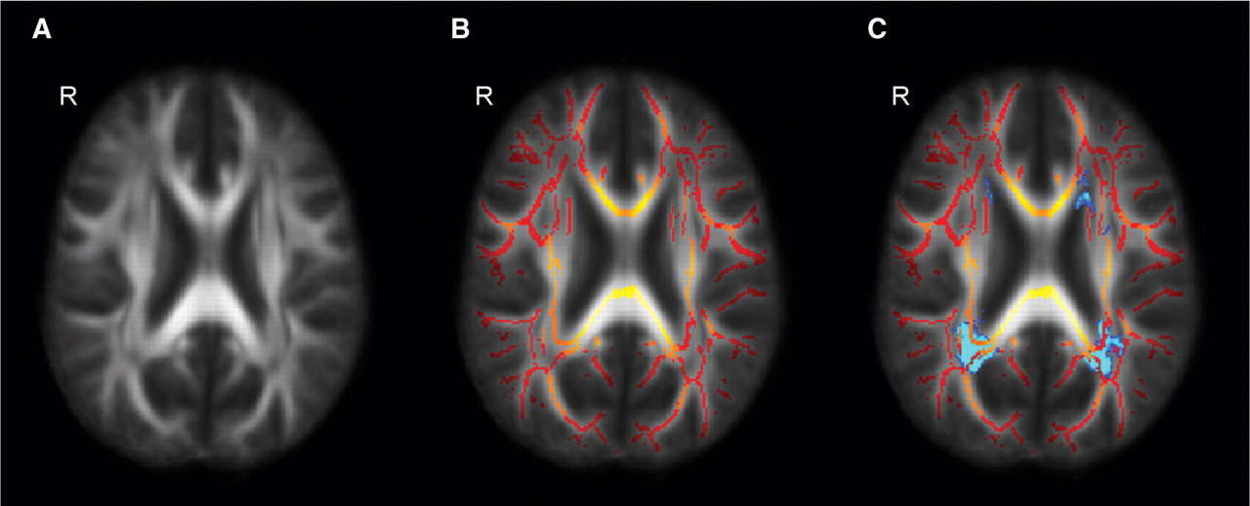
Fig. 1 (A) Mean FA image (MNI coordinate z = 96). (B) Mean TBSS tract skeleton with lower FA display threshold of ...
Notes:
Fig. 1 (A) Mean FA image (MNI coordinate z = 96). (B) Mean TBSS tract skeleton with lower FA display threshold of 0.2, overlaid on the mean FA image. Colour scale shows skeletal voxels with lower FA as red and higher FA as yellow. (C) As for (B) with mean FLAIR lesion probability distribution thresholded at 10% (blue).
Unless provided in the caption above, the following copyright applies to the content of this slide: © The Author (2008). Published by Oxford University Press on behalf of the Guarantors of Brain. All rights reserved. For Permissions, please email: journals.permissions@oxfordjournals.org

Slide 2
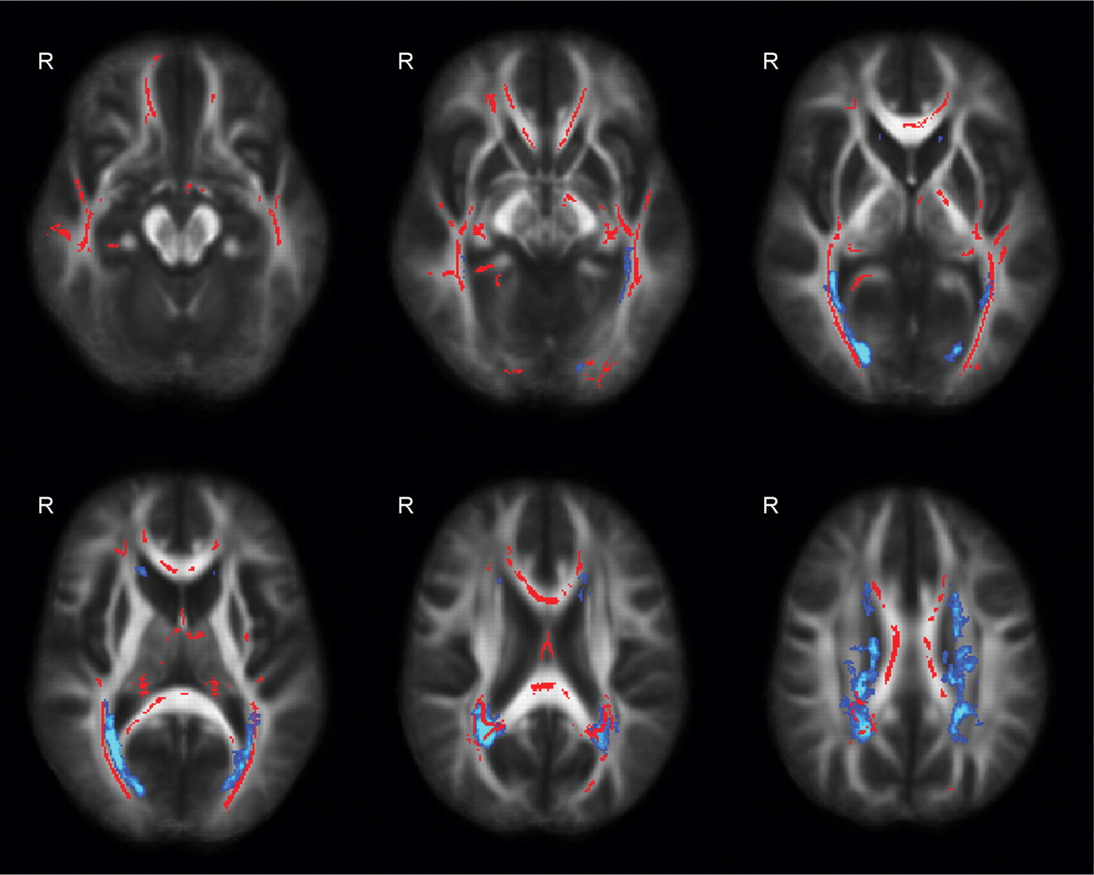
Fig. 2 Skeletal voxels where patient FA < control FA, P ≤ 0.05; Cluster-based thresholding corrected for multiple ...
Notes:
Fig. 2 Skeletal voxels where patient FA < control FA, P ≤ 0.05; Cluster-based thresholding corrected for multiple comparisons. Uncorrected for the effects of age. Background: greyscale mean FA map with mean FLAIR lesion probability distribution thresholded at 10% shown in blue.
Unless provided in the caption above, the following copyright applies to the content of this slide: © The Author (2008). Published by Oxford University Press on behalf of the Guarantors of Brain. All rights reserved. For Permissions, please email: journals.permissions@oxfordjournals.org

Slide 3
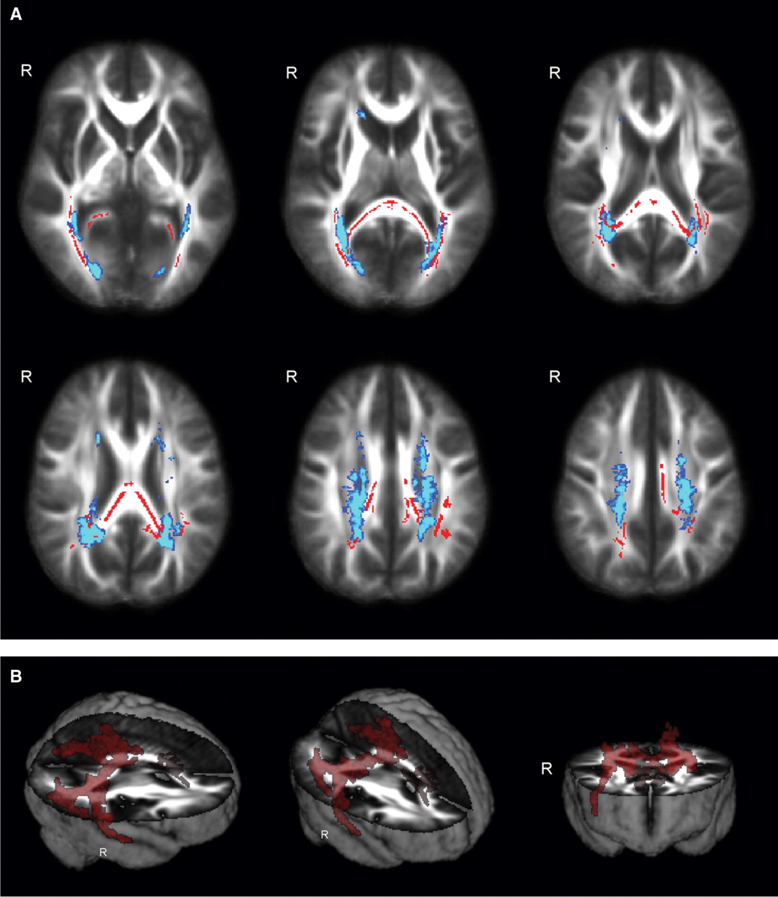
Fig. 3 (A) Axial images demonstrating skeletal voxels (red) significantly correlating with PASAT z-scores, treating ...
Notes:
Fig. 3 (A) Axial images demonstrating skeletal voxels (red) significantly correlating with PASAT z-scores, treating age as a covariate of no interest. Cluster-based thresholding. P ≤ 0.05. Background as for Fig. 2. (B) Surface rendered version of (A), without mean lesion probability distribution overlay.
Unless provided in the caption above, the following copyright applies to the content of this slide: © The Author (2008). Published by Oxford University Press on behalf of the Guarantors of Brain. All rights reserved. For Permissions, please email: journals.permissions@oxfordjournals.org

Slide 4
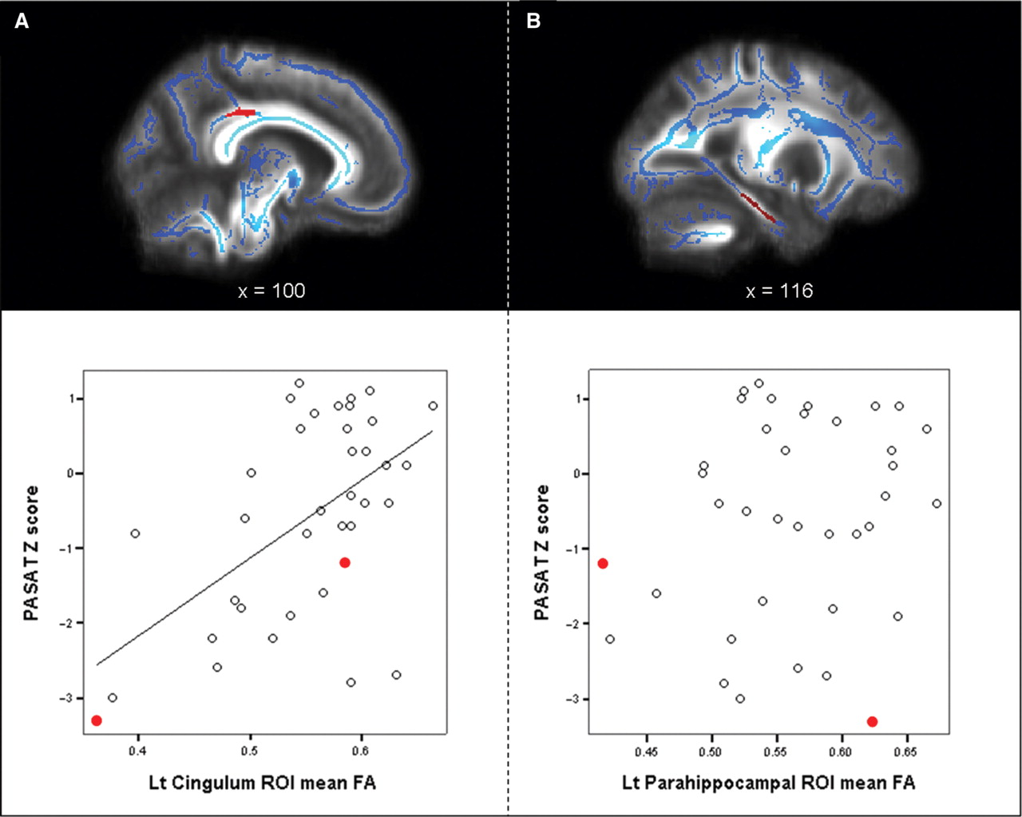
Fig. 4 (A) Location of the left posterior cingulate ROI (red) drawn on the mean tract skeleton (blue, thresholded at ...
Notes:
Fig. 4 (A) Location of the left posterior cingulate ROI (red) drawn on the mean tract skeleton (blue, thresholded at tract voxel FA ≥ 0.2), with scatterplot demonstrating a relationship between ROI mean FA and PASAT z-score (red dots—SPMS patients). (B) Location of the left parahippocampal white matter ROI, with corresponding scatterplot showing no relationship with PASAT z-scores.
Unless provided in the caption above, the following copyright applies to the content of this slide: © The Author (2008). Published by Oxford University Press on behalf of the Guarantors of Brain. All rights reserved. For Permissions, please email: journals.permissions@oxfordjournals.org

Slide 5
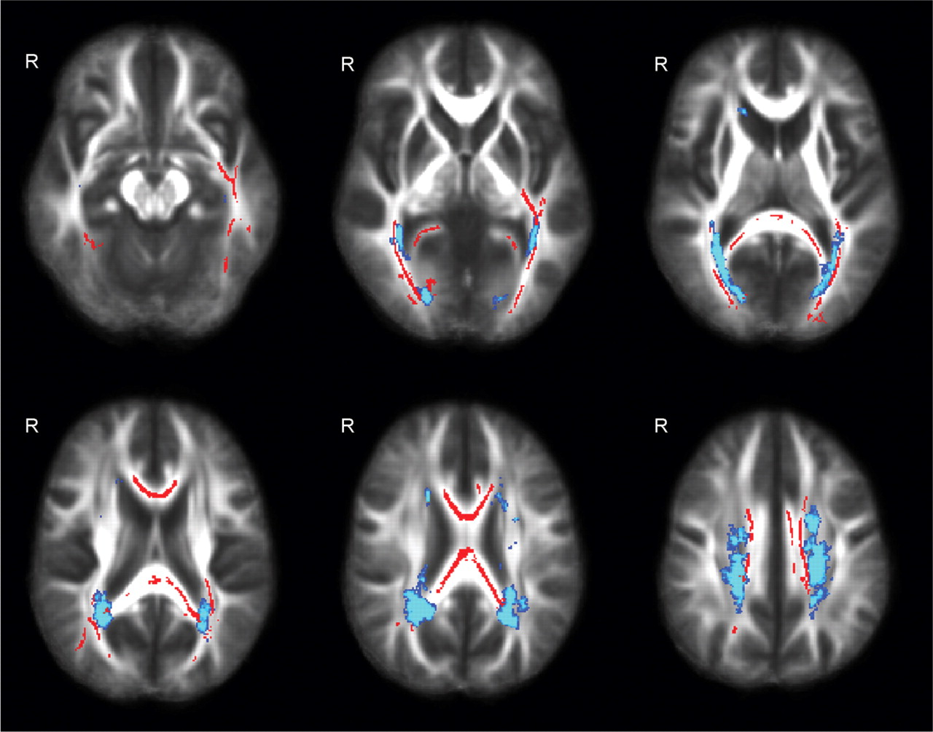
Fig. 5 Skeletal voxels (red) which show significant correlation with BVRT z-scores, with age treated as a covariate ...
Notes:
Fig. 5 Skeletal voxels (red) which show significant correlation with BVRT z-scores, with age treated as a covariate of no interest. Cluster-based thresholding corrected for multiple comparisons, P < 0.05. Background as for Fig. 2.
Unless provided in the caption above, the following copyright applies to the content of this slide: © The Author (2008). Published by Oxford University Press on behalf of the Guarantors of Brain. All rights reserved. For Permissions, please email: journals.permissions@oxfordjournals.org

Slide 6
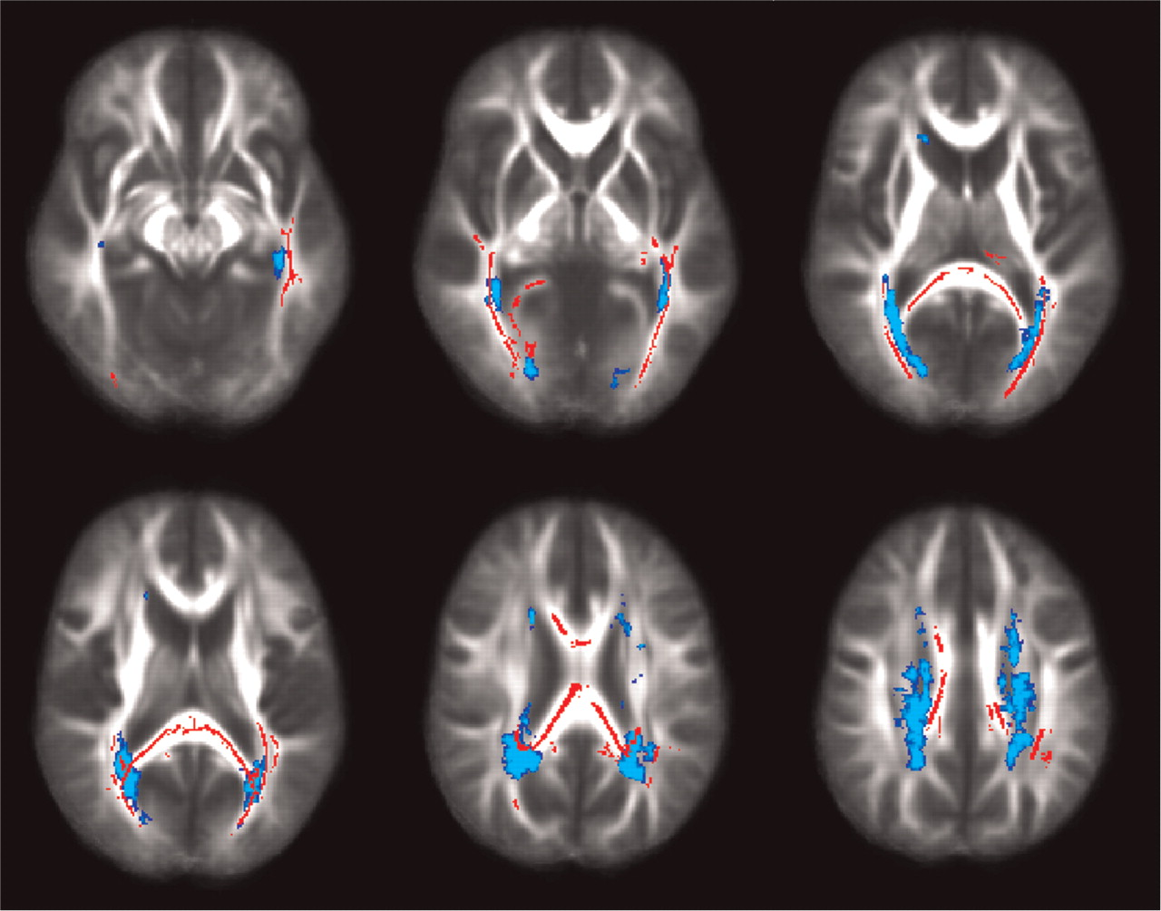
Fig. 6 Axial images demonstrating skeletal voxels (red) which significantly correlate with CVLT-II sdf z-scores, ...
Notes:
Fig. 6 Axial images demonstrating skeletal voxels (red) which significantly correlate with CVLT-II sdf z-scores, treating age as a covariate of no interest. Cluster-based thresholding corrected for multiple comparisons, P < 0.05. Background as for Fig. 2.
Unless provided in the caption above, the following copyright applies to the content of this slide: © The Author (2008). Published by Oxford University Press on behalf of the Guarantors of Brain. All rights reserved. For Permissions, please email: journals.permissions@oxfordjournals.org

