Slide 1
Figure 1 Expected wealth.
Notes:
Figure 1 Expected wealth.
Unless provided in the caption above, the following copyright applies to the content of this slide: © Oxford University Press 2008

Slide 2
Figure 2 Equilibrium period-2 price level when (17) is satisfied.
Notes:
Figure 2 Equilibrium period-2 price level when (17) is satisfied.
Unless provided in the caption above, the following copyright applies to the content of this slide: © Oxford University Press 2008

Slide 3
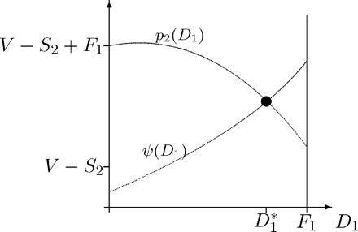
Figure 3 Existence of equilibrium when (17) is satisfied.
Notes:
Figure 3 Existence of equilibrium when (17) is satisfied.
Unless provided in the caption above, the following copyright applies to the content of this slide: © Oxford University Press 2008

Slide 4
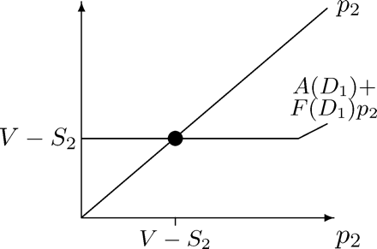
Figure 4 Equilibrium period-2 price level when (40) is satisfied.
Notes:
Figure 4 Equilibrium period-2 price level when (40) is satisfied.
Unless provided in the caption above, the following copyright applies to the content of this slide: © Oxford University Press 2008

Slide 5
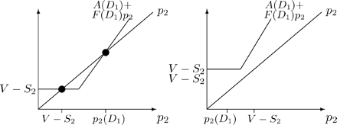
Figure 6 Equilibrium period-2 price level when (49) and (50) or (51) are satisfied and D₁ > ...
Notes:
Figure 6 Equilibrium period-2 price level when (49) and (50) or (51) are satisfied and D1 > D∞1.
Unless provided in the caption above, the following copyright applies to the content of this slide: © Oxford University Press 2008

Slide 6
Figure 5 Existence of equilibrium when (40) is satisfied (left panel: (44) satisfied, right panel: (45) satisfied).
Notes:
Figure 5 Existence of equilibrium when (40) is satisfied (left panel: (44) satisfied, right panel: (45) satisfied).
Unless provided in the caption above, the following copyright applies to the content of this slide: © Oxford University Press 2008

Slide 7
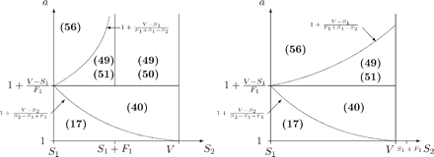
Figure 8 Case distinctions: numbers refer to Equation numbers in the running text (left panel: S₁ + ...
Notes:
Figure 8 Case distinctions: numbers refer to Equation numbers in the running text (left panel: S1 + F1 < V, right panel: S1 + F1 ≥ V).
Unless provided in the caption above, the following copyright applies to the content of this slide: © Oxford University Press 2008

Slide 8
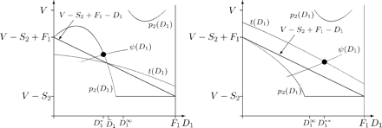
Figure 7 Existence of equilibrium when (49) and (50) or (51) are satisfied (left panel: (44) satisfied, right panel: ...
Notes:
Figure 7 Existence of equilibrium when (49) and (50) or (51) are satisfied (left panel: (44) satisfied, right panel: (45) satisfied).
Unless provided in the caption above, the following copyright applies to the content of this slide: © Oxford University Press 2008

Slide 9
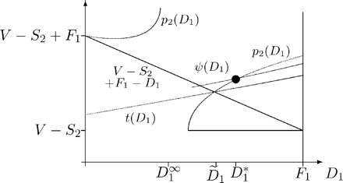
Figure 9 Existence of equilibrium when (56) is satisfied.
Notes:
Figure 9 Existence of equilibrium when (56) is satisfied.
Unless provided in the caption above, the following copyright applies to the content of this slide: © Oxford University Press 2008

Slide 10
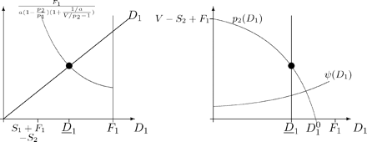
Figure 10 Existence of equilibrium when arbitrageurs obey (58) and (17) holds.
Notes:
Figure 10 Existence of equilibrium when arbitrageurs obey (58) and (17) holds.
Unless provided in the caption above, the following copyright applies to the content of this slide: © Oxford University Press 2008

Slide 11
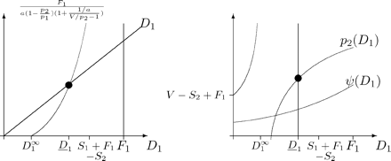
Figure 11 Existence of equilibrium when arbitrageurs obey (58) and (56) holds.
Notes:
Figure 11 Existence of equilibrium when arbitrageurs obey (58) and (56) holds.
Unless provided in the caption above, the following copyright applies to the content of this slide: © Oxford University Press 2008

