Slide 1
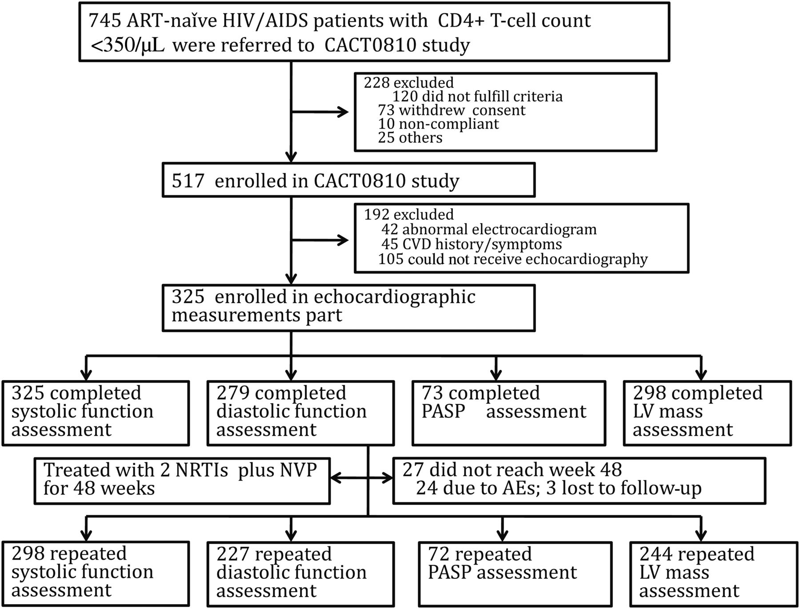
Figure 1. Study design. Abbreviations: AE, adverse effect; ART, antiretroviral therapy; CACT0810, China AIDS Clinical ...
Notes:
Figure 1. Study design. Abbreviations: AE, adverse effect; ART, antiretroviral therapy; CACT0810, China AIDS Clinical Trial 0810; CVD, cardiovascular disease; HIV, human immunodeficiency virus; LV, left ventricular; NRTI, nucleoside reverse transcriptase inhibitor; NVP, nevirapine; PASP, pulmonary artery systolic pressure.
Unless provided in the caption above, the following copyright applies to the content of this slide: © The Author 2014. Published by Oxford University Press on behalf of the Infectious Diseases Society of America. All rights reserved. For Permissions, please e-mail: journals.permissions@oup.com.

Slide 2
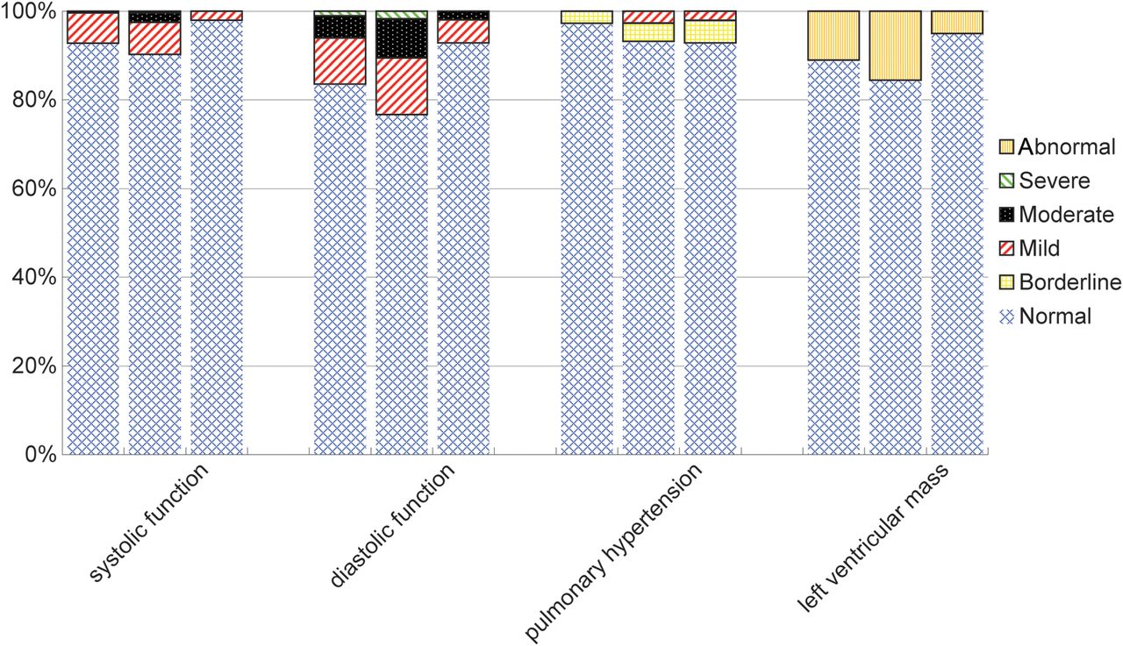
Figure 2. Distribution of echocardiographic abnormalities among China AIDS Clinical Trial 0810 (CACT0810) participants ...
Notes:
Figure 2. Distribution of echocardiographic abnormalities among China AIDS Clinical Trial 0810 (CACT0810) participants at baseline and at week 48 and controls. The A column represents CACT0810 participants at baseline; the B column represents CACT0810 participants at week 48; the C column represents HIV-negative controls. #P < .05 for antiretroviral therapy (ART)–naive participants vs controls in the prevalence of cardiac dysfunction. +P < .05 for combination ART after 48 weeks vs controls in the prevalence of cardiac dysfunction.
Unless provided in the caption above, the following copyright applies to the content of this slide: © The Author 2014. Published by Oxford University Press on behalf of the Infectious Diseases Society of America. All rights reserved. For Permissions, please e-mail: journals.permissions@oup.com.

