Slide 1
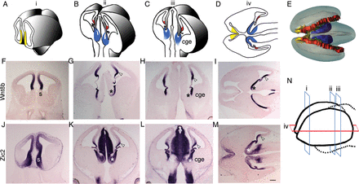
Figure 1. Medial forebrain structures. (A–C) Schematics of 3 coronal levels of sectioning in the E12.5 mouse brain, ...
Notes:
Figure 1. Medial forebrain structures. (A–C) Schematics of 3 coronal levels of sectioning in the E12.5 mouse brain, corresponding to “i,” “ii,” and “iii” in N, respectively. “i” is at the level of septum (yellow); “ii” and “iii” show the cortical hem (red) and the thalamic eminence (TE; blue). TE is contiguous with the CGE as seen in level “iii.” (D) Schematic depicting the positions of septum, cortical hem, and TE in a horizontal section, corresponding to “iv” in N. The 3 rostro-caudal coronal levels (i, ii, and iii) and 1 horizontal level (iv) of sectioning in the E12.5 whole forebrain are schematized in N. (E) Dorsal view of a 3-D model of E12.5 brain showing the locations of septum (yellow), hem (red), and TE (blue), encircling the choroid plexus (green). Wnt8b is expressed in the medial neuroepithelium of the dorsal telencephalon, including the pallial septum (F), cortical hem (open arrowhead), and also in the ventricular zone of TE (asterisk; G–I). (J–M) Zic2 is expressed in the entire medial forebrain, including the forebrain hem system. CGE, caudal ganglionic eminence; h, hem; s, septum; TE, thalamic eminence. Scale bar: 300 µm.
Unless provided in the caption above, the following copyright applies to the content of this slide: © The Author 2013. Published by Oxford University Press.This is an Open Access article distributed under the terms of the Creative Commons Attribution License (http://creativecommons.org/licenses/by-nc/3.0/), which permits non-commercial use, distribution, and reproduction in any medium, provided the original work is properly cited. For commercial re-use, please contact journals.permissions@oup.com.

Slide 2
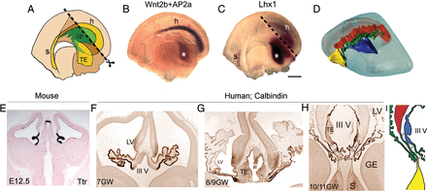
Figure 2. Connection of the choroid plexus with components of the forebrain hem system. (A) Schematic of the medial ...
Notes:
Figure 2. Connection of the choroid plexus with components of the forebrain hem system. (A) Schematic of the medial view of an E11.5 hemi-forebrain showing the position of the forebrain hem system (yellow), encircling the choroid plexus (cp; green). The dashed line (A and C) corresponds to the diencephalic midline that was bisected for the hemi-forebrain preparation (B). Whole mount in situ hybridization of an E12.5 hemi-forebrain reveals Wnt2b expression, specific to the cortical hem (purple), and AP2α expression, specific to the thalamic eminence (asterisk; brown). (C) Lhx1 is expressed in the E11.5 septum and thalamic eminence (asterisk) and also weakly in the cortical hem. (D) Lateral view of a single hemisphere in 3-D model of E12.5 brain showing the location of the septum (yellow), hem (red), and thalamic eminence (blue), encircling the choroid plexus (green). (E) E12.5 mouse brain sections processed for marker Ttr show the presence of the choroid plexus adjacent to both the lateral ventricles and the third ventricle. (F–H) Human sections immunostained by calbindin antibody show the development of choroid plexus from 7 to 10/11 GWs. (H) An oblique section of 10/11-GW human brain that shows the connection of choroid plexus with both the septum and cortical hem (open arrowheads), as also depicted in I. cp, choroid plexus; h, hem; s, septum; TE, thalamic eminence; III V, third ventricle. Scale bar: 200 µm (B and C).
Unless provided in the caption above, the following copyright applies to the content of this slide: © The Author 2013. Published by Oxford University Press.This is an Open Access article distributed under the terms of the Creative Commons Attribution License (http://creativecommons.org/licenses/by-nc/3.0/), which permits non-commercial use, distribution, and reproduction in any medium, provided the original work is properly cited. For commercial re-use, please contact journals.permissions@oup.com.

Slide 3
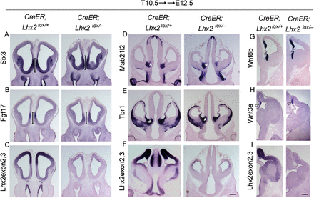
Figure 6. Critical period for Lhx2 to regulate the forebrain hem system ends by E10.5. Conditional deletion of Lhx2 ...
Notes:
Figure 6. Critical period for Lhx2 to regulate the forebrain hem system ends by E10.5. Conditional deletion of Lhx2 using a tamoxifen-inducible CreER driver. Tamoxifen administration at E10.5 (T10.5) does not interfere with forebrain development in control (CreER;Lhx2lox/+) embryos (A–I). A probe against Lhx2 exon 2,3 indicates that Lhx2 deletion has occurred throughout the brain of the floxed (CreER;Lhx2lox/−) embryos (C, F, I). (A–C) The septum in the floxed embryos appears normal as evident from Six3 and Fgf17 expression (bars; A and B). (D and E) Thalamic eminence expressing Mab21l2 and Tbr1 appear similar in the floxed embryos as that in controls (asterisk). Similarly, expression of Wnt8b in the cortical hem, medial pallium, and thalamic eminence as well as of Wnt3a in the cortical hem is comparable between floxed and control embryos (G and H). Scale bar: 300 µm.
Unless provided in the caption above, the following copyright applies to the content of this slide: © The Author 2013. Published by Oxford University Press.This is an Open Access article distributed under the terms of the Creative Commons Attribution License (http://creativecommons.org/licenses/by-nc/3.0/), which permits non-commercial use, distribution, and reproduction in any medium, provided the original work is properly cited. For commercial re-use, please contact journals.permissions@oup.com.

Slide 4
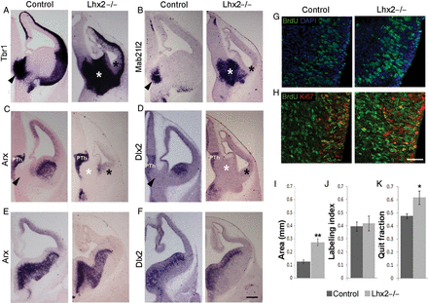
Figure 5. The thalamic eminence expands in the Lhx2 mutant. (A and B) Tbr1 and Mab21l2 expression in the mantle of the ...
Notes:
Figure 5. The thalamic eminence expands in the Lhx2 mutant. (A and B) Tbr1 and Mab21l2 expression in the mantle of the thalamic eminence in E12.5 control brains (arrowheads) reveal a profound expansion of this territory in the Lhx2 mutant (white asterisk). (A–D) The Lhx2 mutant CGE at E12.5 appears morphologically reduced and lacks Arx expression in its mantle (black asterisk, C) and Dlx2 expression in its ventricular zone and mantle (black asterisk, D). (E and F) Arx and Dlx2 expression appear normal in the LGE and MGE (E and F) and prethalamus (PTh; C and D). Arrowheads in control sections and white asterisks in Lhx2 mutant sections in A–D indicate the thalamic eminence. (G and J) Sections of E11.5 control and Lhx2 mutant brains, after a 2-h BrdU pulse, processed for BrdU and DAPI staining. Labeling indices (BrdU+ cells/total DAPI+ cells) at E11.5 are similar in the thalamic eminence of control (39%) and Lhx2 mutant (42%) brains. (H and K) Sections of E12.5 Lhx2 control and mutant brains harvested 1 day after BrdU administration at E11.5; and processed for BrdU–Ki67 double immunohistochemistry. The quit fraction (BrdU+; Ki67− cells/total BrdU+ cells) is significantly greater in the Lhx2 mutant thalamic eminence (62%; P < 0.05) when compared with control brains (48%). (I) Area occupied by the thalamic eminence is significantly increased in Lhx2 mutant brains compared with that of controls (**P < 0.005). Scale bars: 300 µm (A–F) and 50 µm (G and H).
Unless provided in the caption above, the following copyright applies to the content of this slide: © The Author 2013. Published by Oxford University Press.This is an Open Access article distributed under the terms of the Creative Commons Attribution License (http://creativecommons.org/licenses/by-nc/3.0/), which permits non-commercial use, distribution, and reproduction in any medium, provided the original work is properly cited. For commercial re-use, please contact journals.permissions@oup.com.

Slide 5
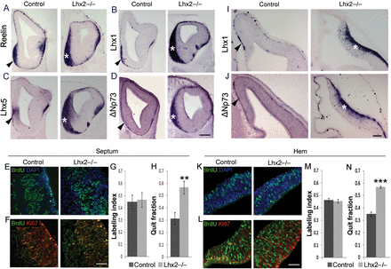
Figure 4. Loss of Lhx2 results in an increase in Cajal–Retzius cells. (A–D) Expression of Reelin (A), Lhx1 (B), Lhx5 ...
Notes:
Figure 4. Loss of Lhx2 results in an increase in Cajal–Retzius cells. (A–D) Expression of Reelin (A), Lhx1 (B), Lhx5 (C), and ΔNp73 (D) at E12.5 reveals a considerable increase in the Cajal–Retzius cells accumulated at the septum of Lhx2 mutants (asterisks) compared with control brains (arrowheads). (I and J) Similarly, the mantle of the mutant hem (asterisks) also shows increased Cajal–Retzius cell marker expression compared with controls (arrowheads). (E–H) corresponds to sections and cell counts for the septum and (K–N), for the hem. (E and K) Sections of E11.5 control and Lhx2 mutant brains, after a 2-h BrdU pulse, processed for BrdU and DAPI staining. Labeling indices (BrdU+ cells/total DAPI+ cells) at E11.5 are similar for control and Lhx2 mutant septum (45% and 47%, respectively; E and G) and hem (46% and 45%, respectively; K and M). (F and L) Sections of E12.5 Lhx2 control and mutant brains harvested 1 day after BrdU administration at E11.5 and processed for BrdU–Ki67 double immunohistochemistry. The quit fraction (BrdU+; Ki67− cells/total BrdU+ cells) is significantly greater in the Lhx2 mutant septum (57%; **P < 0.005) and hem (57%; ***P < 0.0005) than in the control septum (31%) and hem (35%). Scale bars: 300 µm (A–D); 50 µm (E, F, K, L); 100 µm (I, J).
Unless provided in the caption above, the following copyright applies to the content of this slide: © The Author 2013. Published by Oxford University Press.This is an Open Access article distributed under the terms of the Creative Commons Attribution License (http://creativecommons.org/licenses/by-nc/3.0/), which permits non-commercial use, distribution, and reproduction in any medium, provided the original work is properly cited. For commercial re-use, please contact journals.permissions@oup.com.

Slide 6
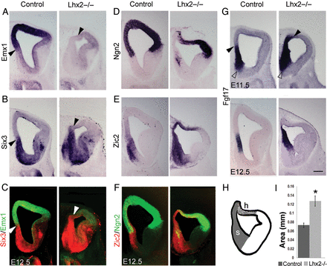
Figure 3. The septum expands in the Lhx2 mutant. (A and D) In control brains at E12.5, Emx1 (A) and Ngn2 (D) are ...
Notes:
Figure 3. The septum expands in the Lhx2 mutant. (A and D) In control brains at E12.5, Emx1 (A) and Ngn2 (D) are expressed in the pallium (dorsal telencephalon), their expression extending medially to include the pallial septum. (B) Six3 is expressed in the subpallial component of the septum and also in the subpallium (E). Zic2 is expressed in both components of the septum and also adjacent medial pallial regions. In Lhx2 mutant brains, Emx1 and Ngn2 expression recedes from the medial telencephalon, whereas Zic2 and Six3 expression expand to fill this territory (A, B, D, E), as seen in false-color overlays of adjacent sections showing Emx1/Six3 (C) and Ngn2/Zic2 (F) expression. Ngn2 and Zic2 expressions overlap in the cortical hem (F and H). Arrowheads in A, B, and C mark the dorsal limit of the septum and the beginning of the Emx1-expressing domain (A) in control and Lhx2 mutant sections. (G) Fgf17 is expressed in both pallial and subpallial components of control septum shown at E11.5 and E12.5. In Lhx2 mutant, Fgf17 expression expands dorsally (arrowhead), while its ventral limit remains normally positioned (open arrowhead). (H) Schematic of Lhx2 mutant section at level “i” of Figure 1F, showing the extent of the expanded septum (s) and hem (h). (I) Area occupied by the septum is significantly increased in Lhx2 mutant brains compared with that of control brains (*P < 0.01). Scale bar: 300 µm.
Unless provided in the caption above, the following copyright applies to the content of this slide: © The Author 2013. Published by Oxford University Press.This is an Open Access article distributed under the terms of the Creative Commons Attribution License (http://creativecommons.org/licenses/by-nc/3.0/), which permits non-commercial use, distribution, and reproduction in any medium, provided the original work is properly cited. For commercial re-use, please contact journals.permissions@oup.com.

Slide 7
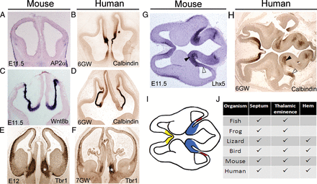
Figure 7. Presence of the forebrain hem system components in extant vertebrates. (A–F) Morphological comparisons ...
Notes:
Figure 7. Presence of the forebrain hem system components in extant vertebrates. (A–F) Morphological comparisons between stage-matched mouse and human embryonic sections at rostral (A and B), middle (C and D), and caudal (E and F) levels. Tbr1 immunostaining marks the thalamic eminence in both E12 mouse and 7-GW human fetus. (G and H) A horizontal section of an E11.5 mouse brain appears morphologically comparable with a 6-GW human fetal brain section. Both species reveal the hem in the caudal telencephalon (open arrowhead) and the thalamic eminence (arrowhead) at the transition of the caudal telencephalon to the diencephalon. (I) Schematic of the mouse brain section in A, depicting the positions of the septum (yellow), cortical hem (red), and thalamic eminence (blue). (J) Tabulation of the presence of the 3 medial sources of Cajal–Retzius cells in the developing forebrain of different vertebrates (Grove et al. 1998; Abbott and Jacobowitz 1999; Puelles et al. 2000; Cobos et al. 2001; Brox et al. 2002, 2003; Meyer et al. 2002; Wullimann and Rink 2002; Wullimann and Mueller 2004; Cabrera-Socorro et al. 2007).
Unless provided in the caption above, the following copyright applies to the content of this slide: © The Author 2013. Published by Oxford University Press.This is an Open Access article distributed under the terms of the Creative Commons Attribution License (http://creativecommons.org/licenses/by-nc/3.0/), which permits non-commercial use, distribution, and reproduction in any medium, provided the original work is properly cited. For commercial re-use, please contact journals.permissions@oup.com.

