Slide 1
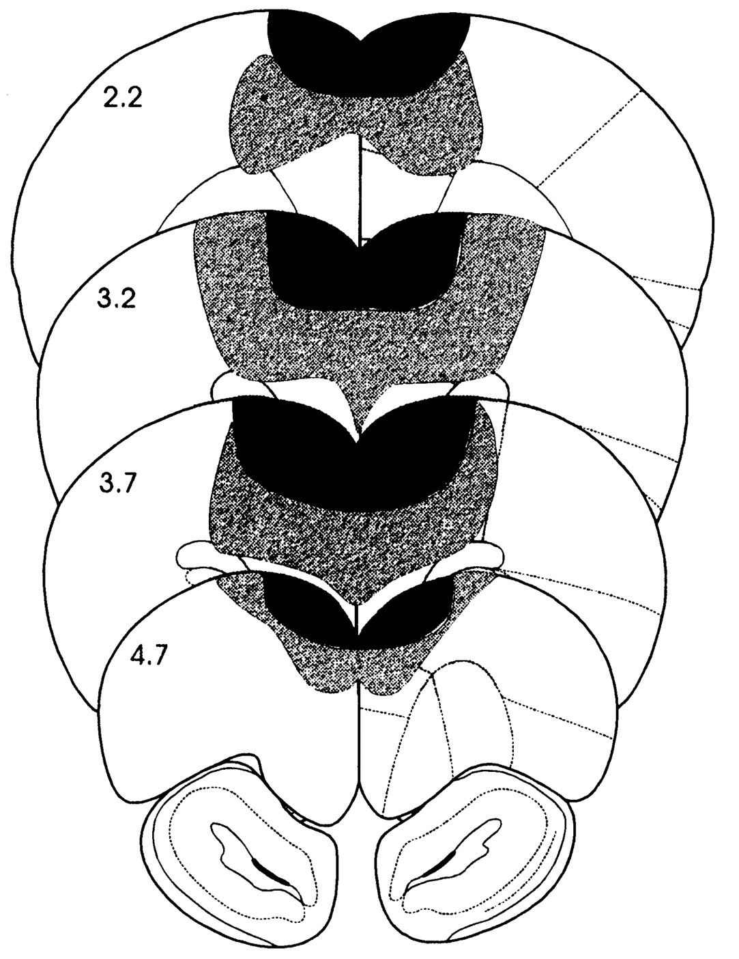
Figure 1. Coronal sections of the rat brain showing the location of prefrontal cortex lesions. Solid black regions ...
Notes:
Figure 1. Coronal sections of the rat brain showing the location of prefrontal cortex lesions. Solid black regions represent the extent of the smallest lesions, and shaded regions show the extent of the largest lesions. Numbers indicate the distance (mm) of each section anterior to Bregma.
Unless provided in the caption above, the following copyright applies to the content of this slide: © Oxford University Press

Slide 2
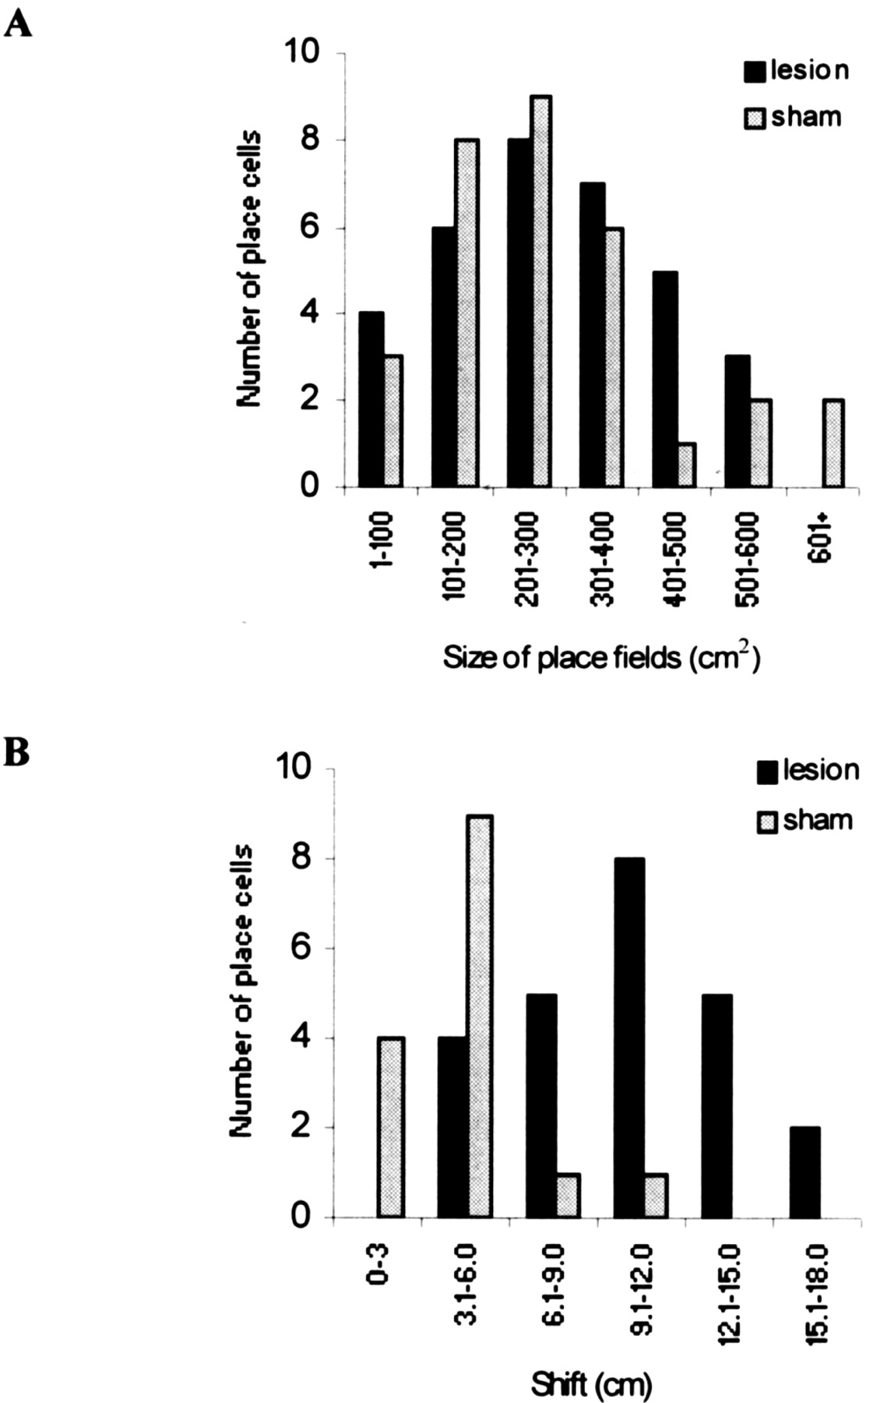
Figure 2. (A) A comparison of the distribution of the size of sham and lesion place fields. Note the similarity between ...
Notes:
Figure 2. (A) A comparison of the distribution of the size of sham and lesion place fields. Note the similarity between the two groups. (B) A comparison of the distribution of the shifts in firing field centre of mass across the 5 h delay period. The fields of cells in lesion rats shifted a greater distance than the fields of sham-group cells.
Unless provided in the caption above, the following copyright applies to the content of this slide: © Oxford University Press

Slide 3
Figure 3. Firing rate maps of sham- (a and b) and lesion-group cells (c, d and e) showing the position of place fields ...
Notes:
Figure 3. Firing rate maps of sham- (a and b) and lesion-group cells (c, d and e) showing the position of place fields before and after the 5 h delay. The darker pixels correspond to regions where the cell fired at a higher rate. In sham animals the cells fired in the same location before and after the delay period (e.g. cells a and b). The centre of mass of firing fields of lesion cells however, tended to vary between the two recording sessions (c, d and e). Examples of the spike waveforms for recording a (middle) and e (lower) are shown pre- and post-delay.
Unless provided in the caption above, the following copyright applies to the content of this slide: © Oxford University Press

Slide 4
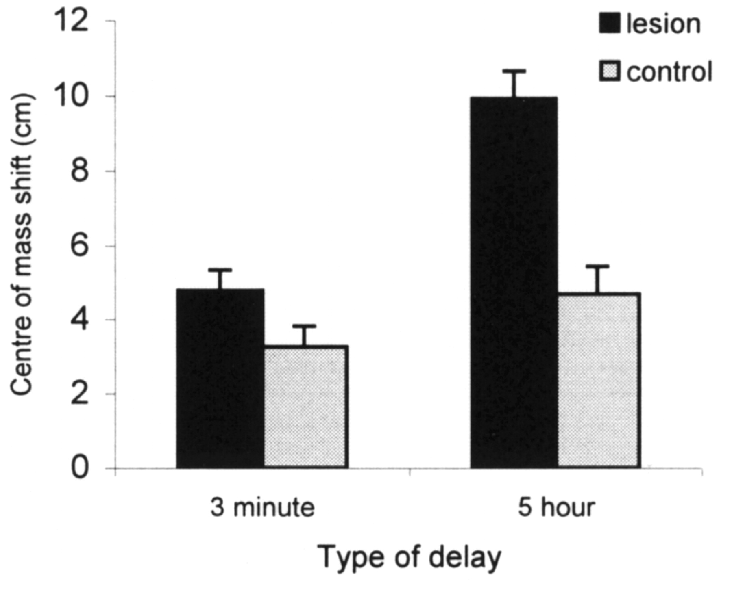
Figure 4. Comparison of the mean (± SEM) shift in firing field centre of mass in sham- and lesion-group cells for the 5 ...
Notes:
Figure 4. Comparison of the mean (± SEM) shift in firing field centre of mass in sham- and lesion-group cells for the 5 h and 3 min delay conditions.
Unless provided in the caption above, the following copyright applies to the content of this slide: © Oxford University Press

