Slide 1
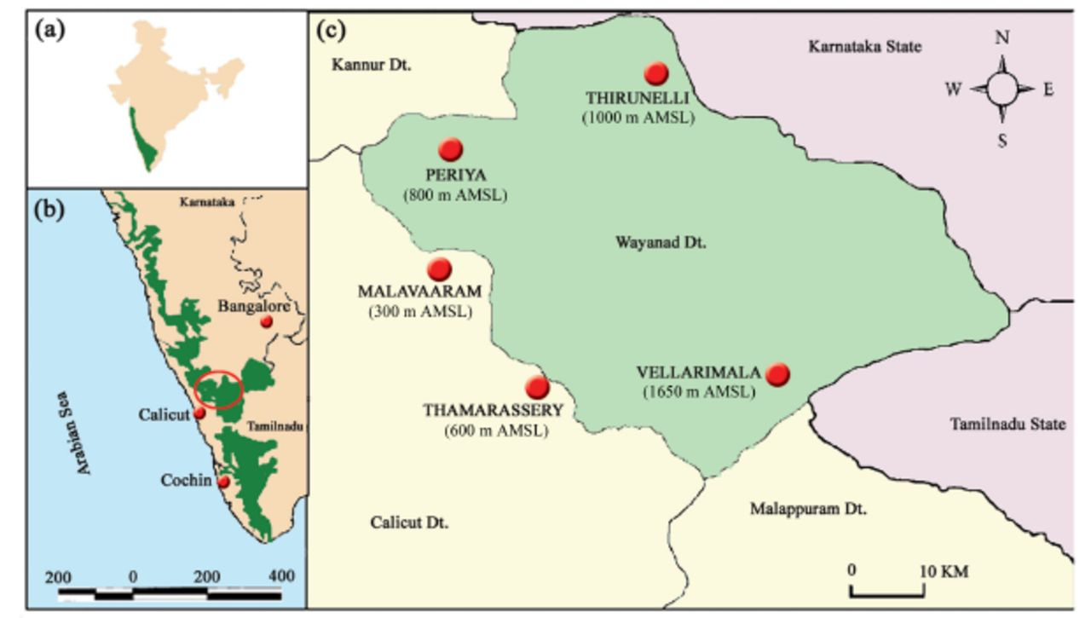
Figure 1 (a) Map of India showing the location of the Western Ghats, (b) the Western Ghats and (c) Wayanad forests and ...
Notes:
Figure 1 (a) Map of India showing the location of the Western Ghats, (b) the Western Ghats and (c) Wayanad forests and location of study sites.
Unless provided in the caption above, the following copyright applies to the content of this slide: This is an open access paper. We use the Creative Commons Attribution 3.0 license that permits unrestricted use, provided that the paper is properly attributed.This is an Open Access article distributed under the terms of the Creative Commons Attribution License (http://creativecommons.org/licenses/by/3.0/), which permits unrestricted reuse, distribution, and reproduction in any medium, providedthe original work is properly cited.

Slide 2
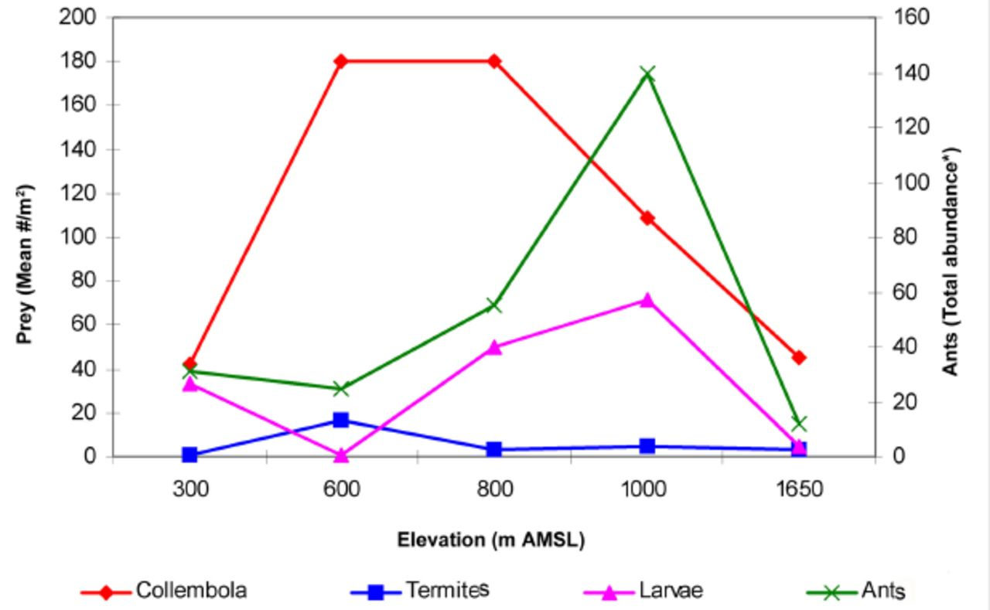
Figure 2 Overall abundance of litter ants from 30 samples and prey resources along the varying elevations of Wayanad ...
Notes:
Figure 2 Overall abundance of litter ants from 30 samples and prey resources along the varying elevations of Wayanad forests.
Unless provided in the caption above, the following copyright applies to the content of this slide: This is an open access paper. We use the Creative Commons Attribution 3.0 license that permits unrestricted use, provided that the paper is properly attributed.This is an Open Access article distributed under the terms of the Creative Commons Attribution License (http://creativecommons.org/licenses/by/3.0/), which permits unrestricted reuse, distribution, and reproduction in any medium, providedthe original work is properly cited.

Slide 3
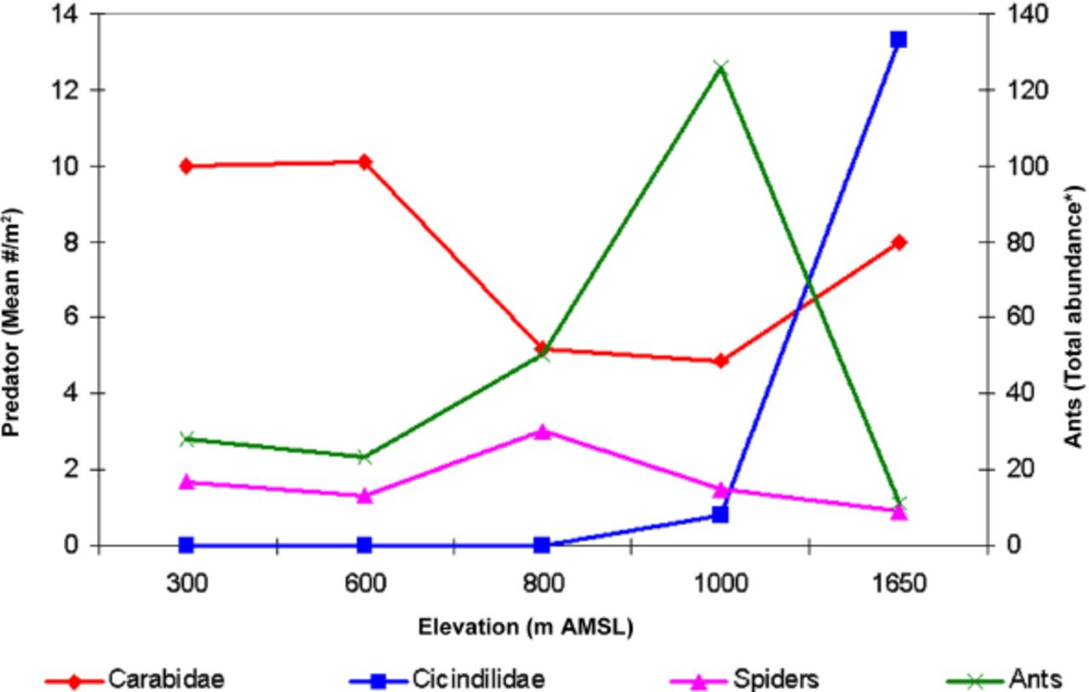
Figure 3 Overall distribution of ants from 30 samples and competitive predators at each elevation.
Notes:
Figure 3 Overall distribution of ants from 30 samples and competitive predators at each elevation.
Unless provided in the caption above, the following copyright applies to the content of this slide: This is an open access paper. We use the Creative Commons Attribution 3.0 license that permits unrestricted use, provided that the paper is properly attributed.This is an Open Access article distributed under the terms of the Creative Commons Attribution License (http://creativecommons.org/licenses/by/3.0/), which permits unrestricted reuse, distribution, and reproduction in any medium, providedthe original work is properly cited.

Slide 4
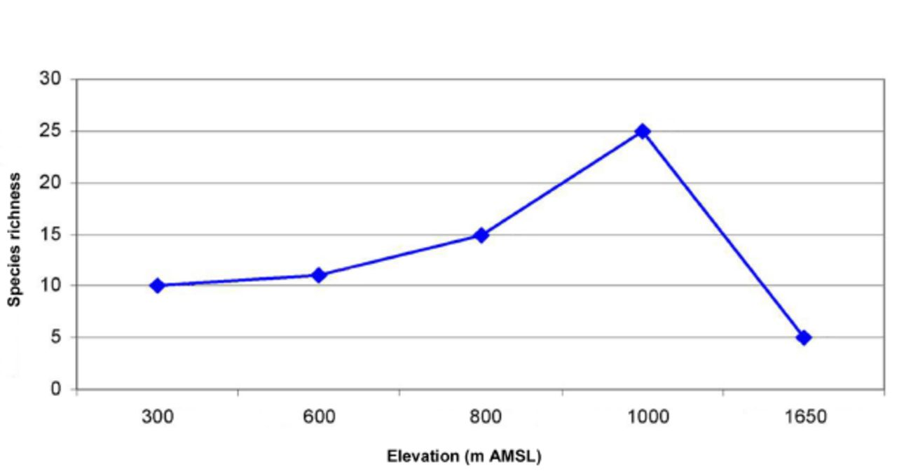
Figure 4 Hump-shaped richness pattern of litter ants along the varying elevations of Wayanad forests.
Notes:
Figure 4 Hump-shaped richness pattern of litter ants along the varying elevations of Wayanad forests.
Unless provided in the caption above, the following copyright applies to the content of this slide: This is an open access paper. We use the Creative Commons Attribution 3.0 license that permits unrestricted use, provided that the paper is properly attributed.This is an Open Access article distributed under the terms of the Creative Commons Attribution License (http://creativecommons.org/licenses/by/3.0/), which permits unrestricted reuse, distribution, and reproduction in any medium, providedthe original work is properly cited.

Slide 5
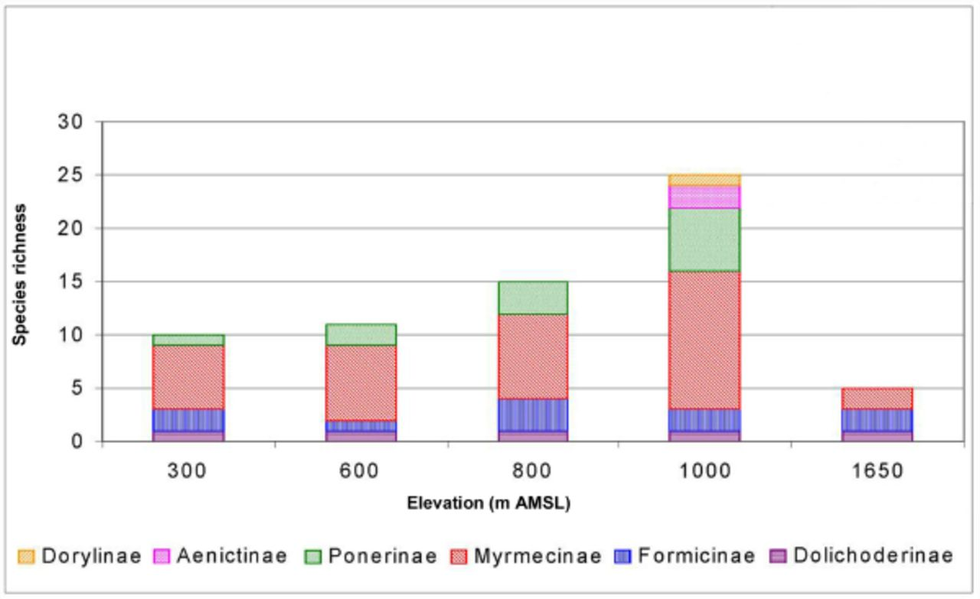
Figure 5 Family-wise species richness of litter ants along the varying elevations of Wayanad forests.
Notes:
Figure 5 Family-wise species richness of litter ants along the varying elevations of Wayanad forests.
Unless provided in the caption above, the following copyright applies to the content of this slide: This is an open access paper. We use the Creative Commons Attribution 3.0 license that permits unrestricted use, provided that the paper is properly attributed.This is an Open Access article distributed under the terms of the Creative Commons Attribution License (http://creativecommons.org/licenses/by/3.0/), which permits unrestricted reuse, distribution, and reproduction in any medium, providedthe original work is properly cited.

Slide 6
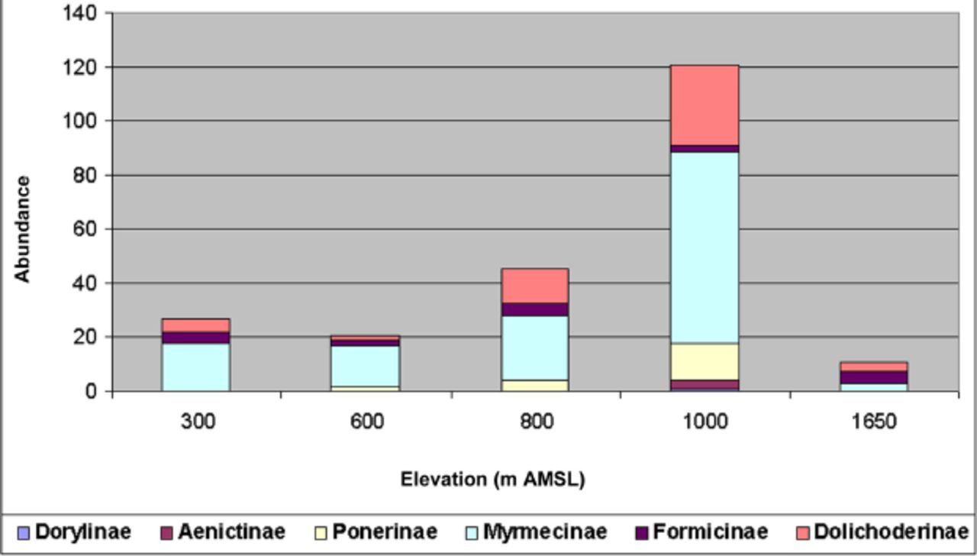
Figure 6 Family-wise abundance of litter ants along the varying elevations of Wayanad forests.
Notes:
Figure 6 Family-wise abundance of litter ants along the varying elevations of Wayanad forests.
Unless provided in the caption above, the following copyright applies to the content of this slide: This is an open access paper. We use the Creative Commons Attribution 3.0 license that permits unrestricted use, provided that the paper is properly attributed.This is an Open Access article distributed under the terms of the Creative Commons Attribution License (http://creativecommons.org/licenses/by/3.0/), which permits unrestricted reuse, distribution, and reproduction in any medium, providedthe original work is properly cited.

Slide 7
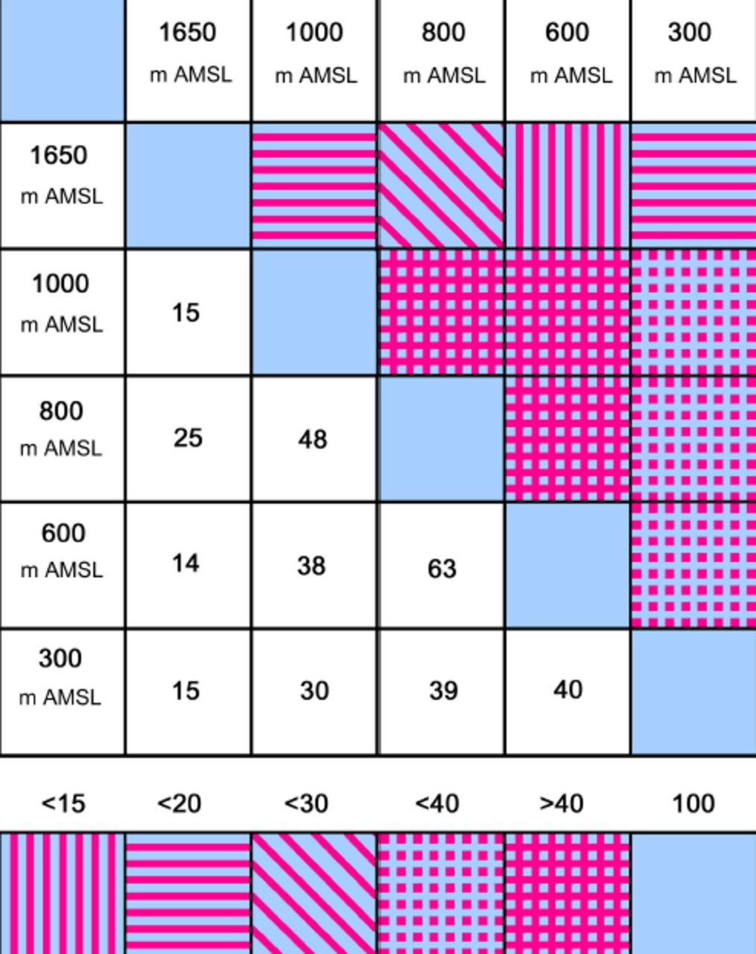
Figure 7 Trellis diagram showing the affinities between litter ant assemblages at five different elevations in the ...
Notes:
Figure 7 Trellis diagram showing the affinities between litter ant assemblages at five different elevations in the Wayanad forests.
Unless provided in the caption above, the following copyright applies to the content of this slide: This is an open access paper. We use the Creative Commons Attribution 3.0 license that permits unrestricted use, provided that the paper is properly attributed.This is an Open Access article distributed under the terms of the Creative Commons Attribution License (http://creativecommons.org/licenses/by/3.0/), which permits unrestricted reuse, distribution, and reproduction in any medium, providedthe original work is properly cited.

