Slide 1
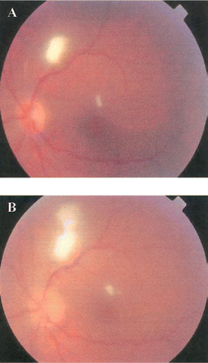
Figure 1 Chorioretinitis and endophthalmitis of the left eye (A) at initial presentation and (B) after progression to ...
Notes:
Figure 1 Chorioretinitis and endophthalmitis of the left eye (A) at initial presentation and (B) after progression to vitritis.
Unless provided in the caption above, the following copyright applies to the content of this slide: © 2005 by the Infectious Diseases Society of America

