Slide 1
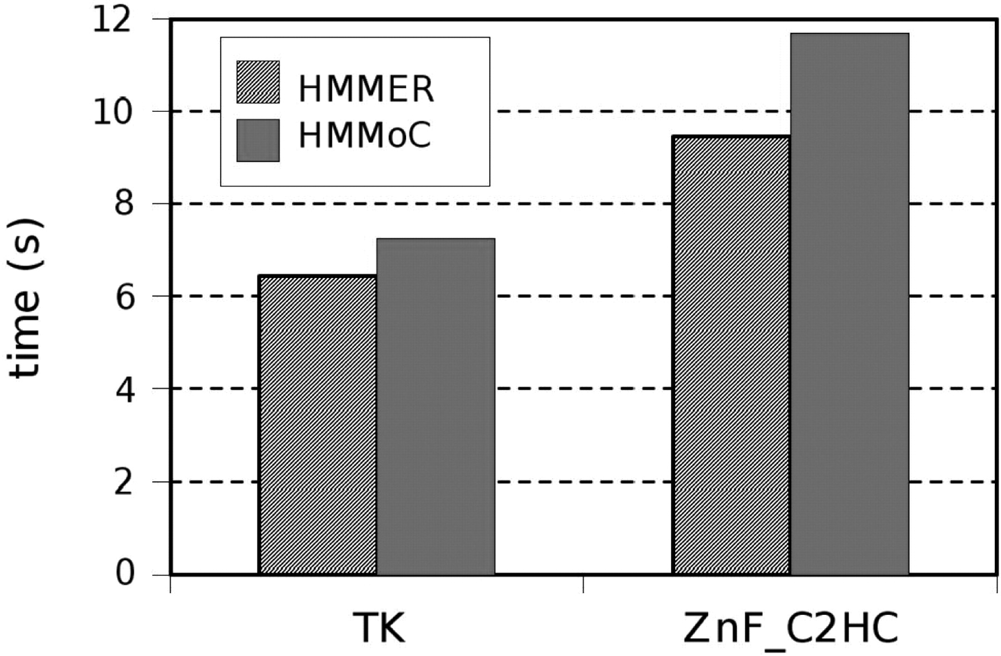
Fig. 1. Execution times for performing a database search using HMM profiles of the TK and ZnF_C2HC domains (38 and 56 ...
Notes:
Fig. 1. Execution times for performing a database search using HMM profiles of the TK and ZnF_C2HC domains (38 and 56 states, respectively), in a database of 4.84 million amino acids on a desktop computer (2.33 GHz E5345 Xeon, 4 MB cache). For this comparison, HMMER and HMMoC performed a Viterbi and a Forward recursion. The HMMoC-generated algorithm uses logspace real numbers for the Viterbi recursion, and BFloats for the Forward recursion.
Unless provided in the caption above, the following copyright applies to the content of this slide: © The Author 2007. Published by Oxford University Press. All rights reserved. For Permissions, please email: journals.permissions@oxfordjournals.org

