Slide 1
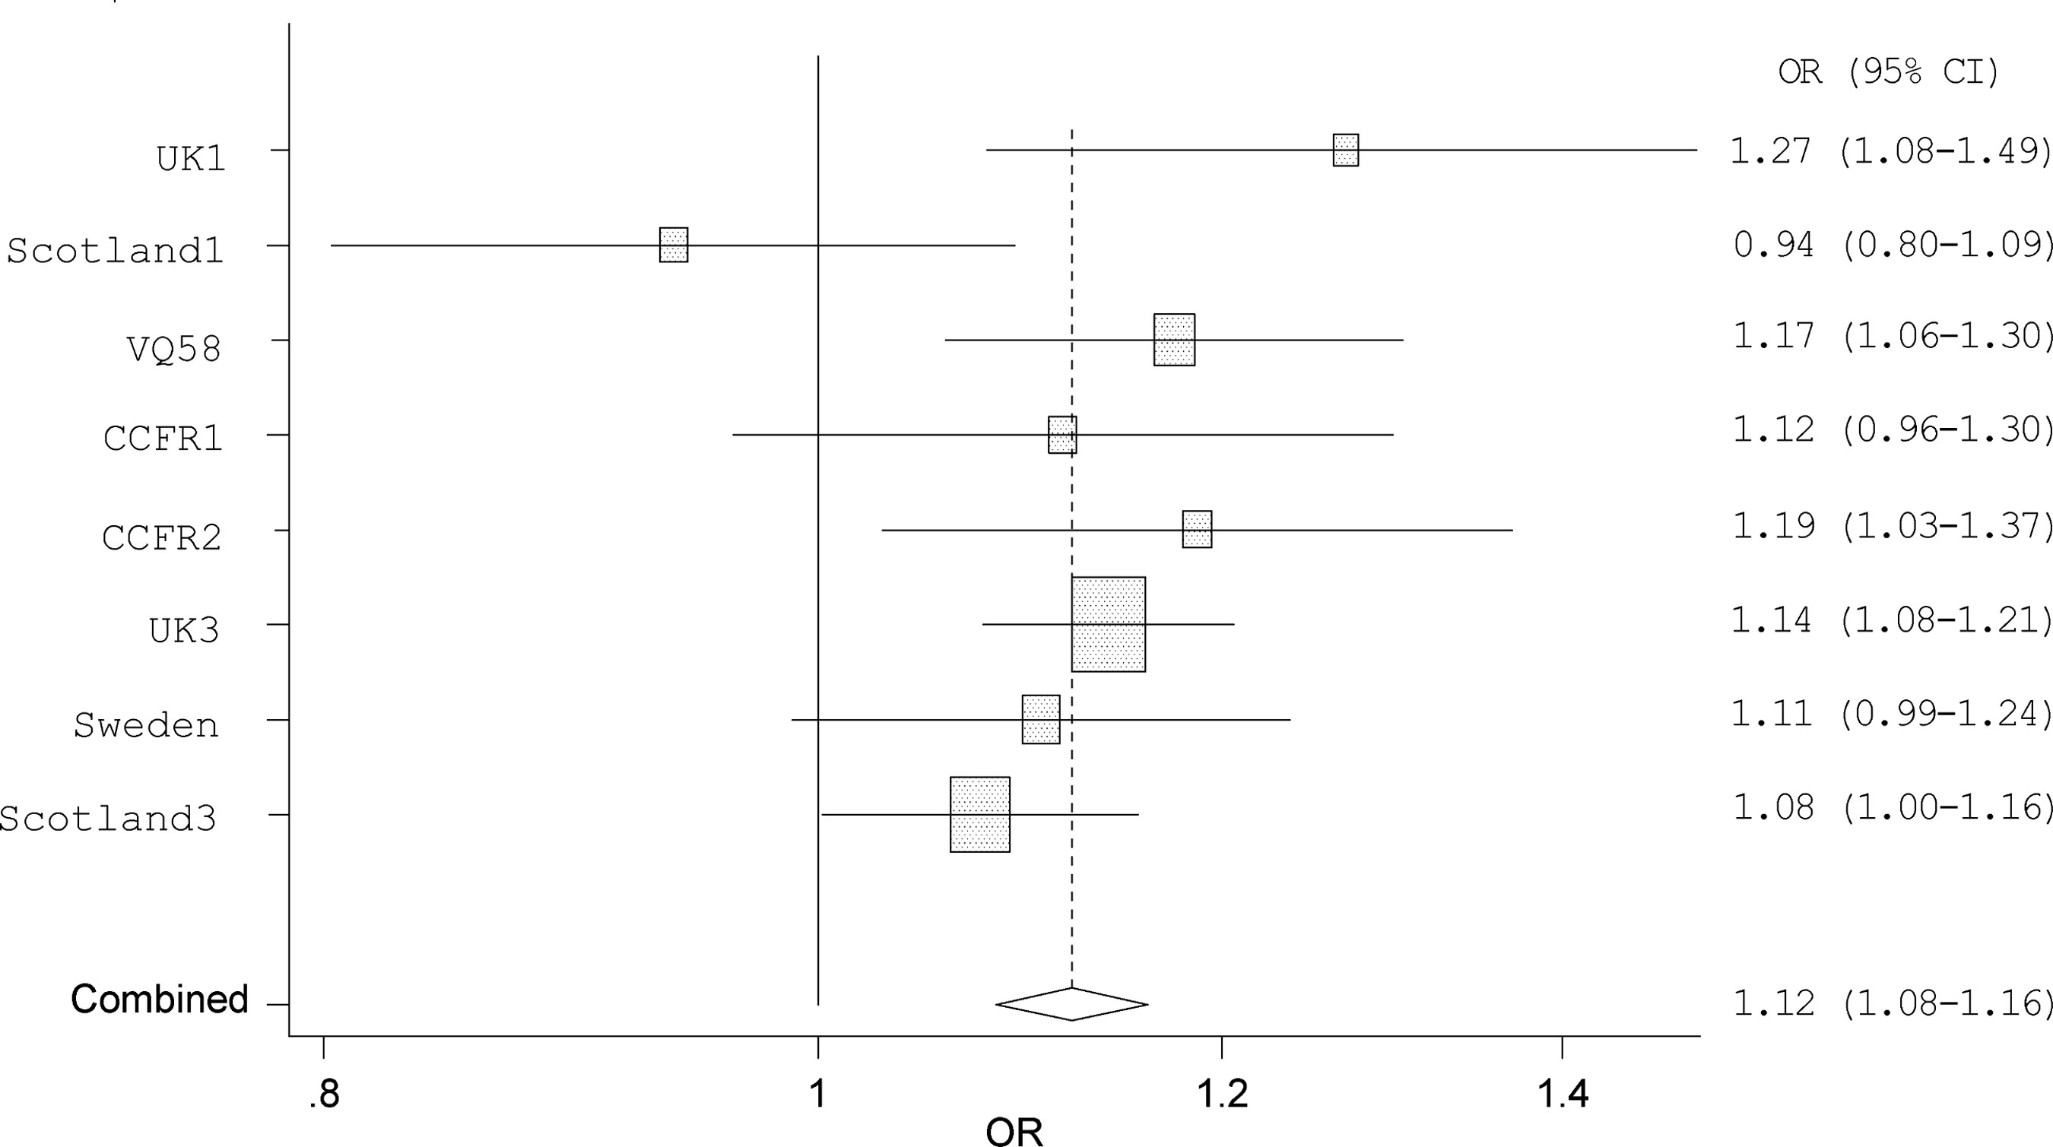
Figure 1. Forest plot of the ORs for the association between CRC and rs1035209. Studies were weighted according to the ...
Notes:
Figure 1. Forest plot of the ORs for the association between CRC and rs1035209. Studies were weighted according to the inverse of the variance of the log of the OR calculated by unconditional logistic regression. Horizontal lines: 95% CI. Box: OR point estimate; its area is proportional to the weight of the study. Diamond (and broken line): overall summary estimate, with CI given by its width. Unbroken vertical line: null value (OR = 1.0).
Unless provided in the caption above, the following copyright applies to the content of this slide: © The Author 2014. Published by Oxford University Press. All rights reserved. For Permissions, please email: journals.permissions@oup.com

Slide 2
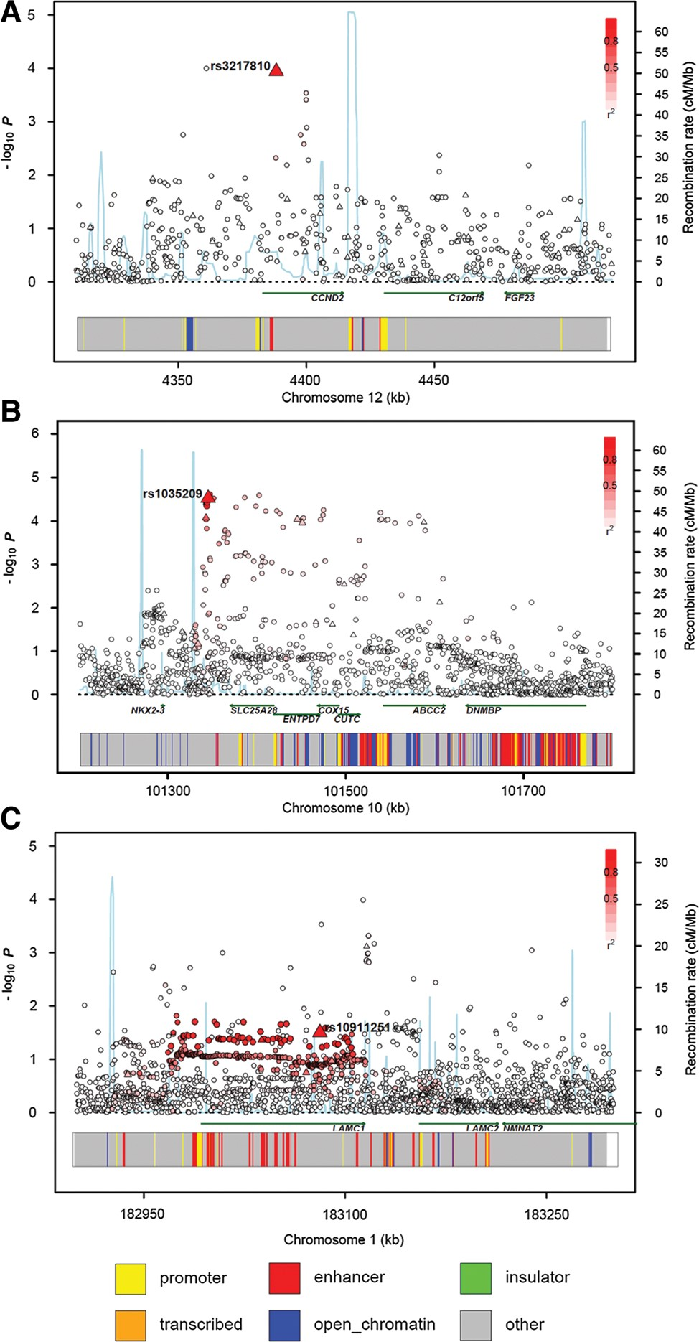
Figure 2. Regional plots of association results, recombination rates and chromatin state segmentation track for (A) ...
Notes:
Figure 2. Regional plots of association results, recombination rates and chromatin state segmentation track for (A) 10q24.2, (B) 12p13.32 and (C) 1q25.3 susceptibility loci. Association results of both genotyped (triangles) and imputed (circles) SNPs in the GWAS samples and recombination rates for rates. −log10P-values (y axis) of the SNPs are shown according to their chromosomal positions (x axis). The top genotyped SNP in each combined analysis is shown as a large triangle and is labelled by its rsID. Colour intensity of each symbol reflects the extent of LD with the top genotyped SNP; white (r2 = 0) through to dark red (r2 = 1.0) Genetic recombination rates, estimated using HapMap Utah residents of Western and Northern European ancestry (CEU) samples, are shown with a light blue line. Physical positions are based on NCBI Build 37 of the human genome. Also shown are the relative positions of genes and transcripts mapping to the region of association. Genes have been redrawn to show the relative positions; therefore, maps are not to physical scale. The lower panel shows the chromatin state segmentation track (ChromHMM).
Unless provided in the caption above, the following copyright applies to the content of this slide: © The Author 2014. Published by Oxford University Press. All rights reserved. For Permissions, please email: journals.permissions@oup.com

Slide 3
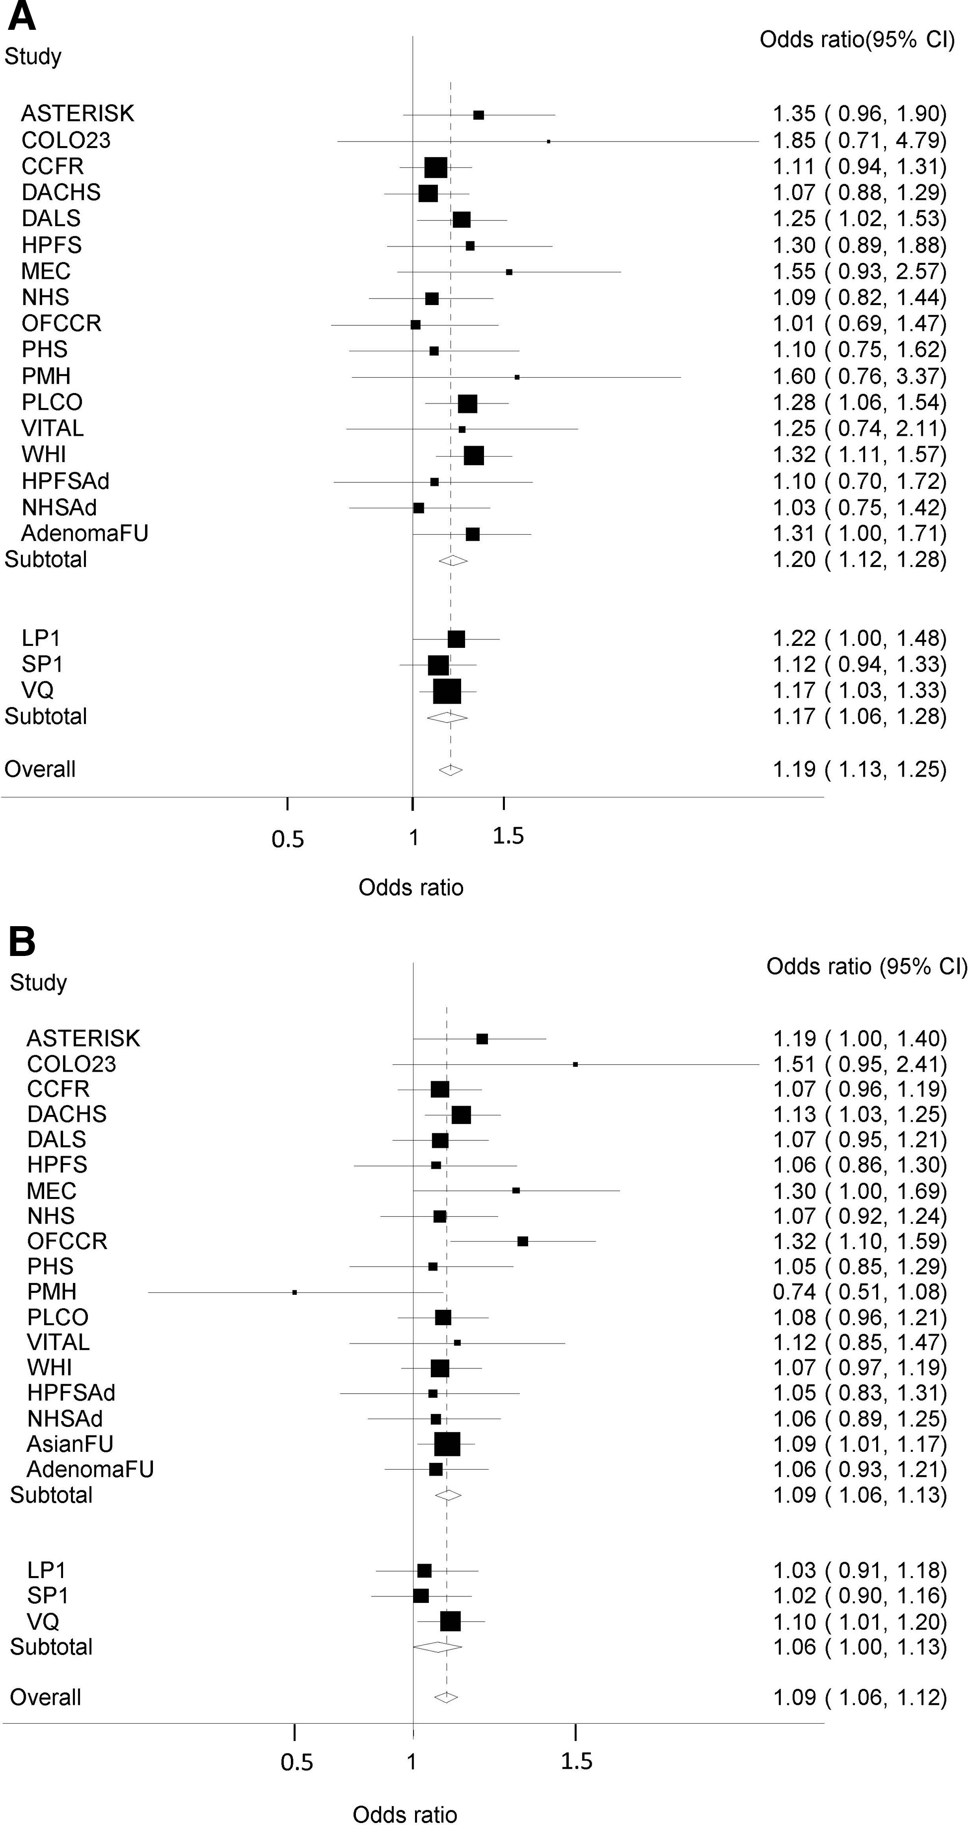
Figure 3. Forest plot of the ORs for associations between CRC and (A) rs3217810 and (B) rs10911251. Studies were ...
Notes:
Figure 3. Forest plot of the ORs for associations between CRC and (A) rs3217810 and (B) rs10911251. Studies were weighted according to the inverse of the variance of the log of the OR calculated by unconditional logistic regression. Horizontal lines: 95% CI. Box: OR point estimate; its area is proportional to the weight of the study. Diamond (and broken line): overall summary estimate, with CI given by its width. Unbroken vertical line: null value (OR = 1.0). Summary estimates are shown for studies from Peters et al., from the three GWAS not included in that study and a combined estimate.
Unless provided in the caption above, the following copyright applies to the content of this slide: © The Author 2014. Published by Oxford University Press. All rights reserved. For Permissions, please email: journals.permissions@oup.com

