Slide 1
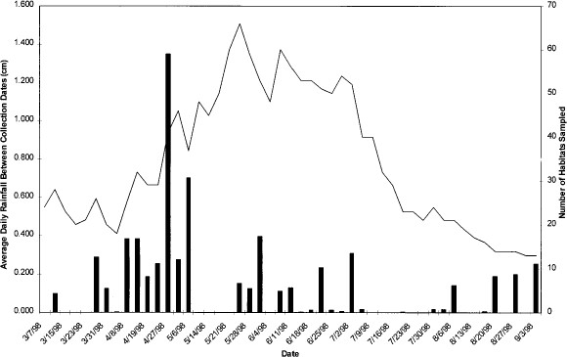
Fig. 1 Number of discrete habitats sampled on each date (line) and the average daily rainfall between sampling dates ...
Notes:
Fig. 1 Number of discrete habitats sampled on each date (line) and the average daily rainfall between sampling dates (bars).
Unless provided in the caption above, the following copyright applies to the content of this slide: © 2001 Entomological Society of AmericaThis is an Open Access article distributed under the terms of the Creative Commons Attribution Non-Commercial License (http://creativecommons.org/licenses/by-nc/3.0/), which permits non-commercial reuse, distribution, and reproduction in any medium, provided the original work is properly cited. For commercial re-use, please contact journals.permissions@oup.com

Slide 2
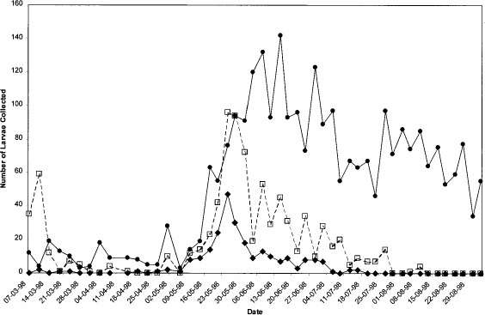
Fig. 2 Total number of An. gambiae (diamonds), An. arabiensis (open squares) and An. funestus (circles) identified ...
Notes:
Fig. 2 Total number of An. gambiae (diamonds), An. arabiensis (open squares) and An. funestus (circles) identified during each sampling date.
Unless provided in the caption above, the following copyright applies to the content of this slide: © 2001 Entomological Society of AmericaThis is an Open Access article distributed under the terms of the Creative Commons Attribution Non-Commercial License (http://creativecommons.org/licenses/by-nc/3.0/), which permits non-commercial reuse, distribution, and reproduction in any medium, provided the original work is properly cited. For commercial re-use, please contact journals.permissions@oup.com

