Slide 1
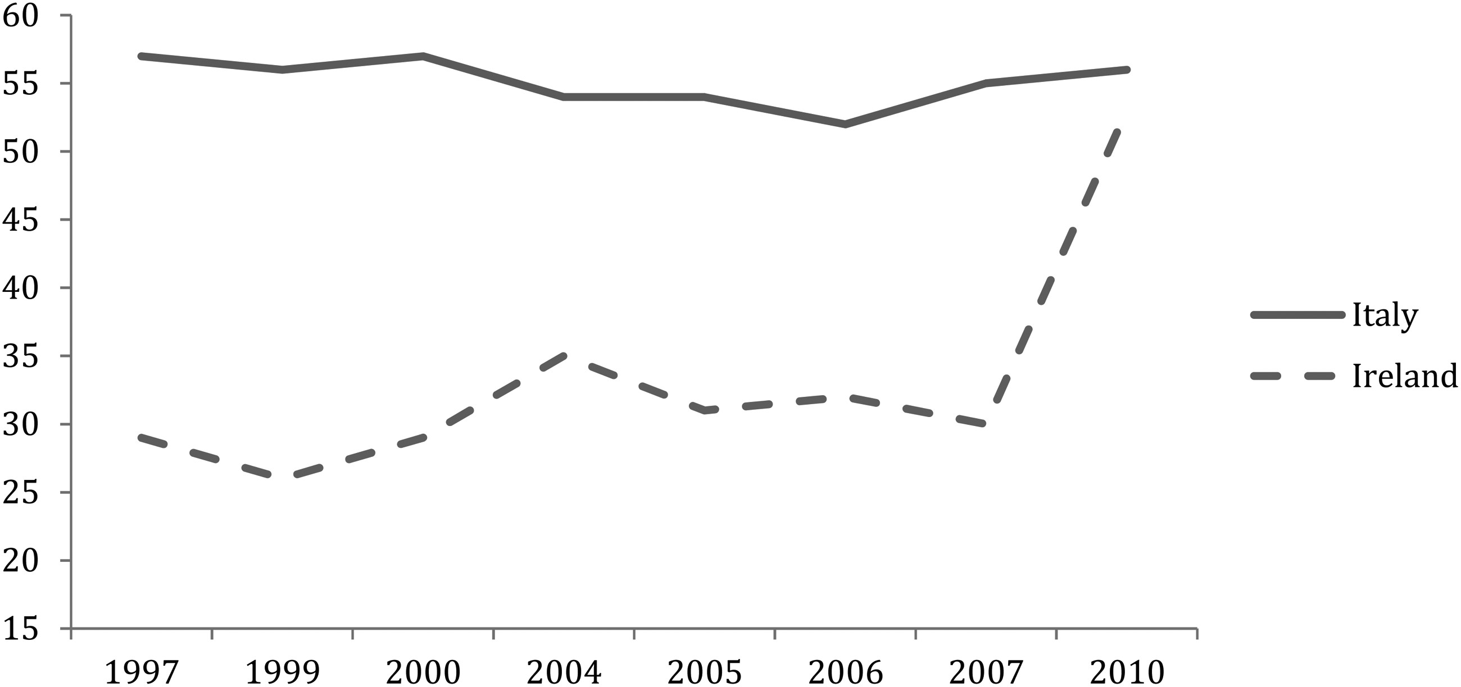
Figure 1 Levels of distrust in Trade Unions in Ireland and Italy. Source: Eurobarometer 1997–2010.
Notes:
Figure 1 Levels of distrust in Trade Unions in Ireland and Italy. Source: Eurobarometer 1997–2010.
Unless provided in the caption above, the following copyright applies to the content of this slide: © The Author 2014. Published by Oxford University Press and the Society for the Advancement of Socio-Economics. All rights reserved. For Permissions, please email: journals.permissions@oup.com

Slide 2
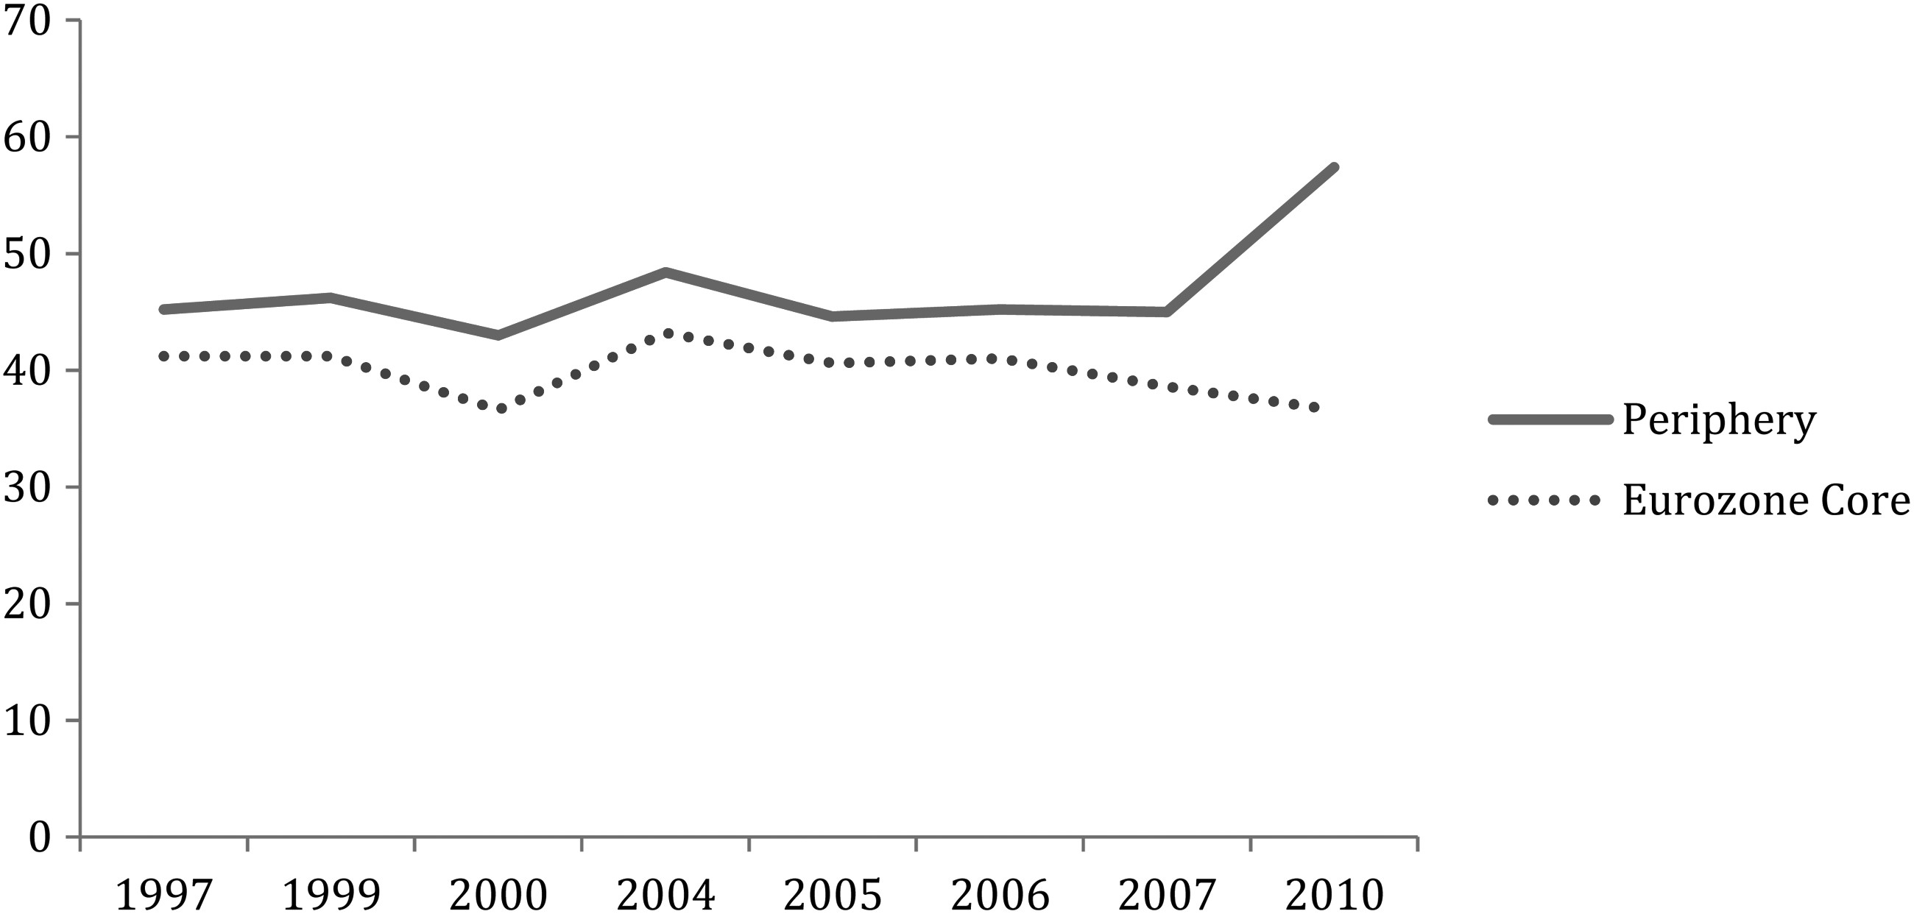
Figure 2 Levels of distrust in Trade Unions in Eurozone Core and Periphery. Source: Eurobarometer 1997–2010. Periphery ...
Notes:
Figure 2 Levels of distrust in Trade Unions in Eurozone Core and Periphery. Source: Eurobarometer 1997–2010. Periphery includes Greece, Ireland, Italy, Portugal, and Spain; Eurozone core includes Austria, Belgium, Finland, Germany, and the Netherlands.
Unless provided in the caption above, the following copyright applies to the content of this slide: © The Author 2014. Published by Oxford University Press and the Society for the Advancement of Socio-Economics. All rights reserved. For Permissions, please email: journals.permissions@oup.com

