Slide 1
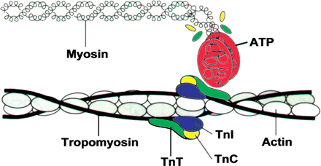
Figure 1 Acto-myosin interaction. The myosin head carrying the ATPase site combines with actin to produce force. ...
Notes:
Figure 1 Acto-myosin interaction. The myosin head carrying the ATPase site combines with actin to produce force. Calcium binding to troponin C (TnC) results in a conformational change of tropomyosin, troponin I (TnI), and troponin T (TnT), allowing the myosin head to attach to actin, facilitating the acto-myosin cross-bridge to cycle (see also Figures 2 and 6).
Unless provided in the caption above, the following copyright applies to the content of this slide: Published on behalf of the European Society of Cardiology. All rights reserved. © The Author 2011. For permissions please email: journals.permissions@oup.com

Slide 2
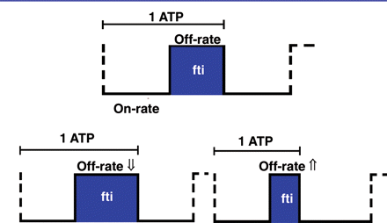
Figure 2 Cartoon of a simple two-state on–off cross-bridge model. Assuming that one molecule of ATP is hydrolysed ...
Notes:
Figure 2 Cartoon of a simple two-state on–off cross-bridge model. Assuming that one molecule of ATP is hydrolysed during each cycle, the duration of the on-state determines cross-bridge economy: prolonged attachment increases and shortened decreases cross-bridge economy. Force development of the muscle depends on the number of cross-bridges attached per unit of time. fti, cross-bridge force-time integral.
Unless provided in the caption above, the following copyright applies to the content of this slide: Published on behalf of the European Society of Cardiology. All rights reserved. © The Author 2011. For permissions please email: journals.permissions@oup.com

Slide 3
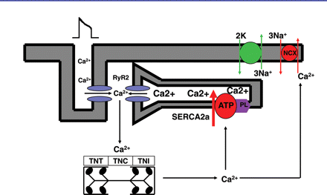
Figure 3 Excitation–contraction coupling. Calcium enters the cell through the l-type calcium channel during the action ...
Notes:
Figure 3 Excitation–contraction coupling. Calcium enters the cell through the l-type calcium channel during the action potential and triggers the release of a larger amount of calcium from the sarcoplasmic reticulum. This calcium binds to troponin C resulting in activation of contractile proteins. The muscle relaxes when calcium is removed into the sarcoplasmic reticulum by sarcoplasmic reticulum calcium pump or outside the cell by the sodium-calcium exchanger. RyR2, ryanodine receptor 2; TNT, troponin T; TNC, troponin C; TNI, troponin I; PL, phospholamban.
Unless provided in the caption above, the following copyright applies to the content of this slide: Published on behalf of the European Society of Cardiology. All rights reserved. © The Author 2011. For permissions please email: journals.permissions@oup.com

Slide 4
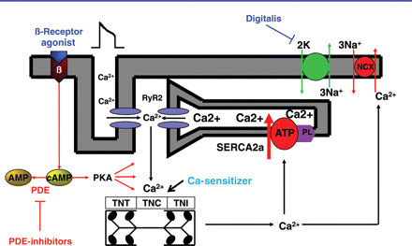
Figure 4 Inotropic mechanisms and current inotropic interventions. Activation of the β-adrenoceptor stimulates ...
Notes:
Figure 4 Inotropic mechanisms and current inotropic interventions. Activation of the β-adrenoceptor stimulates adenylyl cyclase to produce cAMP, which activates protein kinase A (PKA) to phosphorylate intracellular calcium-cycling proteins. Phosphodiesterases (PDEs) degrade cAMP. Phosphodiesterases are inhibited by Phosphodiesterase inhibitors. Digitalis inhibits transport of three sodium ions for two potassium ions through Na/K-ATPase. Calcium sensitizers increase the affinity of troponin C for calcium.
Unless provided in the caption above, the following copyright applies to the content of this slide: Published on behalf of the European Society of Cardiology. All rights reserved. © The Author 2011. For permissions please email: journals.permissions@oup.com

Slide 5
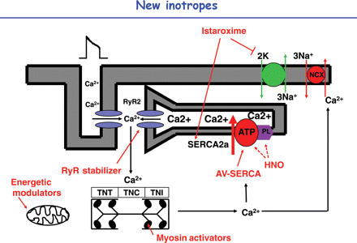
Figure 5 Future inotropic compounds: the ryanodine receptor (RyR) stabilizers reduce sarcoplasmic reticulum leak ...
Notes:
Figure 5 Future inotropic compounds: the ryanodine receptor (RyR) stabilizers reduce sarcoplasmic reticulum leak through the ryanodine receptor and reconstitute ryanodine receptor channel function. Istaroxime inhibits sodium-potassium-ATPase and stimulates SERCA2a. Cardiac myosin activators promote transition of cross-bridges from the weakly to the strongly bound force-producing state. Energetic modulators improve myocardial energetics through switching from fatty acid to glucose oxidation or by other mechanisms including means to increase the cellular phosphorylation potential. Virus-mediated sarcoplasmic reticulum calcium pump gene transfer (AV-SERCA) increases sarcoplasmic reticulum calcium uptake. Nitroxyl (HNO) may increase sarcoplasmic reticulum calcium uptake by modification of sarcoplasmic reticulum calcium pump and/or phospholamban (PL).
Unless provided in the caption above, the following copyright applies to the content of this slide: Published on behalf of the European Society of Cardiology. All rights reserved. © The Author 2011. For permissions please email: journals.permissions@oup.com

Slide 6
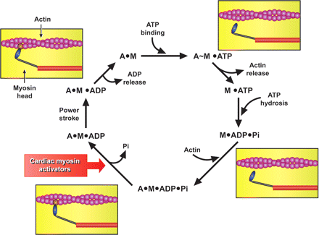
Figure 6 Mode of action of cardiac myosin activators. The agents promote actin-dependent phosphate release ...
Notes:
Figure 6 Mode of action of cardiac myosin activators. The agents promote actin-dependent phosphate release (Pi–release) moving the cross-bridge into its strongly bound force-producing state (see text). A, actin; M, myosin.
Unless provided in the caption above, the following copyright applies to the content of this slide: Published on behalf of the European Society of Cardiology. All rights reserved. © The Author 2011. For permissions please email: journals.permissions@oup.com

