Slide 1
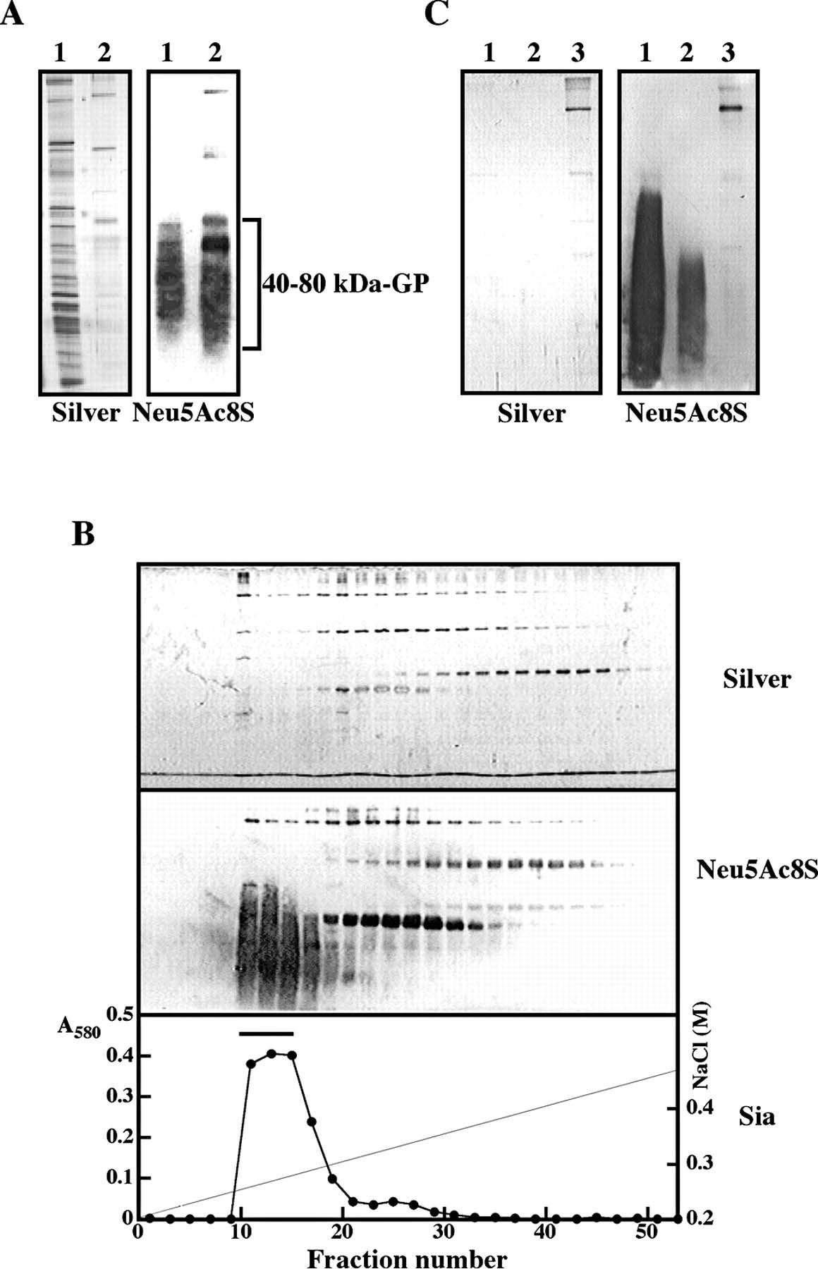
Fig. 1. Purification of the 40–80 kDa-GP from Hemicentrotus pulcherrimus sperm. (A) Western blotting of the 0.2 M ...
Notes:
Fig. 1. Purification of the 40–80 kDa-GP from Hemicentrotus pulcherrimus sperm. (A) Western blotting of the 0.2 M (lane 1) and 0.4 M NaCl (lane 2) fractions from DEAE-Toyopearl chromatography of the Triton X-100 extract of sperm. Each fraction was subjected to SDS–PAGE followed by the silver staining (Silver) and western blotting with mAb.3G9 (Neu5Ac8S). (B) DEAE-Toyopearl chromatography of the 0.4 M NaCl fraction obtained in (A). The 0.4 M NaCl fraction was applied to the same DEAE-Toyopearl column as in (A) and eluted with a linear gradient of 0.2–0.5 M NaCl in 1% Triton X-100, and 10 mM Tris–HCl (pH 8.0). The elution profiles were monitored by SDS–PAGE followed by silver staining (Silver), western blotting with mAb.3G9 (Neu5Ac8S), and the resorcinol method for the amount of Sia (A580; Sia). The 40–80 kDa-GP-containing fractions as indicated by the bar were pooled. The NaCl concentration is shown by the straight line. (C) WGA-affinity chromatography of the 40–80 kDa-GP-containing fraction in (B). The pooled fraction was applied to the WGA column (2 mL) and washed with 0.5 M NaCl, 0.1% Triton X‐100, and 10 mM Tris–HCl (pH 8.0) and eluted with washing buffer containing 100 mM GlcNAc. The flow-through fraction (lane 1), the wash fraction (lane 2), and the GlcNAc-eluted fraction (lane 3) were subjected to SDS–PAGE followed by silver staining (Silver) and western blotting with mAb.3G9 (Neu5Ac8S).
Unless provided in the caption above, the following copyright applies to the content of this slide: © The Author 2006. Published by Oxford University Press. All rights reserved. For permissions, please e-mail: journals.permissions@oxfordjournals.org

Slide 2
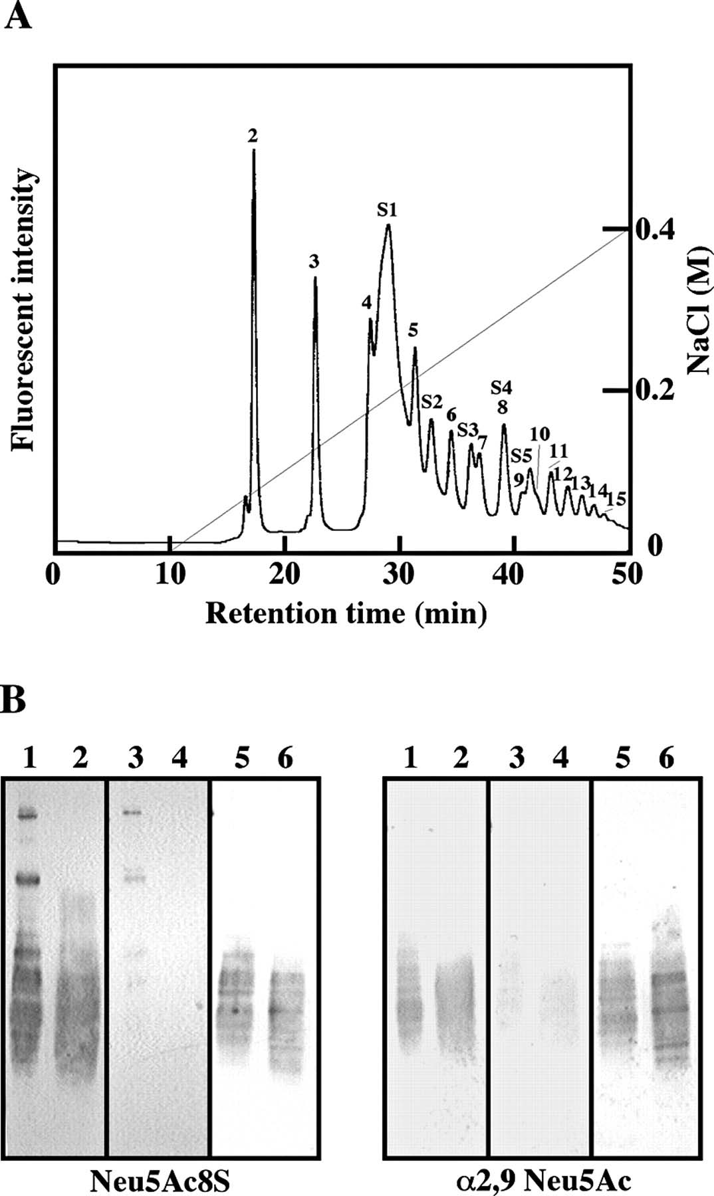
Fig. 2. Chemical and immunochemical detection of the sulfated α2,9‐linked polyNeu5Ac structure in the 40–80 kDa-GP by ...
Notes:
Fig. 2. Chemical and immunochemical detection of the sulfated α2,9‐linked polyNeu5Ac structure in the 40–80 kDa-GP by mild acid hydrolysis/fluorometric anion-exchange HPLC and western blot analysis. (A) Fluorometric anion-exchange HPLC of DMB derivatives of the mild acid hydrolysate of purified 40–80 kDa-GP. The mild acid hydrolysate of the purified 40–80 kDa-GP was derivatized with DMB and applied to a Mono Q anion-exchange HPLC as described under Materials and methods. The peaks designated as 2, 3, 4, and so on are corresponding to the α2,9-linked diNeu5Ac, triNeu5Ac, tetraNeu5Ac, and so on. The peaks designated as S2, S3, S4, and S5 are corresponding to Neu5Ac8S linked to monoNeu5Ac, diNeu5Ac, triNeu5Ac, and tetraNeu5Ac. The peak S1 corresponds to Neu5Ac8S. The NaCl concentration is shown by the straight line. (B) Western blotting of the Triton-extracted sperm lysate and the purified 40–80 kDa-GP that were untreated and treated with PNGase F or 0.1 M NaOH. The Triton X-100 extract of whole sperm (lanes 1, 3, and 5) and the purified 40–80 kDa-GP (lanes 2, 4, and 6) were analyzed. For PNGase F treatment, the samples were treated with PNGase F at 37°C for 24 h and subjected to SDS–PAGE/Western blotting (lanes 5 and 6). For alkaline treatment, the samples were subjected to SDS–PAGE and electroblotted onto polyvinylidene difluoride (PVDF) membranes. The membranes were untreated (lanes 1 and 2) and treated with 0.1 N NaOH at 37°C for 18 h (lanes 3 and 4). Under these conditions, the β-elimination of O-glycans occurred. Immunodetection was performed with mAb.3G9 (Neu5Ac8S) or anti-α2,9 Neu5Ac (α2,9 Neu5Ac).
Unless provided in the caption above, the following copyright applies to the content of this slide: © The Author 2006. Published by Oxford University Press. All rights reserved. For permissions, please e-mail: journals.permissions@oxfordjournals.org

Slide 3
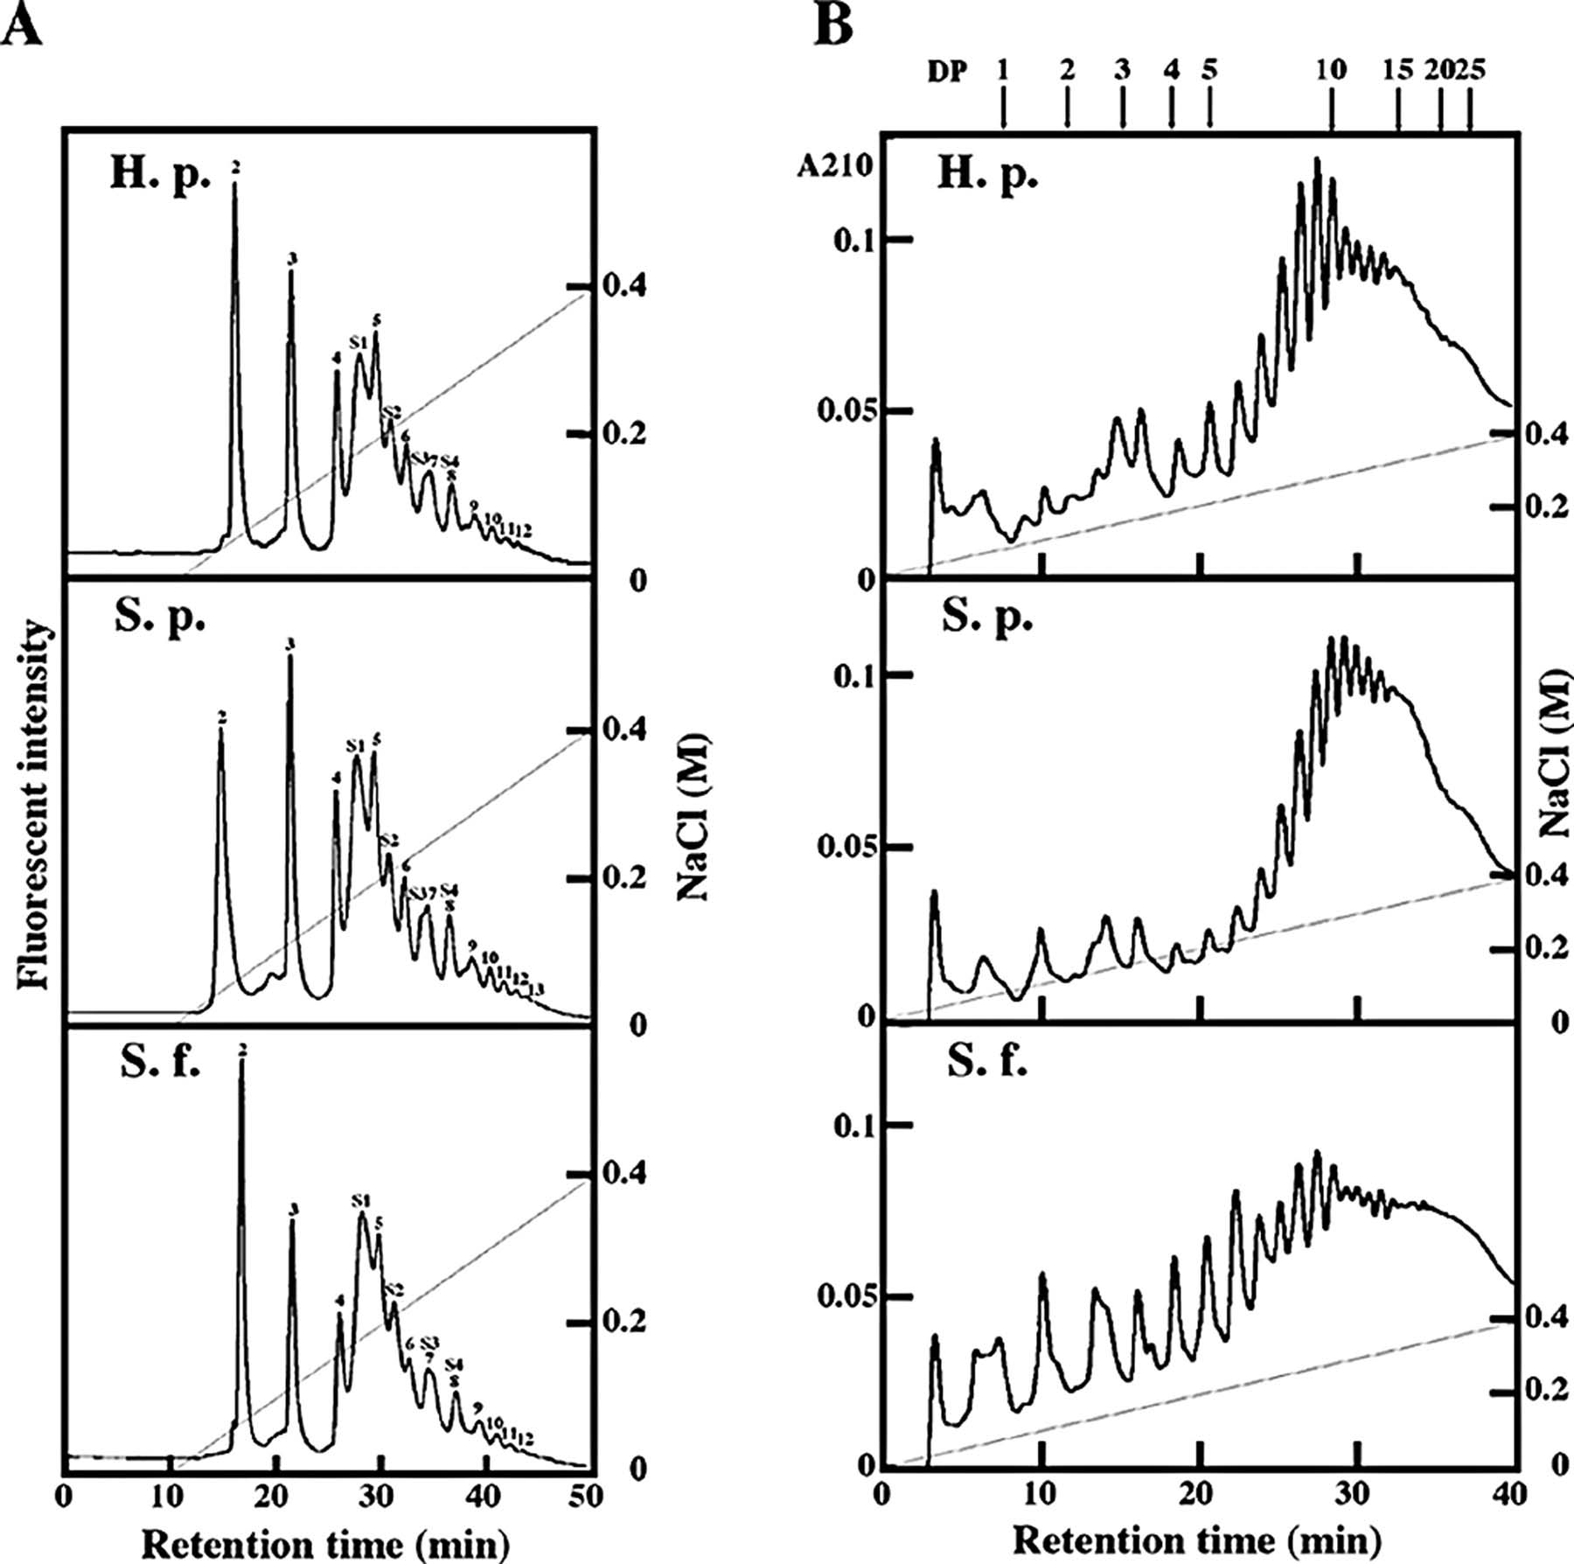
Fig. 6. Comparative structural analyses of polySia chains obtained from sea urchin sperm of the three species. A ...
Notes:
Fig. 6. Comparative structural analyses of polySia chains obtained from sea urchin sperm of the three species. A major Sia-containing glycopeptide fraction (SGP) was prepared from sperm of Hemicentrotus pulcherrimus (H.p), Strongylocentrotus purpuratus (S.p), and Strongylocentrotus franciscanus (S.f) as described under Materials and methods. (A) Mono Q-HPLC of DMB derivatives of mild acid hydrolysate of SGP. SGP was mild acid hydrolyzed to release a series of oligo/polyNeu5Ac. These oligo/polyNeu5Ac were DMB labeled and analyzed on an anion-exchange HPLC. Elution was performed with a linear gradient of NaCl (straight line) and monitored with fluorescence (excitation 373 nm, emission 448 nm). See also the legend of Figure 2A. (B) Mono Q-HPLC of sialoglycan alditols obtained from SGP by alkaline borohydride treatment. The sialooligosaccharide alditols obtained by the treatment with 0.1 N NaOH and 1 M NaBH4 were subjected to anion-exchange HPLC as described above. An elution profile was monitored by measuring the absorbance at 210 nm (A210). The arrowheads with numbers show the elution positions of α2,8-linked oligo/polyNeu5Ac with a series of DP. The NaCl concentration is shown by the straight line.
Unless provided in the caption above, the following copyright applies to the content of this slide: © The Author 2006. Published by Oxford University Press. All rights reserved. For permissions, please e-mail: journals.permissions@oxfordjournals.org

Slide 4
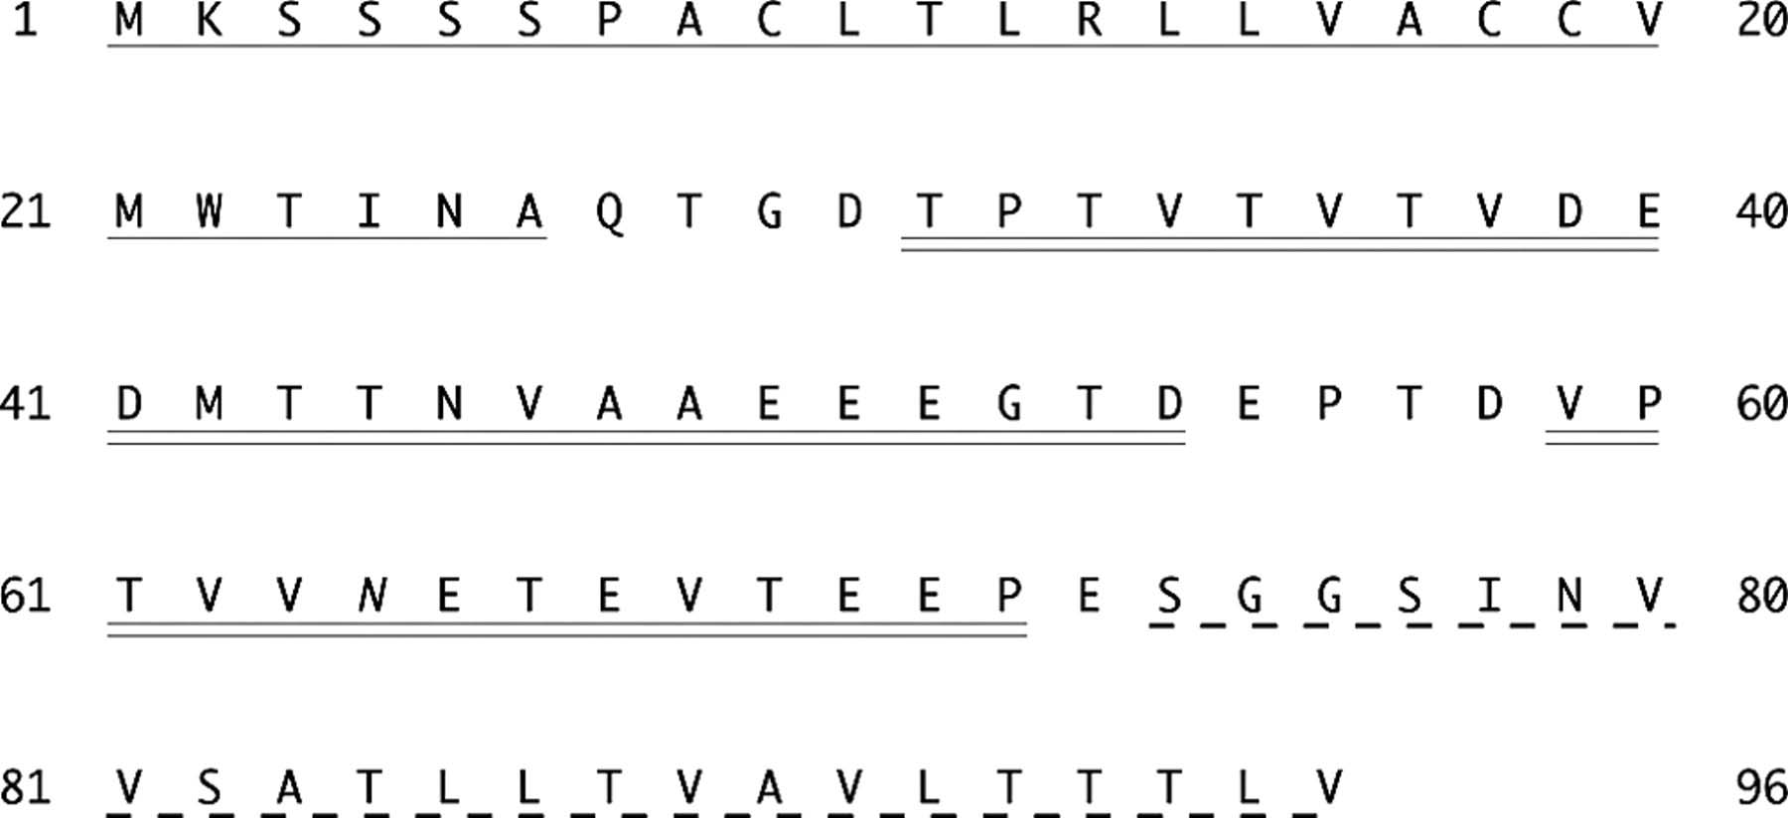
Fig. 3. The deduced amino acid sequence of the 40–80 kDa-GP or flagellasialin. The deduced amino acid sequence is ...
Notes:
Fig. 3. The deduced amino acid sequence of the 40–80 kDa-GP or flagellasialin. The deduced amino acid sequence is numbered from the initiation Met. The putative signal sequence is underlined. The putative transmembrane domain is marked by a dashed underline. One potential N-glycosylation site is italicized at N64. Two amino acid sequences that were determined by the Edman degradation of peptide fragments obtained from purified 40–80 kDa-GP are double underlined (see Table I).
Unless provided in the caption above, the following copyright applies to the content of this slide: © The Author 2006. Published by Oxford University Press. All rights reserved. For permissions, please e-mail: journals.permissions@oxfordjournals.org

Slide 5
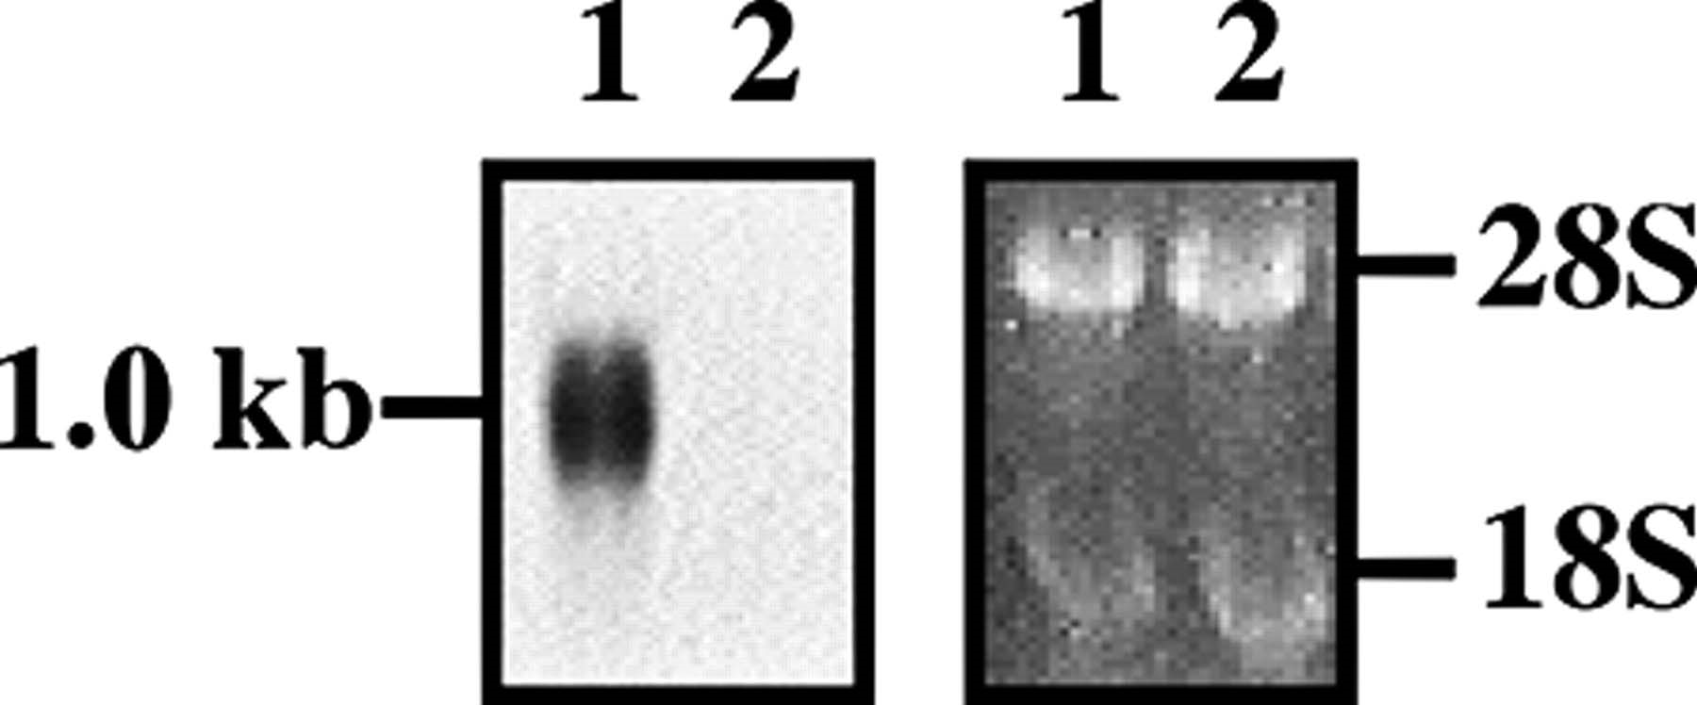
Fig. 4. Northern blot analysis of the flagellasialin mRNA. Total RNA fractions isolated from the testis (lane 1) and ...
Notes:
Fig. 4. Northern blot analysis of the flagellasialin mRNA. Total RNA fractions isolated from the testis (lane 1) and ovary (lane 2) of Hemicentrotus pulcherrimus were analyzed by northern blotting using full-length flagellasialin cDNA as a probe (left) or visualized with ethidium bromide (right) to show equal loading. The positions of 18S and 28S rRNA are indicated on the right.
Unless provided in the caption above, the following copyright applies to the content of this slide: © The Author 2006. Published by Oxford University Press. All rights reserved. For permissions, please e-mail: journals.permissions@oxfordjournals.org

Slide 6
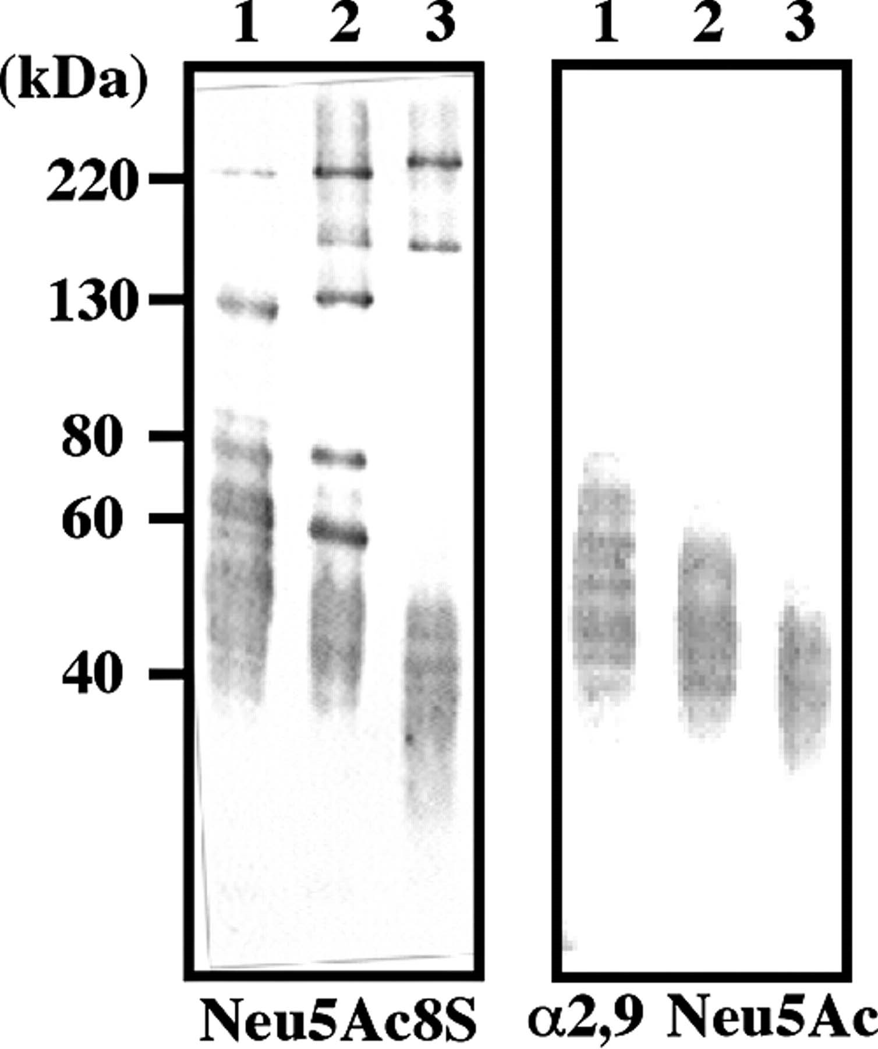
Fig. 5. Immunodetection of flagellasialin from sperm from three sea urchin species. The Triton X-100 extracts of ...
Notes:
Fig. 5. Immunodetection of flagellasialin from sperm from three sea urchin species. The Triton X-100 extracts of Hemicentrotus pulcherrimus (lane 1), Strongylocentrotus purpuratus (lane 2), and Strongylocentrotus franciscanus (lane 3) sperm were subjected to SDS–PAGE (1 µg protein/lane) and immunoblotted with mAb.3G9 (Neu5Ac8S) or anti-α2,9Neu5Ac (α2,9 Neu5Ac).
Unless provided in the caption above, the following copyright applies to the content of this slide: © The Author 2006. Published by Oxford University Press. All rights reserved. For permissions, please e-mail: journals.permissions@oxfordjournals.org

Slide 7
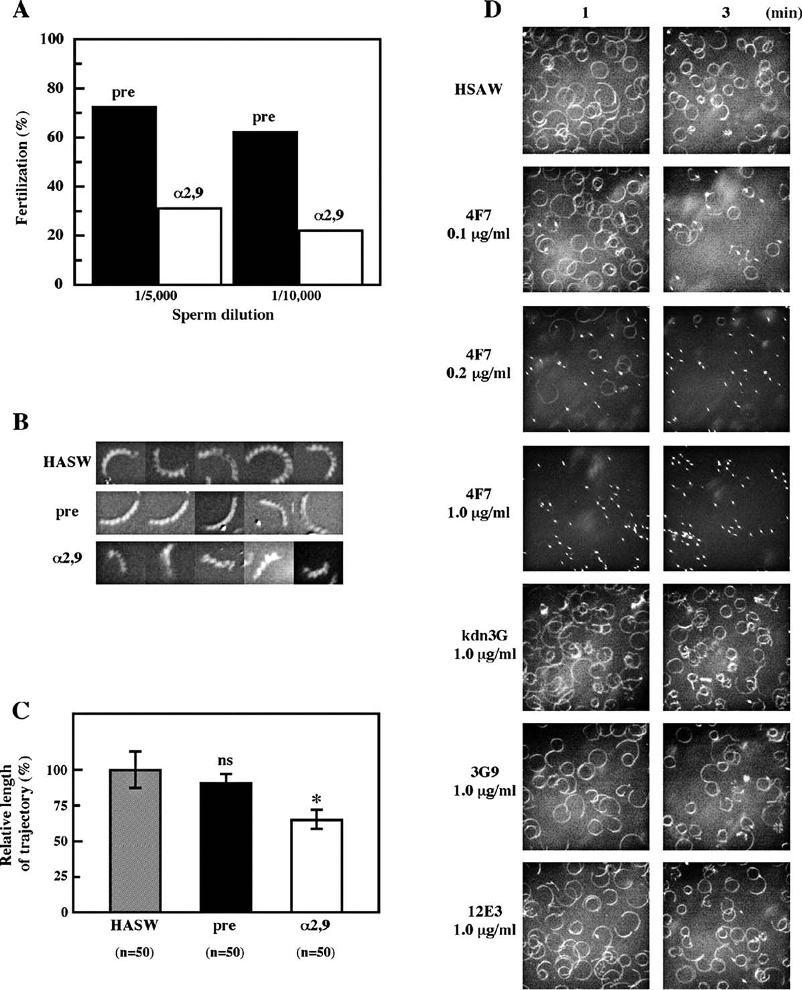
Fig. 7. Significance of flagellasialin containing the α2,9-linked polyNeu5Ac in sperm fertility and motility. (A) ...
Notes:
Fig. 7. Significance of flagellasialin containing the α2,9-linked polyNeu5Ac in sperm fertility and motility. (A) Effects of anti-α2,9-linked polySia on sperm fertility. Hemicentrotus pulcherrimus sperm was pre-incubated with pre-immune sera (pre) or anti-α2,9-linked polyNeu5Ac (α2,9), followed by the fertilization of fresh eggs. Four independent experiments were performed on different days, and the figure shows representative data. (B) Sperm motility. Sperm was incubated with HASW (HASW), pre-immune sera (pre), or anti-α2,9-linked polyNeu5Ac antibodies (α2,9) for 1 min. Each panel shows the time-lapse photographs, showing the trajectory of swimming sperm heads during 0.2 s. (C) Sperm motility. The swimming length of sperm during 0.2 s was measured and a value expressed as relative length to that in HASW set to 100%. Bars represent ± SD. The number of observed sperm is indicated in parentheses. Statistics: ns, p > 0.05; *, P<0.001. (D) Sperm motility. Sperm were photographed (1 s exposures) using dark field conditions 1 min and 3 min after mixing with 0.1–1.0 µg/mL of mAb.4F7 (IgG), mAb.12E3 (IgM), mAb.3G9 (IgM), and mAb.kdn3G (IgG).
Unless provided in the caption above, the following copyright applies to the content of this slide: © The Author 2006. Published by Oxford University Press. All rights reserved. For permissions, please e-mail: journals.permissions@oxfordjournals.org

Slide 8
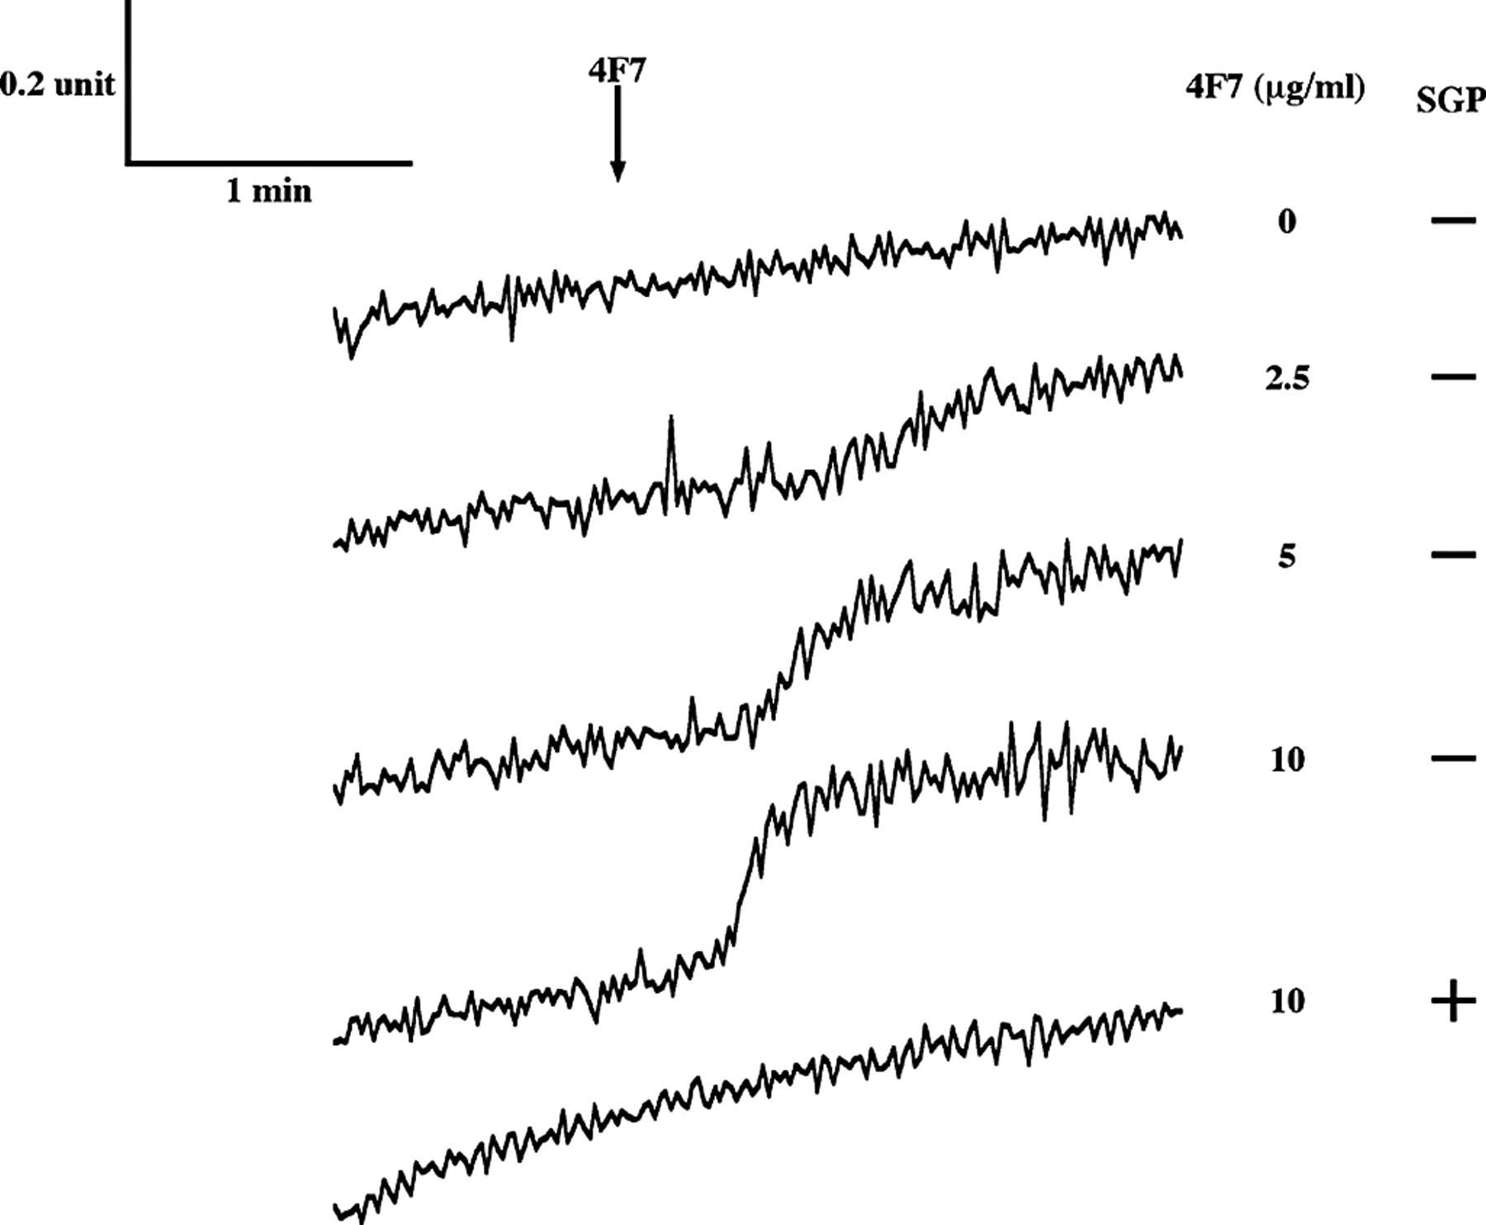
Fig. 8. Effects of mAb.4F7 on intracellular Ca²⁺. Fura-2-loaded sperm were used for intracellular ...
Notes:
Fig. 8. Effects of mAb.4F7 on intracellular Ca2+. Fura-2-loaded sperm were used for intracellular Ca2+ measurements. mAb.4F7 (0–10 µg) was pre-incubated with or without SGP (13 µg as Sia). After 10 min, various concentrations of mAb.4F7 were added (at the arrow). The Ca2+ signal is presented as the F340/F380 ratio.
Unless provided in the caption above, the following copyright applies to the content of this slide: © The Author 2006. Published by Oxford University Press. All rights reserved. For permissions, please e-mail: journals.permissions@oxfordjournals.org

Slide 9
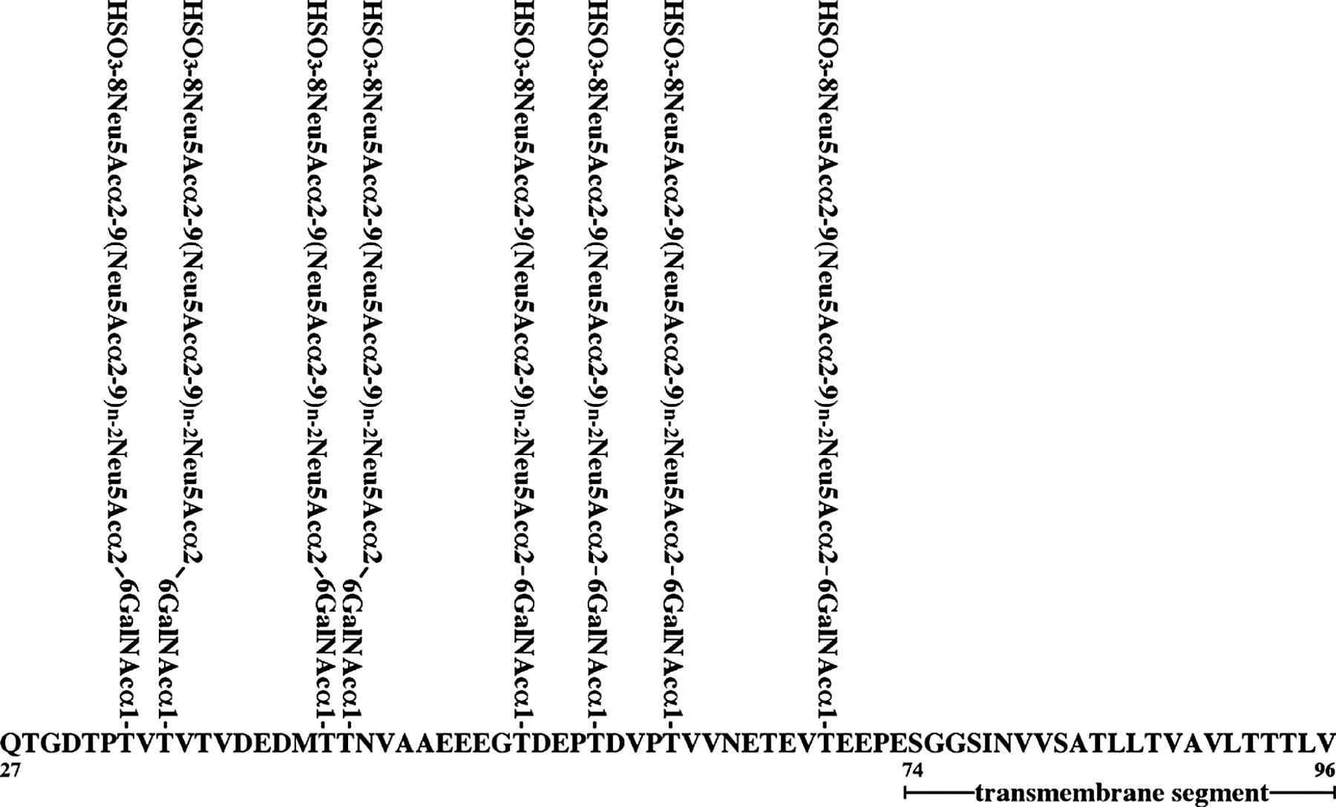
Fig. 9. Overall structure of flagellasialin. Flagellasialin consists of a 47-amino acid extracellular domain and a ...
Notes:
Fig. 9. Overall structure of flagellasialin. Flagellasialin consists of a 47-amino acid extracellular domain and a 23-amino acid transmembrane segment with a short or no cytosolic domain. The signal peptide is cleaved off in this figure. In the extracellular domain, of 12 Thr residues, 8 residues are O-glycosylated, and most contain HSO3→8Neu5Acα2,9(Neu5Ac2,9)n–2Neu5Acα2,6GalNAcα1→Thr (n = at least 2) structure.
Unless provided in the caption above, the following copyright applies to the content of this slide: © The Author 2006. Published by Oxford University Press. All rights reserved. For permissions, please e-mail: journals.permissions@oxfordjournals.org

