Slide 1
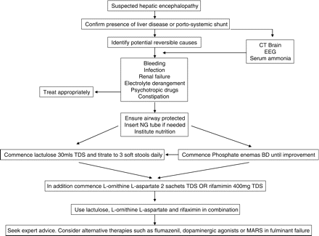
Figure 1. Suggested algorithm for the management of hepatic encephalopathy.
Notes:
Figure 1. Suggested algorithm for the management of hepatic encephalopathy.
Unless provided in the caption above, the following copyright applies to the content of this slide: © The Author 2009. Published by Oxford University Press on behalf of the Association of Physicians. All rights reserved. For Permissions, please email: journals.permissions@oxfordjournals.org

