Slide 1
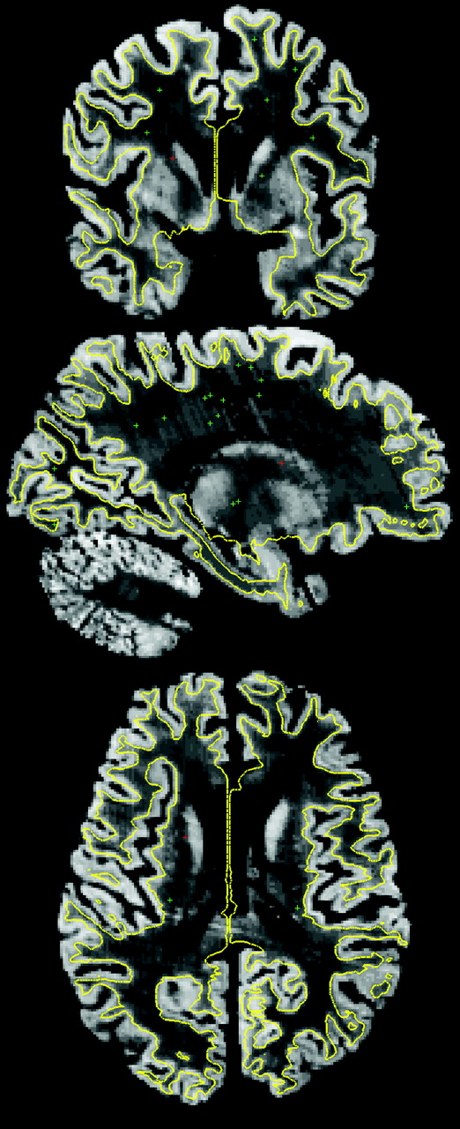
Figure 1. Image of a representative reconstructed histology dataset with the gray/white surface overlaid in yellow. ...
Notes:
Figure 1. Image of a representative reconstructed histology dataset with the gray/white surface overlaid in yellow. Top: coronal, middle: sagittal, bottom: axial. The green crosses represent the locations of the manually selected control points in the body of the white matter for these slices. The red cross represents the point in common for the 3 views.
Unless provided in the caption above, the following copyright applies to the content of this slide: © 2007 The AuthorsThis is an Open Access article distributed under the terms of the Creative Commons Attribution Non-Commercial License (http://creativecommons.org/licenses/by-nc/2.0/uk/) which permits unrestricted non-commercial use, distribution, and reproduction in any medium, provided the original work is properly cited.

Slide 2
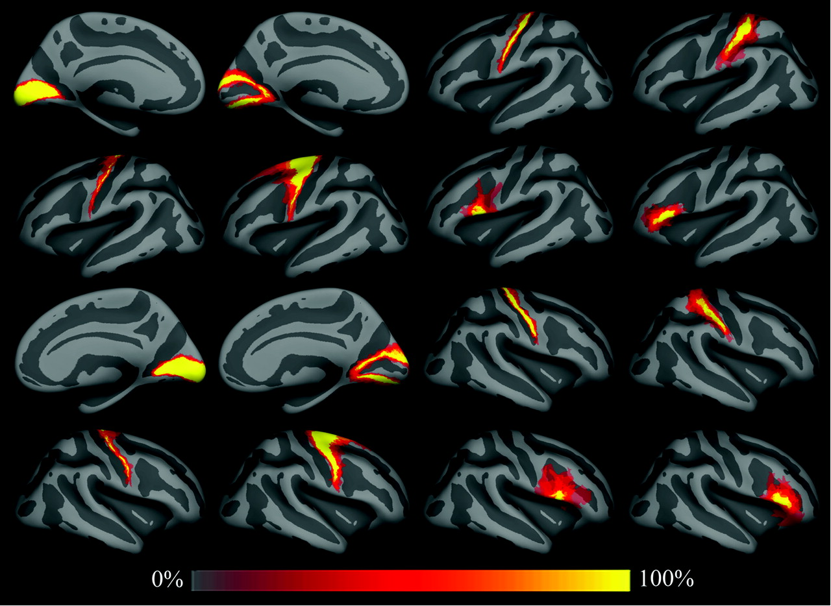
Figure 2. Spatial probability maps of different BAs. Top row: left hemisphere areas 17, 18, 4p, and 2 (from left to ...
Notes:
Figure 2. Spatial probability maps of different BAs. Top row: left hemisphere areas 17, 18, 4p, and 2 (from left to right). Second row: areas 4a, 6, 44, and 45. Third and fourth rows are same as first and second for the right hemisphere. Fifth row: color scale used for spatial probability maps.
Unless provided in the caption above, the following copyright applies to the content of this slide: © 2007 The AuthorsThis is an Open Access article distributed under the terms of the Creative Commons Attribution Non-Commercial License (http://creativecommons.org/licenses/by-nc/2.0/uk/) which permits unrestricted non-commercial use, distribution, and reproduction in any medium, provided the original work is properly cited.

Slide 3
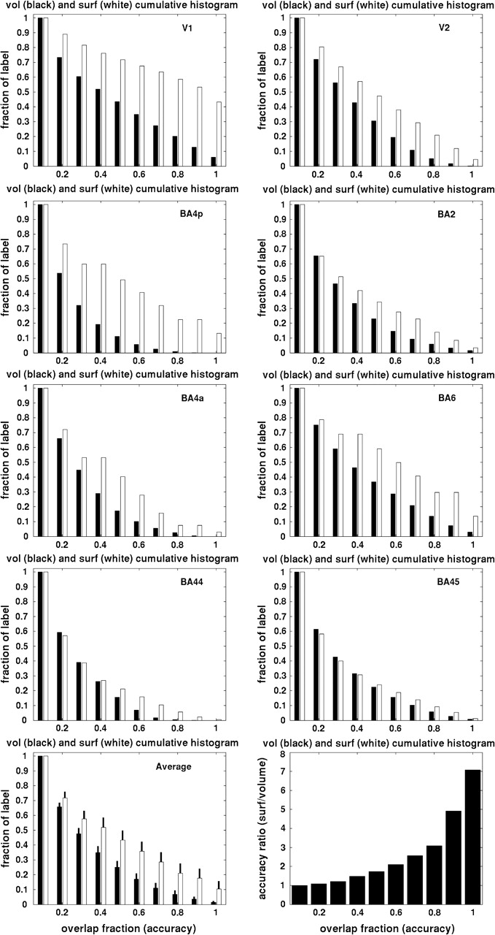
Figure 3. Cumulative histograms of surface (white) and nonlinear volume (black) accuracy. From left to right: top row: ...
Notes:
Figure 3. Cumulative histograms of surface (white) and nonlinear volume (black) accuracy. From left to right: top row: V1 and V2, second row: 4p and 2, third row: 4a and 6, fourth row: 44 and 45. Bottom: mean across the set of areas (left), black bars are standard errors of the mean, and ratio of surface to volume (right).
Unless provided in the caption above, the following copyright applies to the content of this slide: © 2007 The AuthorsThis is an Open Access article distributed under the terms of the Creative Commons Attribution Non-Commercial License (http://creativecommons.org/licenses/by-nc/2.0/uk/) which permits unrestricted non-commercial use, distribution, and reproduction in any medium, provided the original work is properly cited.

Slide 4
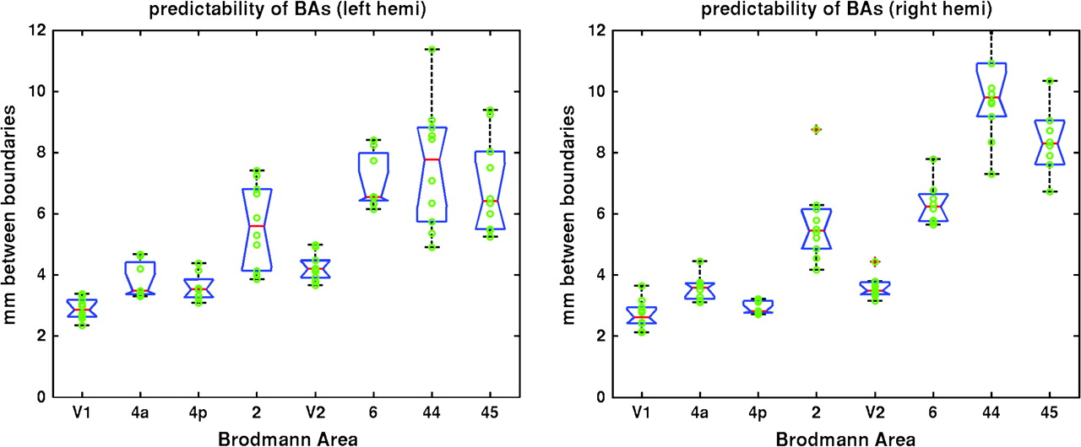
Figure 4. Box plot of the accuracy of the predicted location of the borders of a set of BAs as estimated by the average ...
Notes:
Figure 4. Box plot of the accuracy of the predicted location of the borders of a set of BAs as estimated by the average distance between boundaries of the corresponding areas in millimeter, using a modified Hausdorff distance (y-axis). The higher the accuracy, the lower the distance. Left: 8 BAs in the left hemisphere, right: 8 BAs in the right hemisphere. Blue boxes indicate the lower and upper quartiles; red lines are the medians. The lines extend to 1.5 times the interquartile spacing. Data points outside of the lines are outliers.
Unless provided in the caption above, the following copyright applies to the content of this slide: © 2007 The AuthorsThis is an Open Access article distributed under the terms of the Creative Commons Attribution Non-Commercial License (http://creativecommons.org/licenses/by-nc/2.0/uk/) which permits unrestricted non-commercial use, distribution, and reproduction in any medium, provided the original work is properly cited.

