Slide 1
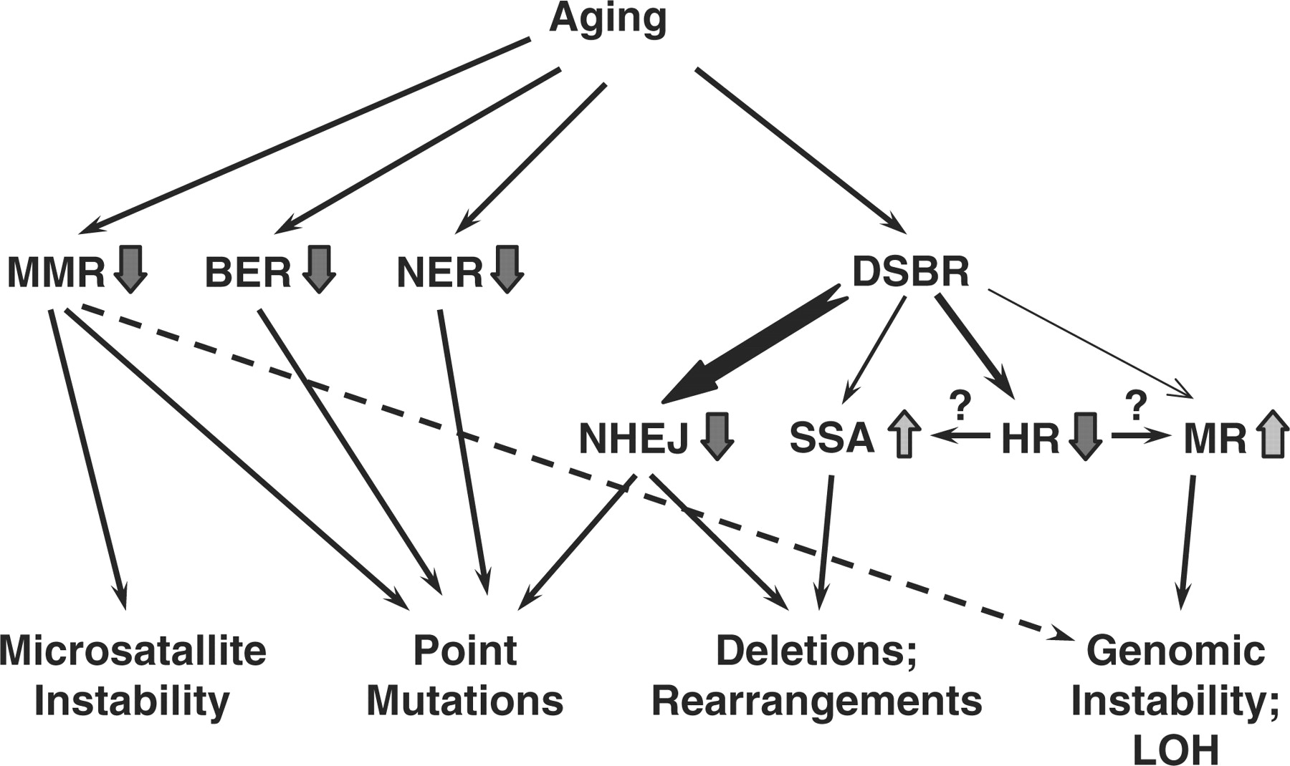
Figure 1. Age-related changes in DNA repair and their consequences. Inefficient MMR leads to microsatellite ...
Notes:
Figure 1. Age-related changes in DNA repair and their consequences. Inefficient MMR leads to microsatellite instability, point mutations and potentially, to increased frequency of LOH. Decline in efficiency and fidelity of BER and NER leads to point mutations. Less efficient and more error-prone NHEJ results in point mutations and genomic rearrangements. As fewer cells are in G2 stage, the usage of sub-pathways of DSB repair (DSBR) may also change, where precise HR between sister chromatids declines, giving way to more mutagenic SSA and mitotic recombination (MR) with homologous chromosome leading to genomic instability and LOH.
Unless provided in the caption above, the following copyright applies to the content of this slide: © 2007 The Author(s)This is an Open Access article distributed under the terms of the Creative Commons Attribution Non-Commercial License (http://creativecommons.org/licenses/by-nc/2.0/uk/) which permits unrestricted non-commercial use, distribution, and reproduction in any medium, provided the original work is properly cited.

Slide 2
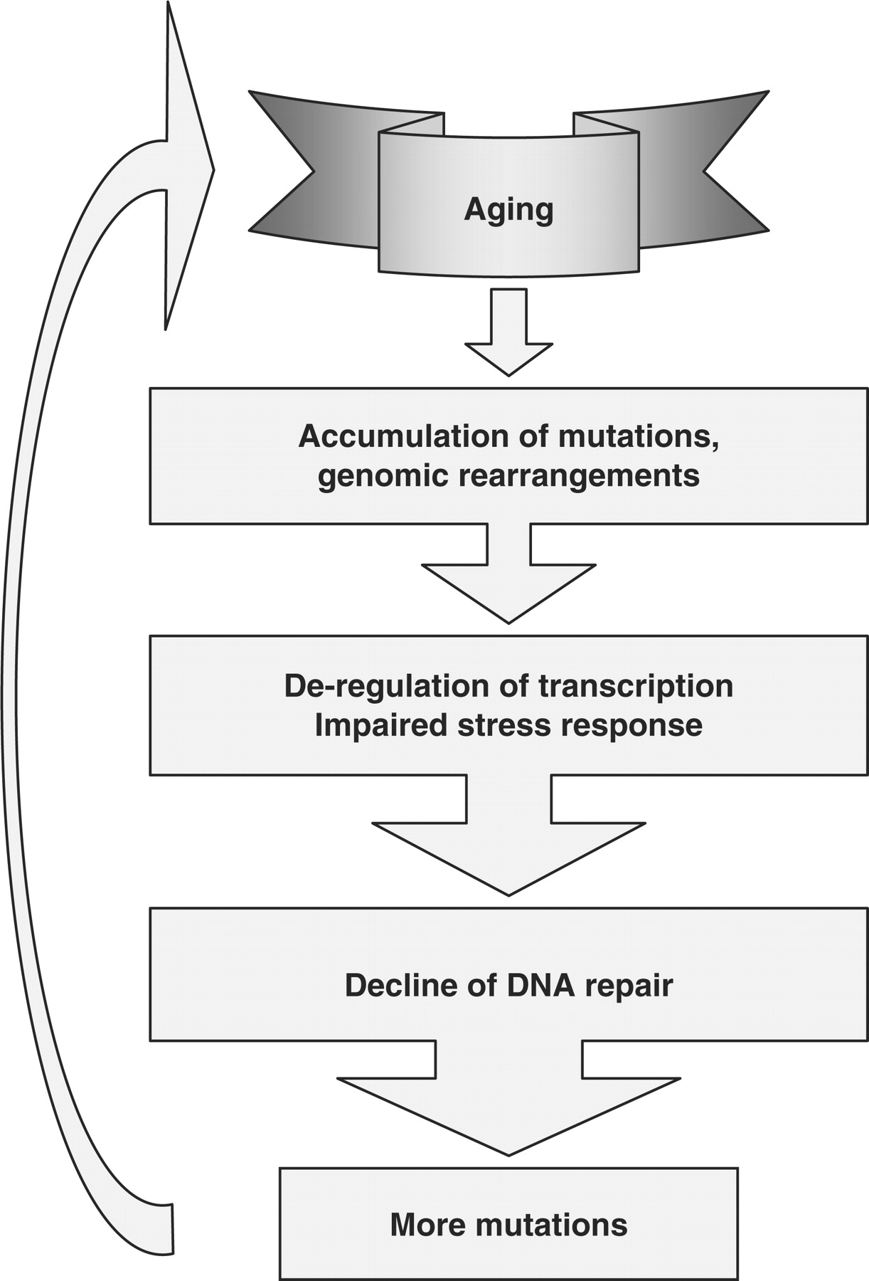
Figure 2. The vicious cycle of aging and genomic instability. Spontaneous mutations and rearrangements accumulate with ...
Notes:
Figure 2. The vicious cycle of aging and genomic instability. Spontaneous mutations and rearrangements accumulate with time leading deregulation of transcription, impaired stress response and diminished function of DNA repair genes. Decline of DNA repair efficiency and fidelity leads to more mutations, and further exacerbates the age-related functional decline.
Unless provided in the caption above, the following copyright applies to the content of this slide: © 2007 The Author(s)This is an Open Access article distributed under the terms of the Creative Commons Attribution Non-Commercial License (http://creativecommons.org/licenses/by-nc/2.0/uk/) which permits unrestricted non-commercial use, distribution, and reproduction in any medium, provided the original work is properly cited.

