Slide 1
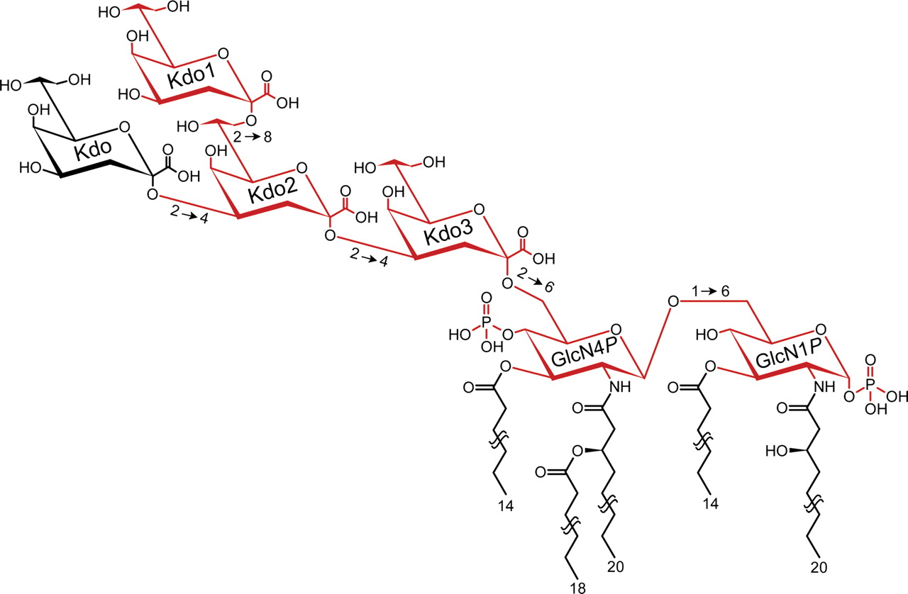
Fig. 1. Chemical structure of Chlamydia psittaci LPS which harbors all the antigen fragments listed in Table I. ...
Notes:
Fig. 1. Chemical structure of Chlamydia psittaci LPS which harbors all the antigen fragments listed in Table I. S64-4's immunogen, the 2→8 pentasaccharide bisphosphate (Table I, h), is shown by red in the online version and grey in the printed version.
Unless provided in the caption above, the following copyright applies to the content of this slide: © The Author 2011. Published by Oxford University Press. All rights reserved. For permissions, please e-mail: journals.permissions@oup.com

Slide 2
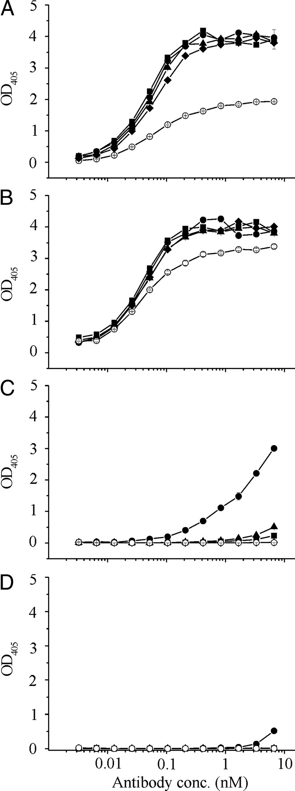
Fig. 2. Binding of mAb S64-4 to Kdo oligosaccharides conjugated to BSA. ELISA plates were coated with graded ...
Notes:
Fig. 2. Binding of mAb S64-4 to Kdo oligosaccharides conjugated to BSA. ELISA plates were coated with graded concentrations of neoglycoconjugates corresponding to 200 (filled circles), 50 (filled triangles), 12.5 (filled squares), 3.2 (filled diamonds), 0.8 (open circles) pmol of ligand per milliliter using 50 µL/well and reacted with mAb S64-4 at the concentrations indicated on the abscissa. The antigens were: 2→8 pentasaccharide bisphosphate (Table I, h) Kdo(2→8)Kdo(2→4)Kdo(2→6)βGlcN-4P(1→6)αGlcN-1P-BSA (A), 2→8 pentasaccharide 4-phosphate (Table I, g) Kdo(2→8)Kdo(2→4)Kdo(2→6)βGlcNAc-4P(1→6)GlcNAcol-BSA (B), 2→8 pentasaccharide 1-phosphate (Table I, f) Kdo(2→8)Kdo(2→4)Kdo(2→6)βGlcN(1→6)αGlcN-1P-BSA (C) and 2→8 pentasaccharide (Table I, e) Kdo(2→8)Kdo(2→4)Kdo(2→6)βGlcNAc(1→6)GlcNAcol-BSA (D). The average of quadruplicate measurements is shown for A–C. The measurements for D are single data points.
Unless provided in the caption above, the following copyright applies to the content of this slide: © The Author 2011. Published by Oxford University Press. All rights reserved. For permissions, please e-mail: journals.permissions@oup.com

Slide 3
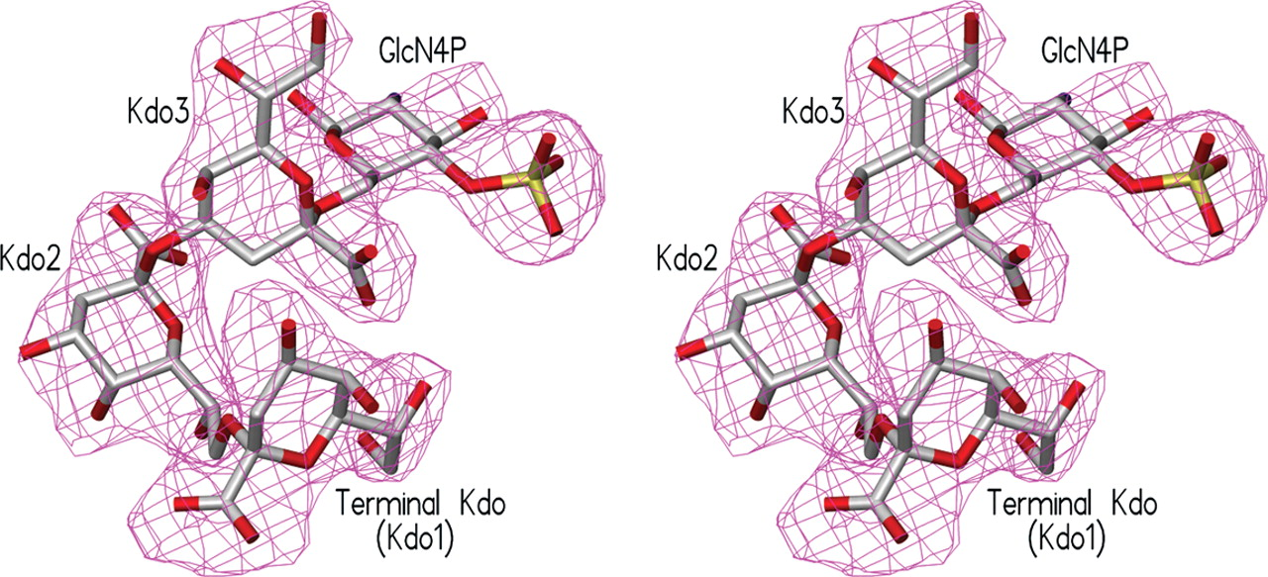
Fig. 3. Stereo view of refined omit electron density map contoured at 3σ for 2→8 pentasaccharide bisphosphate ...
Notes:
Fig. 3. Stereo view of refined omit electron density map contoured at 3σ for 2→8 pentasaccharide bisphosphate (Table I, h), showing the four ordered residues: the terminal Kdo, Kdo2, Kdo3 and the glucosamine 4-phosphate residues.
Unless provided in the caption above, the following copyright applies to the content of this slide: © The Author 2011. Published by Oxford University Press. All rights reserved. For permissions, please e-mail: journals.permissions@oup.com

Slide 4
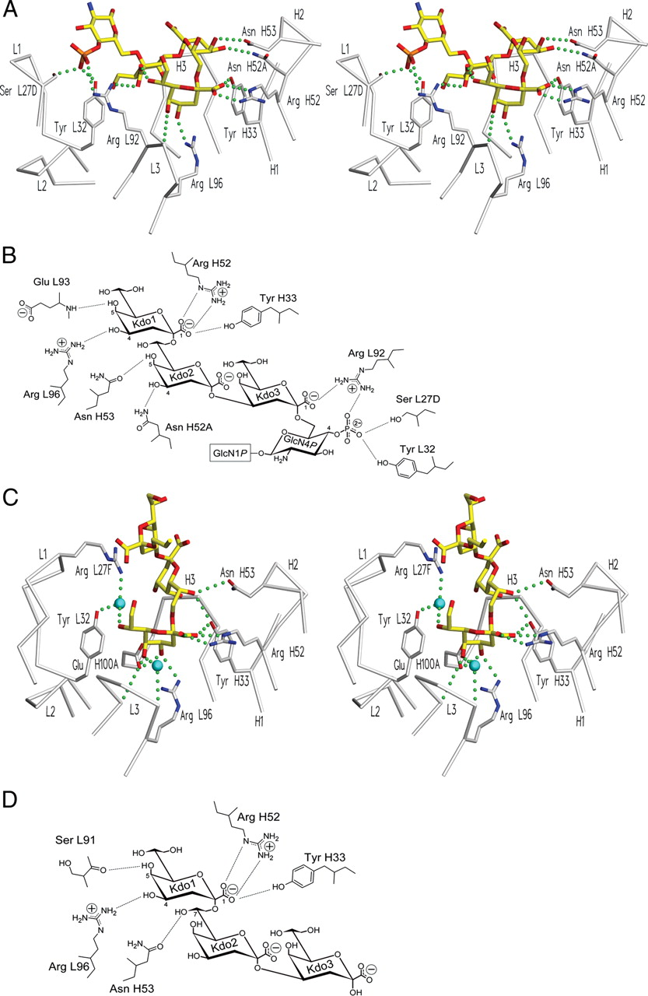
Fig. 4. Antigen-binding sites showing key interactions of S64-4 and S25-2. (A) Stereo view of S64-4 with 2→8 ...
Notes:
Fig. 4. Antigen-binding sites showing key interactions of S64-4 and S25-2. (A) Stereo view of S64-4 with 2→8 pentasaccharide bisphosphate (Table I, h); (B) 2D view of S64-4 with 2→8 pentasaccharide bisphosphate (Table I, h); (C) stereo view of S25-2 with 2→8 Kdo trisaccharide (Table I, c) (PDB entry 1Q9Q; Nguyen et al. 2003); and (D) 2D view of S25-2 with 2→8 Kdo trisaccharide (Table I, c).
Unless provided in the caption above, the following copyright applies to the content of this slide: © The Author 2011. Published by Oxford University Press. All rights reserved. For permissions, please e-mail: journals.permissions@oup.com

Slide 5
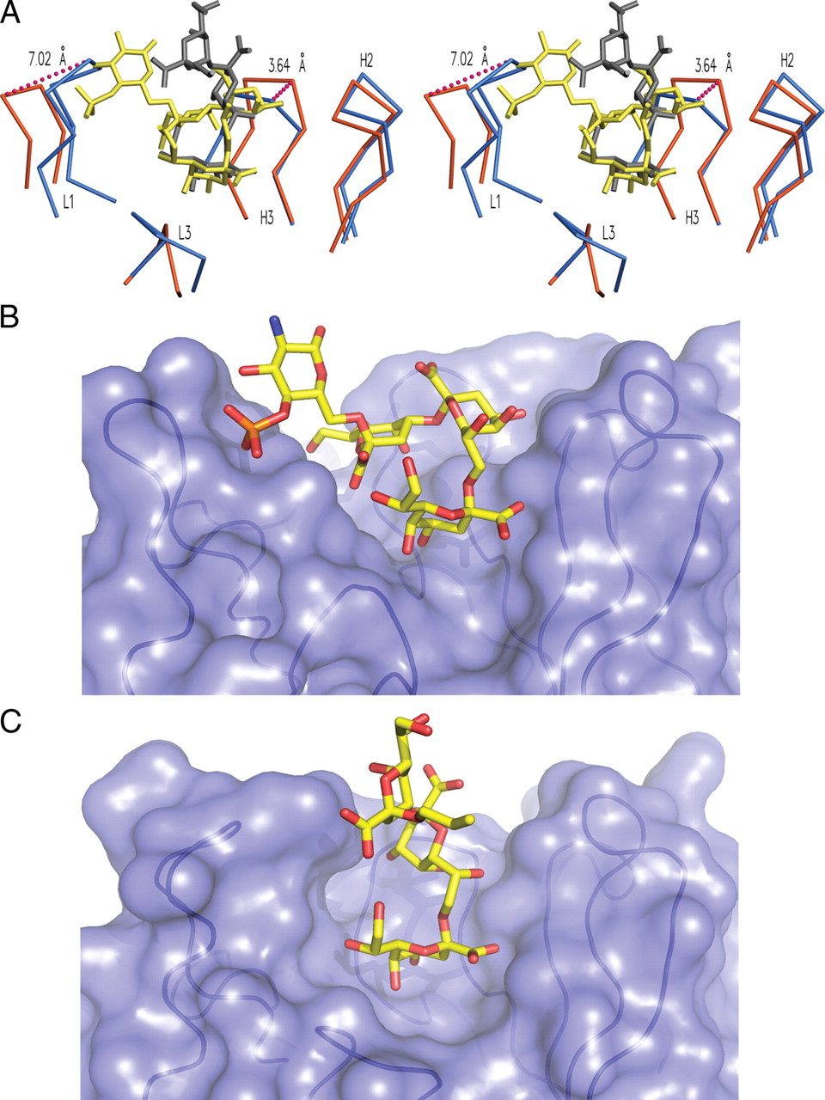
Fig. 5. Antigen-binding sites showing size differences between S64-4 and S25-2. (A) Stereo view of an overlay of the ...
Notes:
Fig. 5. Antigen-binding sites showing size differences between S64-4 and S25-2. (A) Stereo view of an overlay of the antigen-binding sites, see online version for color figures (orange, S64-4; yellow, 2→8 pentasaccharide bisphosphate [Table I, h]; blue, S25-2; grey, 2→8 Kdo trisaccharide [Table I, c]); (B) molecular surface representation of S64-4 with 2→8 pentasaccharide bisphosphate (Table I, h); and (C) molecular surface representation of S25-2 with 2→8 Kdo trisaccharide (Table I, c).
Unless provided in the caption above, the following copyright applies to the content of this slide: © The Author 2011. Published by Oxford University Press. All rights reserved. For permissions, please e-mail: journals.permissions@oup.com

