Slide 1
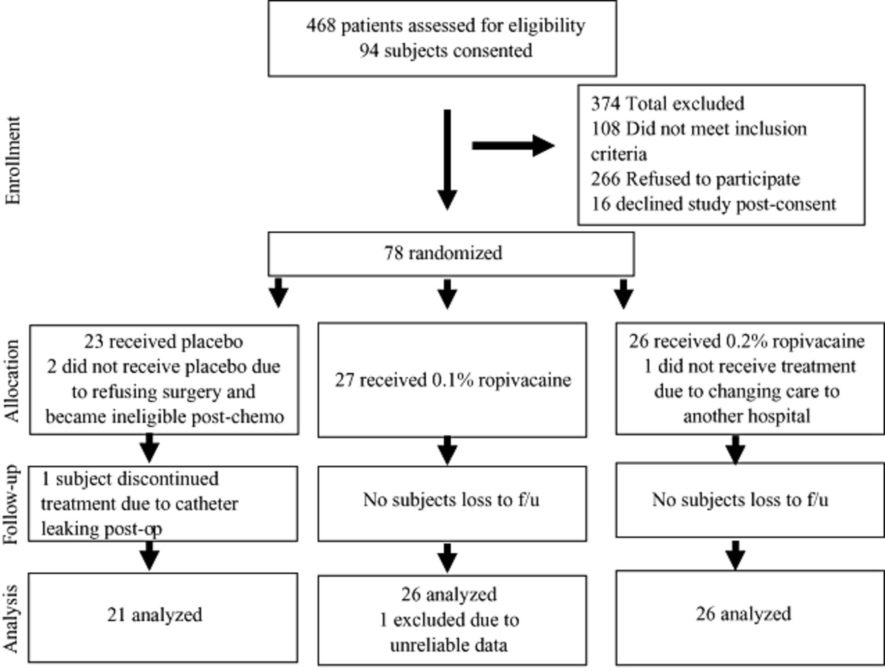
Figure 1 Randomization flow diagram. f/u = follow-up.
Notes:
Figure 1 Randomization flow diagram. f/u = follow-up.
Unless provided in the caption above, the following copyright applies to the content of this slide: Wiley Periodicals, Inc.

Slide 2
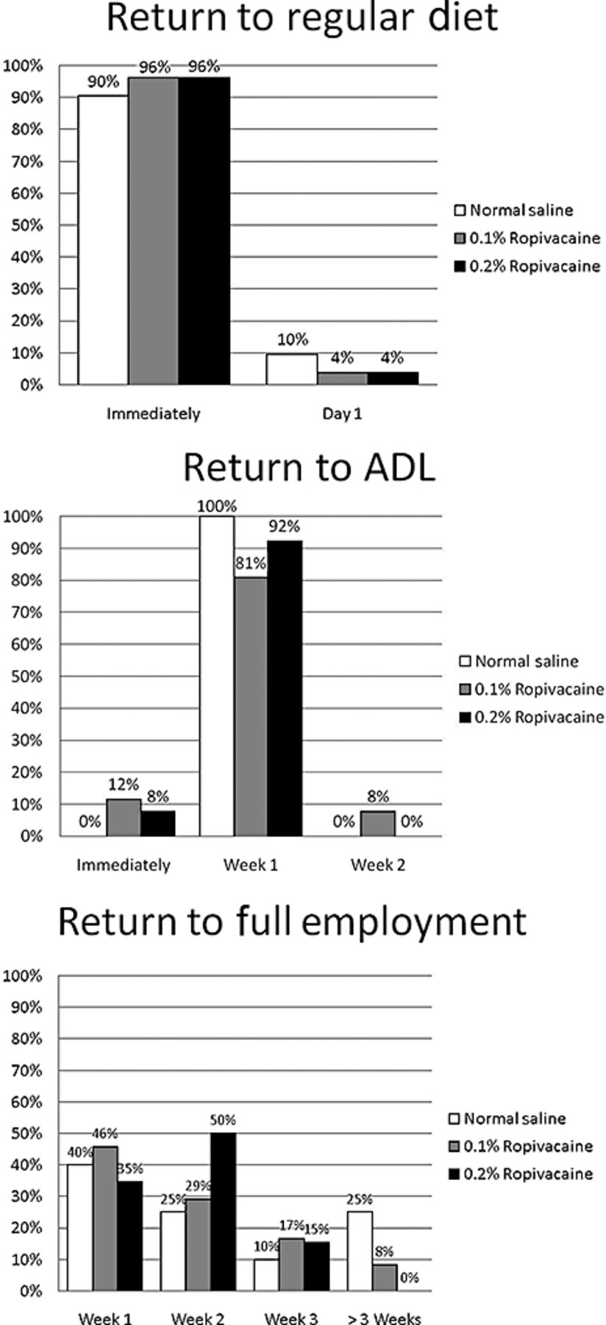
Figure 3 Time to return to regular diet, activities of daily living (ADL), and full employment.
Notes:
Figure 3 Time to return to regular diet, activities of daily living (ADL), and full employment.
Unless provided in the caption above, the following copyright applies to the content of this slide: Wiley Periodicals, Inc.

Slide 3
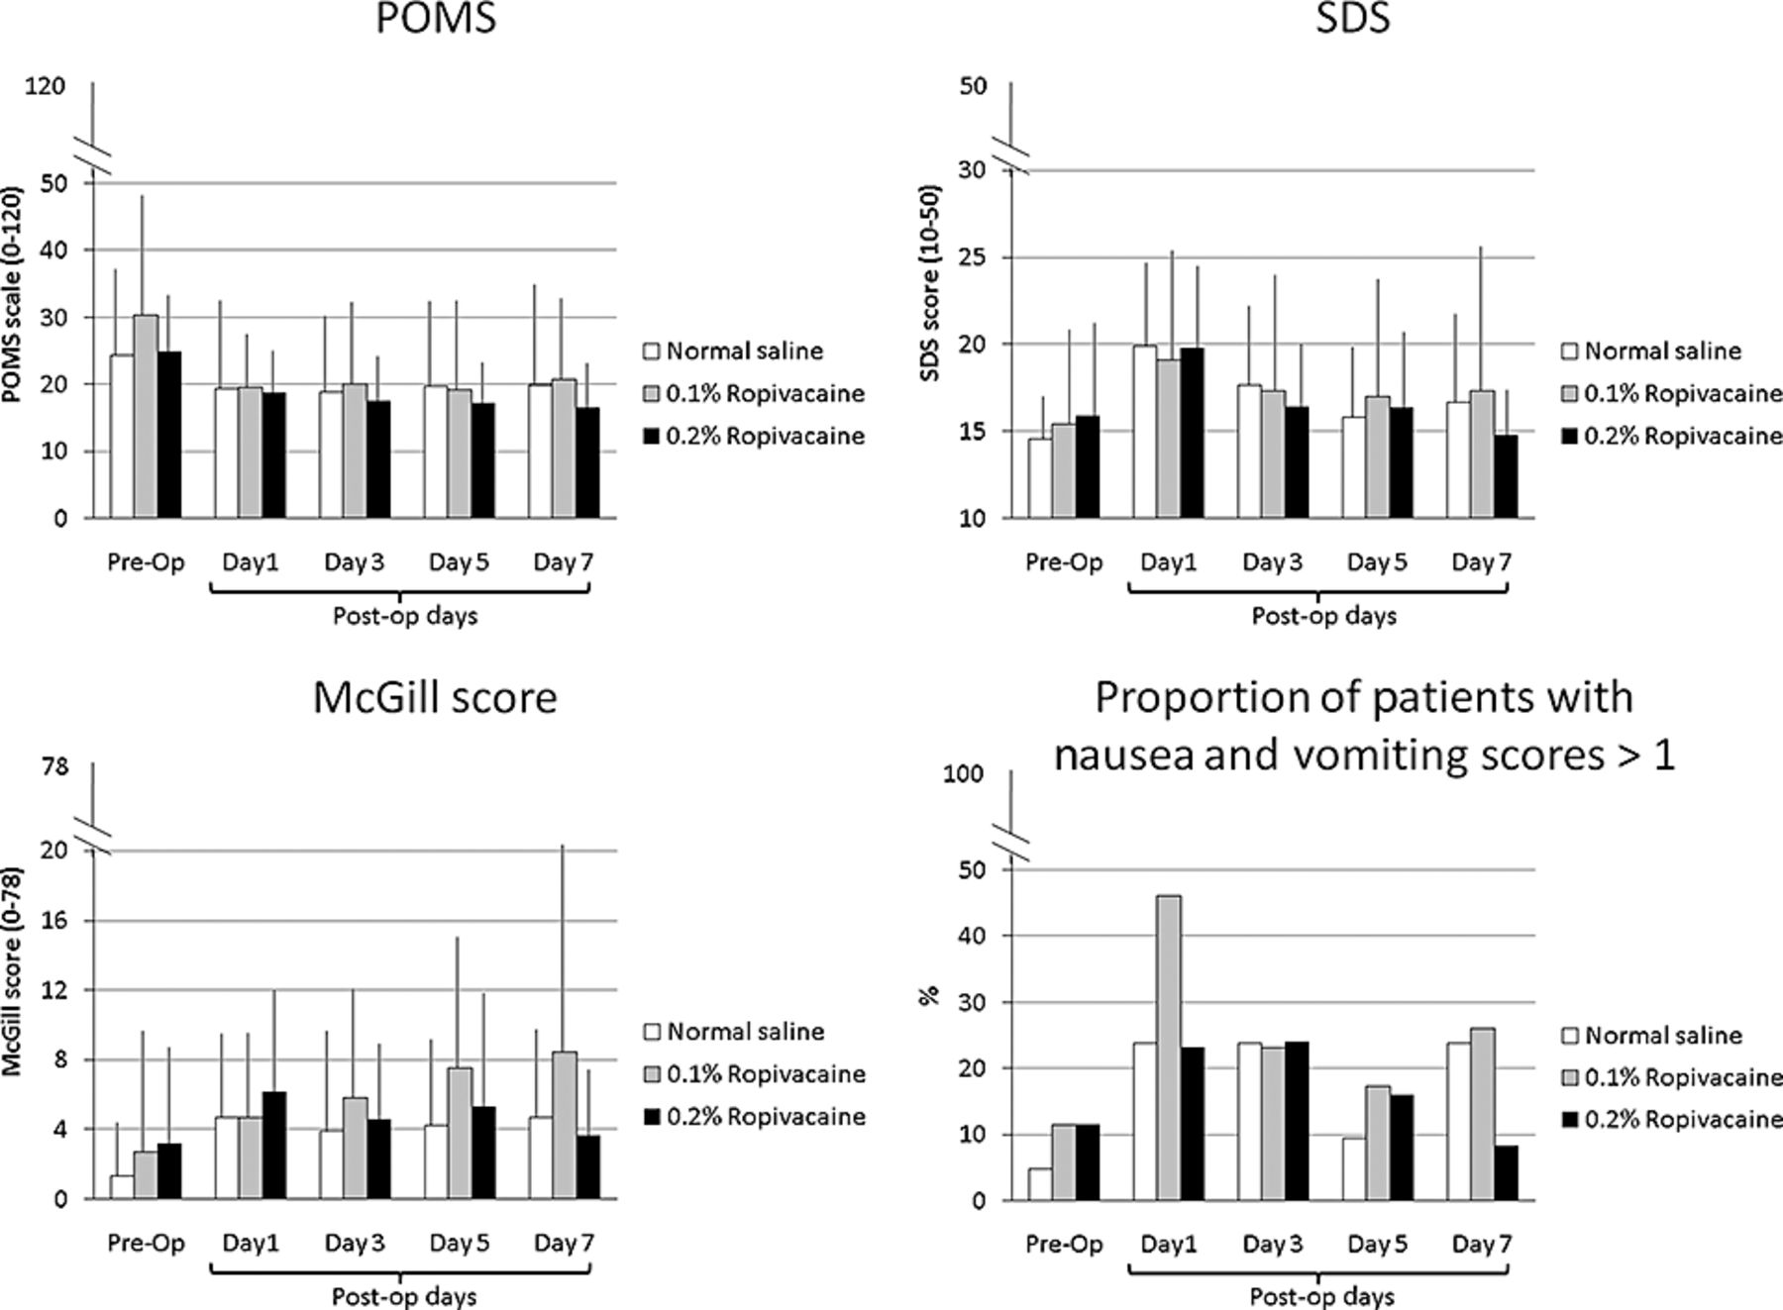
Figure 2 Perioperative profile of mood state (POMS-SV), symptom distress score (McCorkle SDS), pain score (McGill Pain ...
Notes:
Figure 2 Perioperative profile of mood state (POMS-SV), symptom distress score (McCorkle SDS), pain score (McGill Pain Questionnaire), and nausea/vomiting scores.
Unless provided in the caption above, the following copyright applies to the content of this slide: Wiley Periodicals, Inc.

