Slide 1
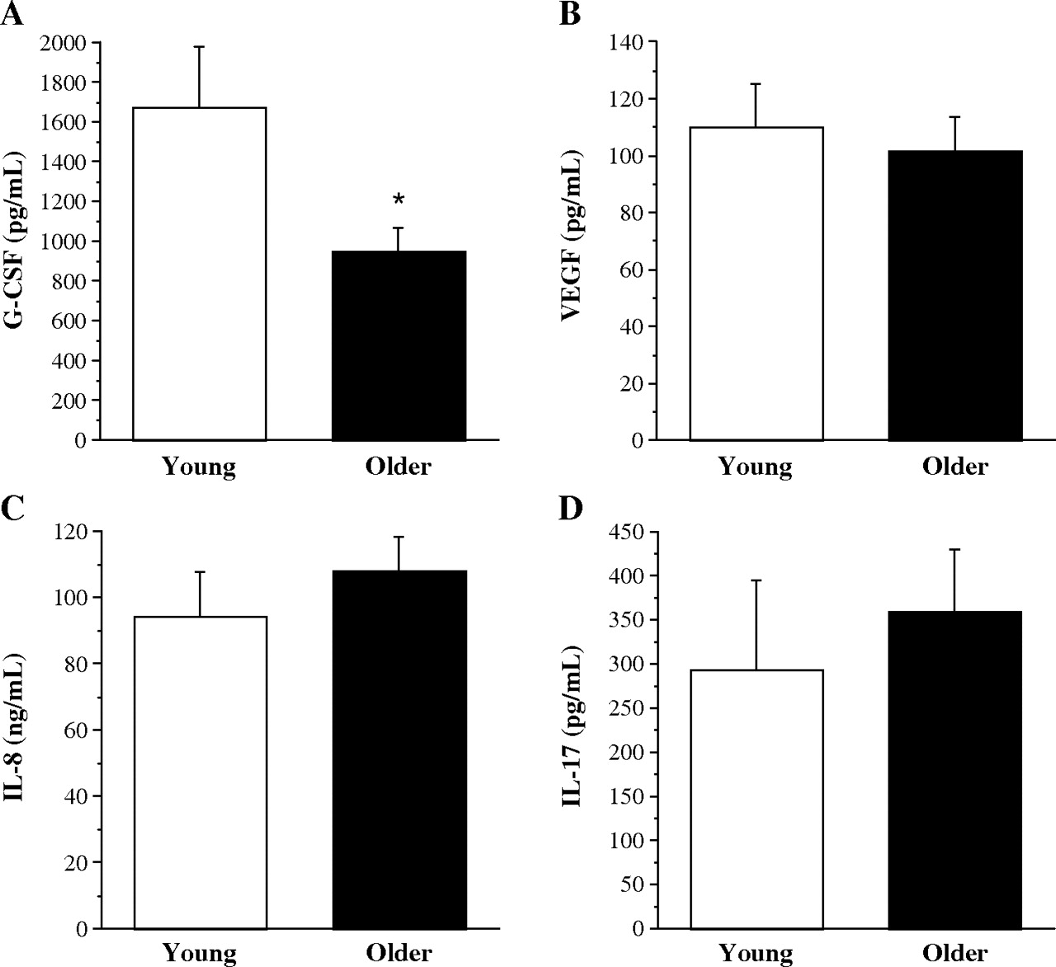
Figure 1 PHA-stimulated EPC release of proangiogenic cytokines G-CSF (A), VEGF (B), IL-8 (C) and IL-17 (D) from young ...
Notes:
Figure 1 PHA-stimulated EPC release of proangiogenic cytokines G-CSF (A), VEGF (B), IL-8 (C) and IL-17 (D) from young and older men. Values are mean ± SEM. *P < 0.05.
Unless provided in the caption above, the following copyright applies to the content of this slide: © Oxford University Press 2010

