Slide 1
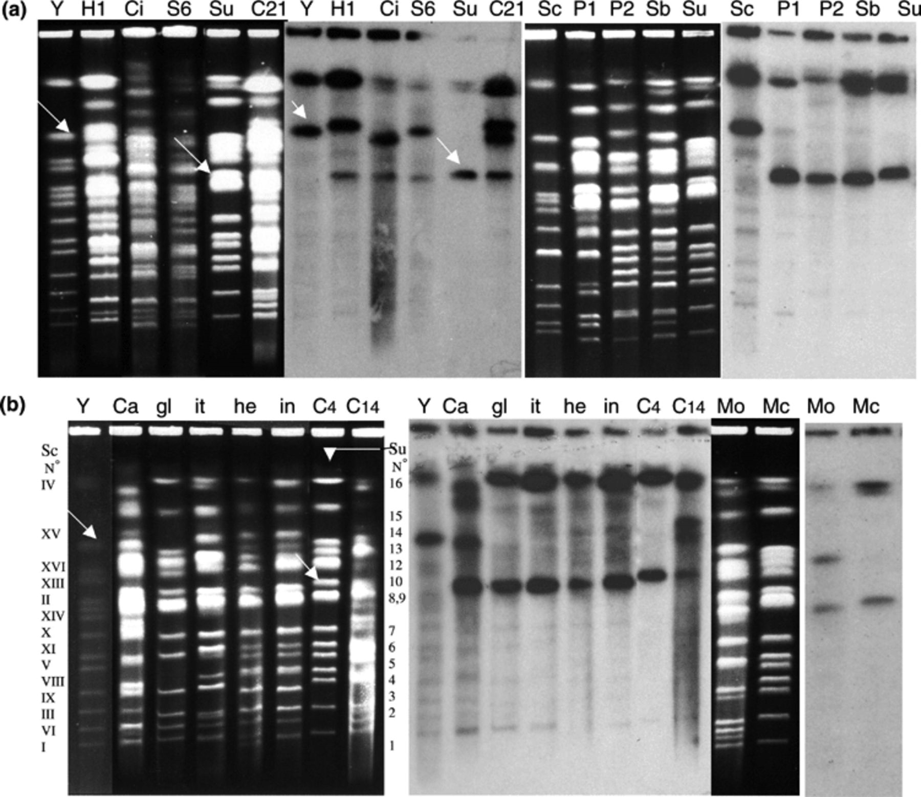
1 Detection of GDH1 in Saccharomyces strains. Left panels: Electrophoretic karyotypes of yeast strains stained ...
Notes:
1 Detection of GDH1 in Saccharomyces strains. Left panels: Electrophoretic karyotypes of yeast strains stained with ethidium bromide. Right panels: Southern-blot hybridisation with ScGDH1 probe. (a) Strains: Y: YNN 295; H1: hybrid S. cerevisiae×S. uvarum; Ci: CID1; S6: S6U; Su: S. uvarum CBS 395T; C21: CBS 2156; Sc: S. cerevisiae S288c; P1: S. pastorianus CBS 1538NT; P2: S. pastorianus NRRL Y-1551; Sb: S. bayanus CBS 380T. Arrows indicate chromosomes carrying GDH1 of S. cerevisae and S. uvarum. (b) Strains: Ca: S. carlsbergensis CBS 1513; gl: S. globosus CBS 424; it: S. intermedius CBS 1505; he: S. heterogenicus CBS 425; in: S. inusitatus CBS 1546; C4: S. uvarum CBS 426; C14: CBS 1462; Mo: S. monacensis CBS 1503; Mc: CLIB 533 (623-6c).
Unless provided in the caption above, the following copyright applies to the content of this slide: © 2004 Federation of European Microbiological Societies. Published by Elsevier B.V. All rights reserved.

Slide 2
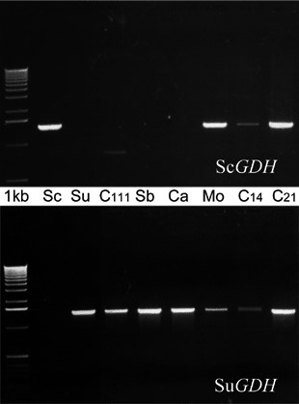
2 PCR amplification of ScGDH1 (upper panel) and SuGDH1 (lower panel). Strains: Sc: S. cerevisiae S288c; Su: S. ...
Notes:
2 PCR amplification of ScGDH1 (upper panel) and SuGDH1 (lower panel). Strains: Sc: S. cerevisiae S288c; Su: S. uvarum CBS 395T; C111: S. uvarum CLIB 111; Sb: S. bayanus CBS 380T; Ca: S. carlsbergensis CBS 1513; Mo: S. monacensis CBS 1503; C14: CBS 1462; C21: CBS 2156.
Unless provided in the caption above, the following copyright applies to the content of this slide: © 2004 Federation of European Microbiological Societies. Published by Elsevier B.V. All rights reserved.

Slide 3
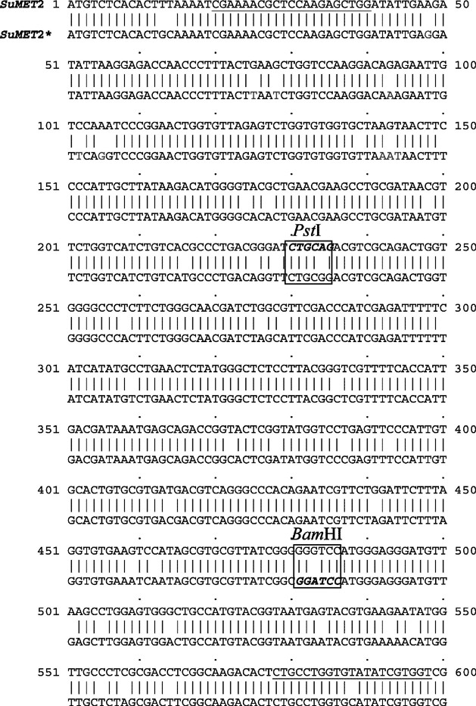
3 Sequence changes in the SuMET2 alleles. Partial alignment of the SuMET2 ORF from S. uvarum (SuMET2) and S. ...
Notes:
3 Sequence changes in the SuMET2 alleles. Partial alignment of the SuMET2 ORF from S. uvarum (SuMET2) and S. pastorianus (SuMET2*), showing nucleotide substitutions, the loss of one PstI site and the gain of one BamHI site (boxes) in SuMET2* from S. pastorianus. Underlined are the sequences of the primers used to amplify the MET2 partial gene for identification of Saccharomyces species.
Unless provided in the caption above, the following copyright applies to the content of this slide: © 2004 Federation of European Microbiological Societies. Published by Elsevier B.V. All rights reserved.

Slide 4
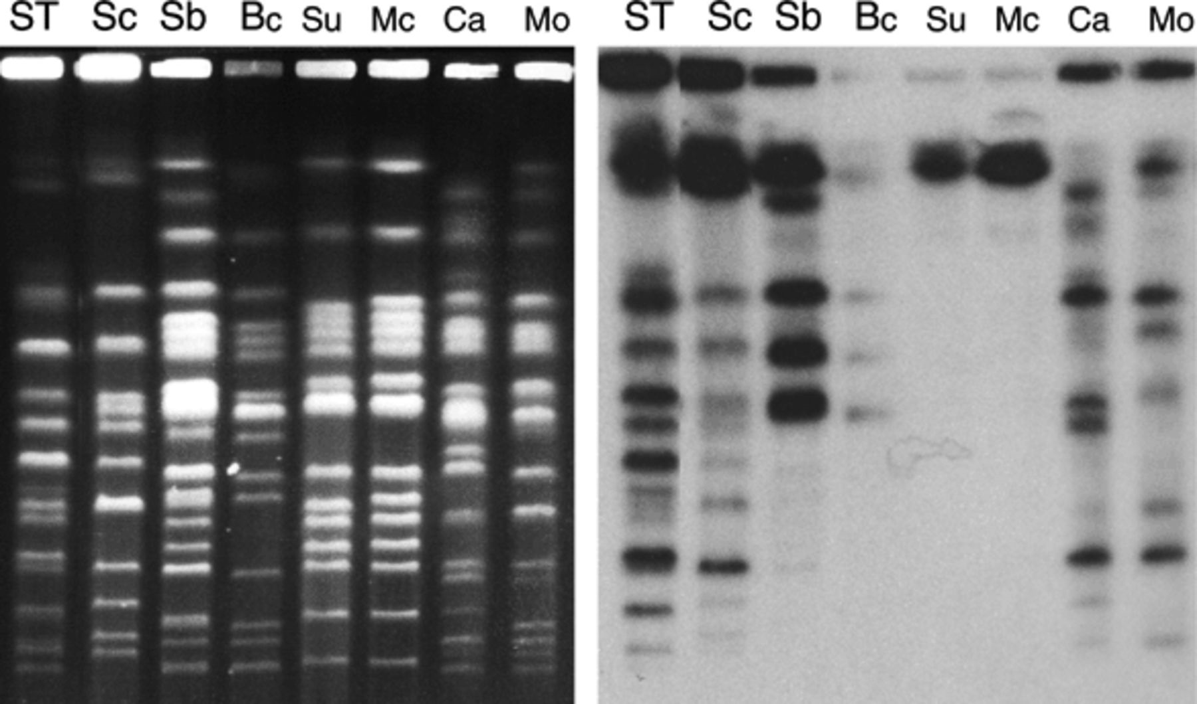
4 Probing of S. cerevisiae SUC4 gene to the chromosomes of Saccharomyces strains. Left panel: Karyotypes ...
Notes:
4 Probing of S. cerevisiae SUC4 gene to the chromosomes of Saccharomyces strains. Left panel: Karyotypes stained with ethidium bromide. Right panel: S. cerevisiae SUC4 probing. Strains: ST: S. cerevisiae CBS 1171T; Sc: S. cerevisiae S288c; Sb: S. bayanus CBS 380T; Bc: B19-3C derivative of CBS 380T; Su: S. uvarum CBS 395T; Mc: S. uvarum CLIB 533 (623-6c); Ca: S. carlsbergensis CBS 1513; Mo: S. monacensis CBS 1503.
Unless provided in the caption above, the following copyright applies to the content of this slide: © 2004 Federation of European Microbiological Societies. Published by Elsevier B.V. All rights reserved.

Slide 5
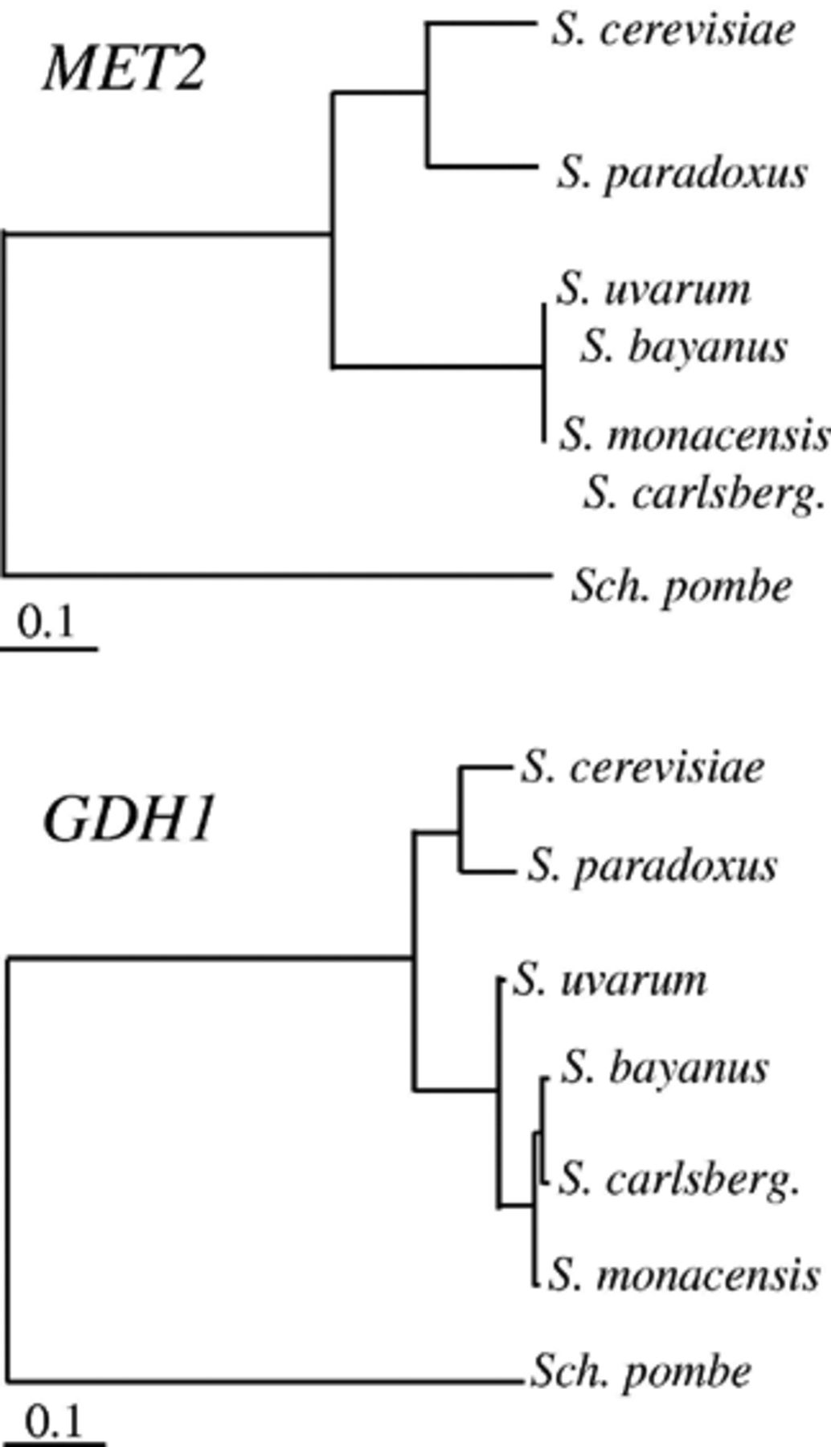
5 Phylogenetic trees established by multiple alignment of GDH1 (top) and MET2 (bottom) CDS determined in this ...
Notes:
5 Phylogenetic trees established by multiple alignment of GDH1 (top) and MET2 (bottom) CDS determined in this study or from databases. The MET2 and GDH1 homologues of Sch. pombe are extracted from deposited sequences (AL023288 and AL033127).
Unless provided in the caption above, the following copyright applies to the content of this slide: © 2004 Federation of European Microbiological Societies. Published by Elsevier B.V. All rights reserved.

Slide 6
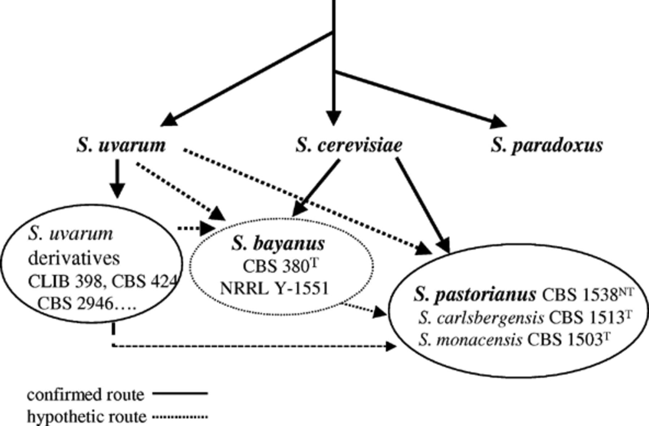
6 Possible routes of evolution from S. uvarum to S. bayanus and S. pastorianus as suggested by sequence ...
Notes:
6 Possible routes of evolution from S. uvarum to S. bayanus and S. pastorianus as suggested by sequence analysis.
Unless provided in the caption above, the following copyright applies to the content of this slide: © 2004 Federation of European Microbiological Societies. Published by Elsevier B.V. All rights reserved.

