Slide 1
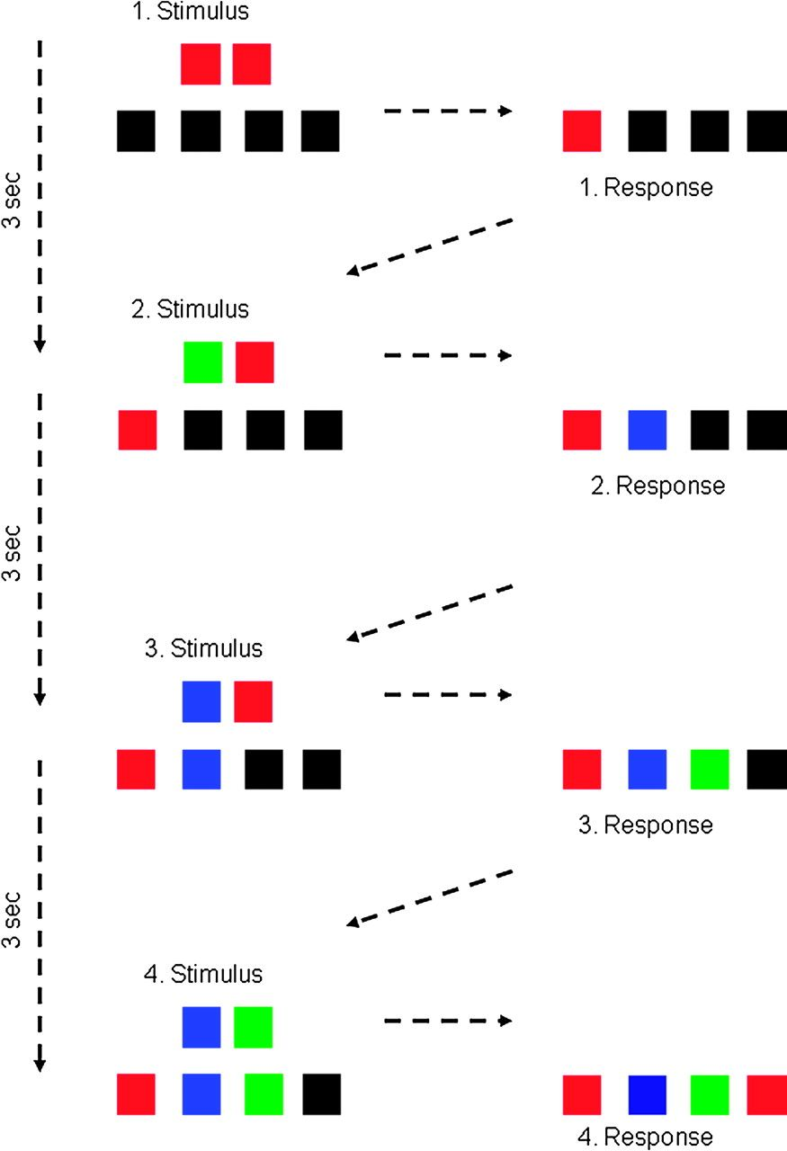
Figure 1. Task example: example of a trial sequence as presented in the experiment. Participants had to process a pair ...
Notes:
Figure 1. Task example: example of a trial sequence as presented in the experiment. Participants had to process a pair of colored squares presented above the 4 response squares by applying 2 rules. Unbeknownst to the participant, the fourth (i.e., last) response in each trial was always identical to the first response regardless of the stimulus sequence (determined by the hidden rule), whereas the second and third responses could not be predicted (undetermined).
Unless provided in the caption above, the following copyright applies to the content of this slide: © The Author 2010. Published by Oxford University Press. All rights reserved. For permissions, please e-mail: journals.permissions@oxfordjournals.org

Slide 2
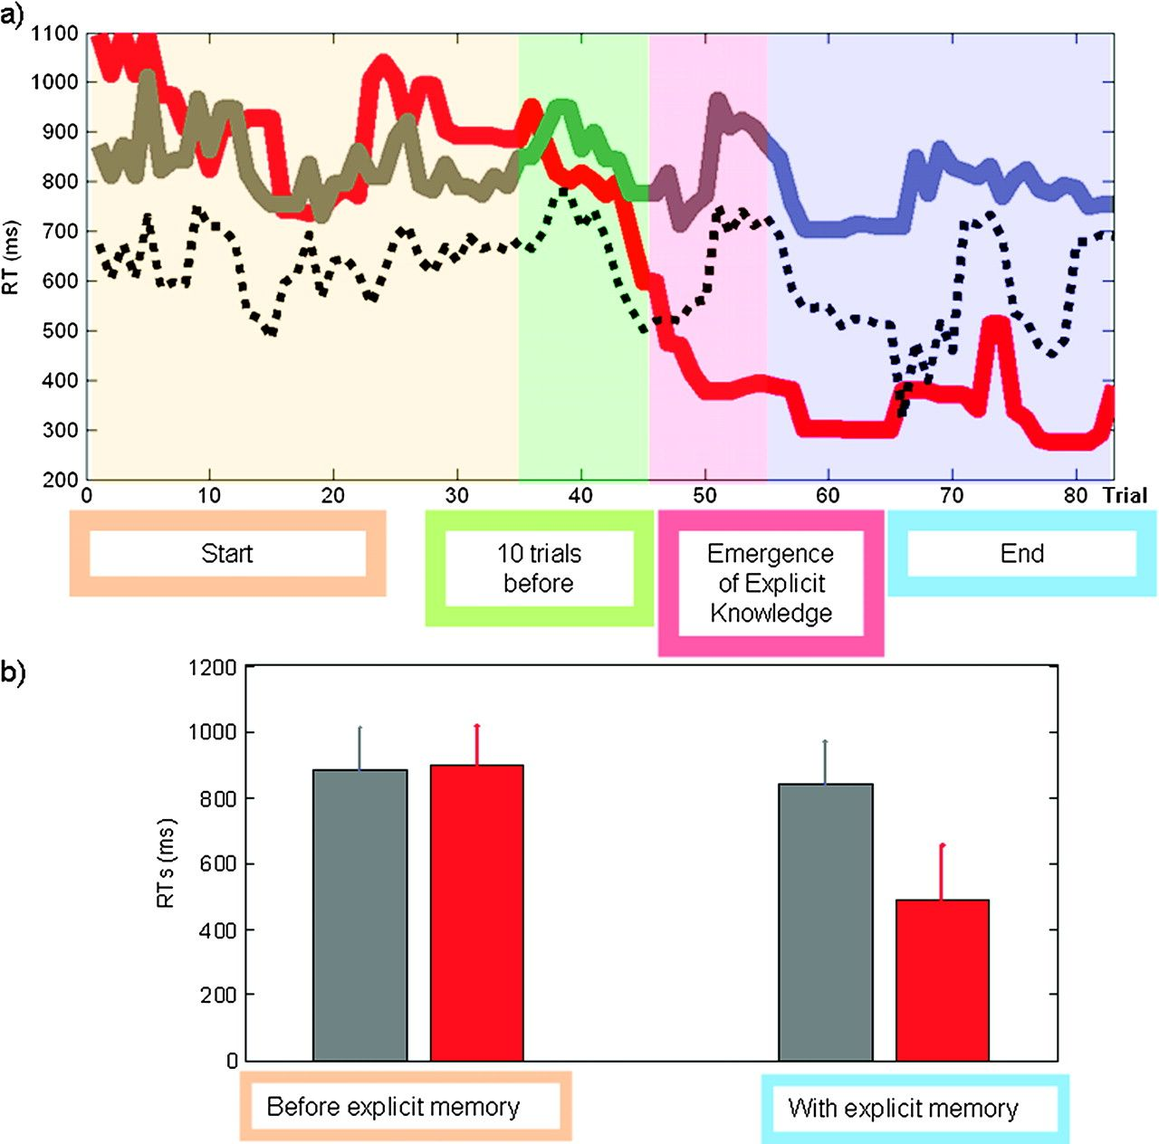
Figure 2. Behavioral results: (a) RT data from the fMRI experiment for a representative subject. RTs for the determined ...
Notes:
Figure 2. Behavioral results: (a) RT data from the fMRI experiment for a representative subject. RTs for the determined last input are shown in red, RTs for undetermined inputs in gray. The RT decrease (TRT) for the determined last input (red) as compared with the undetermined responses (gray) can clearly be seen (around trial 48). The time point of a significant difference between the RTs was statistically verified using the confidence intervals of the undetermined RTs (dotted lines) and was determined for each participant individually. (b) Group-averaged RTs for the determined (red) and undetermined (gray) inputs before (left) and after (right) the occurrence of the RT decrease for the determined inputs (error bars represent the standard error). The reliable difference between the input categories showed that the RTs to the determined input are faster for the whole time series following the TRT.
Unless provided in the caption above, the following copyright applies to the content of this slide: © The Author 2010. Published by Oxford University Press. All rights reserved. For permissions, please e-mail: journals.permissions@oxfordjournals.org

Slide 3
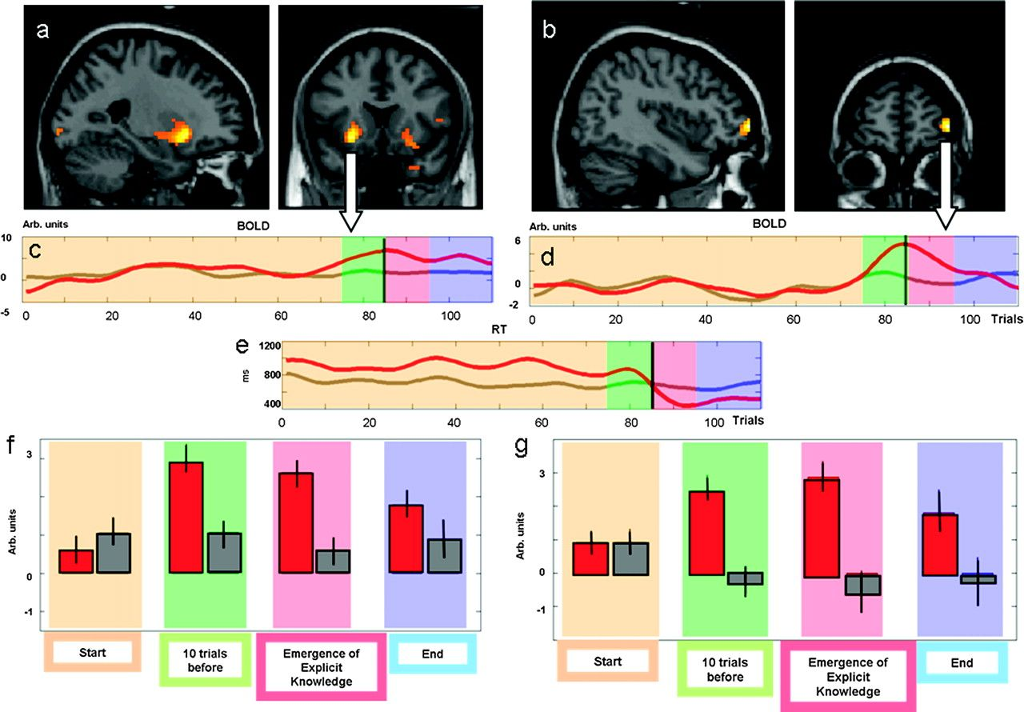
Figure 3. Signal changes preceding the emergence of explicit memory. In the VS (a, left, maximum x, y, z −12, 9, −3 mm) ...
Notes:
Figure 3. Signal changes preceding the emergence of explicit memory. In the VS (a, left, maximum x, y, z −12, 9, −3 mm) and the right VLPFC (b, right, maximum x, y, z 51, 45, −6 mm) the fMRI signal increased even before the TRT. In the middle row (c–e) data from a representative single subject are shown. The bottom row (f,g) shows the result for the whole group. For the individual data, the RTs (e) and the BOLD signal changes across single trials (c–d) for the undetermined second input (gray) and to the determined input (red) are plotted (filtered using a median function (lag 1, width 5)). The line at trial 85 represents the time point of the significant RT decrease (TRT). Importantly, the BOLD signal shows a significant increase 10 trials antecedent. The group data (f,g) show the mean BOLD signal averaged within the different time periods referenced to the TRT. It can be seen that the signal increase is limited to the determined inputs (red bars) as compared with the undetermined inputs (gray bars) and already started in the trials preceding the TRT (error bars represent the standard error).
Unless provided in the caption above, the following copyright applies to the content of this slide: © The Author 2010. Published by Oxford University Press. All rights reserved. For permissions, please e-mail: journals.permissions@oxfordjournals.org

Slide 4
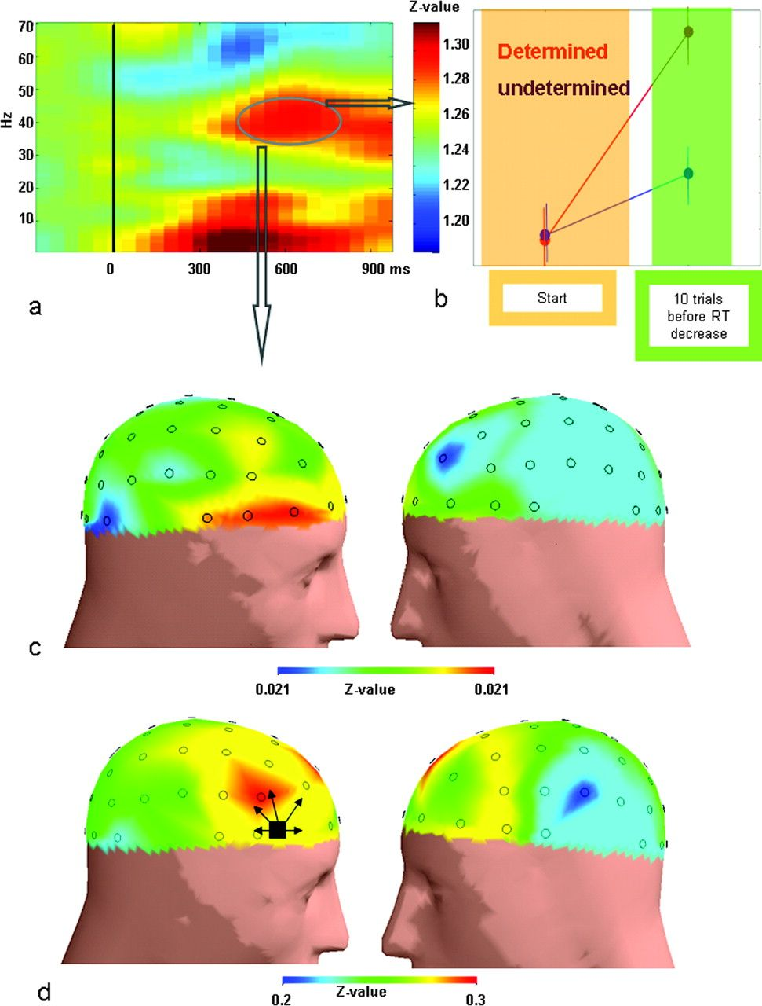
Figure 4. EEG coherence in the gamma and LF band increased between all electrodes 300 ms after the onset of the ...
Notes:
Figure 4. EEG coherence in the gamma and LF band increased between all electrodes 300 ms after the onset of the determined input during the 10 trials before the TRT. (a) Time–frequency plot of the difference of the Z-transformed and normalized coherence values for a period starting 10 trials preceding the TRT and the earlier trials for the determined input. The vertical line represents the time point of appearance of the stimulus pair for the last input of one trial. (b) Gamma-band coherence is shown separately for the determined and undetermined inputs for both time intervals (error bars represent the standard error). (c) The topographic distribution of the gamma-band coherence difference shown at the top illustrates the maximal difference over the rPFC. The topographic distribution represents the mean gamma-band coherence difference at each electrode to all other electrodes. (d) The gamma-band difference for the coherence from the rPFC (black square indicates electrode AF8) to all other electrodes is shown at the bottom, indicating an increase of gamma-band coherence between the rPFC and many other areas with maximal changes over frontal areas.
Unless provided in the caption above, the following copyright applies to the content of this slide: © The Author 2010. Published by Oxford University Press. All rights reserved. For permissions, please e-mail: journals.permissions@oxfordjournals.org

