Slide 1
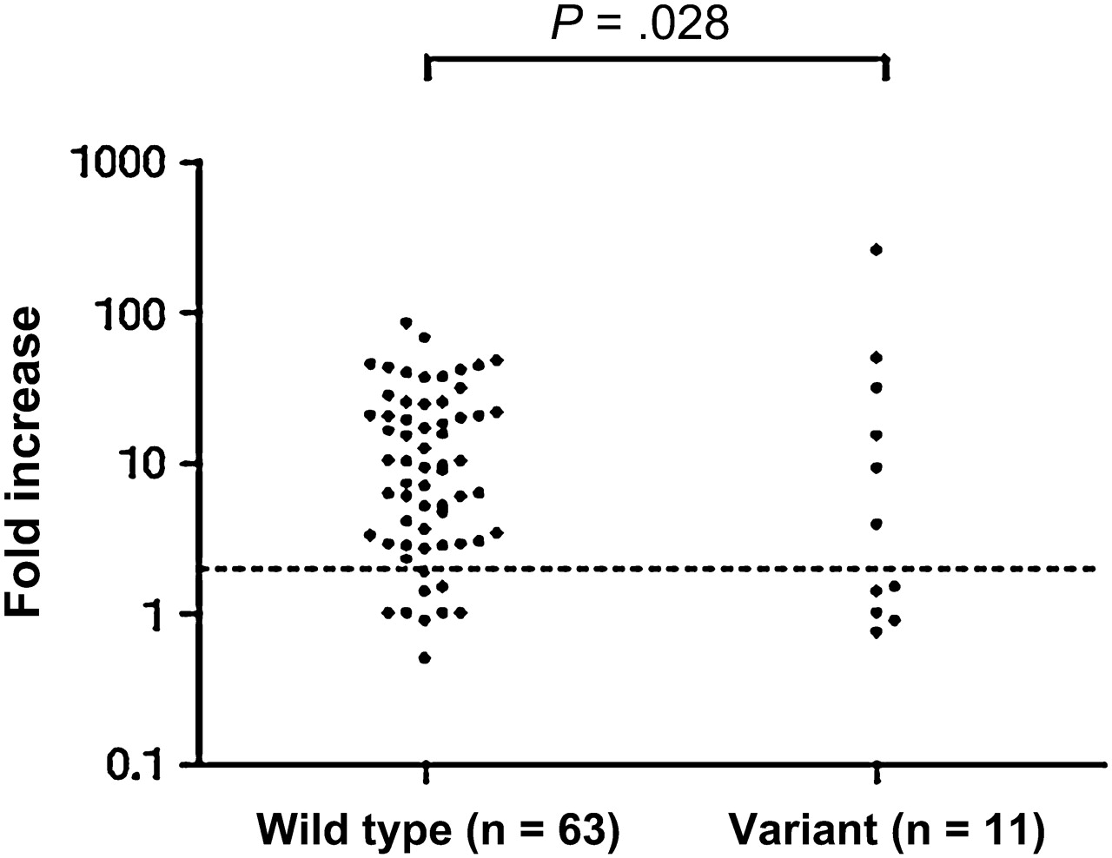
Figure 1. Fold increases in antibodies to pertussis toxin after booster vaccination between subjects with wild-type ...
Notes:
Figure 1. Fold increases in antibodies to pertussis toxin after booster vaccination between subjects with wild-type Toll-like receptor 4 (TLR4) and subjects with variant TLR4 types. A positive antibody response was defined as seroconversion, for initially seronegative subjects (<5 IU/mL), or as a ≥2-fold increase in antibody responses, for initially seropositive subjects. Of the 63 subjects with wild-type TLR4, 54 (86%) had a positive response, whereas of the 11 subjects with variant TLR4 types, only 6 (55%) had a positive response (P = .028). Broken line indicates cutoff for positive antibody response.
Unless provided in the caption above, the following copyright applies to the content of this slide: © The Author 2012. Published by Oxford University Press on behalf of the Infectious Diseases Society of America. All rights reserved. For Permissions, please e-mail: journals.permissions@oup.com

