Slide 1
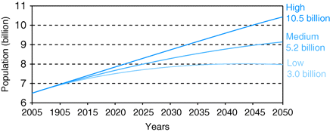
Fig. 1 UN 2008 World Population Projections (future population growth is highly dependent on the path that future ...
Notes:
Fig. 1 UN 2008 World Population Projections (future population growth is highly dependent on the path that future fertility takes. In the medium variant, fertility declines from 2.56 children per woman in 2005–2010 to 2.02 children per woman in 2045–2050. If fertility were to remain about half a child above the levels projected in the medium variant, world population would reach 10.5 billion by 2050. A fertility path half a child below the medium would lead to a population of 8 billion by mid-century. Consequently, population growth until 2050 is inevitable even if the decline of fertility accelerates. UN Population Division, ibid.).
Unless provided in the caption above, the following copyright applies to the content of this slide: © The Author 2010, Published by Oxford University Press on behalf of Faculty of Public Health. All rights reserved

Slide 2
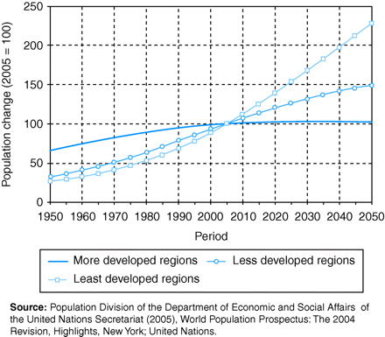
Fig. 2 Population growth by development regions (1950–2050).
Notes:
Fig. 2 Population growth by development regions (1950–2050).
Unless provided in the caption above, the following copyright applies to the content of this slide: © The Author 2010, Published by Oxford University Press on behalf of Faculty of Public Health. All rights reserved

Slide 3
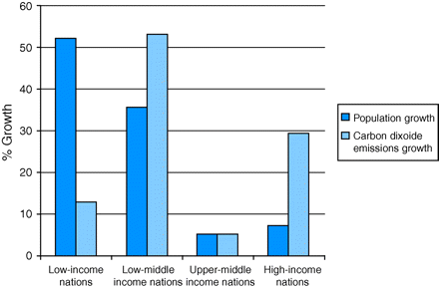
Fig. 3 Contribution to the growth in world population and CO₂ emissions by groups of nations classified ...
Notes:
Fig. 3 Contribution to the growth in world population and CO2 emissions by groups of nations classified according to their average per capita income levels, 1980–2005. Source: Satterthwaite, 2009.14
Unless provided in the caption above, the following copyright applies to the content of this slide: © The Author 2010, Published by Oxford University Press on behalf of Faculty of Public Health. All rights reserved

Slide 4
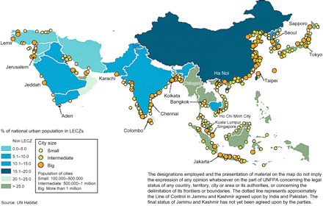
Fig. 4 Map of cities at low-elevation coastal zones (LECZ).
Notes:
Fig. 4 Map of cities at low-elevation coastal zones (LECZ).
Unless provided in the caption above, the following copyright applies to the content of this slide: © The Author 2010, Published by Oxford University Press on behalf of Faculty of Public Health. All rights reserved

