Slide 1
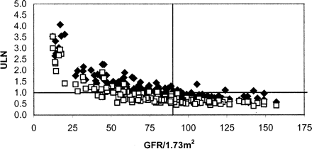
Fig. 1. Relationships of cys C (diamonds) and creatinine (squares) to GFR for all 146 plasma samples investigated. ...
Notes:
Fig. 1. Relationships of cys C (diamonds) and creatinine (squares) to GFR for all 146 plasma samples investigated. Cys C and creatinine are both given as a ratio relative to their respective upper limits of the reference range (ULN). For males and females, their gender-specific creatinine ULN was used. The lower reference limit for GFR of 90 ml/min/1.73 m2 is also indicated in the figure.
Unless provided in the caption above, the following copyright applies to the content of this slide: Nephrol Dial Transplant 18(10) © ERA–EDTA 2003; all rights reserved

Slide 2
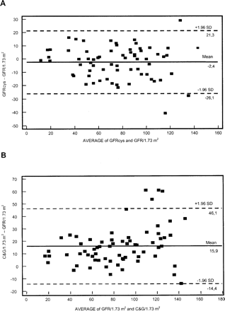
Fig. 2. Bland and Altman plot for differences between estimated GFR and measured GFR. On the x-axis, the average GFR ...
Notes:
Fig. 2. Bland and Altman plot for differences between estimated GFR and measured GFR. On the x-axis, the average GFR is given and on the y-axis the difference in ml/min between the estimated GFR, derived from the cys C formula (A) or the C&G formula (B) is given. The mean difference (solid lines) and the 1.96 SD limits (dotted lines) are also plotted.
Unless provided in the caption above, the following copyright applies to the content of this slide: Nephrol Dial Transplant 18(10) © ERA–EDTA 2003; all rights reserved

