Slide 1
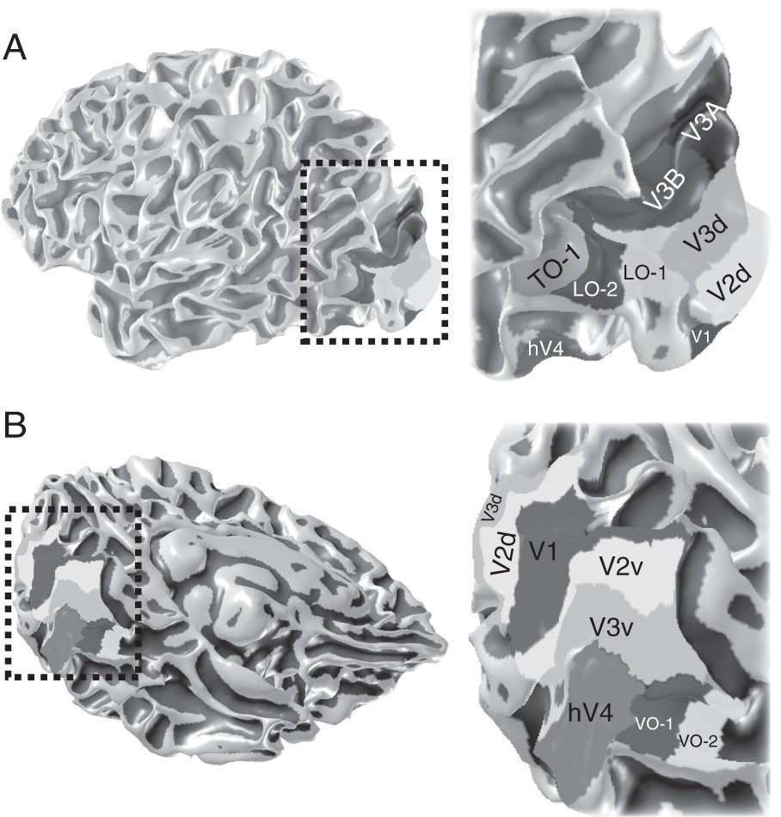
Figure 1. The human dorsal and ventral visual field maps. (A) Lateral view of dorsal visual field maps. (B) Medial view ...
Notes:
Figure 1. The human dorsal and ventral visual field maps. (A) Lateral view of dorsal visual field maps. (B) Medial view of ventral visual field maps. Rectangular outlines in the left panels indicate the region magnified in right panel. LO, lateral occipital; TO, temporal occipital; VO, ventral occipital (Brewer et al. 2005; Larsson and Heeger 2006; Amano et al. 2009).
Unless provided in the caption above, the following copyright applies to the content of this slide: © The Author 2015. Published by Oxford University Press. All rights reserved. For Permissions, please e-mail: journals.permissions@oup.com

Slide 2
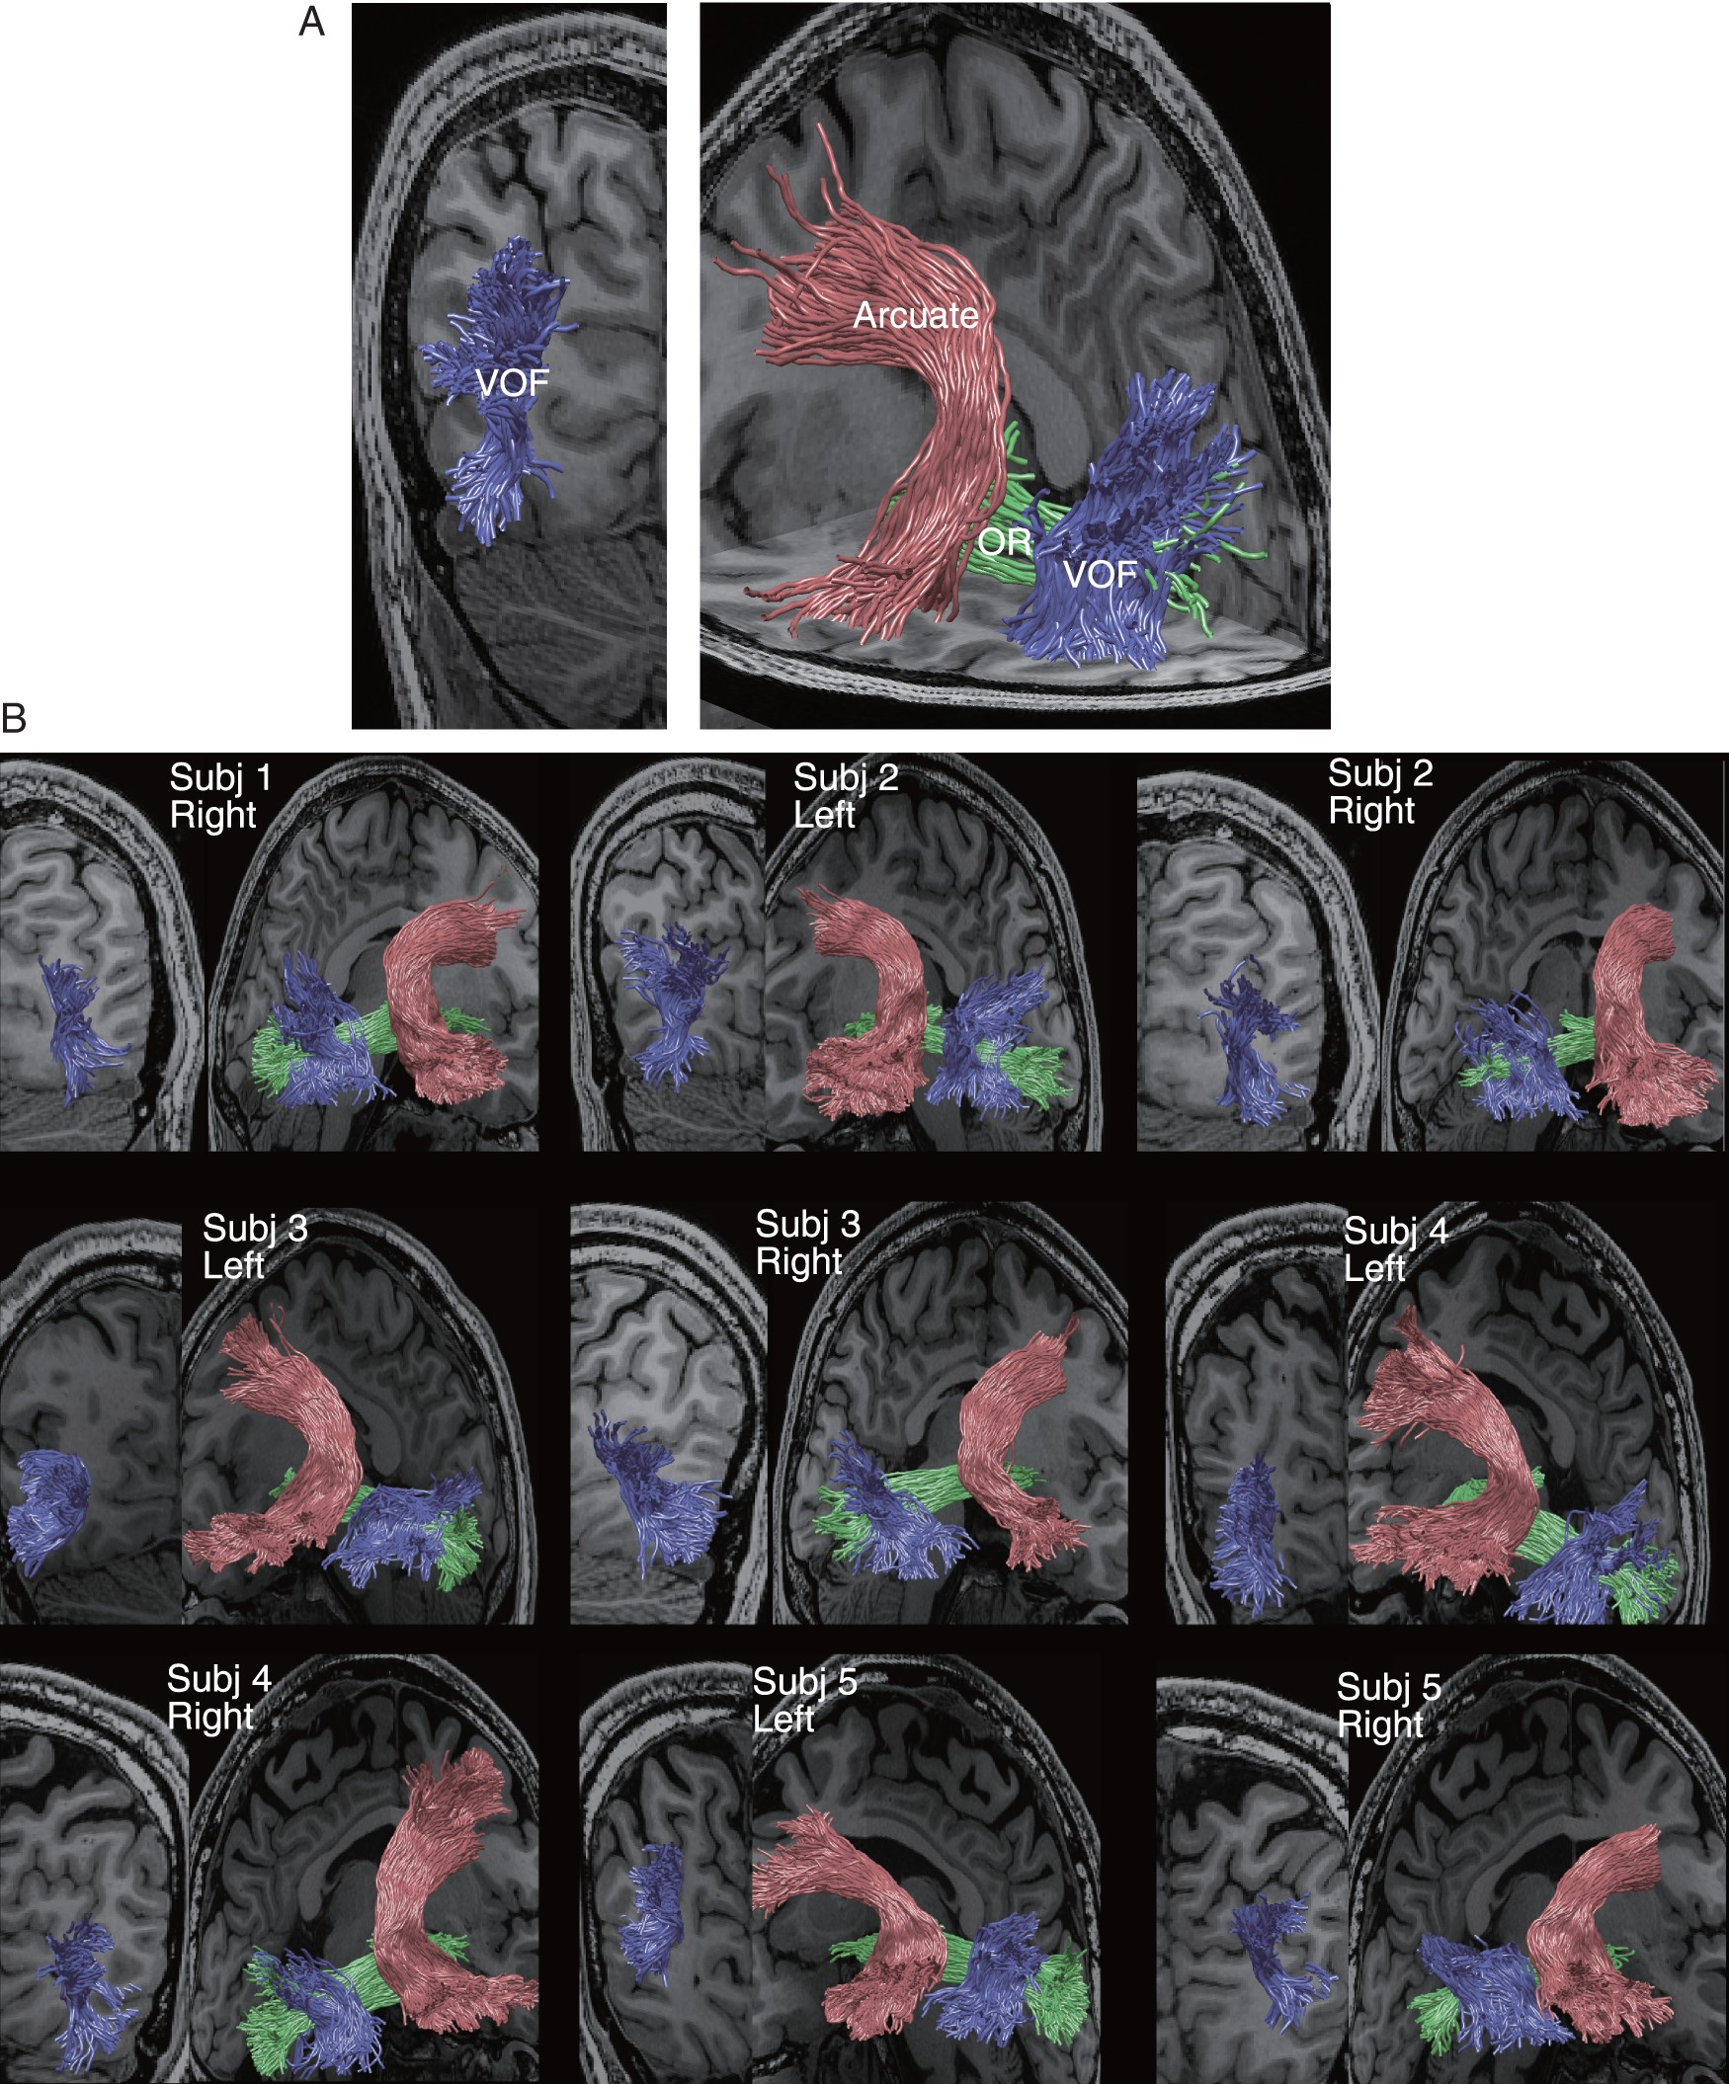
Figure 2. Identification of the human VOF. (A) Left, coronal view of the VOF in 1 living brain (blue, Subject 1, left ...
Notes:
Figure 2. Identification of the human VOF. (A) Left, coronal view of the VOF in 1 living brain (blue, Subject 1, left hemisphere). Right, VOF trajectory within the occipital lobe in relation to the arcuate fasciculus (red, more anterior) and the optic radiation (OR, green, medial). (B) The VOF identified from other 9 hemispheres.
Unless provided in the caption above, the following copyright applies to the content of this slide: © The Author 2015. Published by Oxford University Press. All rights reserved. For Permissions, please e-mail: journals.permissions@oup.com

Slide 3
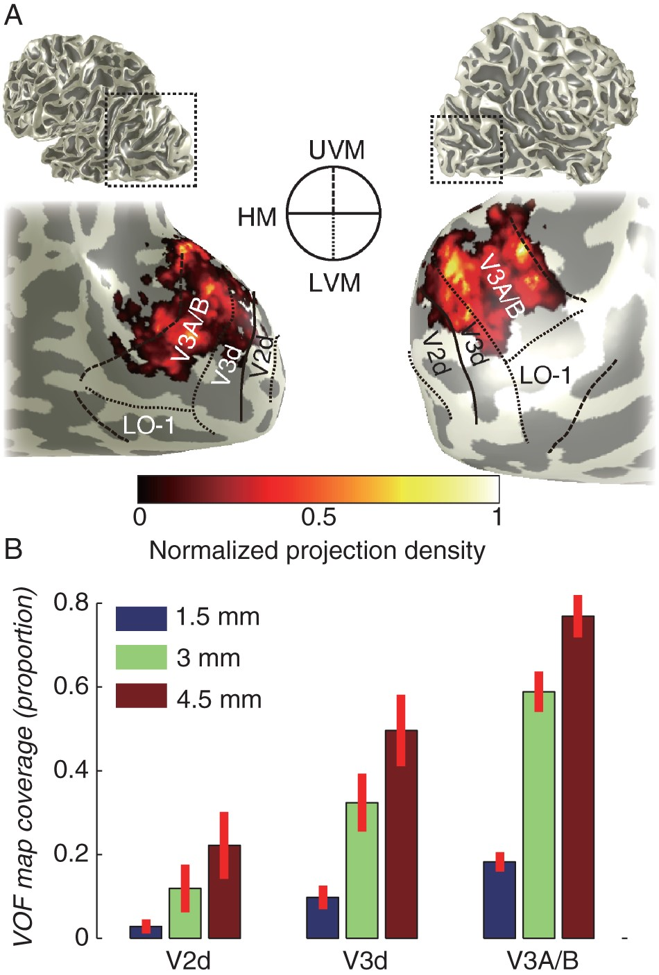
Figure 3. VOF cortical projections in the dorsal visual field maps. (A) Projection pattern of VOF plotted on the ...
Notes:
Figure 3. VOF cortical projections in the dorsal visual field maps. (A) Projection pattern of VOF plotted on the cortical surface (Left panel; Subject 1, left hemisphere; Right panel; Subject 4, right hemisphere). The small image on the top indicates the region shown in magnified and smoothed form on the bottom. Color map depicts a normalized VOF projection density. Visual field map boundaries were identified using the pRF method and are reported as line segments corresponding to polar angle reversals (circular inset; UVF, upper vertical meridian; HM, horizontal meridian; LVM, lower vertical meridian; see caption at the center). (B) VOF map coverage averaged across 10 hemispheres. Vertical axis represents the proportion of voxels in maps within 1.5 mm (blue), 3 mm (green), and 4.5 mm (red) from dorsal VOF terminations. Error bar depicts ±1 SEM across hemispheres. See Supplementary Figure 7, 8, 10–12 for additional analyses.
Unless provided in the caption above, the following copyright applies to the content of this slide: © The Author 2015. Published by Oxford University Press. All rights reserved. For Permissions, please e-mail: journals.permissions@oup.com

Slide 4
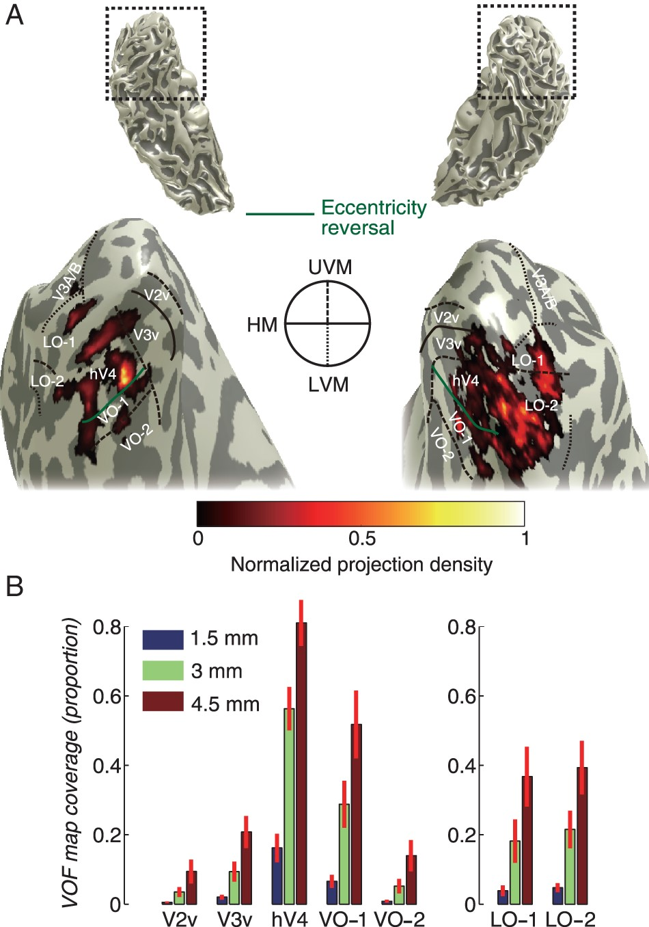
Figure 4. VOF cortical projections in the ventral visual field maps. (A) Ventral VOF projection covers hV4, VO-1, ...
Notes:
Figure 4. VOF cortical projections in the ventral visual field maps. (A) Ventral VOF projection covers hV4, VO-1, LO-map, and the regions between hV4 and LO-map (Left panel; Subject 1, left hemisphere; Right panel; Subject 4, right hemisphere). Figure captions are identical to those in Figure 3 except the green line depicting the eccentricity reversals between hV4 and VO-1 (Brewer et al. 2005; Witthoft et al. 2014). (B) VOF map coverage in each visual field map averaged across 10 hemispheres. Vertical axis represents the proportion of voxels in maps within 1.5 mm (blue), 3 mm (green), and 4.5 mm (red) from dorsal VOF terminations. Left panel, projection in ventral visual field maps. Right panel, projections in LO maps. Error bar depicts ±1 SEM across hemispheres. See Supplementary Figures 13–15 for additional analyses.
Unless provided in the caption above, the following copyright applies to the content of this slide: © The Author 2015. Published by Oxford University Press. All rights reserved. For Permissions, please e-mail: journals.permissions@oup.com

Slide 5
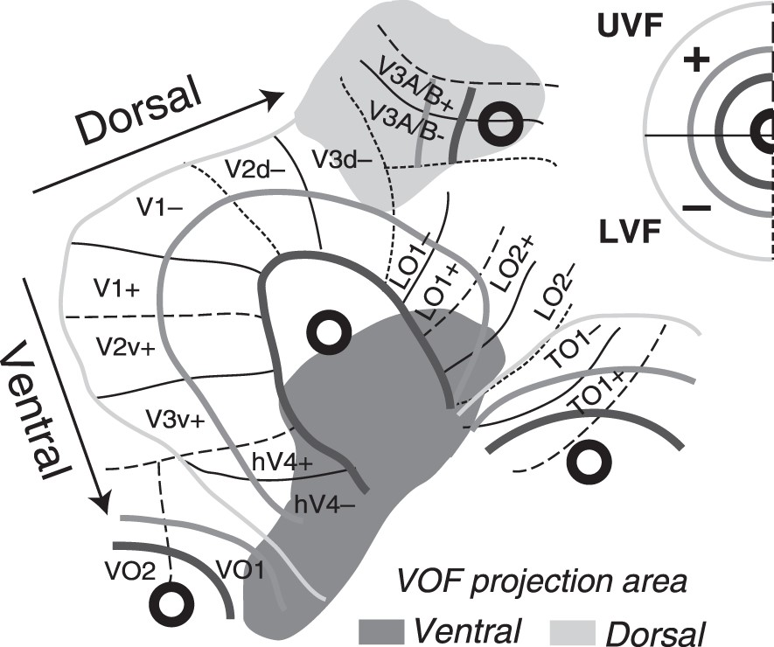
Figure 5. The VOF communication diagram. Schematic diagram of the VOF projections. Visual field topography was ...
Notes:
Figure 5. The VOF communication diagram. Schematic diagram of the VOF projections. Visual field topography was described in a flattened format for the right hemisphere (Larsson and Heeger 2006). Gray regions depict the projection zone of VOF (light gray, dorsal; dark gray, ventral).
Unless provided in the caption above, the following copyright applies to the content of this slide: © The Author 2015. Published by Oxford University Press. All rights reserved. For Permissions, please e-mail: journals.permissions@oup.com

