Slide 1
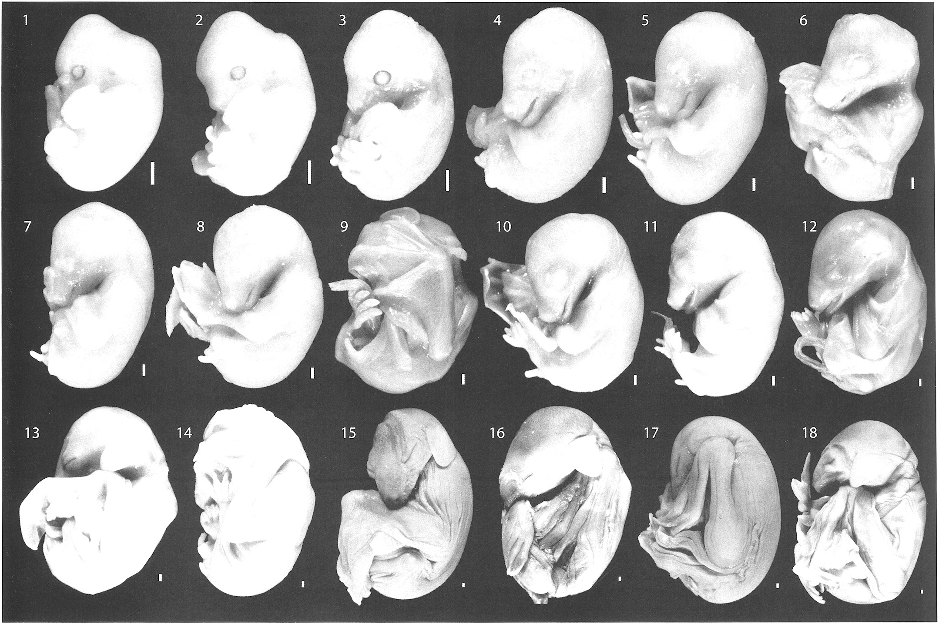
Fig. 1 Overview of embryos and fetuses of Rousettus amplexicaudatus used in this study. Number indicates the order ...
Notes:
Fig. 1 Overview of embryos and fetuses of Rousettus amplexicaudatus used in this study. Number indicates the order assigned to each specimen in the growth series, based on crown-rump length (CRL; see Table 1). Specimens are represented at an approximately uniform CRL. Scale bars (on lower right of each specimen): 1 mm.
Unless provided in the caption above, the following copyright applies to the content of this slide: © 2006 American Society of Mammalogists

Slide 2
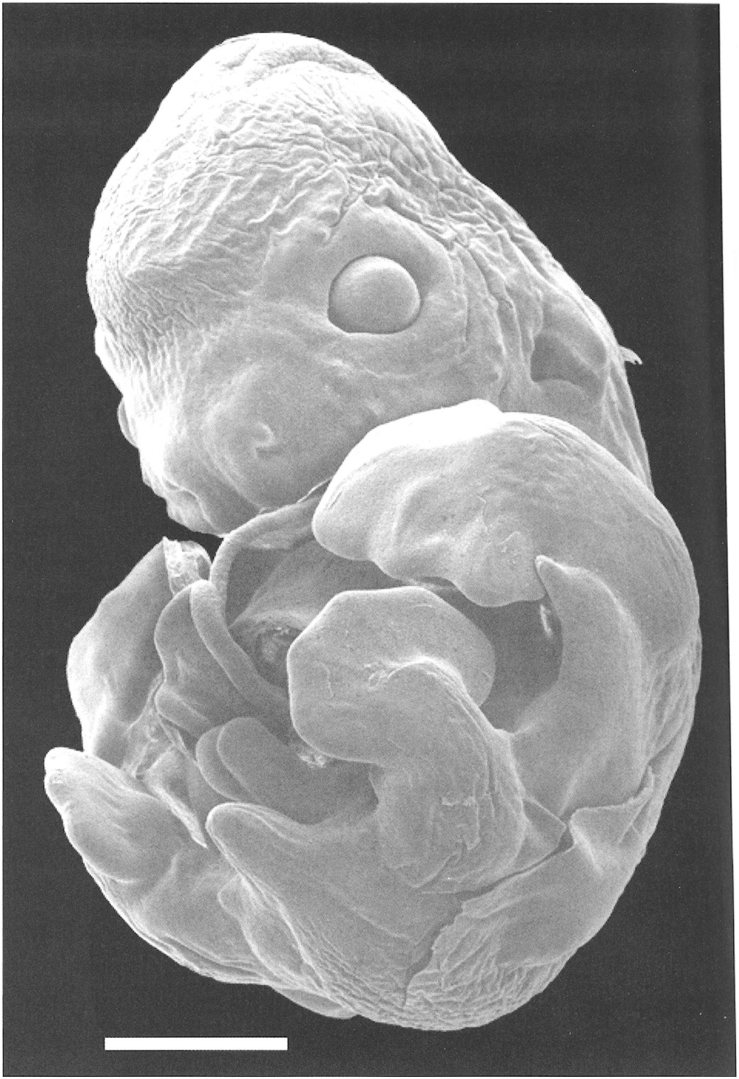
Fig. 2 Rousettus amplexicaudatus, scanning electron microscope image, caudolateral view of one of the smallest ...
Notes:
Fig. 2 Rousettus amplexicaudatus, scanning electron microscope image, caudolateral view of one of the smallest embryos (specimen 2, 8.5 mm in crown-rump length) in stage 16L of the growth series examined. Scale bar: 1 mm.
Unless provided in the caption above, the following copyright applies to the content of this slide: © 2006 American Society of Mammalogists

Slide 3
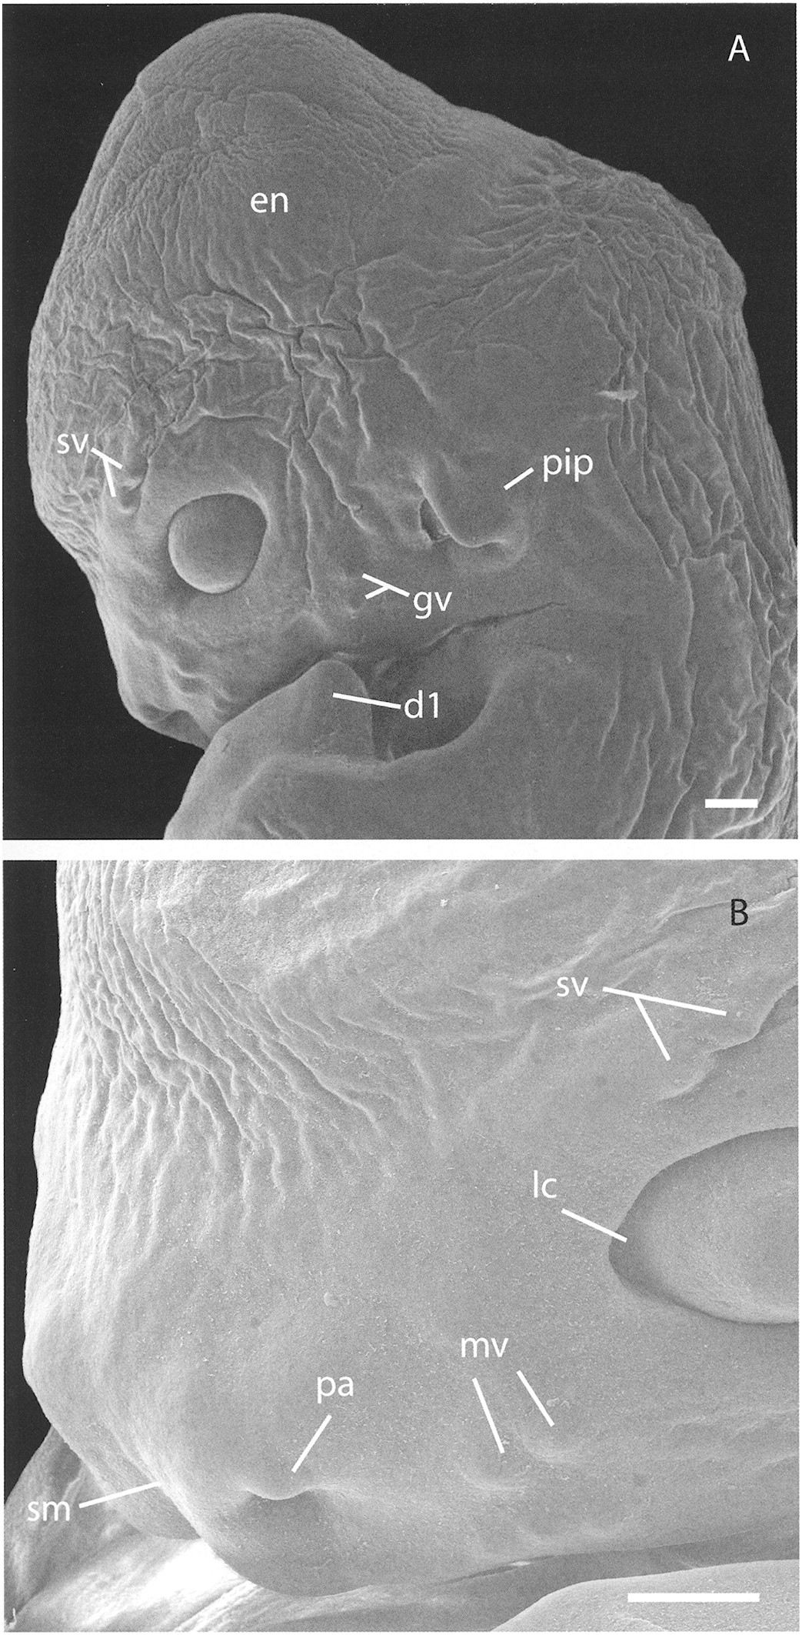
Fig. 3 Rousettus amplexicaudatus, scanning electron microscope image (specimen 1) of A) lateral view of head, and B) ...
Notes:
Fig. 3 Rousettus amplexicaudatus, scanning electron microscope image (specimen 1) of A) lateral view of head, and B) close-up (rostrolateral view) of rostrum. Abbreviations: en, encephalic region; dl, 1st digit; gv, bumps for genal vibrissae; le, lacrimal commissure; mv, bumps for mystacial vibrissae; pa, rhinarium, plica alaris; pip, pinna primordium; sm, rhinarium, sulcus medianus; sv, bumps for supercilliary vibrissae. Scale bars: 0.25 mm.
Unless provided in the caption above, the following copyright applies to the content of this slide: © 2006 American Society of Mammalogists

Slide 4
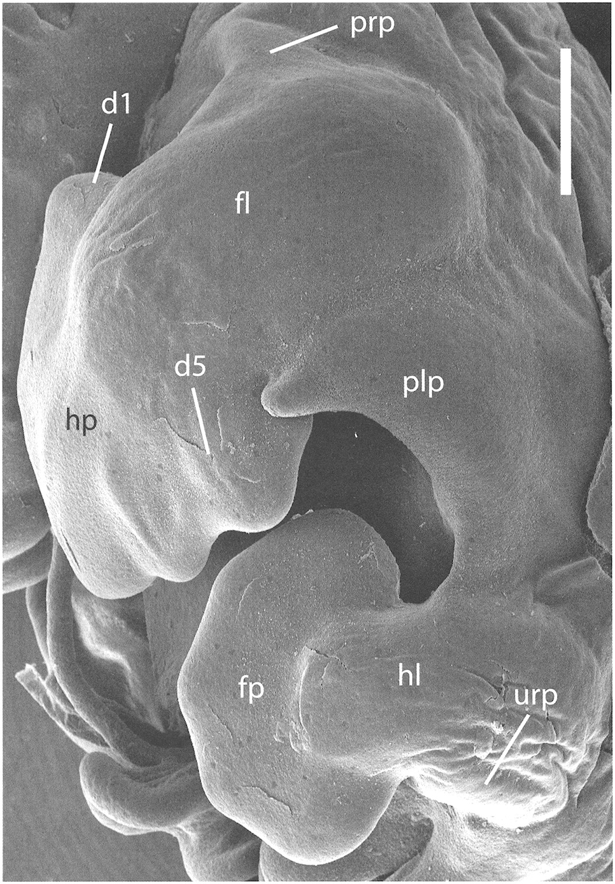
Fig. 4 Rousettus amplexicaudatus, scanning electron microscope image, lateral view of specimen 1 showing autopod ...
Notes:
Fig. 4 Rousettus amplexicaudatus, scanning electron microscope image, lateral view of specimen 1 showing autopod plates and patagial primordia. Note degree of digital condensation (finger rays), anteroposterior patterning, and absolute size of handplate as compared to footplate. Abbreviations: dl, 1st digit; d5, 5th digit; fl, forelimb; fp, footplate; hi, hind limb; hp, handplate; pip, plagiopatagium primordium; prp, propatagium primordium; urp, uropatagium primordium. Scale bar: 0.5 mm.
Unless provided in the caption above, the following copyright applies to the content of this slide: © 2006 American Society of Mammalogists

Slide 5
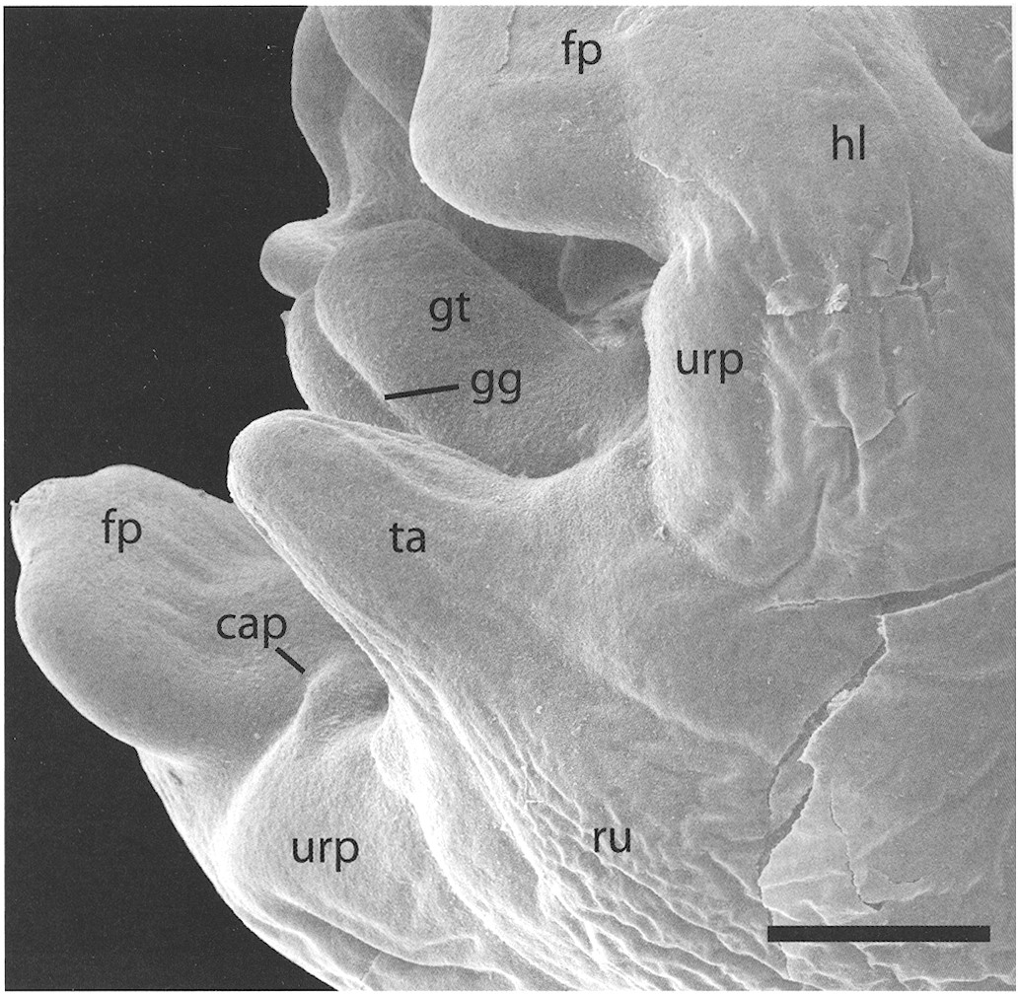
Fig. 5 Rousettus amplexicaudatus, scanning electron microscope image, caudolateral view of specimen 1 showing rump, ...
Notes:
Fig. 5 Rousettus amplexicaudatus, scanning electron microscope image, caudolateral view of specimen 1 showing rump, hind limbs, tail, and genital tubercle. Abbreviations: cap, calcar primordium; fp, foot plate; gg, genital groove; gt, genital tubercle; hl, hind limb; ru, rump; ta, tail; urp, uropatagium primordium. Scale bar: 0.5 mm.
Unless provided in the caption above, the following copyright applies to the content of this slide: © 2006 American Society of Mammalogists

