Slide 1
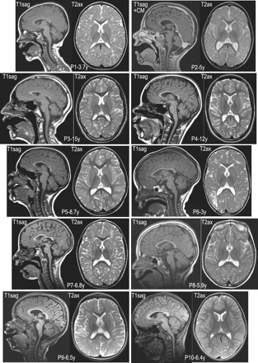
Figure 1 Brain imaging of patients with genetically confirmed cerebral folate transport deficiency. Shown are sagittal ...
Notes:
Figure 1 Brain imaging of patients with genetically confirmed cerebral folate transport deficiency. Shown are sagittal T1-weighted magnetic resonance scans (T1sag) as well as axial T2-weighted magnetic resonance images (T2ax) for all 10 patients that are described and numbered in Table 1. Note that in case of Patient 2 a sagittal T1-weighted MRI with contrast medium (T1sag+CM) is depicted. Patient number and age is indicated in the lower middle area of the pictures.
Unless provided in the caption above, the following copyright applies to the content of this slide: © The Author (2012). Published by Oxford University Press on behalf of the Guarantors of Brain. All rights reserved. For Permissions, please email: journals.permissions@oup.com

Slide 2
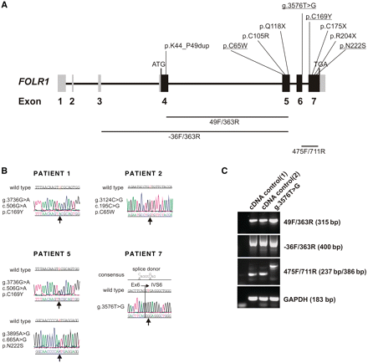
Figure 2 Mutations in the FOLR1 gene. (A) Genetic organization of the FOLR1 gene encoding the FRα. Exons are indicated ...
Notes:
Figure 2 Mutations in the FOLR1 gene. (A) Genetic organization of the FOLR1 gene encoding the FRα. Exons are indicated by boxes with the coding sequences in black. The four novel pathogenic mutations, one splice mutation and three missense mutations, are underlined. The other mutations have been described previously. (B) Sequence chromatograms of the four novel mutations g.3736G>A (p.C169Y), g.3124C>G (p.C65W), g.3895A>G (N222S) and g.3576T>G (splice mutation). The homozygous mutation g.3736G>A (p.C169Y) shown for Patient 1 was also found in Patients 3, 4 and 6. (C) Analysis of complementary DNA (cDNA) of the patient with the splice site mutation g.3576T>G. Amplification with the primer pairs 49F/363R and −36F/363R comprising exon 4 and 5 or exon 3 and 5, respectively, resulted in very similar fragment size and intensity when compared between patient and controls. The size of these fragments corresponds to the amplification product of the FRα complementary DNA. Amplification with the primer pair 475F and 711R resulted in larger fragments in the patient when compared with two controls. The increase in length of the major band is consistent with the size of intron 6 (149 bp).
Unless provided in the caption above, the following copyright applies to the content of this slide: © The Author (2012). Published by Oxford University Press on behalf of the Guarantors of Brain. All rights reserved. For Permissions, please email: journals.permissions@oup.com

Slide 3
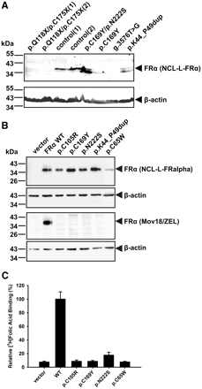
Figure 3 Detection of FRα mutants in patient fibroblasts, heterologous expression and functional characterization of ...
Notes:
Figure 3 Detection of FRα mutants in patient fibroblasts, heterologous expression and functional characterization of wild-type (WT) and mutant FRα in CHO-K1 cells. (A) Immunoblot analysis of endogenous FRα in patient fibroblasts. Protein (80 µg) from fibroblast cell lysates was separated by SDS–PAGE on a 12% acrylamide gel. FRα was detected using the mouse monoclonal anti-human FRα antibody NCL-L-FRalpha. β-Actin served as a loading control. FRα missense mutants (p.C169Y, p.N222S and p.K44_P49dup) revealed species of higher mobility and showed a reduced level of expression of the mature 38 kDa FRα wild-type. FRα stop and splice mutants (p.Q118X, p.C175X and g.3576T>G) gave no detectable expression. (B) Immunoblot analysis from CHO-K1 cells stable transfected with wild-type or mutant FRα. Samples were prepared as described above and 60 µg of protein were separated by SDS–PAGE on a 12% acrylamide gel. Immunodetection was carried out using the FRα antibodies NCL-L-FRalpha and Mov18/ZEL. All depicted FRα missense mutants could be detected by the antibody NCL-L-FRalpha, however the intensity of the mutant p.C65W was only 8% of the FRα wild-type band. In contrast, none of the FRα missense mutants could be detected by the antibody Mov18/ZEL. (C) Folic acid surface binding by CHO-K1 cells stably transfected with wild-type or mutant FRα. Cells were exposed to 5 nmol/l [3H]folic acid for 15 min at pH 7.4. Values are means ± S.D. from three independent experiments, each carried out in duplicate. When compared with vector-transfected CHO-K1, only mutant N222S revealed a slight (2.5-fold) increase in folic acid binding. All other mutants (p.C65W, p.C105R, p.C169Y) failed to increase folic acid binding.
Unless provided in the caption above, the following copyright applies to the content of this slide: © The Author (2012). Published by Oxford University Press on behalf of the Guarantors of Brain. All rights reserved. For Permissions, please email: journals.permissions@oup.com

Slide 4
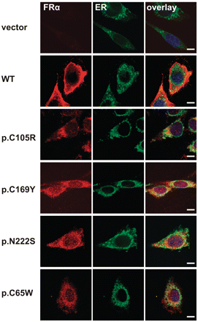
Figure 4 Subcellular localization of wild-type (WT) and mutant FRα in CHO-K1 cells. CHO-K1 cells stable transfected ...
Notes:
Figure 4 Subcellular localization of wild-type (WT) and mutant FRα in CHO-K1 cells. CHO-K1 cells stable transfected with FRα wild-type and the mutants p.C105R, p.C169Y, p.N222S and p.C65W were immunolabelled with mouse monoclonal antibody against human FRα Mov18/ZEL (red) and a rabbit polyclonal antibody against the endoplasmic reticulum (ER) protein disulphide isomerase (green) followed by confocal immunofluorescence microscopy. Nuclei were stained with 4′,6-diamidino-2-phenylindole (DAPI, blue). FRα wild-type localized to the plasma membrane, whereas all three mutants were mistargeted to intracellular compartments that partially co-localized with the endoplasmic reticulum marker protein disulphide isomerase. Scale bars = 10 µm.
Unless provided in the caption above, the following copyright applies to the content of this slide: © The Author (2012). Published by Oxford University Press on behalf of the Guarantors of Brain. All rights reserved. For Permissions, please email: journals.permissions@oup.com

