Slide 1
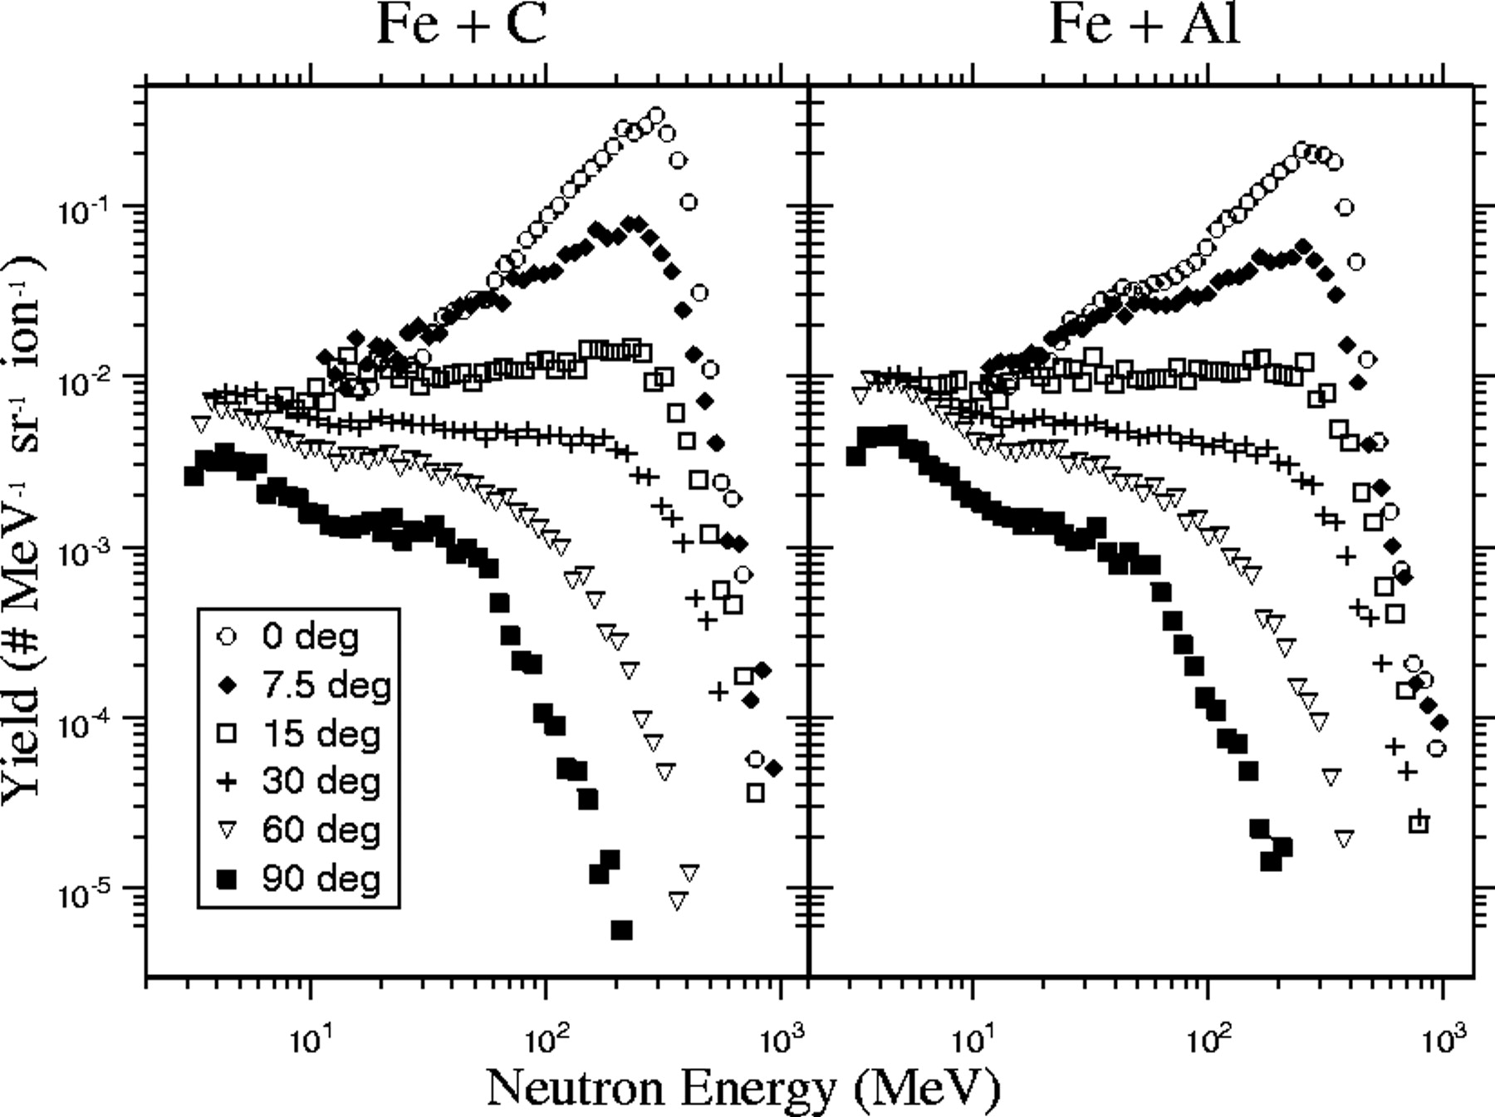
Figure 1. Double differential thick-target yields from 400 MeV per nucleon Fe stopping in a carbon (left plot) and ...
Notes:
Figure 1. Double differential thick-target yields from 400 MeV per nucleon Fe stopping in a carbon (left plot) and aluminum (right plot).
Unless provided in the caption above, the following copyright applies to the content of this slide: Published by Oxford University Press 2005.

Slide 2
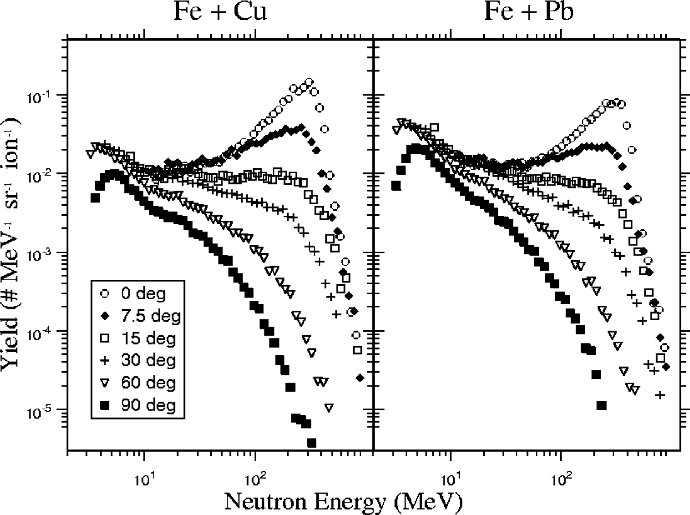
Figure 2. Double differential thick-target yields from 400 MeV per nucleon Fe stopping in a copper (left plot) and lead ...
Notes:
Figure 2. Double differential thick-target yields from 400 MeV per nucleon Fe stopping in a copper (left plot) and lead (right plot).
Unless provided in the caption above, the following copyright applies to the content of this slide: Published by Oxford University Press 2005.

Slide 3
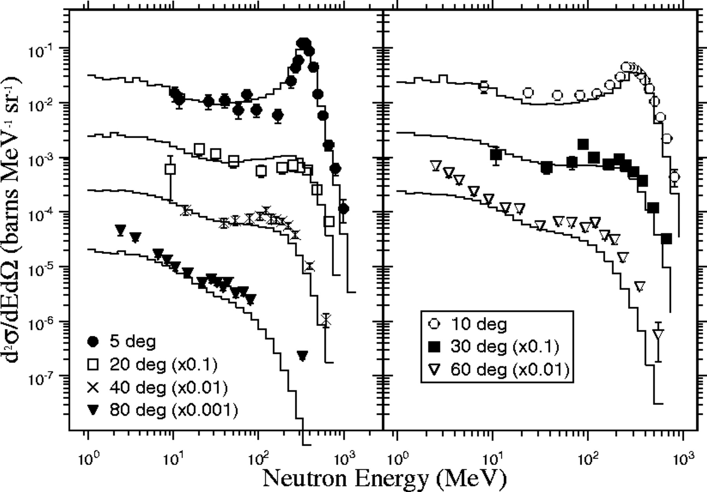
Figure 3. Double-differential neutron spectra from 400 MeV per nucleon Ne + ISS wall, at the indicated laboratory ...
Notes:
Figure 3. Double-differential neutron spectra from 400 MeV per nucleon Ne + ISS wall, at the indicated laboratory angles. The error bars represent the statistical uncertainty. Results from PHITS calculations are shown with the solid histograms. The spectra and calculations are offset by successive factors of 10, as indicated in the legend.
Unless provided in the caption above, the following copyright applies to the content of this slide: Published by Oxford University Press 2005.

