Slide 1
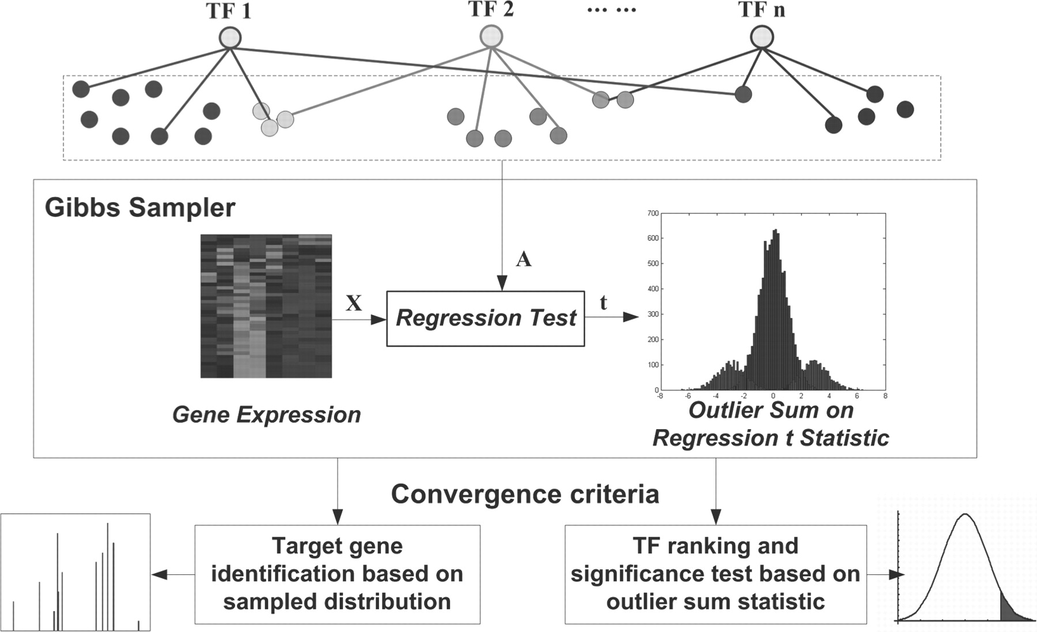
Fig. 1. A general workflow of the Gibbs sampler on OS statistic
Notes:
Fig. 1. A general workflow of the Gibbs sampler on OS statistic
Unless provided in the caption above, the following copyright applies to the content of this slide: © The Author 2012. Published by Oxford University Press. All rights reserved. For Permissions, please email: journals.permissions@oup.com

Slide 2
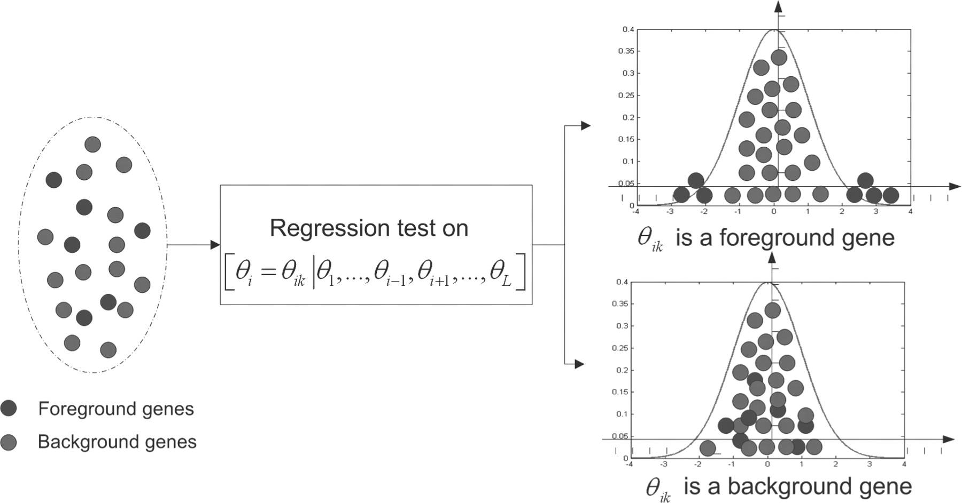
Fig. 2. Target gene identification based on regression analysis
Notes:
Fig. 2. Target gene identification based on regression analysis
Unless provided in the caption above, the following copyright applies to the content of this slide: © The Author 2012. Published by Oxford University Press. All rights reserved. For Permissions, please email: journals.permissions@oup.com

Slide 3
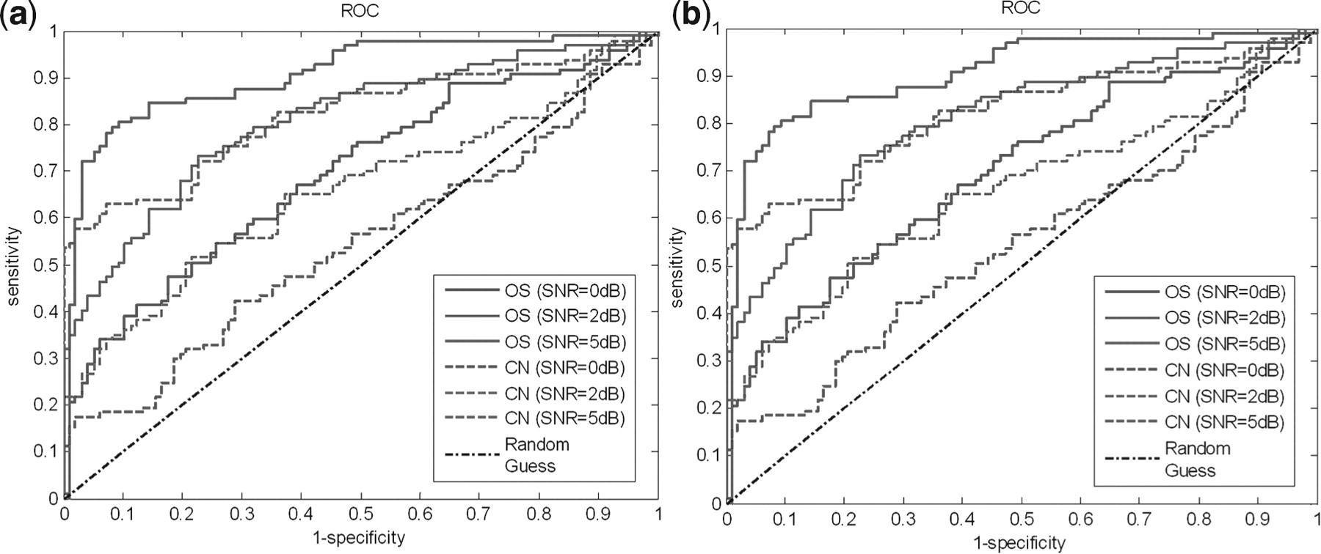
Fig. 3. ROC comparison of Gibbs sampling method based on OS statistic and CN using linear simulation data and ...
Notes:
Fig. 3. ROC comparison of Gibbs sampling method based on OS statistic and CN using linear simulation data and SynTReN. (a) Experiment on linear simulation. (b) Experiment on SynTReN data
Unless provided in the caption above, the following copyright applies to the content of this slide: © The Author 2012. Published by Oxford University Press. All rights reserved. For Permissions, please email: journals.permissions@oup.com

Slide 4
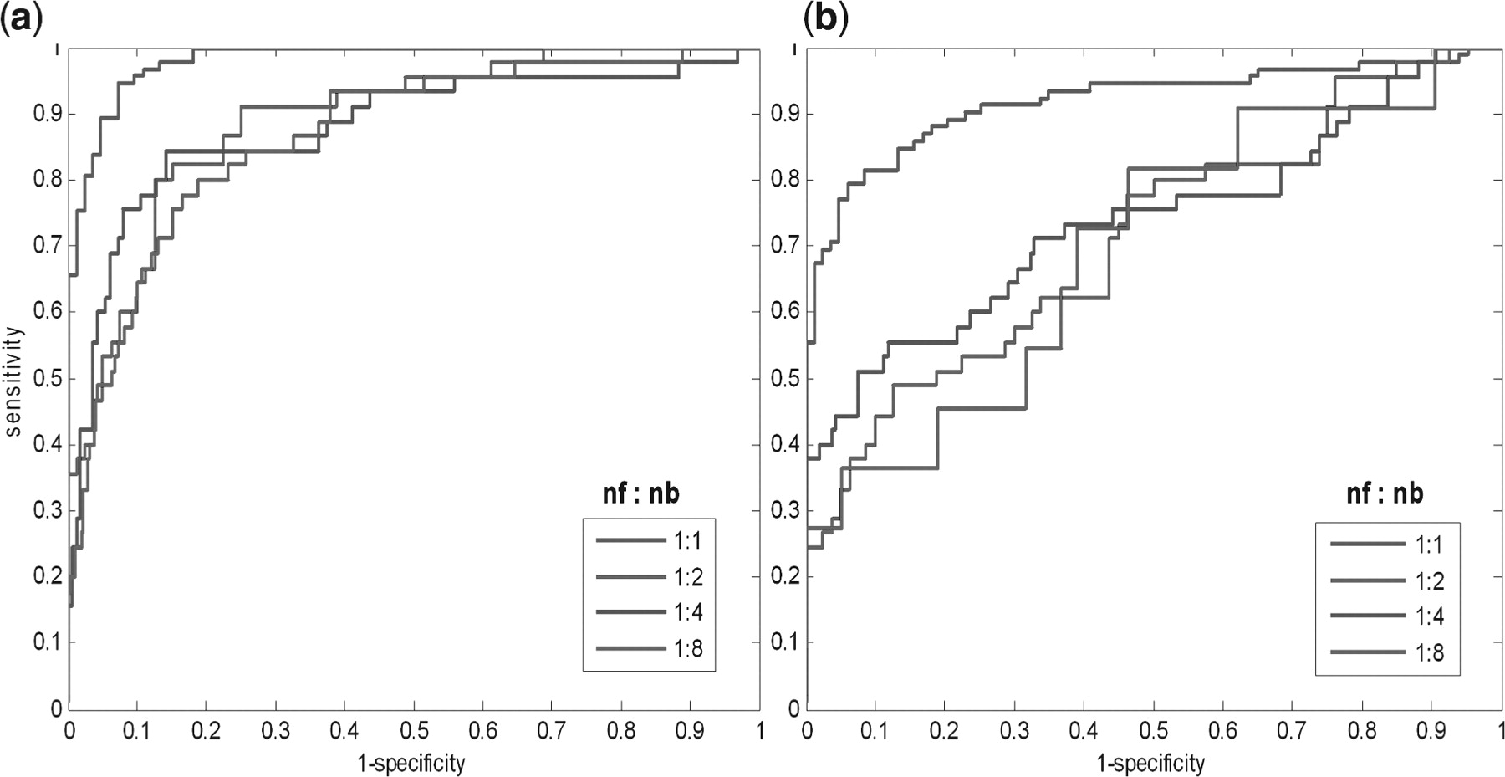
Fig. 4. Performance comparison between the proposed GibbsOS method (a) and the CN-based method (b), when ...
Notes:
Fig. 4. Performance comparison between the proposed GibbsOS method (a) and the CN-based method (b), when false-positive rate in the initial topology increases. ‘nf:nb’ is a parameter used to control the ratio of foreground genes and background genes. ‘nf:nb = 1:1’ means that the number of foreground genes is equal to that of background genes
Unless provided in the caption above, the following copyright applies to the content of this slide: © The Author 2012. Published by Oxford University Press. All rights reserved. For Permissions, please email: journals.permissions@oup.com

Slide 5
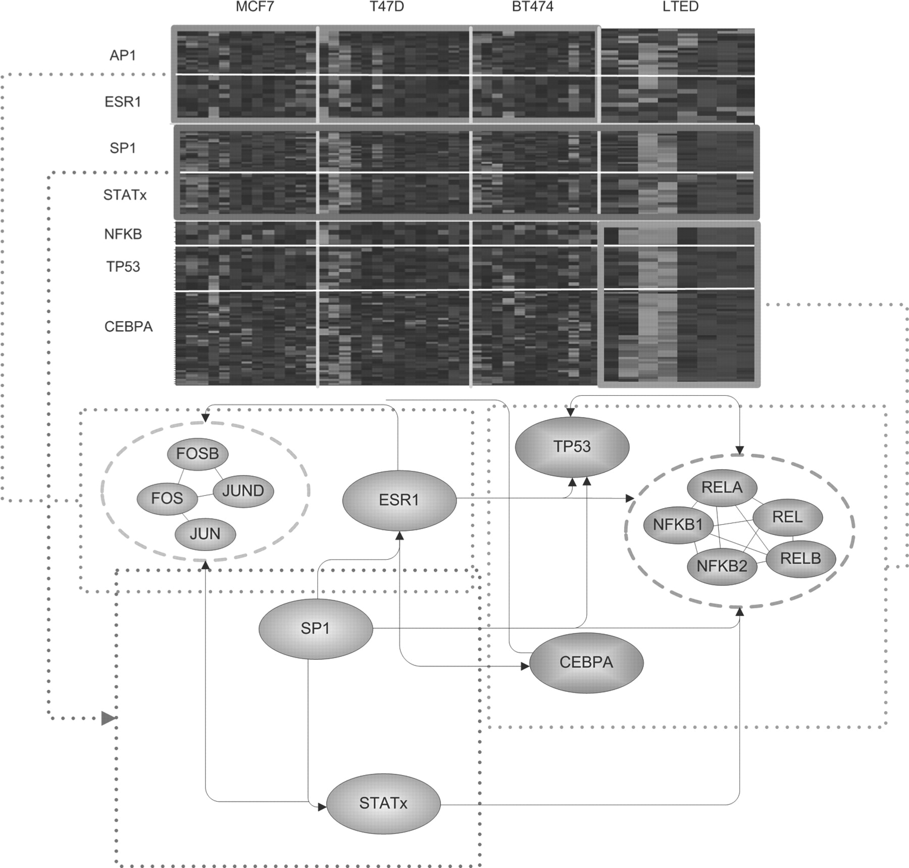
Fig. 5. Identified transcriptional modules and their interactions associated with different estrogen conditions. Note ...
Notes:
Fig. 5. Identified transcriptional modules and their interactions associated with different estrogen conditions. Note that the interactions between different transcription factors were obtained from Ingenuity Pathway Analysis (IPA) (www.ingenuity.com). AP1 and ESR1 are significantly enriched in early up-regulated estrogen-induced group while NFκB, CEBPA and TP53 have significant regulatory activities with late up-regulated long-term deprived group. Meanwhile, there is strong evidence showing that SP1 and STAT family proteins are important mediators for transcriptional regulation under both groups. Identified significant target genes are listed in Supplementary Tables S11–S18
Unless provided in the caption above, the following copyright applies to the content of this slide: © The Author 2012. Published by Oxford University Press. All rights reserved. For Permissions, please email: journals.permissions@oup.com

