Slide 1
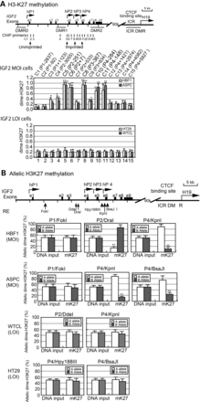
Figure 1. Histone 3 lysine 27 (H3K27) methylation at the IGF2 promoters. (A) H3K27 methylation in IGF2 promoters as ...
Notes:
Figure 1. Histone 3 lysine 27 (H3K27) methylation at the IGF2 promoters. (A) H3K27 methylation in IGF2 promoters as measured by ChIP PCR. Vertical lines: PCR primers (C1–C15) used for ChIP assay. The specific location of each ChIP PCR primer pair was also specified in the parenthesis as the sequence number downstream (+) or upstream (−) of the transcription initiation site. DMR: differentially methylated regions; e1–e9: IGF2 exons; ICR: imprinted control region; MOI: maintenance of imprinting; LOI: loss of imprinting; hP1: non-imprinted promoter; hP2–hP4: imprinted promoters. Chromatin DNAs were immunoprecipitated with antisera against dimethyl H3K27 (dime-H3K27) and quantitated by ChIP primers. Primer sequences are listed in Supplementary Material, Table S2. The ChIP data are presented as the ratio of the dime-H3K27 ChIP signal over the input signal. Error bars represent the standard error of the average of three independent ChIP assays (each with three PCR reactions). *P < 0.05, **P < 0.01 as compared with the unimprinted C1. (B) Allele-specific H3K27 methylation. Allelic ChIP products were separated by polymorphic restriction enzymes (RE). The allelic interaction of CTCF with the IGF2 promoters (P1 and P4) was identified by using six polymorphic restriction enzymes (FokI, DraI, KpnI, DdeI, Hpy188III and BsaJ1), depending on cells used. The source of the specific parental alleles of ‘A’ and ‘B’ is not known. Allelic ChIP enrichment of dime-H3K27 is calculated as the percentage of the A or B allele over the total (A + B) after normalization with the input DNA.
Unless provided in the caption above, the following copyright applies to the content of this slide: © The Author 2013. Published by Oxford University Press. All rights reserved. For Permissions, please email: journals.permissions@oup.com

Slide 2
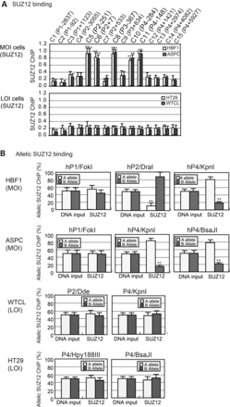
Figure 2. (A) SUZ12–IGF2 promoter interaction. SUZ12 ChIP q-PCR quantitation in IGF2 MOI and LOI cells. Cells were ...
Notes:
Figure 2. (A) SUZ12–IGF2 promoter interaction. SUZ12 ChIP q-PCR quantitation in IGF2 MOI and LOI cells. Cells were immunoprecipitated with antisera against SUZ12, followed by PCR amplification with ChIP primers. Input DNA was DNA control before immunoprecipitation. See Figure 1A legend for details. (B) Allele-specific SUZ12 binding at the IGF2 promoters. The polymorphic restriction enzyme sites and PCR primers are the same as in Figure 1B. Allelic binding of SUZ12 is calculated as the percentage of the A or B allele over the total (A + B) after normalization with the input DNA.
Unless provided in the caption above, the following copyright applies to the content of this slide: © The Author 2013. Published by Oxford University Press. All rights reserved. For Permissions, please email: journals.permissions@oup.com

Slide 3
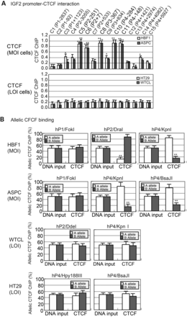
Figure 3. Binding of CTCF to the IGF2 promoters. (A) ChIP q-PCR of CTCF binding in the IGF2 promoters. Chromatin DNAs ...
Notes:
Figure 3. Binding of CTCF to the IGF2 promoters. (A) ChIP q-PCR of CTCF binding in the IGF2 promoters. Chromatin DNAs in MOI (HBF1 and ASPC) and LOI (HT29 and WTCL) cell lines were immunoprecipitated with antisera against CTCF and quantitated by q-PCR. Input DNA was DNA control before immunoprecipitation. Relative enrichments (fold) of CTCF binding across the promoter regions of human IGF2, which were calculated as described previously using input DNA, were plotted along P1–P4 regions of IGF2 DNA. See Figure 1A legend for details. (B) Quantitative allelic CTCF binding. The polymorphic restriction enzyme sites and PCR primers are the same as in Figure 1B. Allelic binding of CTCF is calculated as the percentage of the A or B allele over the total (A + B) after normalization with the input DNA.
Unless provided in the caption above, the following copyright applies to the content of this slide: © The Author 2013. Published by Oxford University Press. All rights reserved. For Permissions, please email: journals.permissions@oup.com

Slide 4
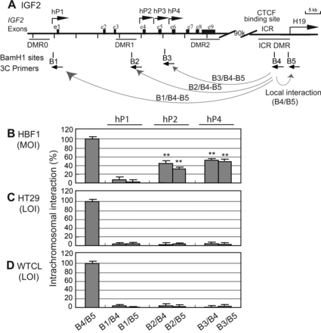
Figure 4. Intrachromosomal interaction between the ICR and IGF2 promoters. (A) Schematic diagram of the IGF2/H19 gene ...
Notes:
Figure 4. Intrachromosomal interaction between the ICR and IGF2 promoters. (A) Schematic diagram of the IGF2/H19 gene locus. DMRs, differentially methylated regions; hP1–hP4, IGF2 promoters; ICR, imprinting control region; B1–B5, BamH1 sites used for 3C assay. The orientation and location of the 3C primers are shown by arrows under each BamH1 restriction site. (B–D) Quantitative intrachromosomal interactions. MOI, maintenance of IGF2 imprinting; LOI, loss of IGF2 imprinting. PCR primers B4 and B5 (ICR) were used in combination with each target primer in IGF2 promoters in (A). Each column represents the relative value of the intrachromosomal interaction. B4/B5 is local interaction used as the 3C control.
Unless provided in the caption above, the following copyright applies to the content of this slide: © The Author 2013. Published by Oxford University Press. All rights reserved. For Permissions, please email: journals.permissions@oup.com

Slide 5
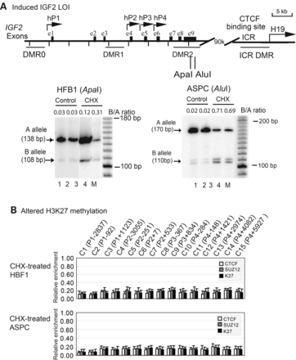
Figure 5. Induced aberrant IGF2 imprinting by cycloheximide (CHX). (A) CHX-induced IGF2 LOI in human HBF1 fibroblasts ...
Notes:
Figure 5. Induced aberrant IGF2 imprinting by cycloheximide (CHX). (A) CHX-induced IGF2 LOI in human HBF1 fibroblasts and ASPC cells. Cell treated with 2.0 mg/ml CHX for 4 days. The parental alleles of IGF2 were separated by ApaI in HBF1 and AluI in ASPC cells. Lanes 1–2: HBF1 cDNA; lanes 3–4: cell treated with CHX. M, 100 bp marker. B/A ratio, quantitation of the normally imprinted ‘B’ allele as calculated by the ratio of the ‘B’ allele over the ‘A’ allele. Note the monoallelic expression of IGF2 (MOI) in untreated control cells and various levels of relaxation of the ‘B’ allele in CHX-treated cells. (B) ChIP q-PCR quantitation for altered CTCF and SUZ12 binding and H3K27 methylation. Cells were treated with CHX and immunoprecipitated with antisera against CTCF, Suz12 and dimethyl-H3-K27 (mK27), followed by q-PCR quantitation. Input DNA was DNA control before immunoprecipitation. Note the lack of CTCF and SUZ12 binding and H3K27 methylation of the IGF2 promoters in CHX-treated cells. See Figure 1A legend for details.
Unless provided in the caption above, the following copyright applies to the content of this slide: © The Author 2013. Published by Oxford University Press. All rights reserved. For Permissions, please email: journals.permissions@oup.com

Slide 6
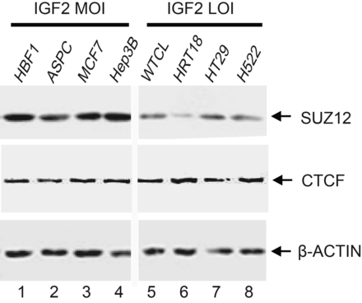
Figure 6. Downregulation of SUZ12 in IGF2 LOI tumor cells. CTCF and SUZ12 proteins were quantitated by western ...
Notes:
Figure 6. Downregulation of SUZ12 in IGF2 LOI tumor cells. CTCF and SUZ12 proteins were quantitated by western blotting. Lanes 1–4: IGF2 MOI cells; lanes 5–8: IGF2 LOI cells. Note the reduced expression of SUZ12 in IGF2 LOI tumor cells.
Unless provided in the caption above, the following copyright applies to the content of this slide: © The Author 2013. Published by Oxford University Press. All rights reserved. For Permissions, please email: journals.permissions@oup.com

