Slide 1
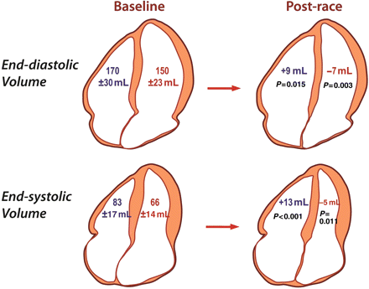
Figure 1 Differential effect of prolonged intense exercise on right and left ventricular volumes. Baseline volumes are ...
Notes:
Figure 1 Differential effect of prolonged intense exercise on right and left ventricular volumes. Baseline volumes are shown on the left and the changes in volume post-race are shown on the right. Right ventricular volumes increased in the post-race setting while left ventricular volumes decreased resulting in a decrease in right ventricular ejection fraction but not left ventricular ejection fraction.
Unless provided in the caption above, the following copyright applies to the content of this slide: Published on behalf of the European Society of Cardiology. All rights reserved. © The Author 2011. For permissions please email: journals.permissions@oup.com

Slide 2
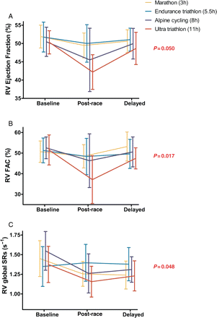
Figure 2 Duration-dependent increase in right ventricular dysfunction. Ejection fraction (A), fractional area change ...
Notes:
Figure 2 Duration-dependent increase in right ventricular dysfunction. Ejection fraction (A), fractional area change (B), and systolic strain rate (C) decreased in the post-race setting. There was a significant interaction between event type and time point (P-value) with a greater reduction in function in those completing the longest event (ultra-triathlon).
Unless provided in the caption above, the following copyright applies to the content of this slide: Published on behalf of the European Society of Cardiology. All rights reserved. © The Author 2011. For permissions please email: journals.permissions@oup.com

Slide 3
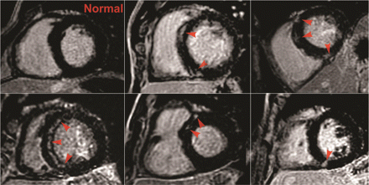
Figure 3 Delayed gadolinium enhancement in five athletes. Images of five athletes in whom focal delayed gadolinium ...
Notes:
Figure 3 Delayed gadolinium enhancement in five athletes. Images of five athletes in whom focal delayed gadolinium enhancement (DGE) was identified in the interventricular septum (indicated with arrows) when compared with an athlete with a normal study (top left).
Unless provided in the caption above, the following copyright applies to the content of this slide: Published on behalf of the European Society of Cardiology. All rights reserved. © The Author 2011. For permissions please email: journals.permissions@oup.com

