Slide 1
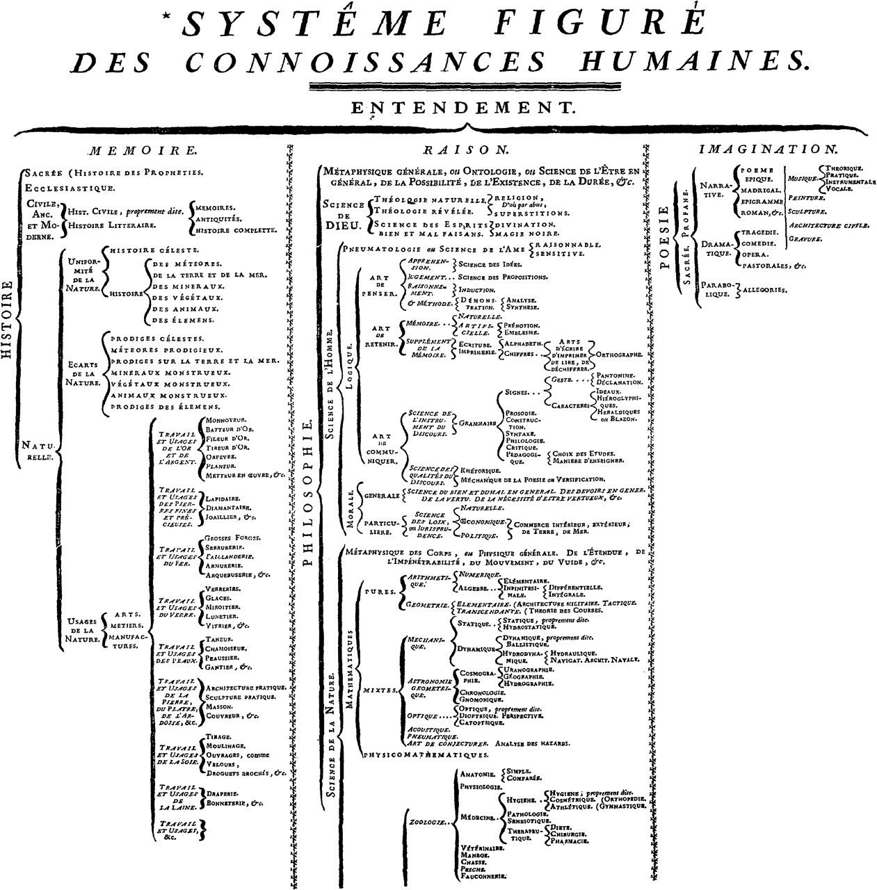
Fig 1. Illustrated system of human knowledge, D’Alembert's Encyclopédie (1751).
Notes:
Fig 1. Illustrated system of human knowledge, D’Alembert's Encyclopédie (1751).
Unless provided in the caption above, the following copyright applies to the content of this slide: © British Society of Aesthetics 2009. Published by Oxford University Press on behalf of the British Society of Aesthetics. All rights reserved. For Permissions, please email: journals.permissions@oxfordjournals.org

