Slide 1
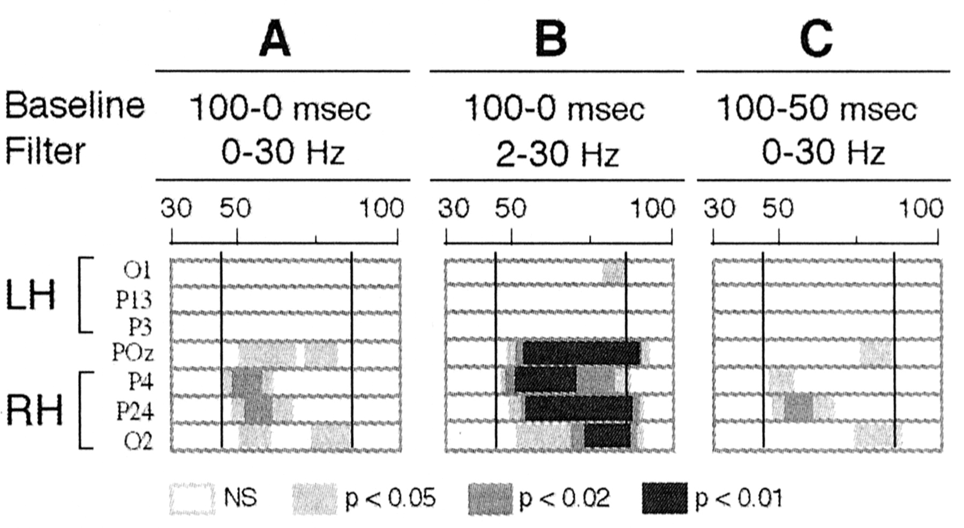
Figure 6. Statistical significance (Student’s t-tests) of the [AV – (Au+Vi)] difference waveform at occipito-parietal ...
Notes:
Figure 6. Statistical significance (Student’s t-tests) of the [AV – (Au+Vi)] difference waveform at occipito-parietal electrodes between 30 and 100 ms post-stimulus in three conditions of data analysis differing according to the digital high-pass filter applied to the data (0 or 2 Hz), and according to the timing of the baseline reference used. (A) Standard conditions (similar to Fig. 3A). (B) Using a 2 Hz cut-off frequency did not decrease the significance of the interactions. (C) Changing the baseline reference period from 100 to 0 ms before stimulus onset to 100 to 50 ms before stimulus did not shorten the latency of the interaction effects (see text).
Unless provided in the caption above, the following copyright applies to the content of this slide: © Oxford University Press

Slide 2
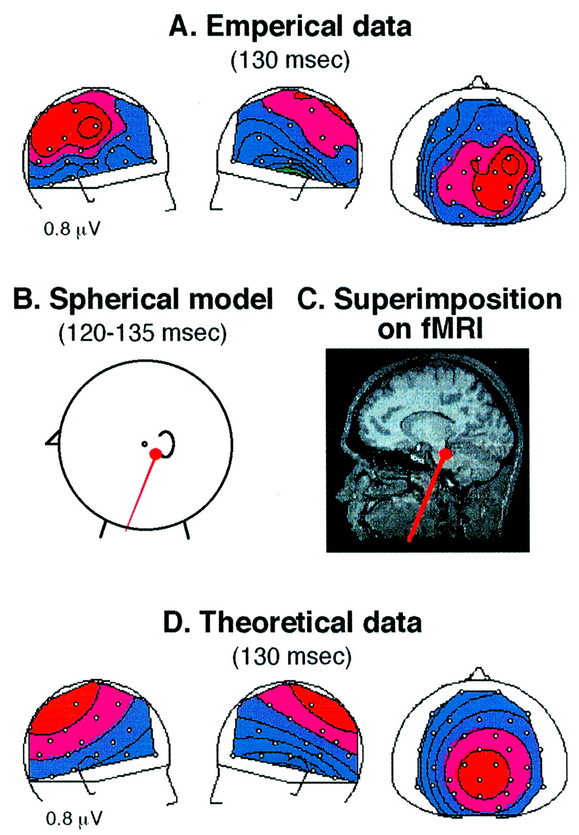
Figure 5. Results of spatio-temporal dipole modeling of [AV – (Au+Vi)] over the 120–135 ms period using the ...
Notes:
Figure 5. Results of spatio-temporal dipole modeling of [AV – (Au+Vi)] over the 120–135 ms period using the three-concentric sphere head model. (A) Experimental potential distributions of the mean amplitude of [AV – (Au+Vi)] between 120 and 135μs after stimulus onset, on right, left and large-top views. (B) One ECD accounts for more than 80% of the total experimental variance. (C) Superimposition of the best fitting ECD onto the closest left sagittal MRI section from one subject. The dipolar source was projected within 15 mm from the superior colliculus. (D) Theoretical potential distributions reconstructed by the model.
Unless provided in the caption above, the following copyright applies to the content of this slide: © Oxford University Press

Slide 3
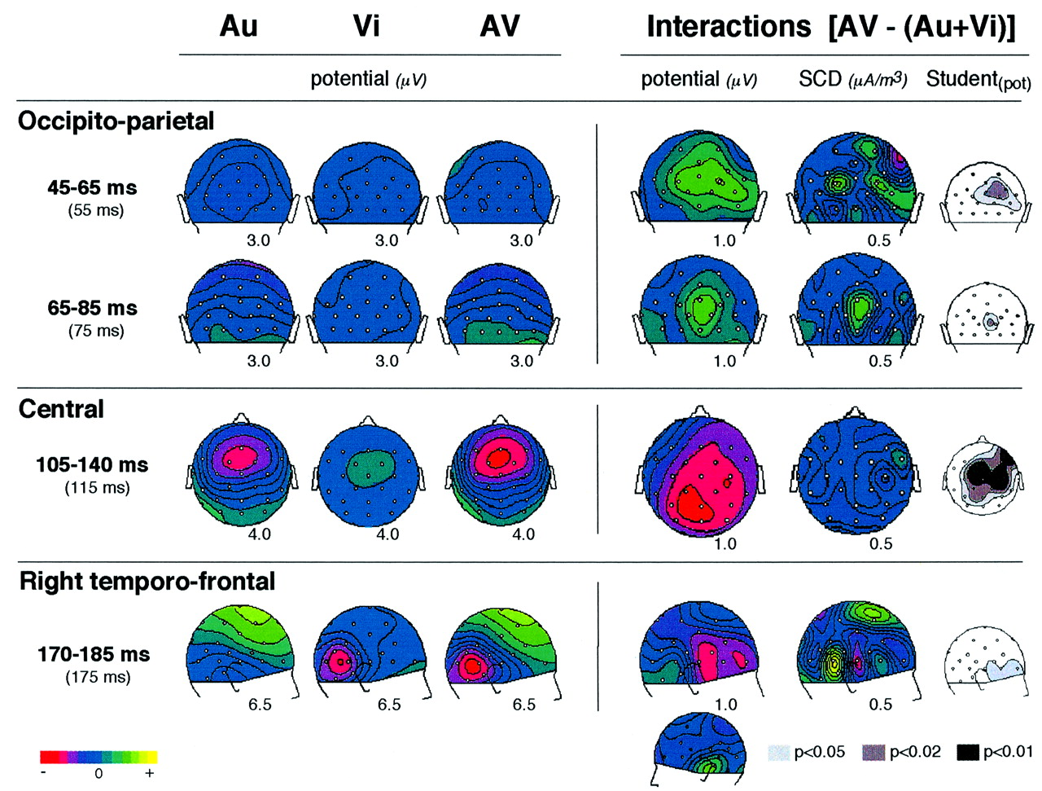
Figure 4. Topography of the different interaction patterns at occipito-parietal, central and right temporo-frontal ...
Notes:
Figure 4. Topography of the different interaction patterns at occipito-parietal, central and right temporo-frontal scalp sites. Each line displays: the time window of the interaction pattern (and the illustrative latency at which the maps are depicted), the potential distributions of the unimodal (Au and Vi) and bimodal (AV) responses at this latency, the potential and SCD distributions of the cross-modal interactions quantified in the difference [AV – (Au+Vi)] between the bimodal responses and the sum of the unimodal responses, and the Student’s t map estimated on the potential values. In Student maps, the gray colors indicate the scalp areas where [AV – (Au+Vi)] amplitudes differ significantly from zero with the probability coded in the gray level. In potential and SCD maps, half range of the scale (μV or μA/m3) is given below each map. It may be seen that: (1) At occipito-parietal sites, [AV – (Au+Vi)] displays significant positive potential fields between 45 and 85 ms post-stimulus, typical of activities in the visual cortex. Over this period, the SCD maps present two different current patterns (45–65 and 65–85 ms) suggesting the existence of several interaction components. (2) Between 105 and 140 ms, the potential distribution of [AV – (Au+Vi)] extends to a wide central region while corresponding SCDs display only very weak currents, indicating the existence of cross-modal activities probably in deep brain structure(s) (superior colliculus?). (3) From ~170 to 185 ms, significant [AV – (Au+Vi)] amplitudes may be seen on the right temporo-frontal region (without counterpart on the left hemiscalp), suggesting cross-modal activities in the right prefrontal cortex and/or the right insula.
Unless provided in the caption above, the following copyright applies to the content of this slide: © Oxford University Press

Slide 4
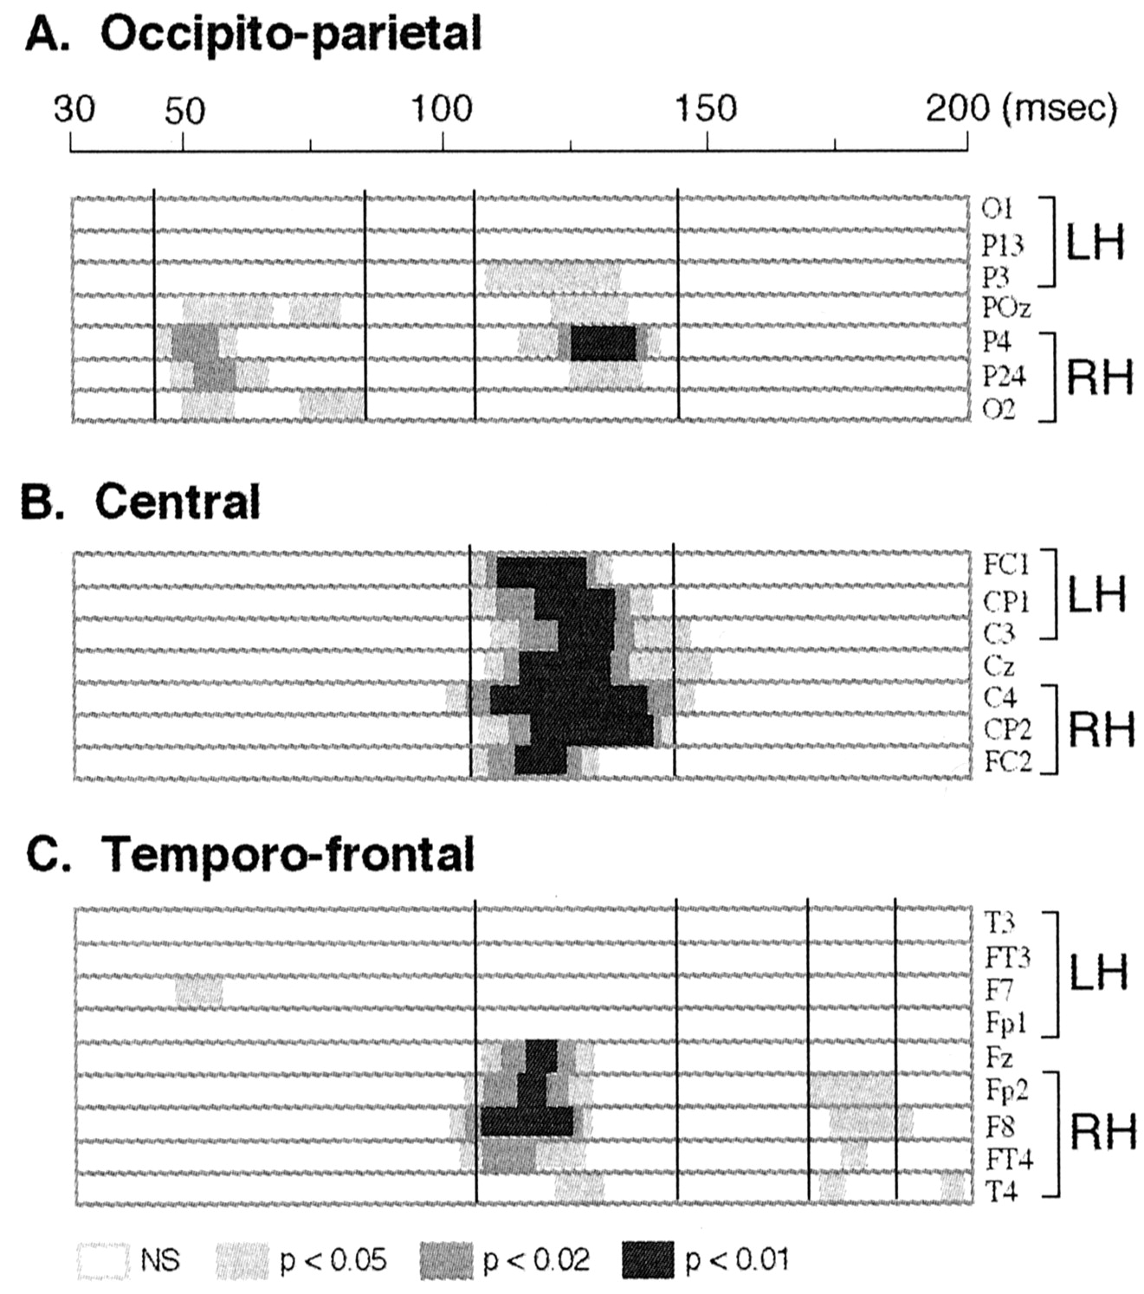
Figure 3. Statistical significance of the [AV – (Au+Vi)] difference waveform measuring the audio-visual interactions at ...
Notes:
Figure 3. Statistical significance of the [AV – (Au+Vi)] difference waveform measuring the audio-visual interactions at a subset of (A) occipito-parietal, (B) central and (C) frontal and temporal electrodes on the right (RH) and left (LH) hemiscalps between 30 and 200 ms post-stimulus (Student’s t-tests comparing the amplitude of [AV – (Au + Vi)] against zero at each latency). Three significant spatio-temporal patterns could be dissociated: at occipito-parietal sites from 45 to 85ms, at fronto-centro-parietal sites from 105 to 140 ms and at the right temporo-frontal electrode sites from 170 to 185μs.
Unless provided in the caption above, the following copyright applies to the content of this slide: © Oxford University Press

Slide 5
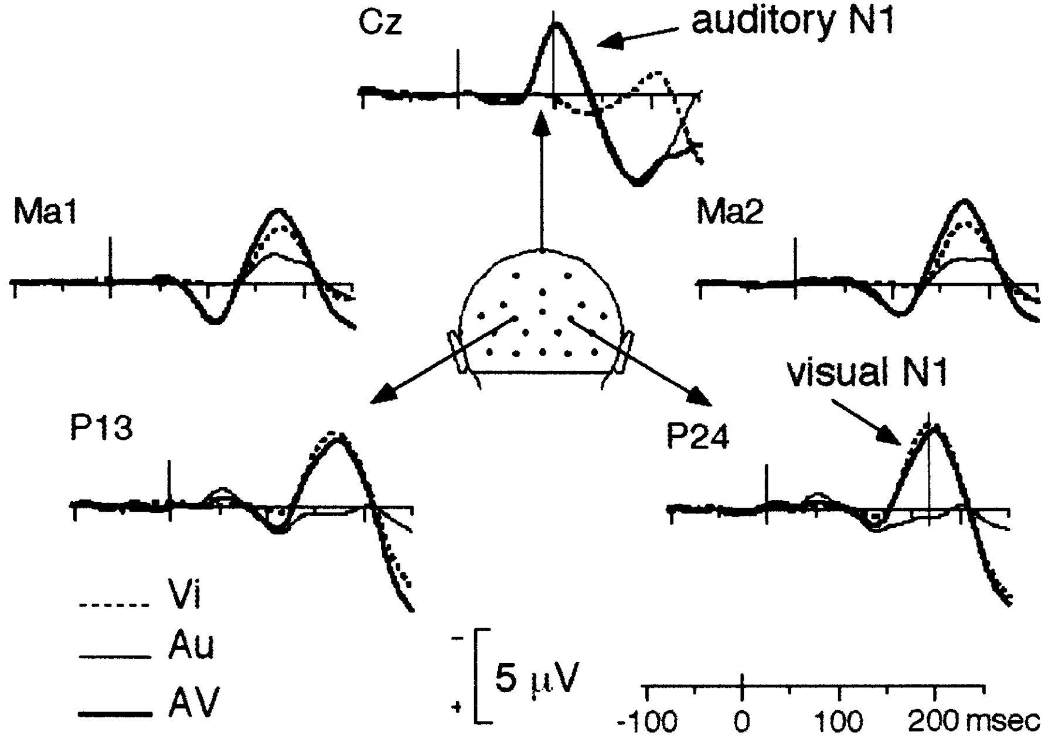
Figure 2. Grand-average ERPs across 14 subjects elicited by unimodal auditory (Au) and visual (Vi) stimuli, and by ...
Notes:
Figure 2. Grand-average ERPs across 14 subjects elicited by unimodal auditory (Au) and visual (Vi) stimuli, and by bimodal (AV) stimuli, at a subset of electrodes from 100_ms before stimulus onset to 250_ms after. Responses to objects A and B are grouped.
Unless provided in the caption above, the following copyright applies to the content of this slide: © Oxford University Press

Slide 6
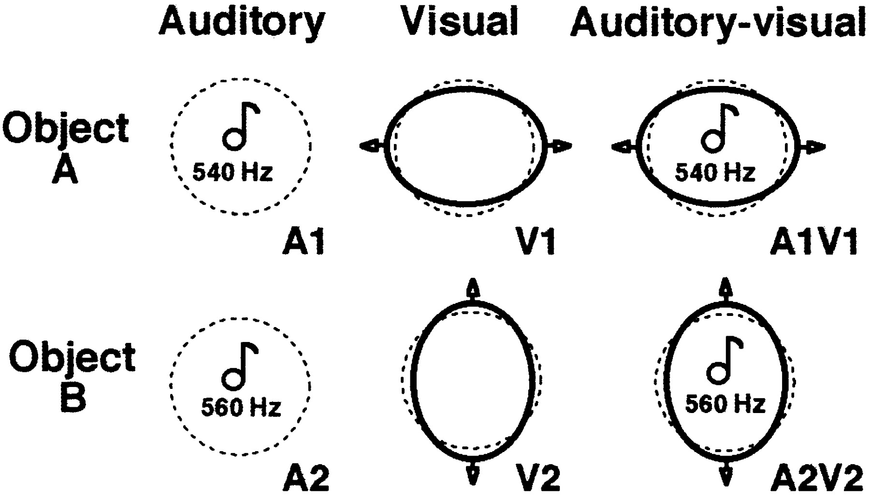
Figure 1. Two objects, A and B, were used. Each of them could be presented either in auditory condition alone (object ...
Notes:
Figure 1. Two objects, A and B, were used. Each of them could be presented either in auditory condition alone (object A: 540 Hz tone burst, object B: 560 Hz), or in visual condition alone [transient deformation of a circle into an horizontal (object A) or vertical (object B) ellipse)], or in bimodal condition by the combination of their respective auditory and visual features.
Unless provided in the caption above, the following copyright applies to the content of this slide: © Oxford University Press

