Slide 1
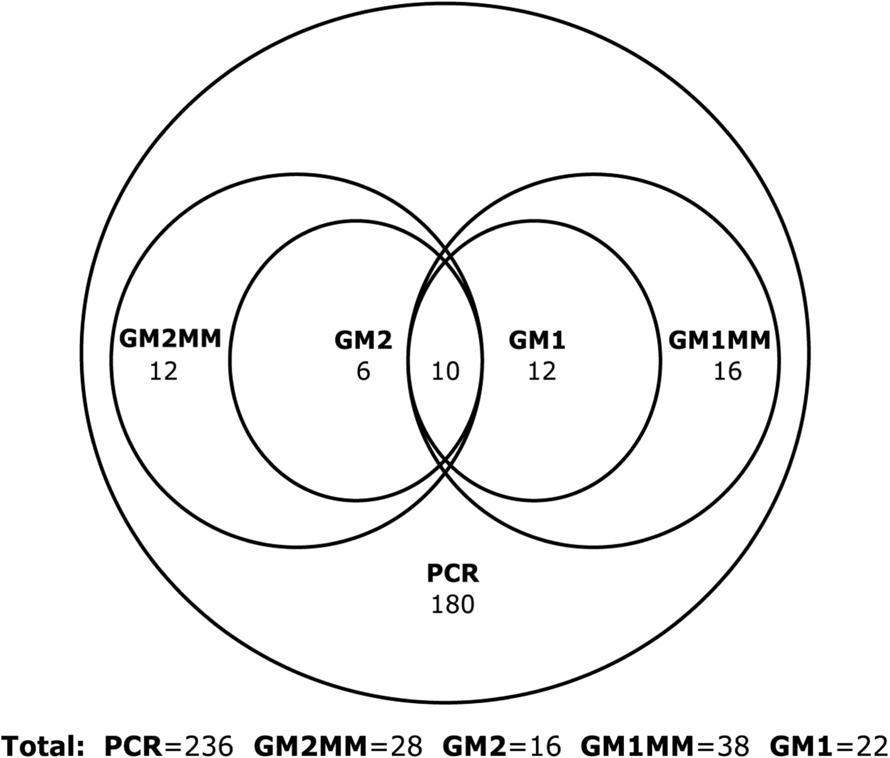
Figure 1. The distribution of factors between different model types.
Notes:
Figure 1. The distribution of factors between different model types.
Unless provided in the caption above, the following copyright applies to the content of this slide: © 2008 The Author(s)This is an Open Access article distributed under the terms of the Creative Commons Attribution Non-Commercial License (http://creativecommons.org/licenses/by-nc/2.0/uk/) which permits unrestricted non-commercial use, distribution, and reproduction in any medium, provided the original work is properly cited.

Slide 2
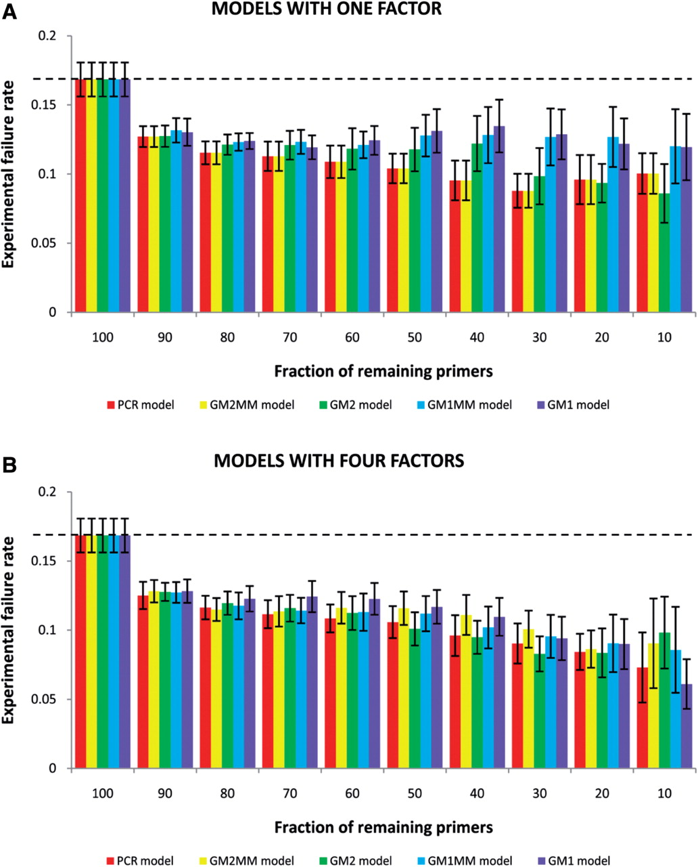
Figure 2. Comparison of five model types at different sensitivity levels. The figure illustrates the efficiency of the ...
Notes:
Figure 2. Comparison of five model types at different sensitivity levels. The figure illustrates the efficiency of the models in predicting the actual failure rate at several cutoff levels with a single factor ( A ) or four factors ( B ) included in the model. Columns illustrate the average failure rate of the remaining primer pairs in 10 control sets using the given cutoff. Dashed line defines the average PCR failure rate of the whole dataset before applying any model. Error bars show 95% confidence limits for the real mean.
Unless provided in the caption above, the following copyright applies to the content of this slide: © 2008 The Author(s)This is an Open Access article distributed under the terms of the Creative Commons Attribution Non-Commercial License (http://creativecommons.org/licenses/by-nc/2.0/uk/) which permits unrestricted non-commercial use, distribution, and reproduction in any medium, provided the original work is properly cited.

Slide 3
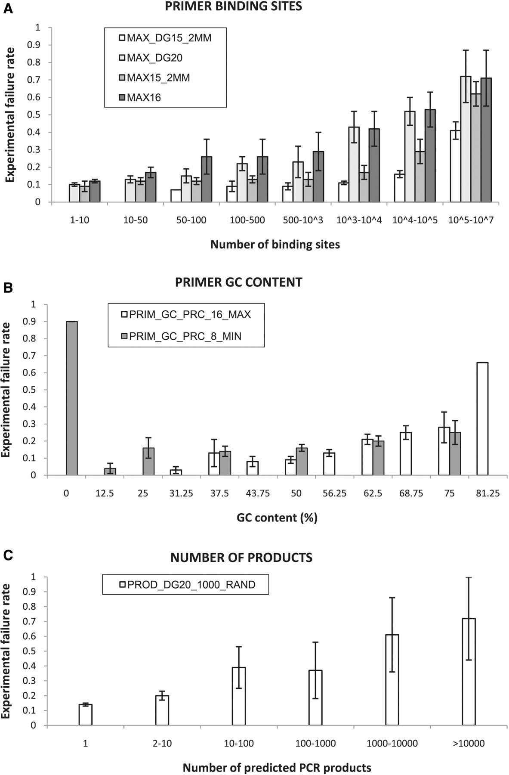
Figure 3. The relationship between some of the statistically significant factors and the PCR failure rate. The binding ...
Notes:
Figure 3. The relationship between some of the statistically significant factors and the PCR failure rate. The binding sites of the primer pairs were counted with the most descriptive factors for each model: ( A ) maximum number of hits with two mismatches allowed and free energy level ≤−15 kcal/mol (PCR and GM2MM models), no mismatches allowed and free energy level ≤−20 kcal/mol (GM2 model), two mismatches allowed and word size = 15 nt. (GM1MM model), no mismatches allowed and word size = 16 nt. (GM1 model). The effects of the primer GC content ( B ) and the number of predicted PCR products ( C ) are also shown. Error bars show 95% confidence limits for the real mean.
Unless provided in the caption above, the following copyright applies to the content of this slide: © 2008 The Author(s)This is an Open Access article distributed under the terms of the Creative Commons Attribution Non-Commercial License (http://creativecommons.org/licenses/by-nc/2.0/uk/) which permits unrestricted non-commercial use, distribution, and reproduction in any medium, provided the original work is properly cited.

