Slide 1
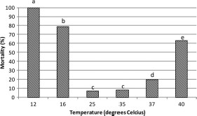
Fig. 1. Effect of constant temperature on mortality of aquatic phase. Treatments with the same letter above the bar ...
Notes:
Fig. 1. Effect of constant temperature on mortality of aquatic phase. Treatments with the same letter above the bar do not differ significantly by contingency test.
Unless provided in the caption above, the following copyright applies to the content of this slide: © 2011 Entomological Society of America

Slide 2
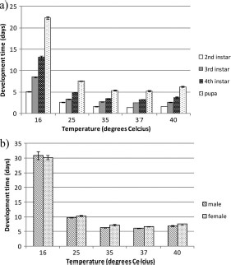
Fig. 2. Effect of temperature on the development time of the aquatic phases (mean ± SEM). (a) Cumulative development ...
Notes:
Fig. 2. Effect of temperature on the development time of the aquatic phases (mean ± SEM). (a) Cumulative development time to the second, third, fourth, and pupal stages; (b) cumulative development time to adult male and female stage. All temperature treatments except for 35°C and 37°C differ significantly by Kruskal-Wallis tests (P < 0.05).
Unless provided in the caption above, the following copyright applies to the content of this slide: © 2011 Entomological Society of America

Slide 3
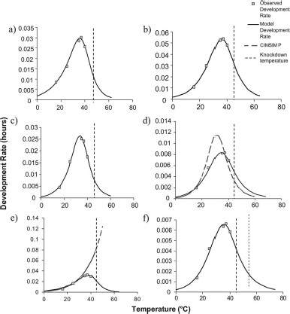
Fig. 3. Modeled development rates according to observed rates for (a) first instar, (b) third instar, (c) fourth ...
Notes:
Fig. 3. Modeled development rates according to observed rates for (a) first instar, (b) third instar, (c) fourth instar, (d) entire larval phase, (e) pupal phase, and (f) entire aquatic phase.
Unless provided in the caption above, the following copyright applies to the content of this slide: © 2011 Entomological Society of America

Slide 4
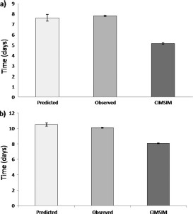
Fig. 4. Predicted and observed development time at cycling temperatures (mean ± SEM). Predictions are based on data ...
Notes:
Fig. 4. Predicted and observed development time at cycling temperatures (mean ± SEM). Predictions are based on data from constant temperature experiments fitted to the Sharpe-Schoolfield model or based on CIMSIM, and are presented for (a) time to pupation and (b) time to emergence.
Unless provided in the caption above, the following copyright applies to the content of this slide: © 2011 Entomological Society of America

Slide 5
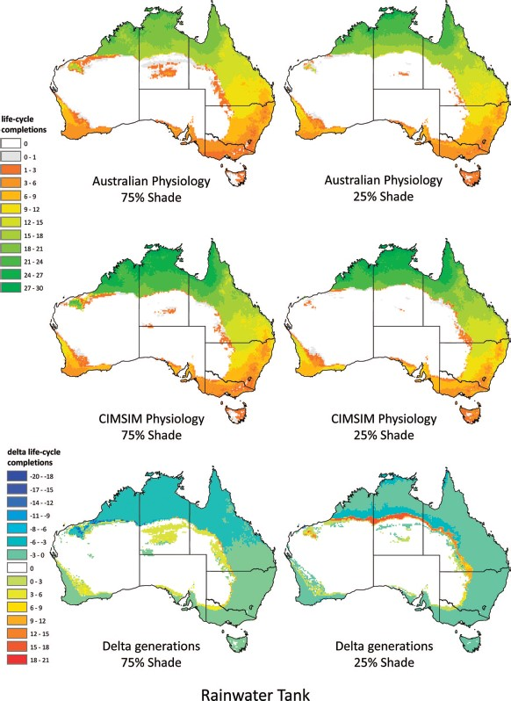
Fig. 5. Potential Ae. aegypti life cycle completions in a rainwater tank in 75 and 25% shade for Australian and ...
Notes:
Fig. 5. Potential Ae. aegypti life cycle completions in a rainwater tank in 75 and 25% shade for Australian and CIMSIM physiology. Delta life cycle completions indicate the differences between the two physiologies. (Online figure in color.)
Unless provided in the caption above, the following copyright applies to the content of this slide: © 2011 Entomological Society of America

Slide 6
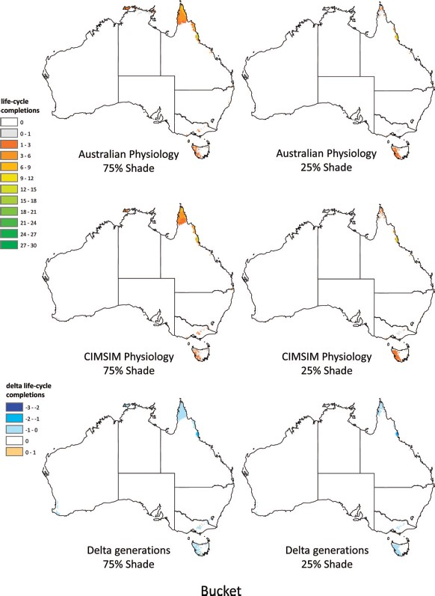
Fig. 6. Potential Ae. aegypti life cycle completions in a bucket in 75 and 25% shade for Australian and CIMSIM ...
Notes:
Fig. 6. Potential Ae. aegypti life cycle completions in a bucket in 75 and 25% shade for Australian and CIMSIM physiology. Delta life cycle completions indicate the differences between the two physiologies. (Online figure in color.)
Unless provided in the caption above, the following copyright applies to the content of this slide: © 2011 Entomological Society of America

