Slide 1
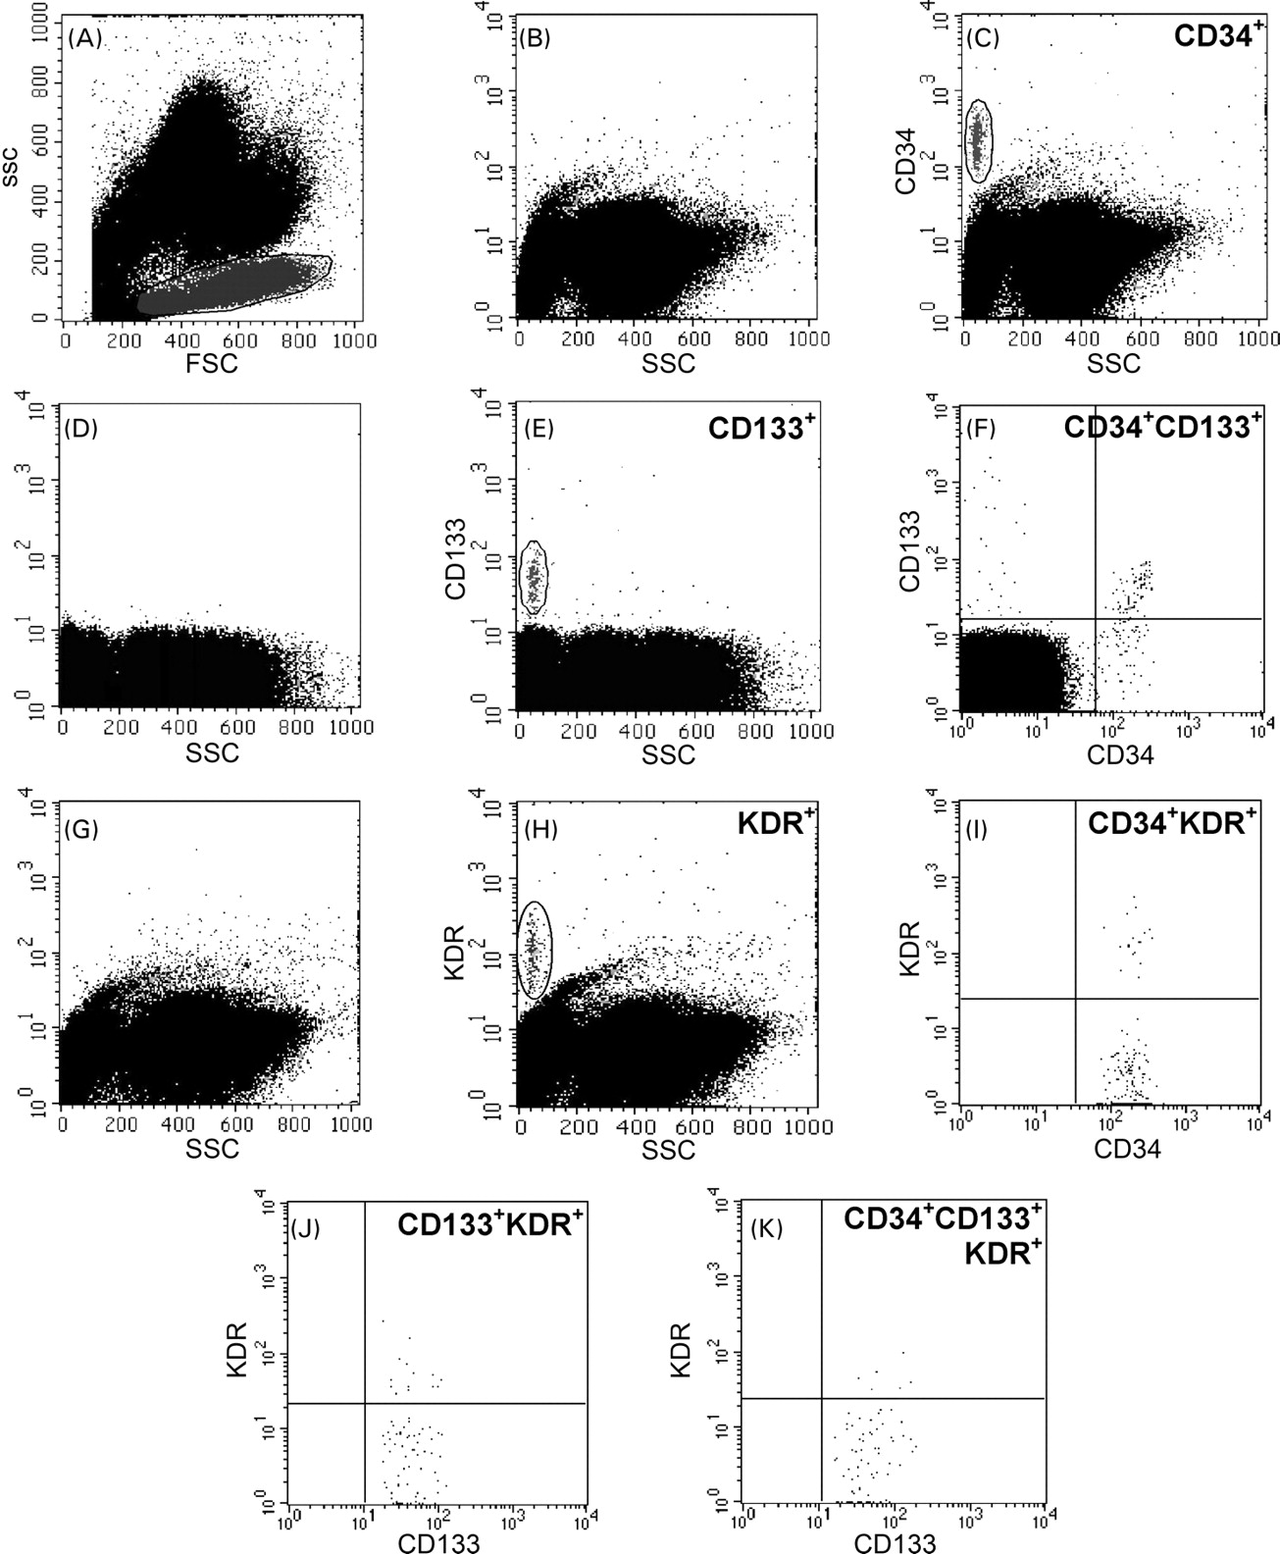
Figure 1 Representative cytograms used for the quantitative enumeration of circulating progenitor cells according to ...
Notes:
Figure 1 Representative cytograms used for the quantitative enumeration of circulating progenitor cells according to six different phenotypes. Peripheral blood progenitor cells belong to the mononuclear cell fraction, which can be identified using a morphological gate, for their low side scatter (A). Then, we gated CD34+ (C) and CD133+ (E) cells in the mononuclear cell fraction, according to the respective isotype controls (B and D, respectively). At the intersection of the CD34 and CD133 gates, we identified CD34+CD133+ cells in the upper-right quadrant (F). We identified in separate analyses total KDR+ cells (H) as cells with high KDR expression with respect to control (G) and low side scatter to exclude granulocytes. Gated CD34+ and CD133+ cells were examined for the dual expression of KDR (I and J, respectively) to derive the count of CD34+KDR+ and CD133+KDR+ cells. Triple positive cells were identified in the CD34 gate as cells positive for KDR and CD133 (K).
Unless provided in the caption above, the following copyright applies to the content of this slide: © The European Society of Cardiology 2006. All rights reserved. For Permissions, please e-mail: journals.permissions@oxfordjournals.org

Slide 2
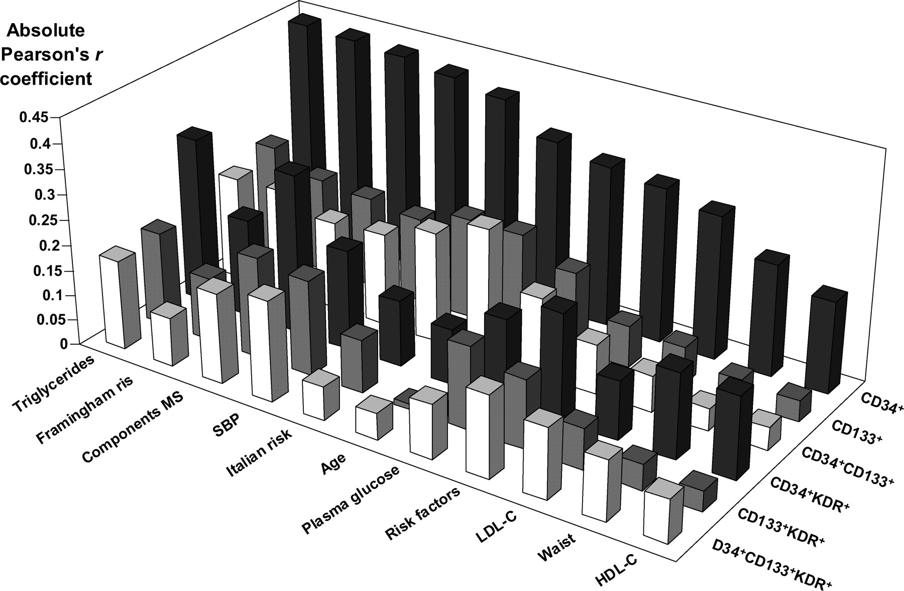
Figure 2 Absolute Pearson's r coefficients of correlation between levels of progenitor cells (defined by six different ...
Notes:
Figure 2 Absolute Pearson's r coefficients of correlation between levels of progenitor cells (defined by six different antigenic profiles) and CV parameters. The analysis was performed in the entire study population for CD34+ and CD34+KDR+ cells.
Unless provided in the caption above, the following copyright applies to the content of this slide: © The European Society of Cardiology 2006. All rights reserved. For Permissions, please e-mail: journals.permissions@oxfordjournals.org

Slide 3
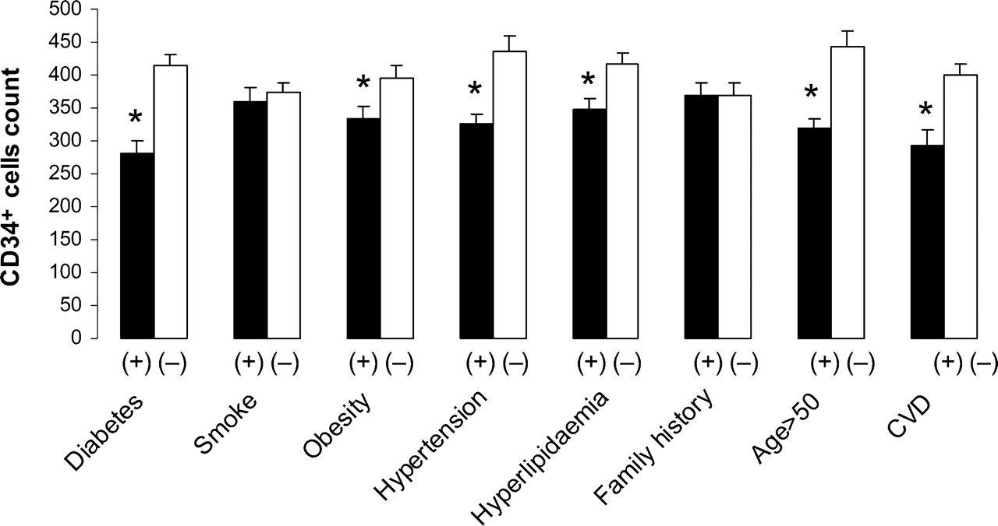
Figure 3 Univariate analysis of CD34⁺ cell levels in the presence or absence of classical risk factors and ...
Notes:
Figure 3 Univariate analysis of CD34+ cell levels in the presence or absence of classical risk factors and established CVD in the entire sample (n=214). Y-error bars represent standard errors. *P<0.05.
Unless provided in the caption above, the following copyright applies to the content of this slide: © The European Society of Cardiology 2006. All rights reserved. For Permissions, please e-mail: journals.permissions@oxfordjournals.org

Slide 4
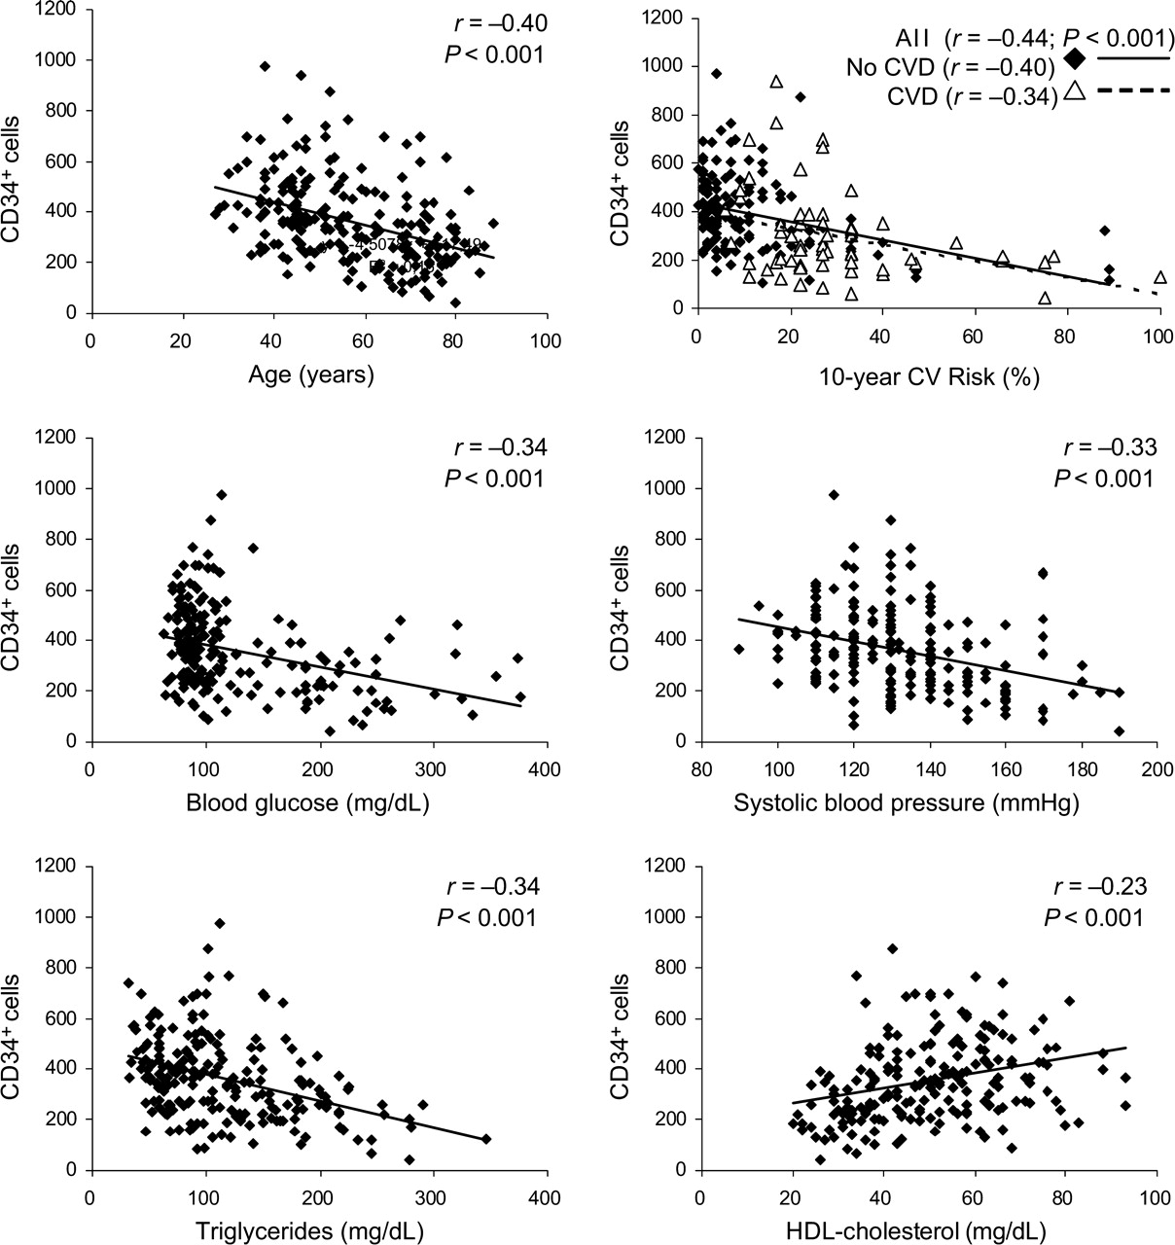
Figure 4 Significant linear correlations between CD34⁺ cell levels and CV/metabolic parameters. When ...
Notes:
Figure 4 Significant linear correlations between CD34+ cell levels and CV/metabolic parameters. When patients were divided according to the presence or absence of CVD, the correlation between CD34+ cells and the 10-year risk is very similar.
Unless provided in the caption above, the following copyright applies to the content of this slide: © The European Society of Cardiology 2006. All rights reserved. For Permissions, please e-mail: journals.permissions@oxfordjournals.org

Slide 5
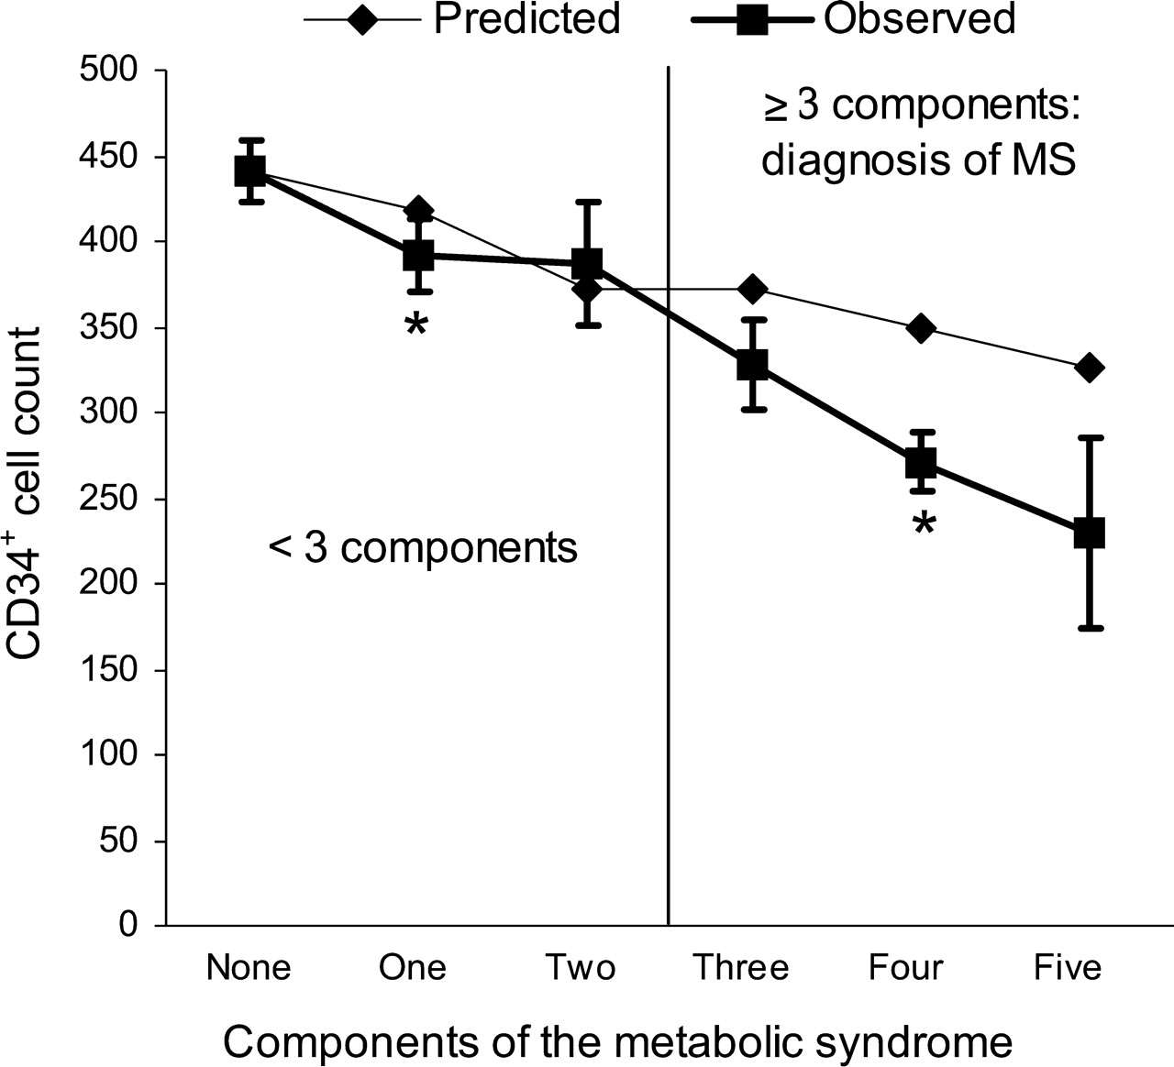
Figure 5 Levels of circulating CD34⁺ cells in subjects grouped according to the number of their metabolic ...
Notes:
Figure 5 Levels of circulating CD34+ cells in subjects grouped according to the number of their metabolic factors. The observed values are plotted against predicted values, calculated using an additive model (see Methods for details). Y-error bars represent standard errors. *P<0.05 indicates a significant difference in the observed values of CD34+ cell counts.
Unless provided in the caption above, the following copyright applies to the content of this slide: © The European Society of Cardiology 2006. All rights reserved. For Permissions, please e-mail: journals.permissions@oxfordjournals.org

Slide 6
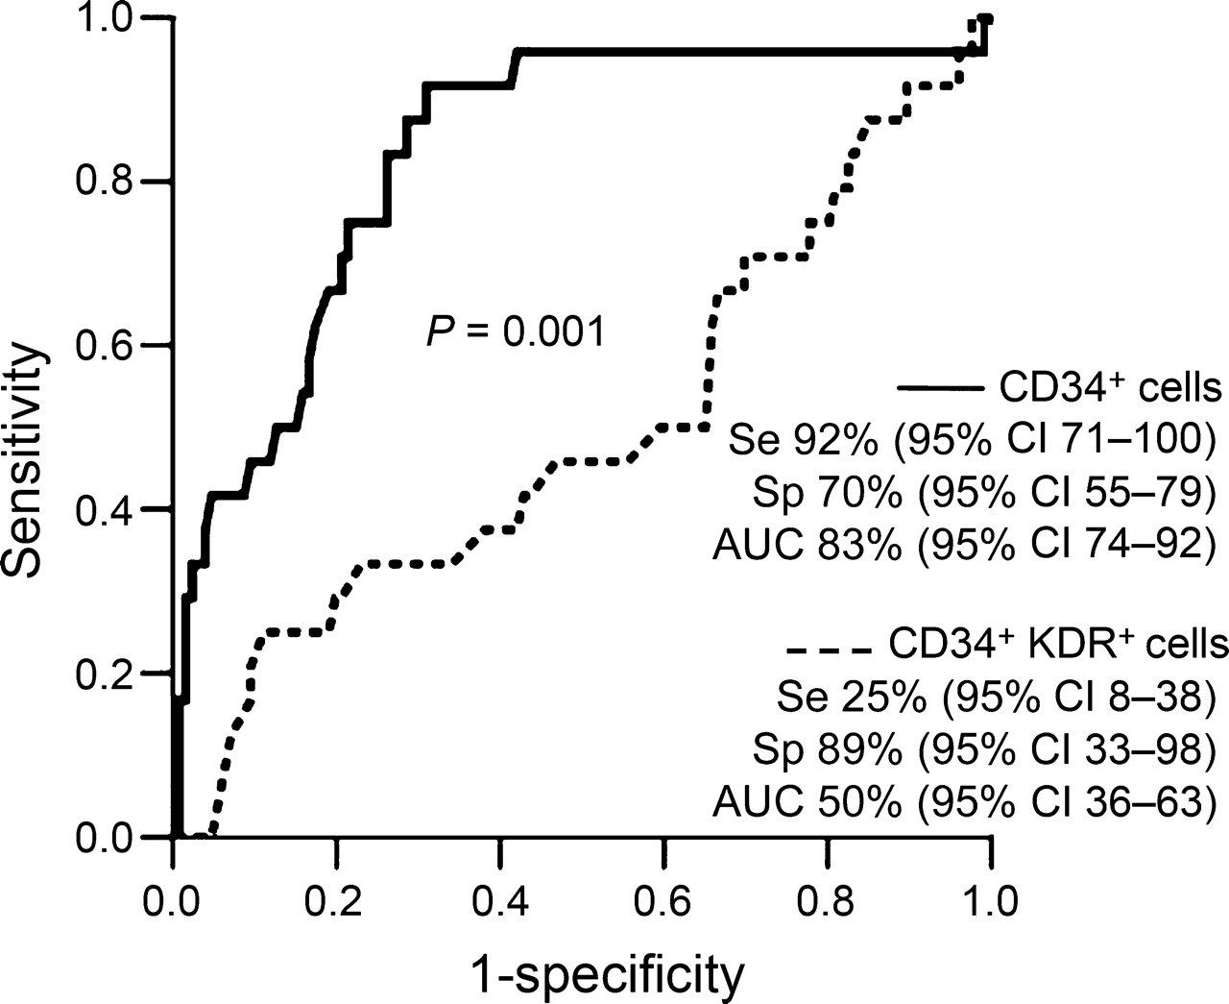
Figure 6 ROC curve assessing the performance of CD34⁺ and CD34⁺KDR⁺ cell count in ...
Notes:
Figure 6 ROC curve assessing the performance of CD34+ and CD34+KDR+ cell count in identifying a predicted Framingham risk >20% in patients without established CVD. Se, sensitivity; Sp, specificity; AUC, area under curve, which indicates the accuracy of the test. Cut-off values for CD34+ and CD34+KDR+ cell counts were 342 (95% CI 277–375) and 26 (95% CI 16–34), respectively.
Unless provided in the caption above, the following copyright applies to the content of this slide: © The European Society of Cardiology 2006. All rights reserved. For Permissions, please e-mail: journals.permissions@oxfordjournals.org

