Slide 1
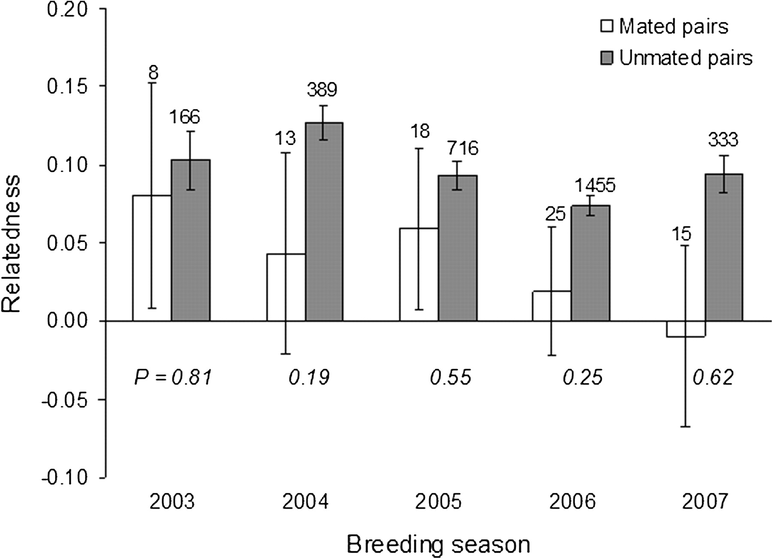
Figure 1 Relatedness of mated and unmated pairs of opposite-sex adult pied babblers per year over 5 years of study. ...
Notes:
Figure 1 Relatedness of mated and unmated pairs of opposite-sex adult pied babblers per year over 5 years of study. Means ± standard error of the mean were generated from relatedness values calculated using the Konovalov and Heg (2008) algorithm within the program KINGROUP v2_090218 (Konovalov et al. 2004); sample sizes are shown. A 2-sample randomization/permutation test with 100 000 permutations within the program RUNDOM PRO 3.14 (Jadwiszczak 2009) was used to calculate significance
Unless provided in the caption above, the following copyright applies to the content of this slide: © The Author 2011. Published by Oxford University Press on behalf of the International Society for Behavioral Ecology. All rights reserved. For permissions, please e-mail: journals.permissions@oup.com

