Slide 1
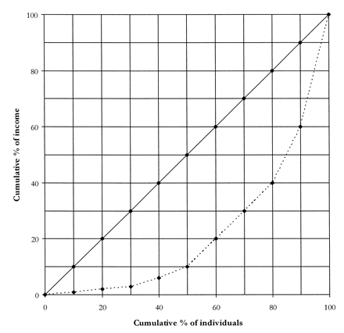
FIGURE 1. Lorenz curve.
Notes:
FIGURE 1. Lorenz curve.
Unless provided in the caption above, the following copyright applies to the content of this slide:

Slide 2
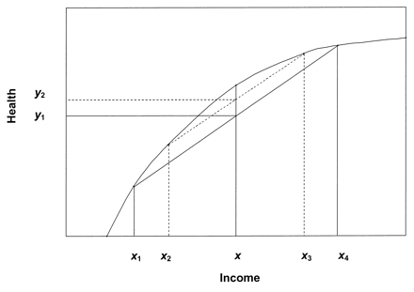
FIGURE 2. The individual-level relation between income and health.
Notes:
FIGURE 2. The individual-level relation between income and health.
Unless provided in the caption above, the following copyright applies to the content of this slide:

