Slide 1
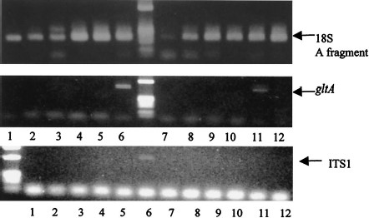
Fig. 1 Amplification of a partial citrate synthase gene (gltA) and the 16S-23S rRNA intergenic spacer region 1 (ITS ...
Notes:
Fig. 1 Amplification of a partial citrate synthase gene (gltA) and the 16S-23S rRNA intergenic spacer region 1 (ITS 1) of Bartonella quintana in body louse. Genomic DNA was extracted and amplified with PCR, and PCR products were electrophoresed on a 2.0% agarose gel and stained with ethidium bromide. Lanes 1–12, body louse from homeless people number 1–12, respectively.
Unless provided in the caption above, the following copyright applies to the content of this slide: © 2002 Entomological Society of America

