Slide 1
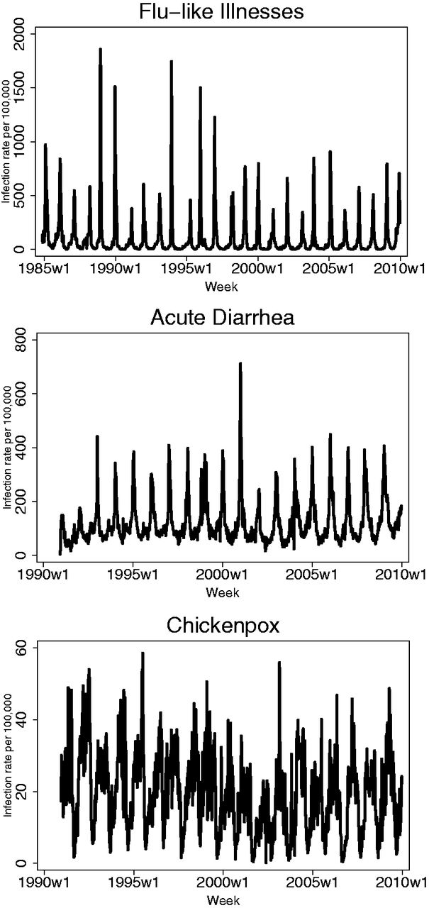
Figure I Weekly Incidence Rates, 1984–2010 Data from InVS. Infection rates per 100,000 individuals.
Notes:
Figure I Weekly Incidence Rates, 1984–2010 Data from InVS. Infection rates per 100,000 individuals.
Unless provided in the caption above, the following copyright applies to the content of this slide: © The Author(s) 2016. Published by Oxford University Press, on behalf of President and Fellows of Harvard College. All rights reserved. For Permissions, please email: journals.permissions@oup.com

Slide 2
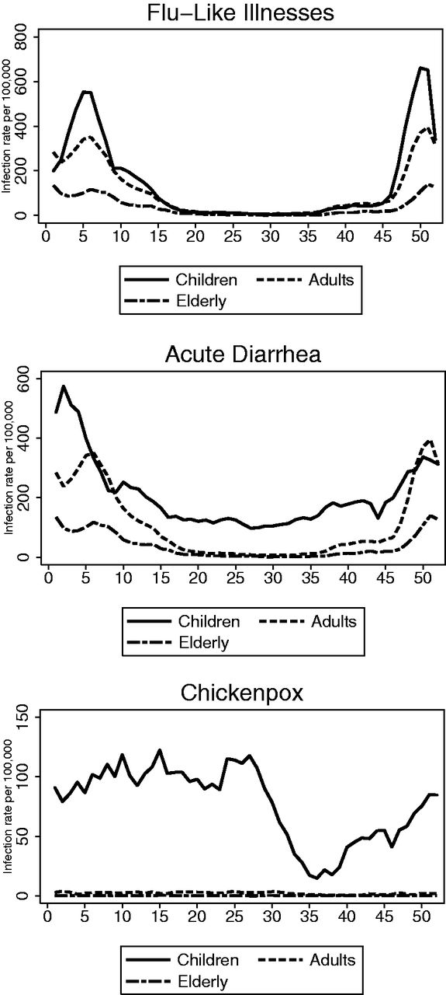
Figure II Prevalence Rates over Calendar Year, by Age, Average 1984–2010 Data from InVS. Weekly infection rates per ...
Notes:
Figure II Prevalence Rates over Calendar Year, by Age, Average 1984–2010 Data from InVS. Weekly infection rates per 100,000 individuals.
Unless provided in the caption above, the following copyright applies to the content of this slide: © The Author(s) 2016. Published by Oxford University Press, on behalf of President and Fellows of Harvard College. All rights reserved. For Permissions, please email: journals.permissions@oup.com

Slide 3
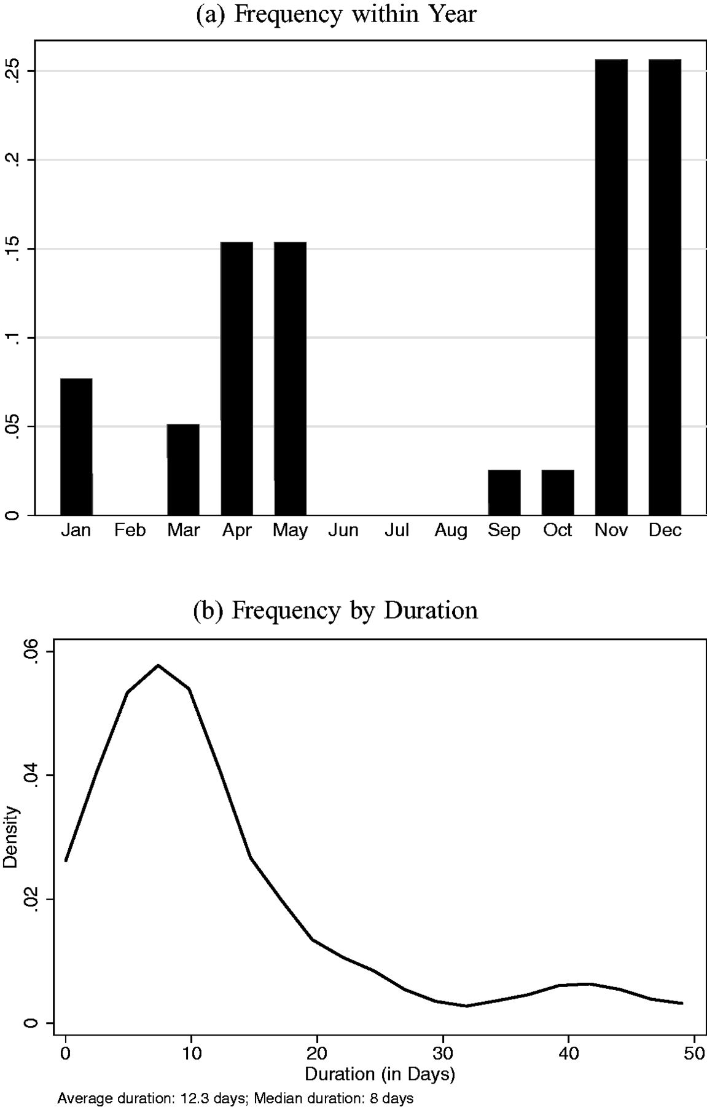
Figure III Public Transportation Strikes, France, 1984–2010 Data collected by the author using the LexisNexis search of ...
Notes:
Figure III Public Transportation Strikes, France, 1984–2010 Data collected by the author using the LexisNexis search of the French written press. All occurrences of a public transportation strike lasting three days at least, either nationally or regionally, were recorded from the national press ( Le Monde , Le Figaro ).
Unless provided in the caption above, the following copyright applies to the content of this slide: © The Author(s) 2016. Published by Oxford University Press, on behalf of President and Fellows of Harvard College. All rights reserved. For Permissions, please email: journals.permissions@oup.com

Slide 4
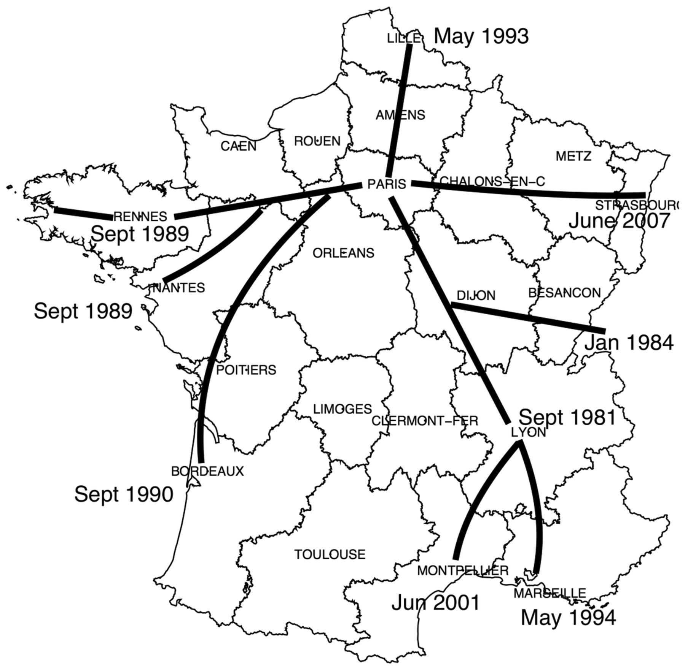
Figure IV Expansion of the High-Speed Railway The map displays the major connections of the high-speed rail link in ...
Notes:
Figure IV Expansion of the High-Speed Railway The map displays the major connections of the high-speed rail link in France and the date of opening. To avoid cluttering, only direct links are displayed. The analysis also takes into account the opening of links between two cities where a stop in Paris was no longer necessary, for example, Marseille-Lille without a change of trains in Paris.
Unless provided in the caption above, the following copyright applies to the content of this slide: © The Author(s) 2016. Published by Oxford University Press, on behalf of President and Fellows of Harvard College. All rights reserved. For Permissions, please email: journals.permissions@oup.com

Slide 5
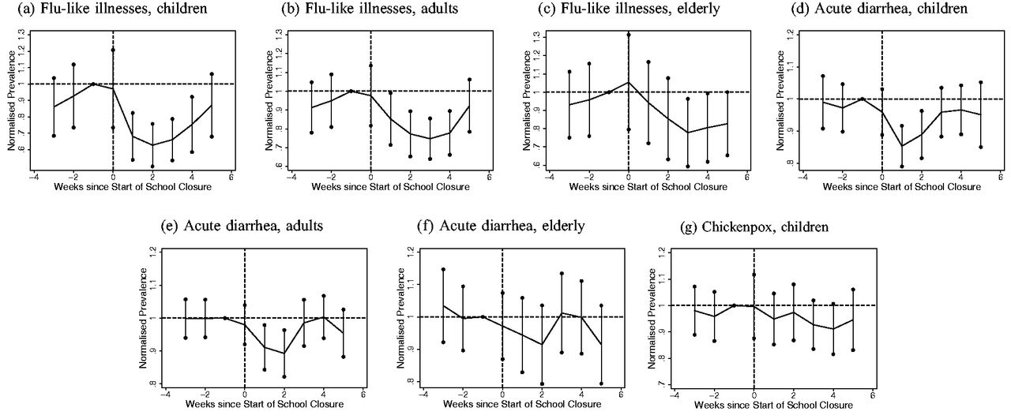
Figure V Event Analysis: School Closures The different panels display the estimates of equation (2) and show the ...
Notes:
Figure V Event Analysis: School Closures The different panels display the estimates of equation (2) and show the weekly incidence of the disease within a region as a function of the time since the first week of school holidays. Results obtained from a regression controlling also for region, year and week effects. Standard errors are clustered by region. The incidence is normalized by the average incidence one week before the strike (labeled as −1). School closures last typically for one or two weeks, except for the 8-week summer break. Solid line is the mean effect by week, 95 percentiles are shown as vertical bars.
Unless provided in the caption above, the following copyright applies to the content of this slide: © The Author(s) 2016. Published by Oxford University Press, on behalf of President and Fellows of Harvard College. All rights reserved. For Permissions, please email: journals.permissions@oup.com

Slide 6
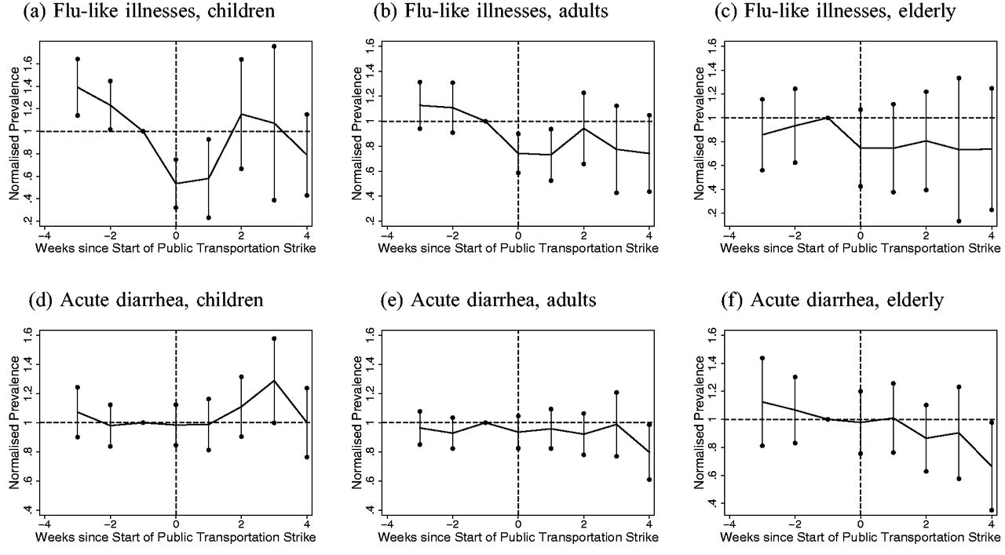
Figure VI Event Analysis: Public Transportation Strike The different panels display the estimates of equation (2) and ...
Notes:
Figure VI Event Analysis: Public Transportation Strike The different panels display the estimates of equation (2) and show the weekly incidence of the disease within a region as a function of the time since the first week of a public transportation strike. Results obtained from a regression controlling also for region, year, and week effects. Standard errors are clustered by region. The incidence is normalized by the average incidence one week before closure (labeled as −1). Solid line is the mean effect by week, 95 percentiles are shown as vertical bars. Chickenpox is omitted as transportation strikes do not have statistically significant effects.
Unless provided in the caption above, the following copyright applies to the content of this slide: © The Author(s) 2016. Published by Oxford University Press, on behalf of President and Fellows of Harvard College. All rights reserved. For Permissions, please email: journals.permissions@oup.com

Slide 7
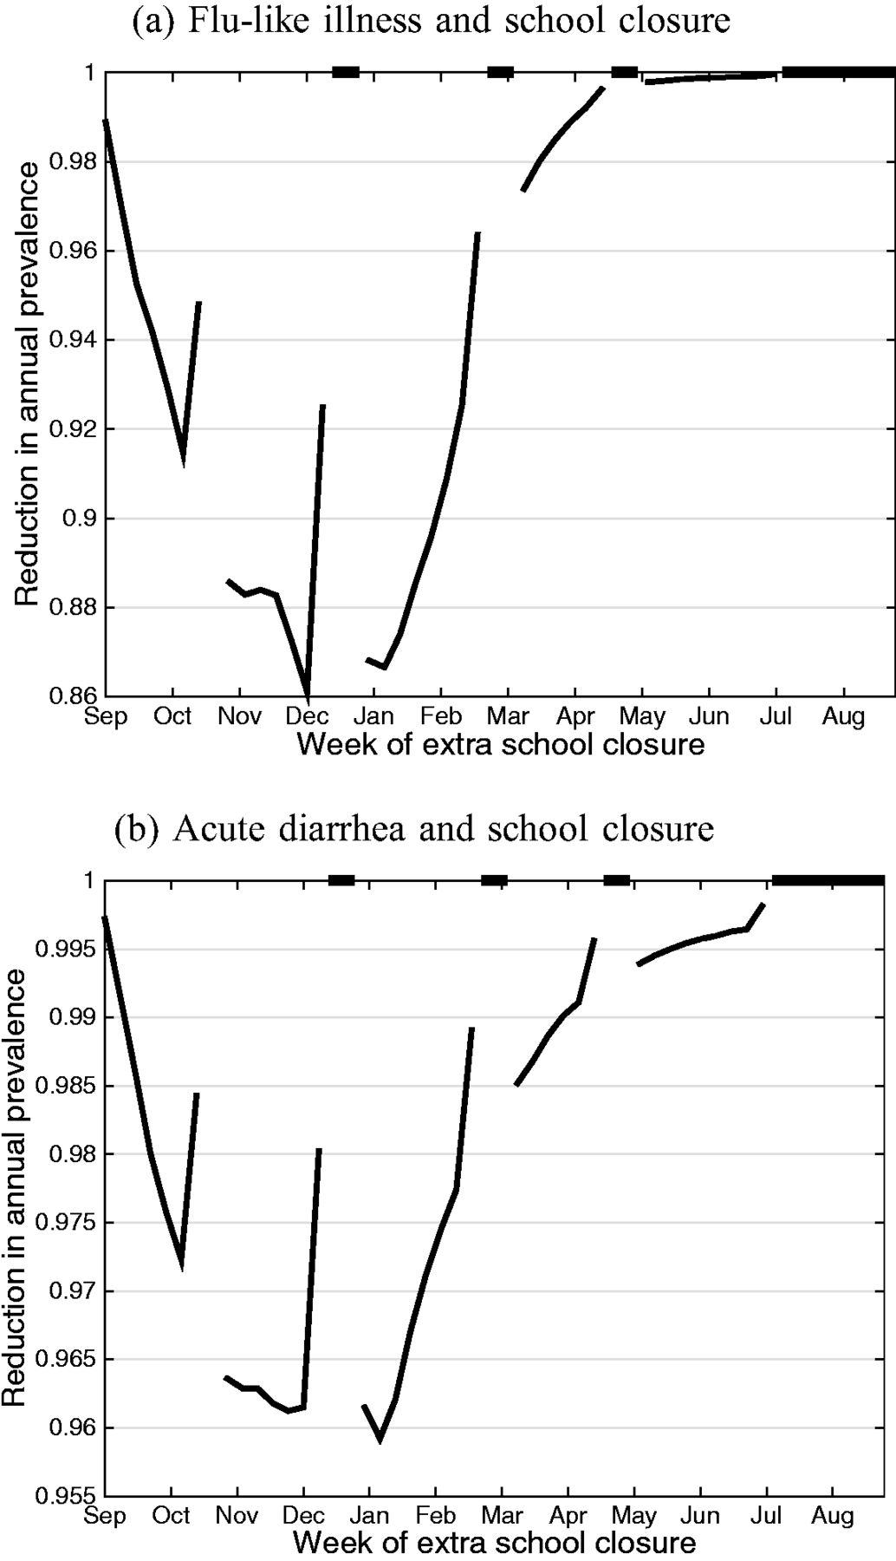
Figure VII Effect of Policy Measures on Annual Disease Prevalence, by Week of Implementation The different panels ...
Notes:
Figure VII Effect of Policy Measures on Annual Disease Prevalence, by Week of Implementation The different panels display the annual prevalence of diseases as a function of the week of implementation of the policy. The prevalence are in deviation from a baseline scenario, which includes school closures due to regular holidays. School closures last for two weeks and public transportation closures for one week. The discontinuous lines in Panels (a) and (b) are due to periods of holidays, when schools are closed anyway. The results are based on estimated coefficients of equation (6) and shown in Table VI . The results were averaged over 500 replications, drawing realizations for the shock in equation (6) and for the estimated coefficients from their asymptotic distribution.
Unless provided in the caption above, the following copyright applies to the content of this slide: © The Author(s) 2016. Published by Oxford University Press, on behalf of President and Fellows of Harvard College. All rights reserved. For Permissions, please email: journals.permissions@oup.com

Slide 8
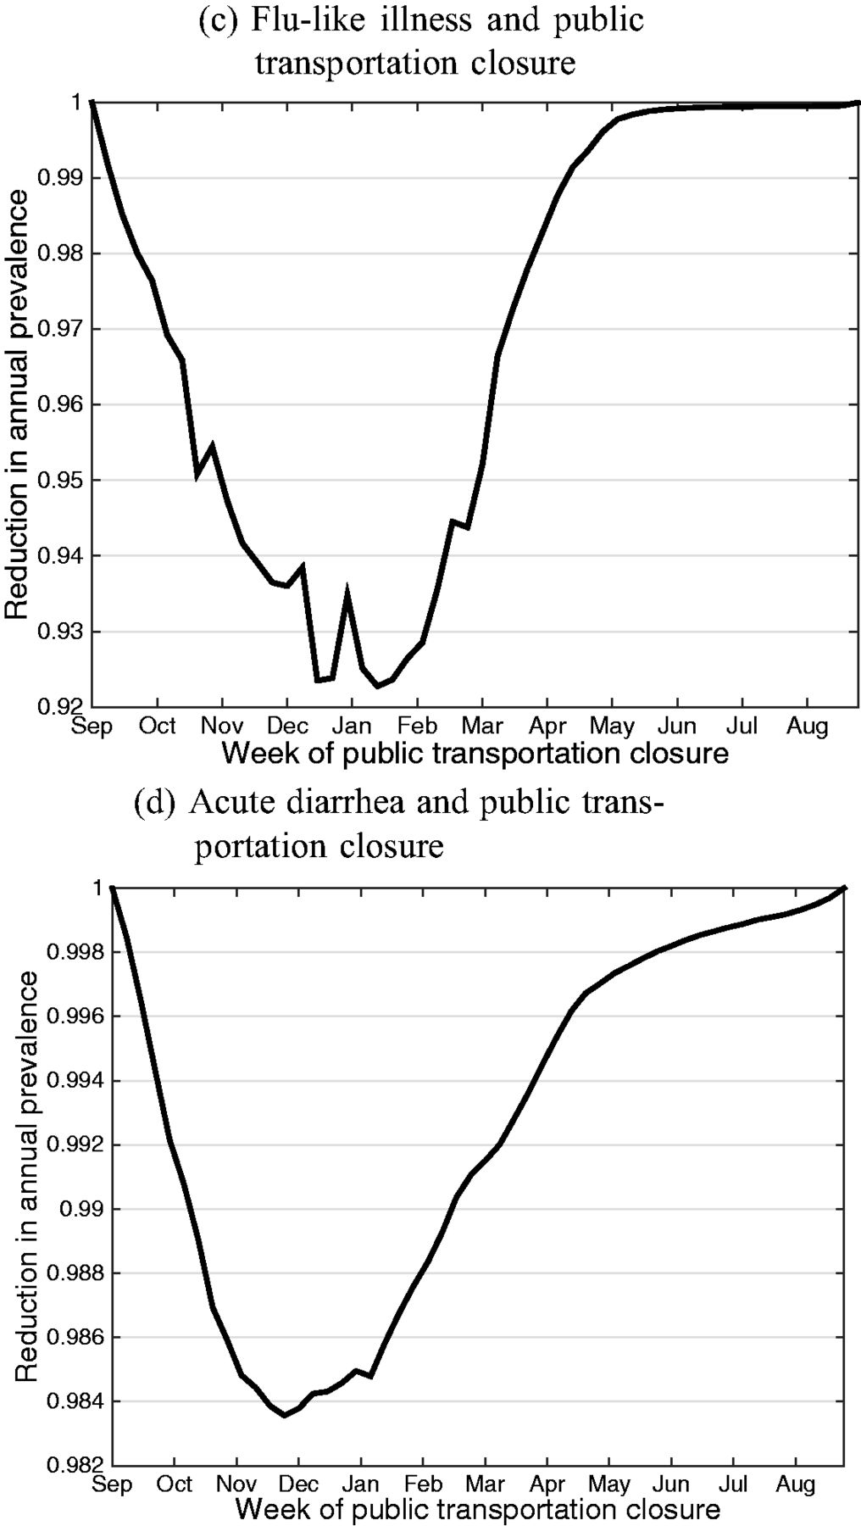
Figure VII Effect of Policy Measures on Annual Disease Prevalence, by Week of Implementation The different panels ...
Notes:
Figure VII Effect of Policy Measures on Annual Disease Prevalence, by Week of Implementation The different panels display the annual prevalence of diseases as a function of the week of implementation of the policy. The prevalence are in deviation from a baseline scenario, which includes school closures due to regular holidays. School closures last for two weeks and public transportation closures for one week. The discontinuous lines in Panels (a) and (b) are due to periods of holidays, when schools are closed anyway. The results are based on estimated coefficients of equation (6) and shown in Table VI . The results were averaged over 500 replications, drawing realizations for the shock in equation (6) and for the estimated coefficients from their asymptotic distribution.
Unless provided in the caption above, the following copyright applies to the content of this slide: © The Author(s) 2016. Published by Oxford University Press, on behalf of President and Fellows of Harvard College. All rights reserved. For Permissions, please email: journals.permissions@oup.com

Slide 9
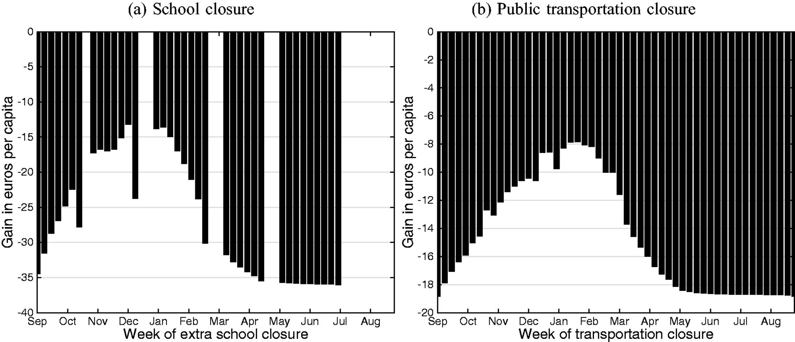
Figure VIII Overall Gain of Policy Measures Closures, by Week of Implementation The different panels display the gain in ...
Notes:
Figure VIII Overall Gain of Policy Measures Closures, by Week of Implementation The different panels display the gain in per capita Euros of the policy compared to a baseline scenario, which includes school closures due to regular holidays. The calculations use a value of statistical life equal to €5 million regardless of age. The results are based on estimated coefficients of equation (6) and cost measures displayed in Tables 4 and 5 in the Online appendix and Table VII . The results were averaged over 500 replications, drawing realizations for the shock in equation (6) and for the estimated coefficients from their asymptotic distribution.
Unless provided in the caption above, the following copyright applies to the content of this slide: © The Author(s) 2016. Published by Oxford University Press, on behalf of President and Fellows of Harvard College. All rights reserved. For Permissions, please email: journals.permissions@oup.com

