Slide 1
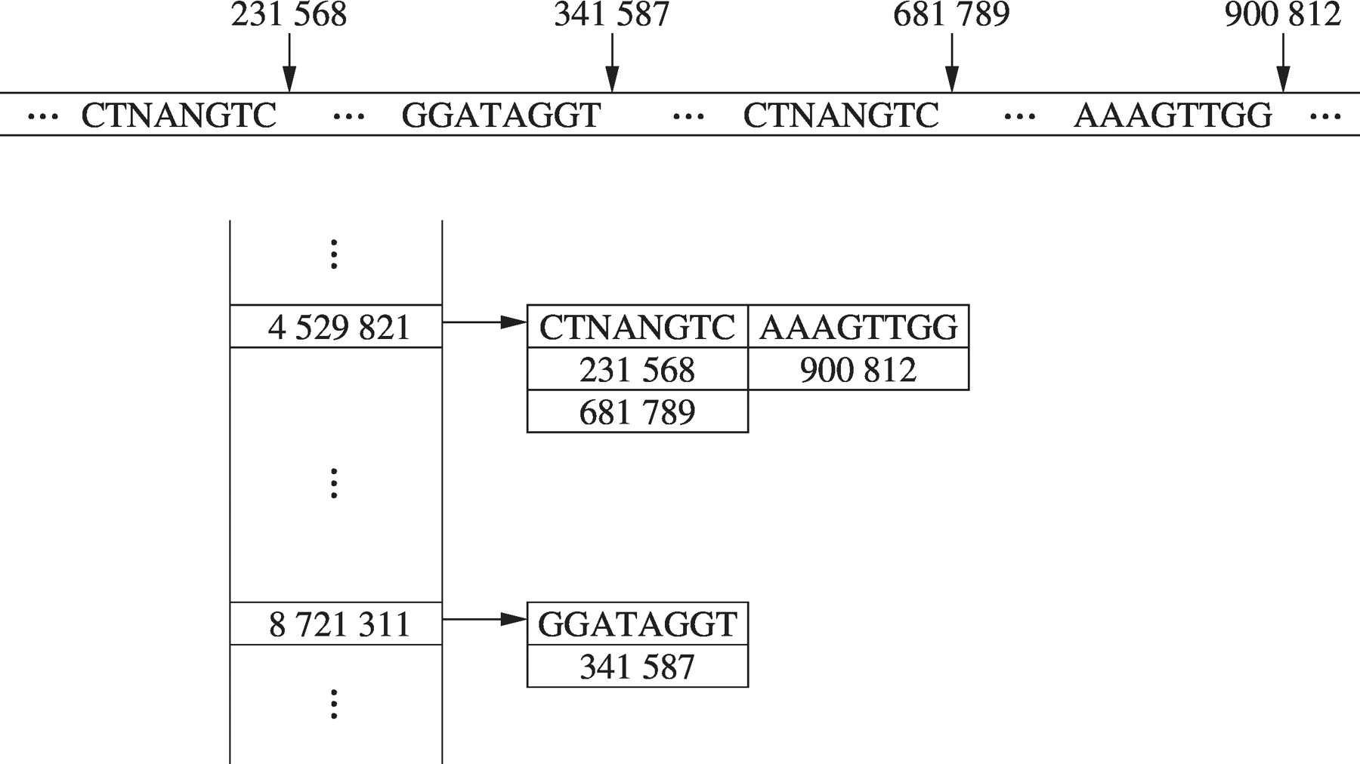
Figure 2. Data organized in a hash table.
Notes:
Figure 2. Data organized in a hash table.
Unless provided in the caption above, the following copyright applies to the content of this slide: © The Author(s) 2011. Published by Oxford University Press.This is an Open Access article distributed under the terms of the Creative Commons Attribution Non-Commercial License (http://creativecommons.org/licenses/by-nc/3.0), which permits unrestricted non-commercial use, distribution, and reproduction in any medium, provided the original work is properly cited.

Slide 2
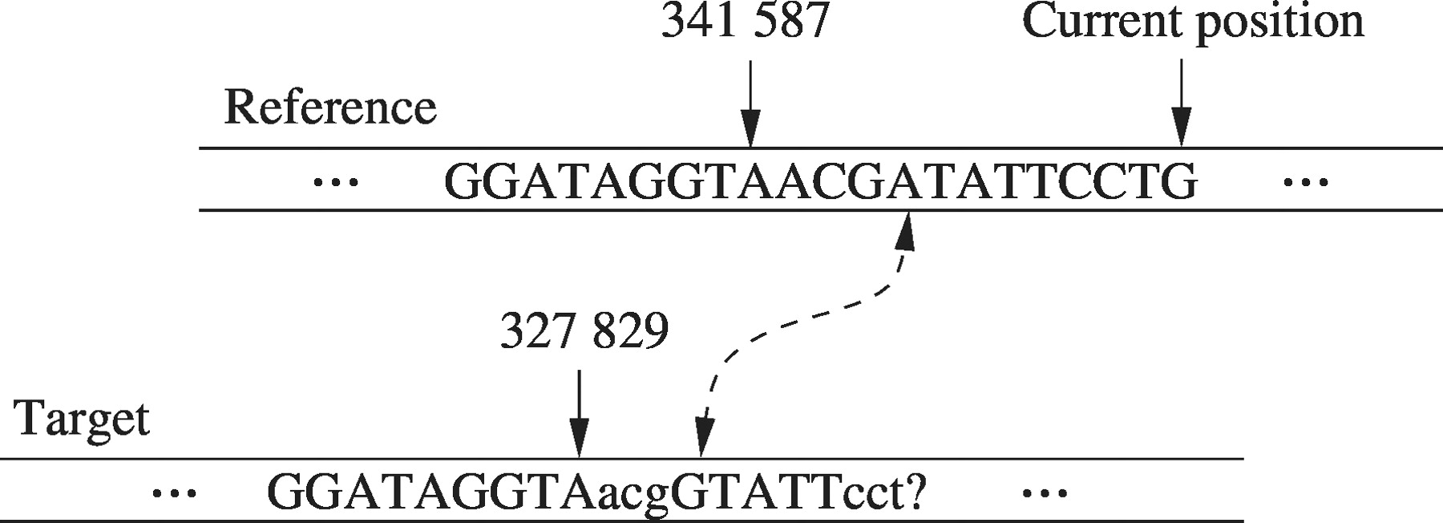
Figure 1. The copy model. In this example, the copy model was restarted at position 341 587 of the reference sequence, ...
Notes:
Figure 1. The copy model. In this example, the copy model was restarted at position 341 587 of the reference sequence, corresponding to position 327 829 of the target sequence. Since then, it has correctly predicted 5 characters, if the case is considered, and a total of 11 characters if the case is ignored. The dashed arrow indicates a failed prediction. According to this example, the next character to be predicted is ‘G’.
Unless provided in the caption above, the following copyright applies to the content of this slide: © The Author(s) 2011. Published by Oxford University Press.This is an Open Access article distributed under the terms of the Creative Commons Attribution Non-Commercial License (http://creativecommons.org/licenses/by-nc/3.0), which permits unrestricted non-commercial use, distribution, and reproduction in any medium, provided the original work is properly cited.

