Slide 1
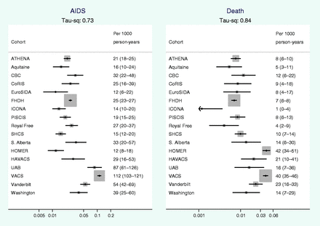
Figure 1 Crude rates (per 1000 person-years) of AIDS and all cause mortality by cohort, average rate estimated during ...
Notes:
Figure 1 Crude rates (per 1000 person-years) of AIDS and all cause mortality by cohort, average rate estimated during the period from 31 days to 2 years after start of ART. The size of the squares represents the weight assigned to each study in the meta-analysis and is proportional to the number of events in that study (whiskers show 95% CI). τ2 is the between-cohort variance in the rate
Unless provided in the caption above, the following copyright applies to the content of this slide: Published by Oxford University Press on behalf of the International Epidemiological Association © The Author 2012; all rights reserved.

Slide 2
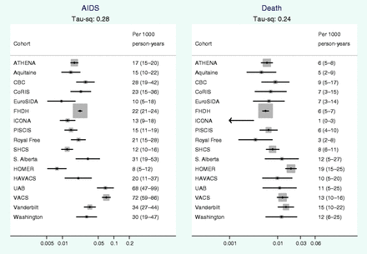
Figure 2 Adjusted rates (per 1000 person-years) of AIDS and all cause mortality by cohort, average rate estimated ...
Notes:
Figure 2 Adjusted rates (per 1000 person-years) of AIDS and all cause mortality by cohort, average rate estimated during the period from 30 days to 2 years after start of ART. Adjusted for CD4 cell count (100–199) cells/mm3, log HIV-1 RNA (4–4.99) log copies/ml, age (30–44 years), sex-risk group (MSM), year of starting ART (2000–03)
Unless provided in the caption above, the following copyright applies to the content of this slide: Published by Oxford University Press on behalf of the International Epidemiological Association © The Author 2012; all rights reserved.

Slide 3
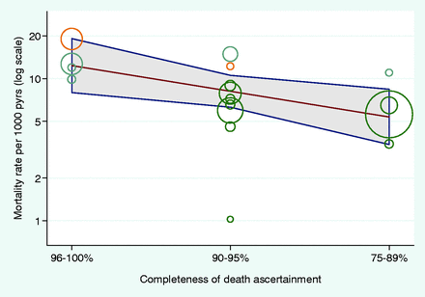
Figure 3 Association of cohort-specific death rate (adjusted for patient characteristics) with ascertainment of death ...
Notes:
Figure 3 Association of cohort-specific death rate (adjusted for patient characteristics) with ascertainment of death category. Circle sizes represent the precision of each cohort-specific estimate (the inverse of within-cohort variance), yellow denotes Canadian, blue USA and green European cohorts. τ2 = 0.11 (from 0.84)
Unless provided in the caption above, the following copyright applies to the content of this slide: Published by Oxford University Press on behalf of the International Epidemiological Association © The Author 2012; all rights reserved.

